Slide 1
KVM Remote Access CLI
James Ginns
starvagrant@github.com

Slide 2
Description
A series of shell scripts designed to give a unix-like CLI for important tasks involving our KVM over IP infrastructure.

Slide 3
Features
Provide KVM access to staff and customers in a consistent way with secure passwords
Offer diagnostic features regarding our network and KVM available KVM units
Provide means to preload standard, specific rescue ISO’s

Slide 4
Planning - User Stories
“As a technician, I want a command that pings kvms show I can tell if one is offline.” In production this is one of the most helpful features.
“As a network administrator, I want a command that ensures password compliance so that I know kvm login credentials are secure.” The program’s password and console launcher features were not separate, which hindered implementation of new commands. Half this program was refactoring.”

Slide 5
Planning – CLI SYNTAX
Getting the CLI syntax correct was a balance of a number of concerns. I wanted to make it easiest to start the launch in a secure way. (Least amount of typing) I also wanted the program to support some commands to issue to all our units (wildcards. So:
`kvm 1` launches a kvm console with a secure client password.
`kvm 0 ping` pings all kvm units to make sure they are live. (there was no kvm labeled 0, making it a perfect wildcard character.
`kvm [number] [command]` for any arbitrary command. Wildcards not guaranteed
to be supported for any given command.

Slide 6
Technology Stack
Bash
Linux
KVM over IP
Samba
Curl

Slide 7
Demo
Features: kvm-ping (next slide),
kvm-mount, kvm-launch (following slide)

Slide 8
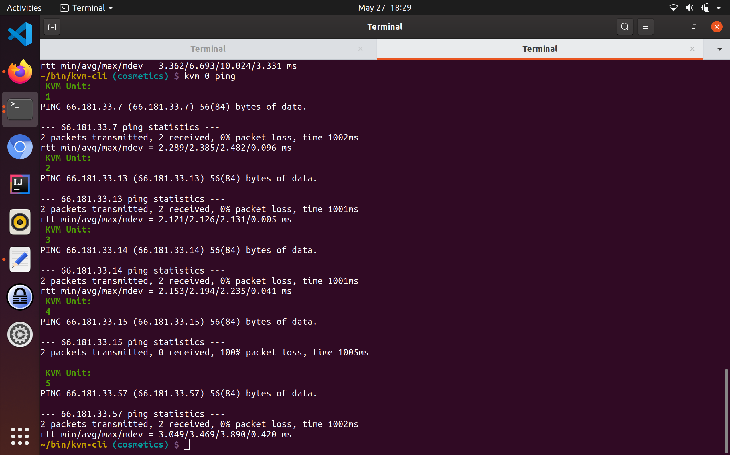

Slide 9
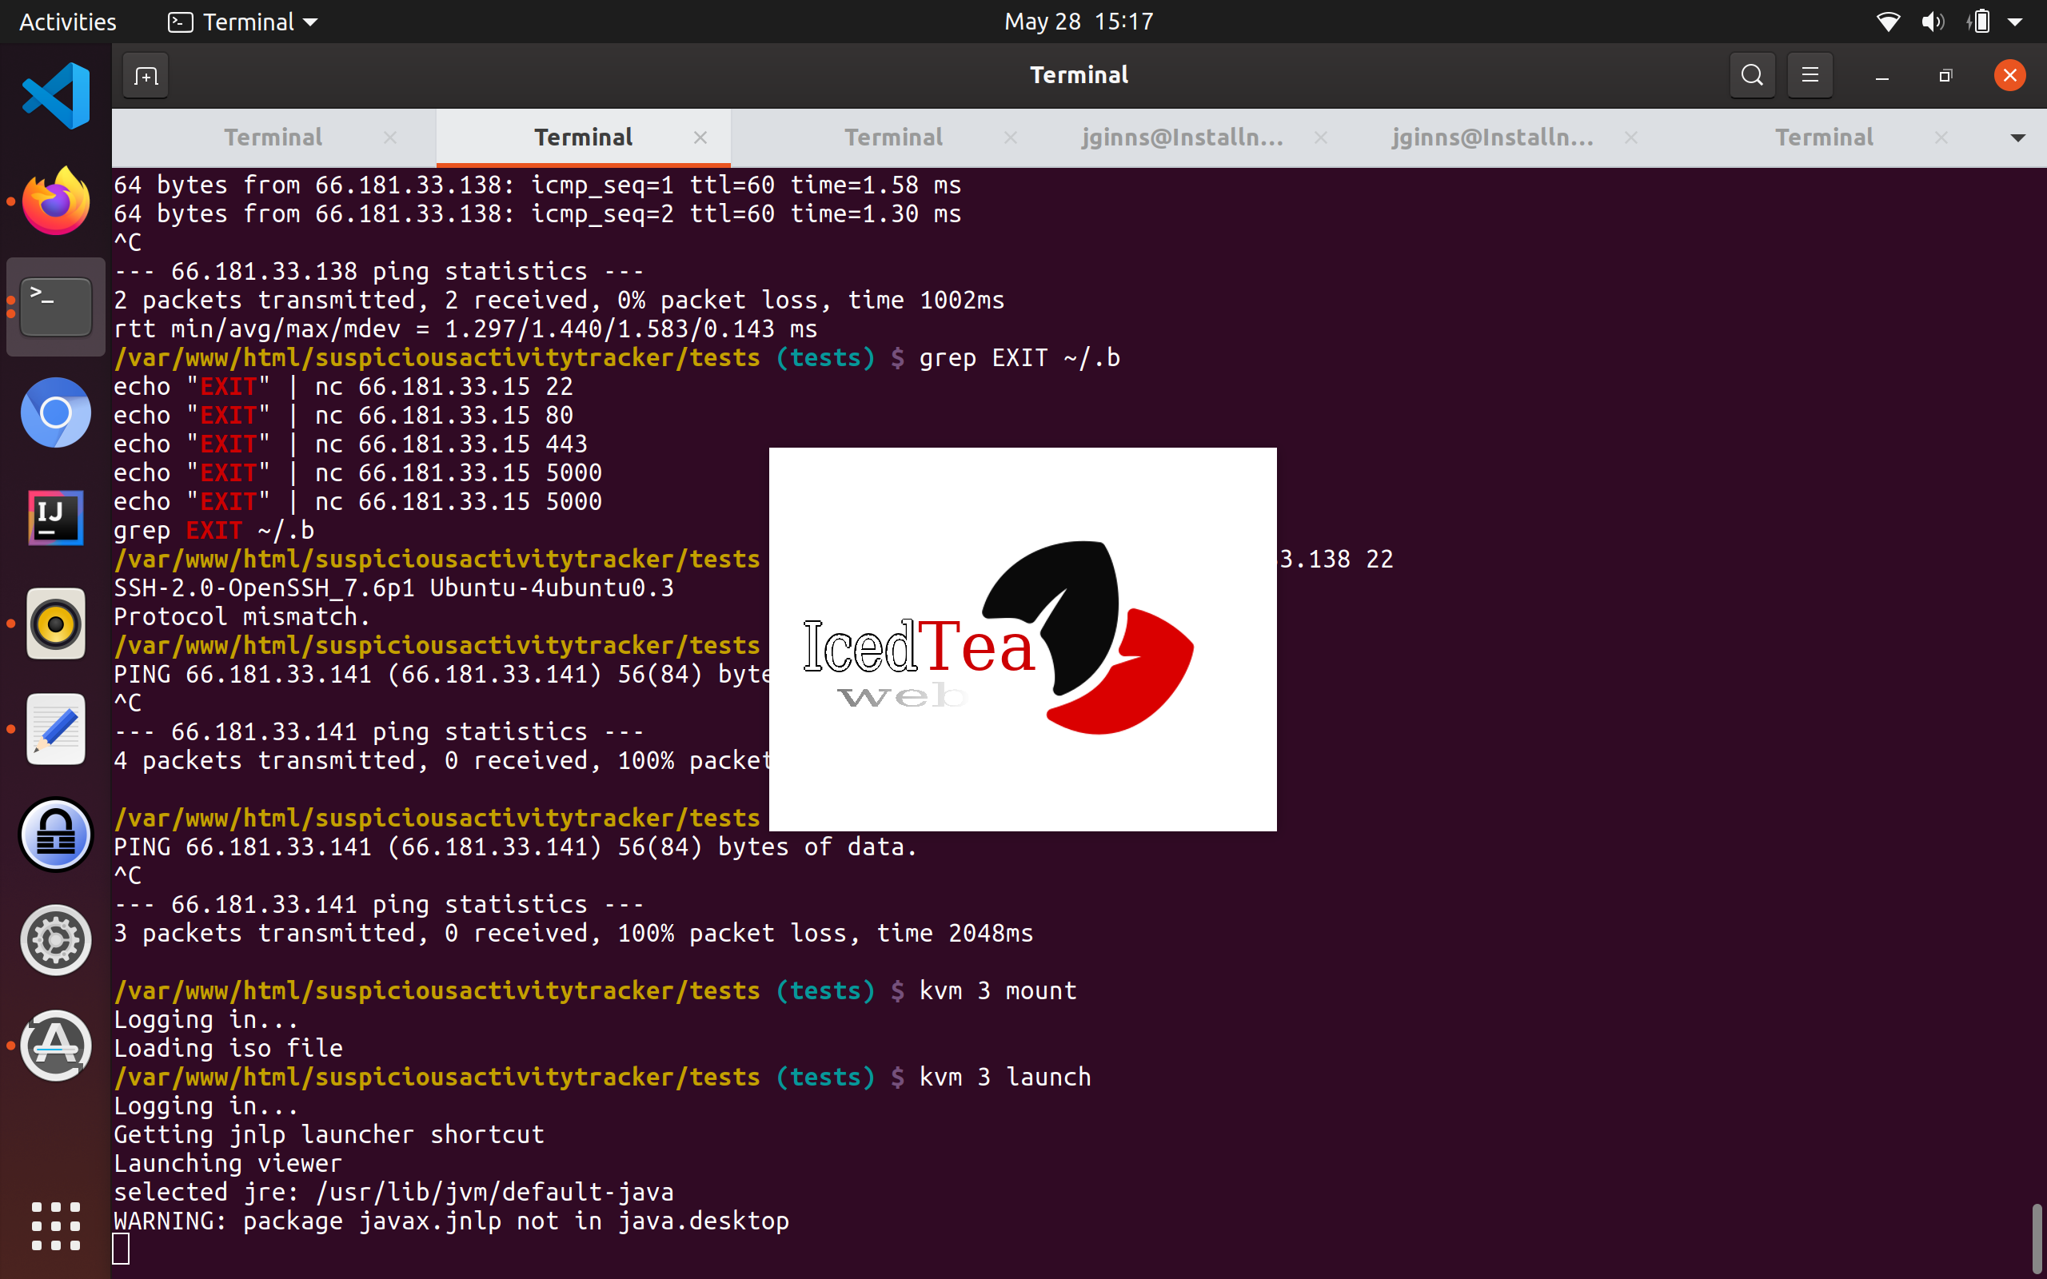

Slide 10
What I Learned
The Bash Scripting Language
Use of Curl and Wireshark for sending/inspecting POST DATA
How to write modular code without objects or classes

Slide 11
What’s Next
More integration with Samba, ability to checksum isos
Write a man page
Learn to make custom iso’s
Notes:
Be specific! If you mention another feature describe why that features is necessary, or what problem it solves. If you mention changing the UI mention specific technologies, or libraries you will use to do that. If you mention a technology, or feature you don’t know yet tell them how you plan on learning it.

