Slide 1
ATM Management System
Object Oriented Software Engineering

Slide 2

Introduction
ATM management system is a software that will control ATM machine and would enable an account holder to setup a connection with the bank so that he could perform various transactions like deposit, withdraw cash, change ATM pin, view account balance, etc. ––without going to any branch of the bank.
The ATM will serve one customer at a time. The customer will be required to insert an ATM card and enter a PIN (Personal Identification Number) – both of which will be sent to the bank for validation as a part of each transaction. The customer will then be able to perform one or more transactions.
After each successful transaction the ATM generates a receipt mentioning the account details.

Slide 3
IRD
INITIAL REQUIREMENT DOCUMENT
Title of the project | ATM Management system
Stakeholder involved in capturing requirements | Professors, Students
Technique used for requirement gathering | Interviewing and Brainstorming
Name of person along with designation | Aditya Miglani: Project head Aadhar Tyagi: Project head
Date | 24 August 2019
Version | 1.0
Information Requirement Document (IRD) is the most basic paperwork produced during the software development. It is written during the inception of the software development process.
The IRD is used to consolidate and compile all the initial requirements of the user/customer. The IRD also consists of other important information about the software, such as Title of Project, Stakeholders Involved, Techniques used to capture requirements, Development Team Members, and the Version of the Software being produced.

Slide 4
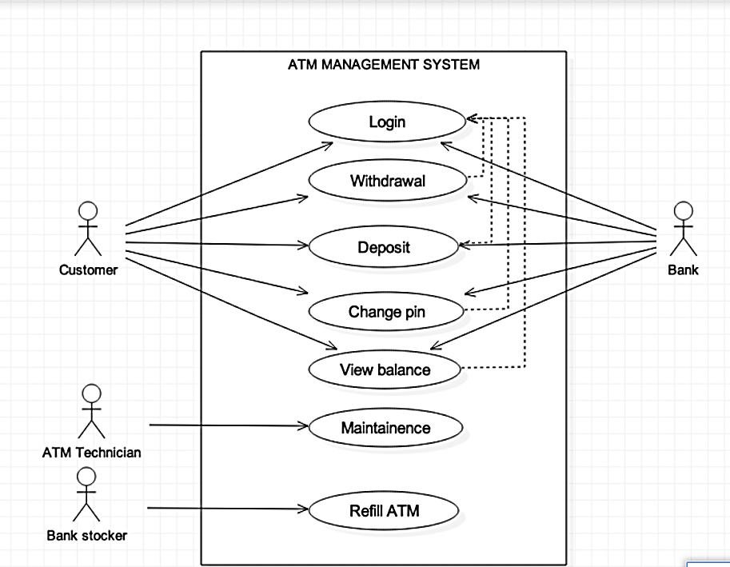
Use Case
The purpose of use case diagram is to capture the dynamic aspect of a system. But this definition is too generic to describe the purpose. Use case diagrams are used to gather the requirements of a system including internal and external influences. These requirements are mostly design requirements. So, when a system is analyzed to gather its functionalities use cases are prepared and actors are identified. Now when the initial task is complete use case diagrams are modelled to present the outside view.
So, in brief, the purposes of use case diagrams can be as follows:
Used to gather requirements of a system.
Used to get an outside view of a system.
Identify external and internal factors influencing the system.
Show the interacting among the requirements are actors.

Slide 5
Use Case Description
Introduction: A login session is started when a customer inserts an ATM card into the card reader slot of machine. The ATM pulls the card into and reads it. If the reader fails to read the card, then card gets ejected and session is aborted. Then the customer is asked to enter his/her ATM pin and allowed to do one or more transaction after verification of pin. After each transaction, customer is asked whether he wants to do more transaction or not , The customer may abort the ongoing login session by pressing the cancel key .
Actor: Customer.
Flow of events: Basic flow: Customer inserts a valid ATM card into the reader slot of the machine. The customer is asked to enter his/her pin, and is then allowed to perform one or more transactions, choosing from a menu of possible type of transactions. Alternative flow: If the reader cannot read the card due to improper insertion or a damaged stripe, the card is ejected, an error message is displayed, and the login is aborted. If the user entered invalid pin more than 3 times in order to continue with login, a SMS verification must be performed through registered mobile number for further process
Special Requirement: Proper insertion of card and valid ATM pin as well as valid card with correct pin.
Pre-condition: Customer inserts a valid ATM card into the card reader slot of the machine.
Post condition: Requested transaction is successfully executed.
Associated use case: Withdraw, deposit, view balance, change pin.
The use case description is a textual module that tells and describes a processing details of a use case. It provides documentation for the processing status that is internal to use case.

Slide 6
Use Case Description
Introduction: A withdrawal transaction asked the customer to choose type of account to withdraw from. The system verifies that it has enough money on hand to satisfy the requested before sending the transaction to the bank If the transaction is approved by the bank, the appropriate amount of cash is dispensed by the machine before it issues a receipt.
Actor: Customer.
Flow of events: Basic flow: The customer is asked to enter amount to be withdrawn. Alternate flow: In case of insufficient balance, a message is displayed showing actual amount of account balance. A withdrawal transaction can be cancelled by the customer by pressing cancel key Any item prior to choosing the amount.
Special Requirement: Enough balance.
Pre-condition: Enough balance in account.
Post condition: Requested withdrawal is successfully cashed out.
Associated use case: Withdraw, deposit, view balance, change pin.
The use case description is a textual module that tells and describes a processing details of a use case. It provides documentation for the processing status that is internal to use case.

Slide 7
Use Case Description
Introduction: A deposit transaction asked the customer to choose type of account to deposit and to type in amount to be deposit The transaction is initially sent to the bank to verify that the ATM accepts the deposit from this customer to this account If the transaction is approved the machine accepts the cash from the customer and checks before issuing a receipt . Once the cash has been received, a second message is sent to the bank, to confirm that bank can credit the customer’s
Actor: Customer.
Flow of events: Basic flow: Total amount deposited should be matched exactly with the entered amount Alternate flow: It deposits amount do not exactly match with the entered amount all deposited amount is ejected out. A deposit transaction can be cancelled by the customer by pressing cancel key any time prior to depositing money.
Special Requirement: Deposited amount should exactly match with entered amount.
Pre-condition: Successfully logged in.
Post condition: Deposit amount is successfully cashed in and is reflected in the account balance.
Associated use case: None.
The use case description is a textual module that tells and describes a processing details of a use case. It provides documentation for the processing status that is internal to use case.

Slide 8
Class Diagram
In software engineering, a class diagram in the Unified Modelling Language (UML) is a type of static structure diagram that describes the structure of a system by showing the system's classes, their attributes, operations (or methods), and the relationships among objects.
The class diagram is the main building block of object-oriented modelling. It is used for general conceptual modelling of the systematic of the application, and for detailed modelling translating the models into programming code. Class diagrams can also be used for data modelling. The classes in a class diagram represent both the main elements, interactions in the application, and the classes to be programmed.

Slide 9

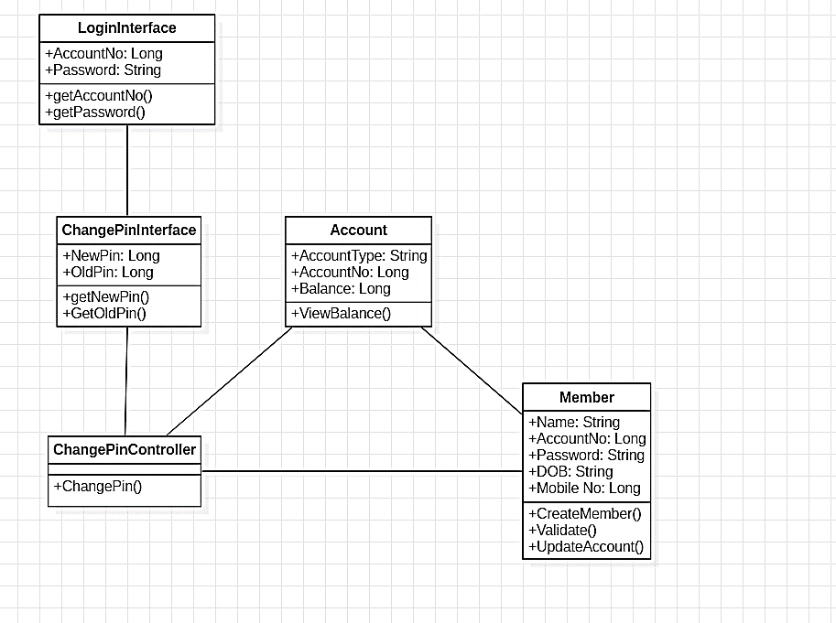
Login Class Diagrams

Slide 10
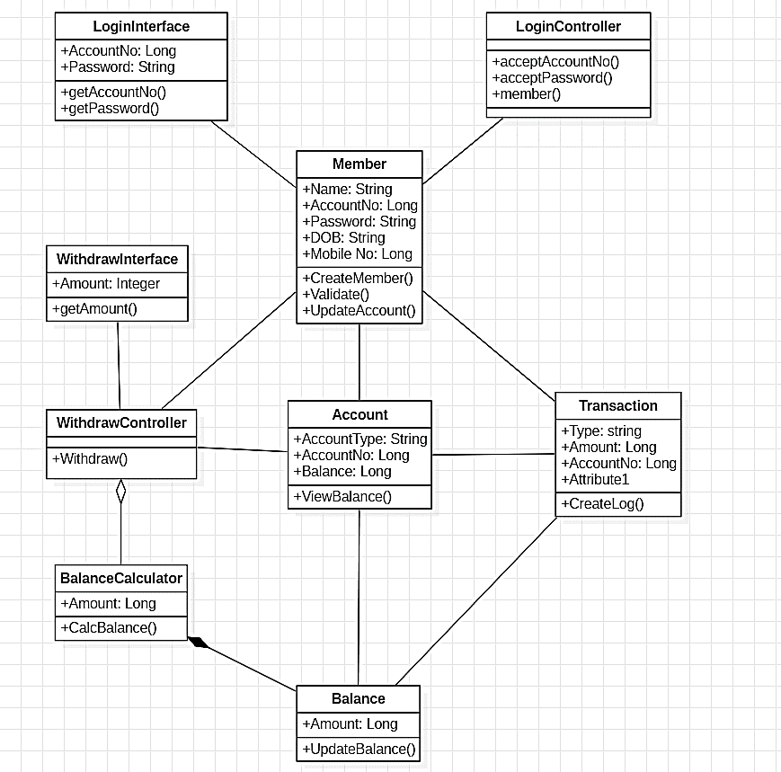
Deposit Class Diagrams

Slide 11
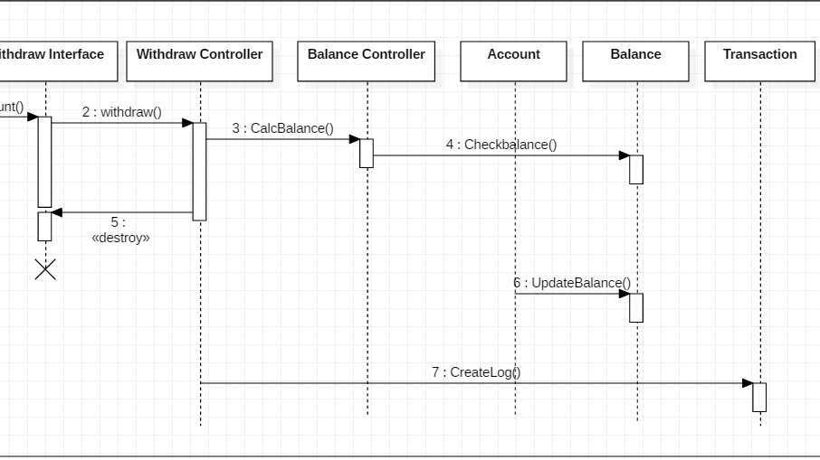
Sequence Diagram
A sequence diagram is an interaction Diagram that shows how objects operate with one another and in what order. It is a construct of a message sequence chart.
A sequence diagram shows object interactions arranged in time sequence. It depicts the objects and classes involved in the scenario and the sequence of messages exchanged between the objects needed to carry out the functionality of the scenario. Sequence diagrams are typically associated with use case realizations in the Logical View of the system under development. Sequence diagrams are sometimes called event diagrammes or event scenarios.

Slide 12
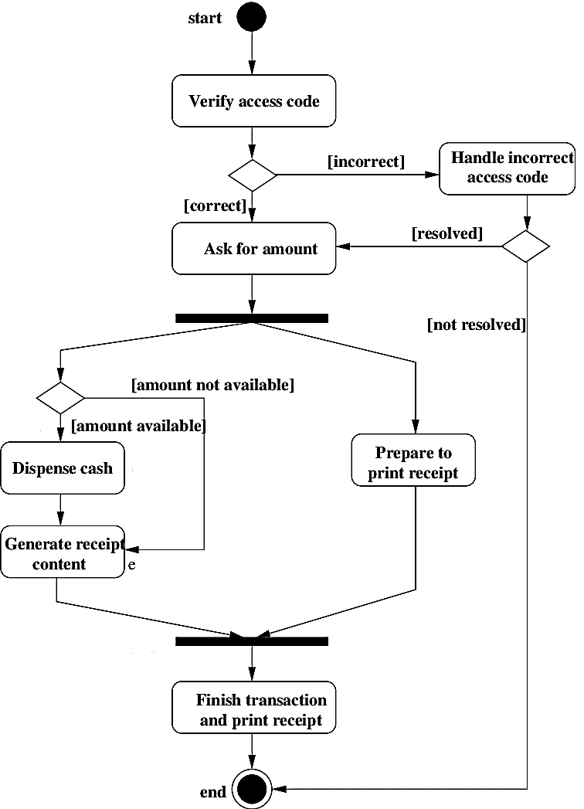
Activity diagram
An Activity diagram is a visual representation of any system's activities and flows of data or decisions between activities. They provide a very broad view of a business process. They represent the dynamics of a system. These are flow charts that are used to show the work flow of a system. They show what activities can be done in parallel, and any alternative paths through the flow.

Slide 13
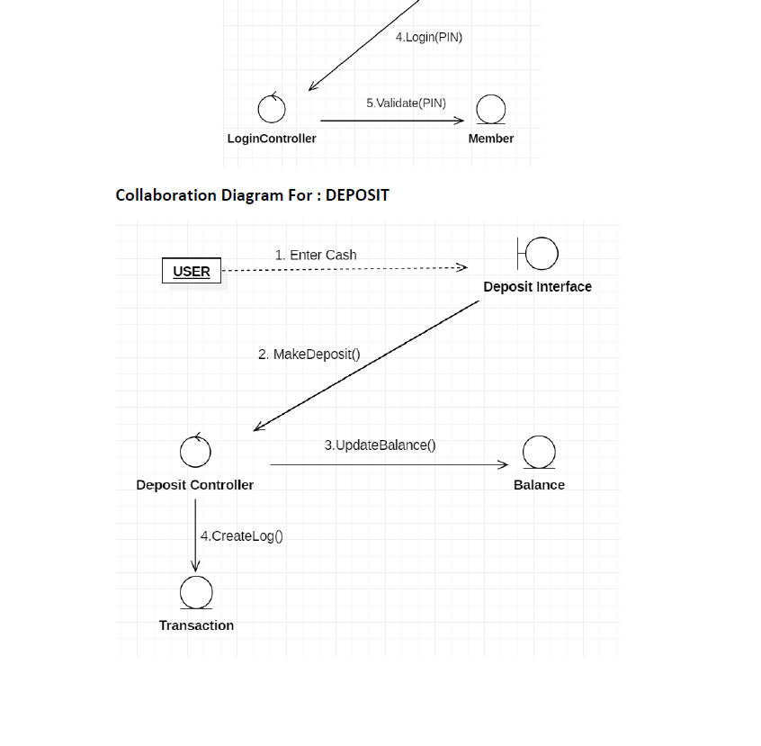
Collaboration Diagram
A collaboration diagram, also called a communication diagram or interaction diagram, is an illustration of the relationships and interactions among software objects in the Unified Modelling Language (UML). The concept is more than a decade old although it has been refined as modelling paradigms have evolved.

Slide 14
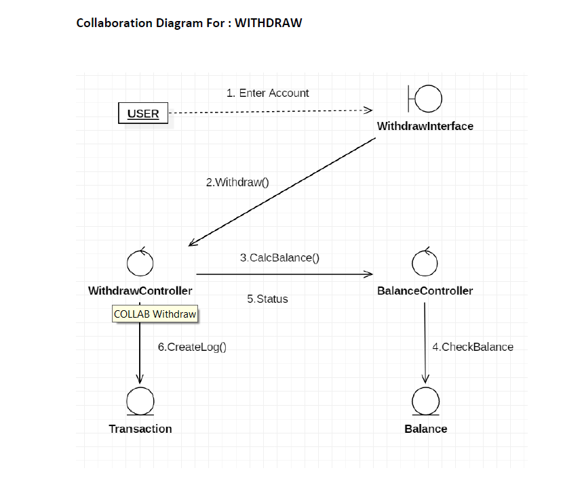
Collaboration Diagram
A collaboration diagram, also called a communication diagram or interaction diagram, is an illustration of the relationships and interactions among software objects in the Unified Modelling Language (UML). The concept is more than a decade old although it has been refined as modelling paradigms have evolved.

Slide 15
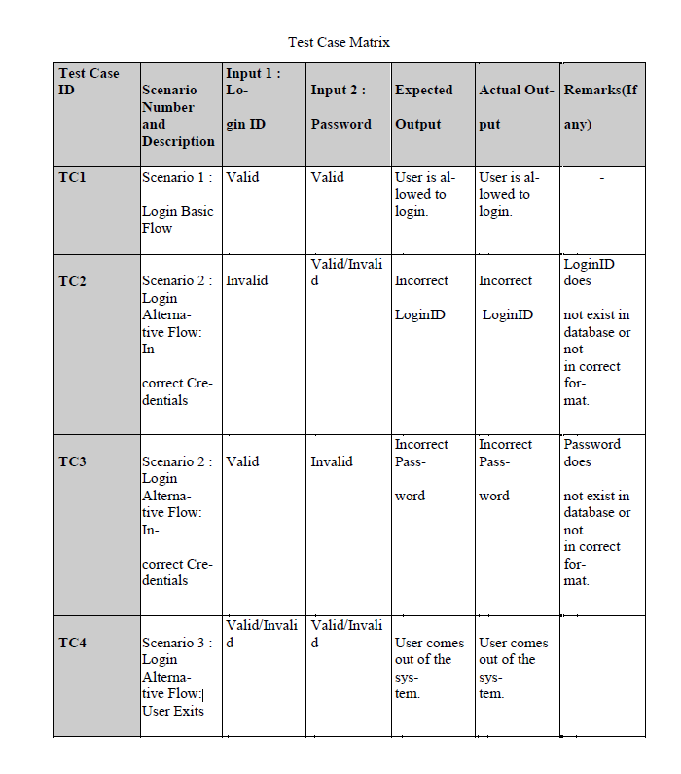
Test Cases
A test case is a set of test inputs, execution conditions, and expected results for those inputs and conditions developed to verify compliance with a specific requirement. The point of running the test is to gain information, for example whether the program will pass or fail the test. Test cases are the cornerstone of Quality Assurance where they are developed to verify the quality and behaviour of a product.

Slide 16
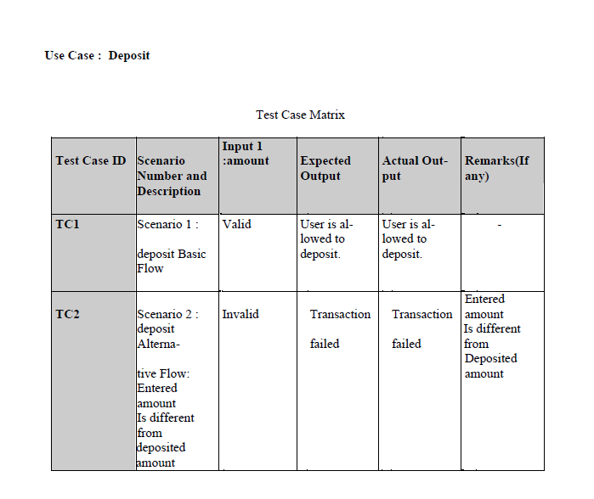
Test Cases

Slide 17
Thank You
Vaibhav verma
Shivam chaudhary

