Slide 1
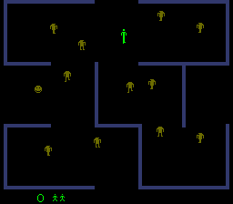
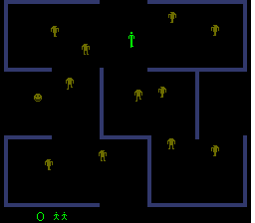

Slide 2
248 = 48 * 1 + 44 * 4 + 4 * (5 + 1)
64
8 x 11
2
8 x 16
208 = 64 * 3 + 4 * (3 + 1)
64
48
44
44
44
44
64

Slide 3
244 = 44 * 5 + 4 * (5 + 1)
244 = 44 * 5 + 4 * (5 + 1)
64
8 x 11
2
8 x 16
208 = 64 * 3 + 4 * (3 + 1)
64
44
44
44
44
44
64

