Slide 1
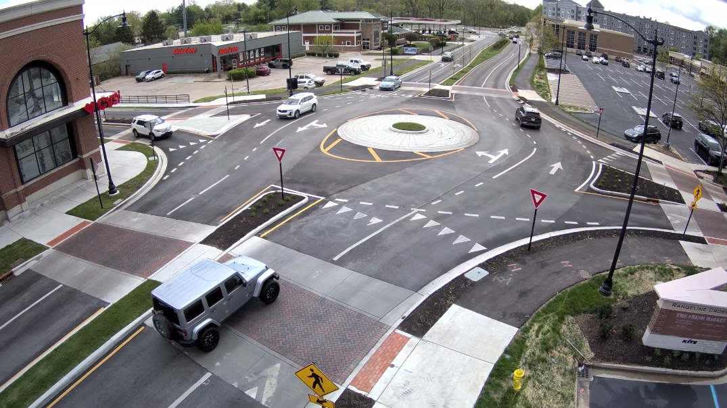
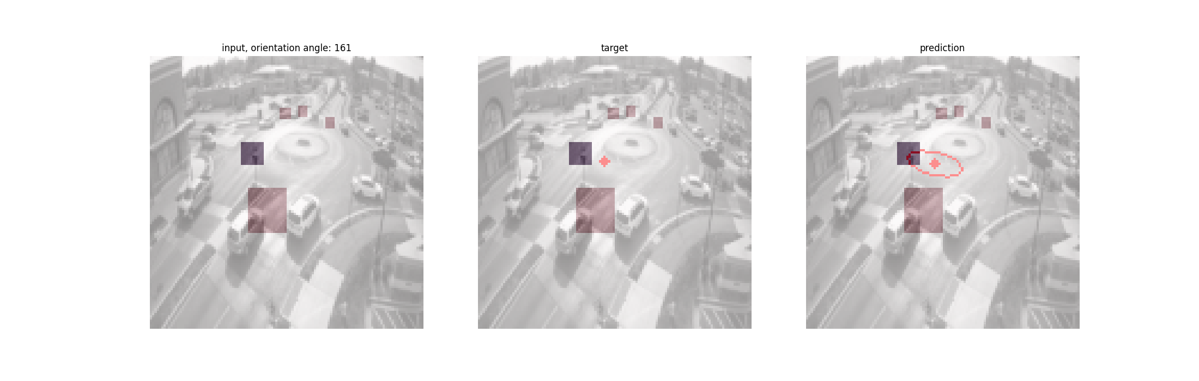
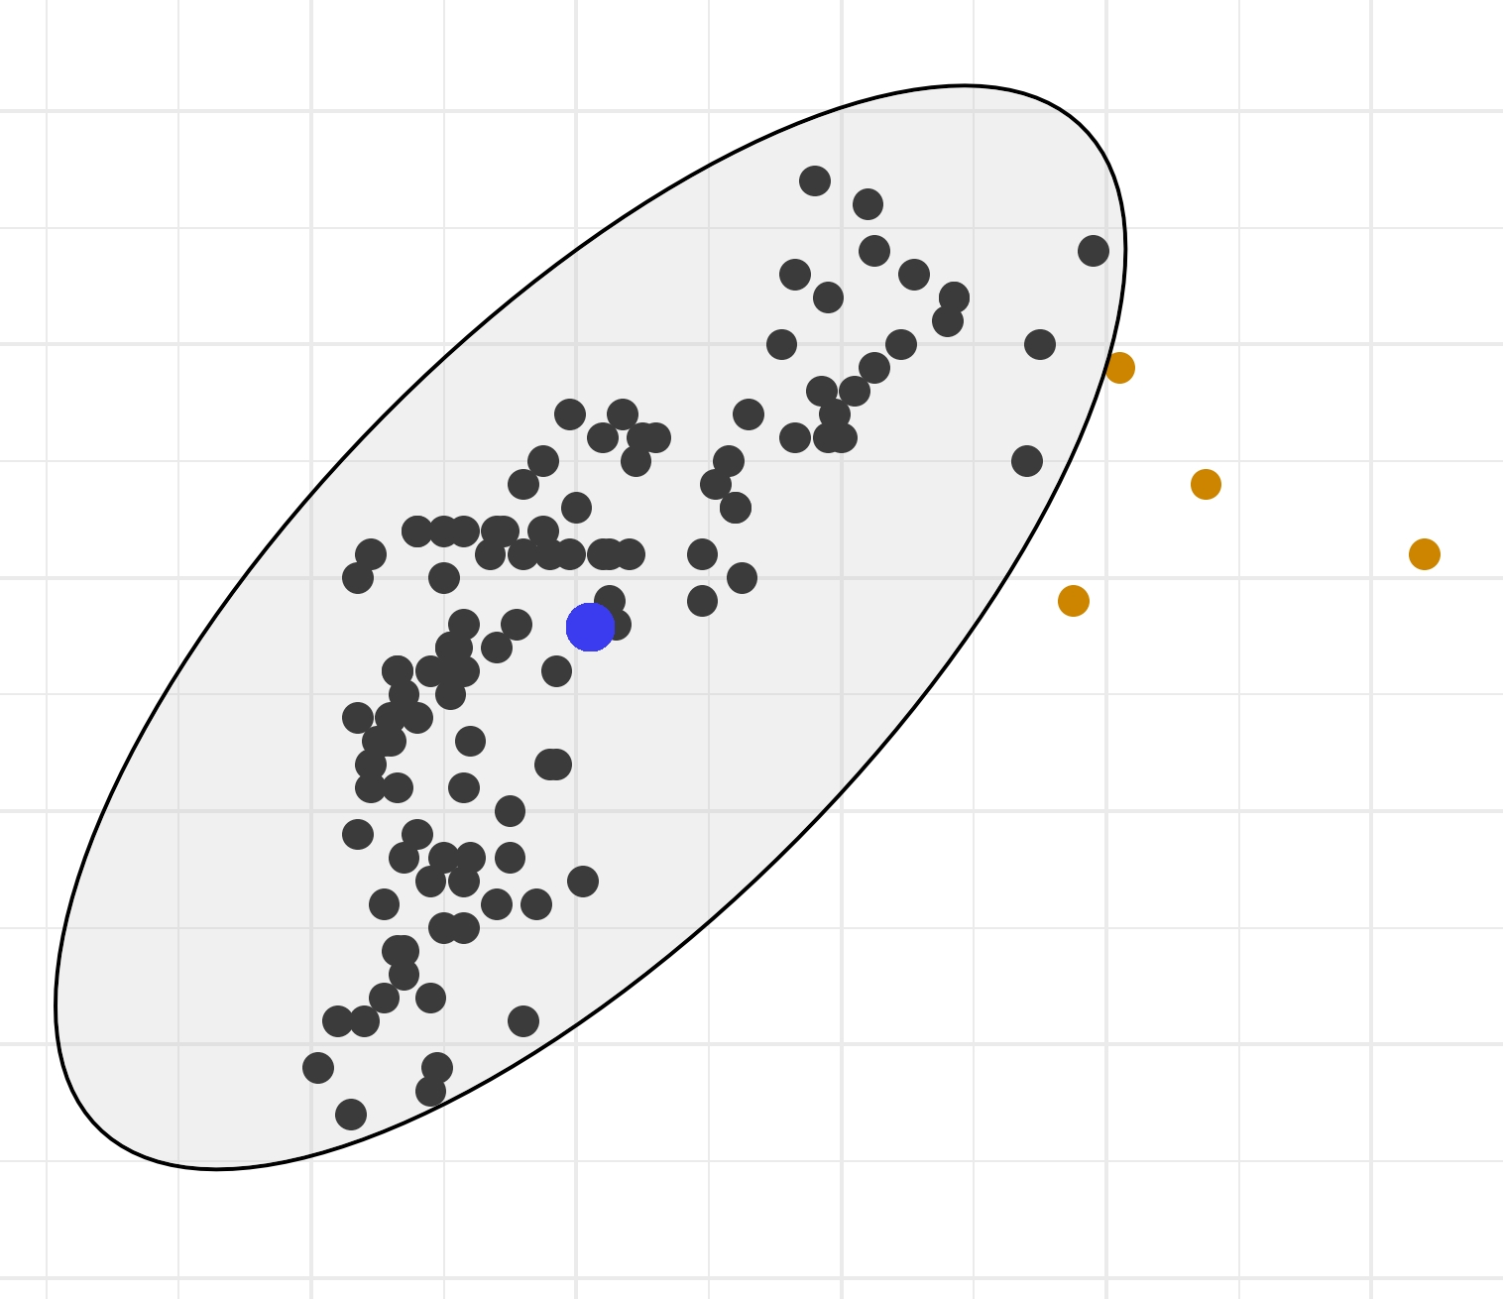
Traffic anomaly detection
Input Frame + Mask bbox vehicle
µ, Σ
Prediction
CNN probabilistic regression
0000000000000000000000000000000000000000000000000000
P(y|µ, Σ)
Mahalanobis Distance
Forecasts the vehicles position 1 second later
(y1, y2)
Target position
Anomaly
No anomaly

Slide 2
Traffic anomaly detection
Training Step 1
Input Frame + Mask targeted vehicle
Position 1s later
µ, Σ
Prediction
0000000000000000000000000000000000000000000000000000
CNN Uncertainty
(x, y)
Target
Training data 1
NNL loss

Slide 3
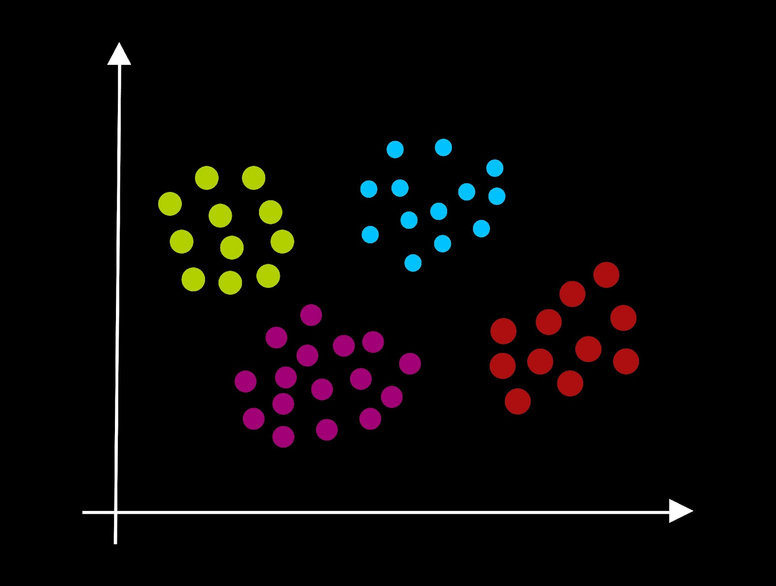
Traffic anomaly detection
Training Step 2
Input Frame + Mask targeted vehicle
Position 1s later
µ, Σ
Prediction
N(µ, Σ)
0000000000000000000000000000000000000000000000000000
CNN Uncertainty
P(y|µ, Σ)
(x, y)
Target
Inferencing
> threshold & |Σ| not too large
Training data 2
< threshold o. |Σ| too large
Clustering of (input-position, y, prediction parameter)
No Anomaly

Slide 4
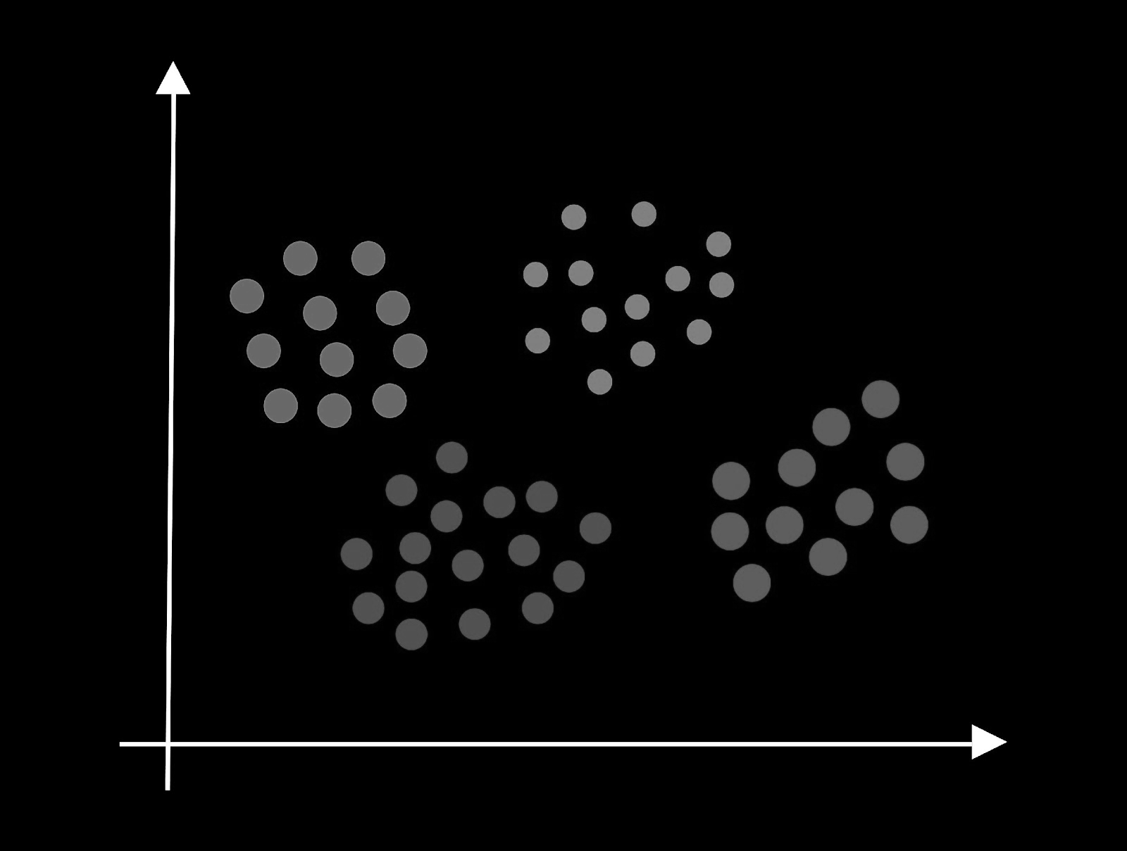
Traffic anomaly detection
Training Step 3
Labelling of Clusters as Anomaly/no Anomaly through classification of one representator pro Cluster (=corresponding video clip) by a human
Labelling
Training data 2
Prediction
Binary Classifier
Anomaly/ no Anomaly
Training

Slide 5
Traffic anomaly detection
Anwendung
Input Frame + Mask targeted vehicle
Position 1s later
µ, Σ
Prediction
N(µ, Σ)
0000000000000000000000000000000000000000000000000000
CNN Uncertainty
P(y|µ, Σ)
(x, y)
Target
Inferencing
> threshold & |Σ| not too large
Test data
< threshold or |Σ| too large
No Anomaly
Prediction
Binary Classifier
(input-position, y, prediction params)
Anomaly/ no Anomaly
User Feedback:
Confirmation or Disagreement
Update

