Slide 1
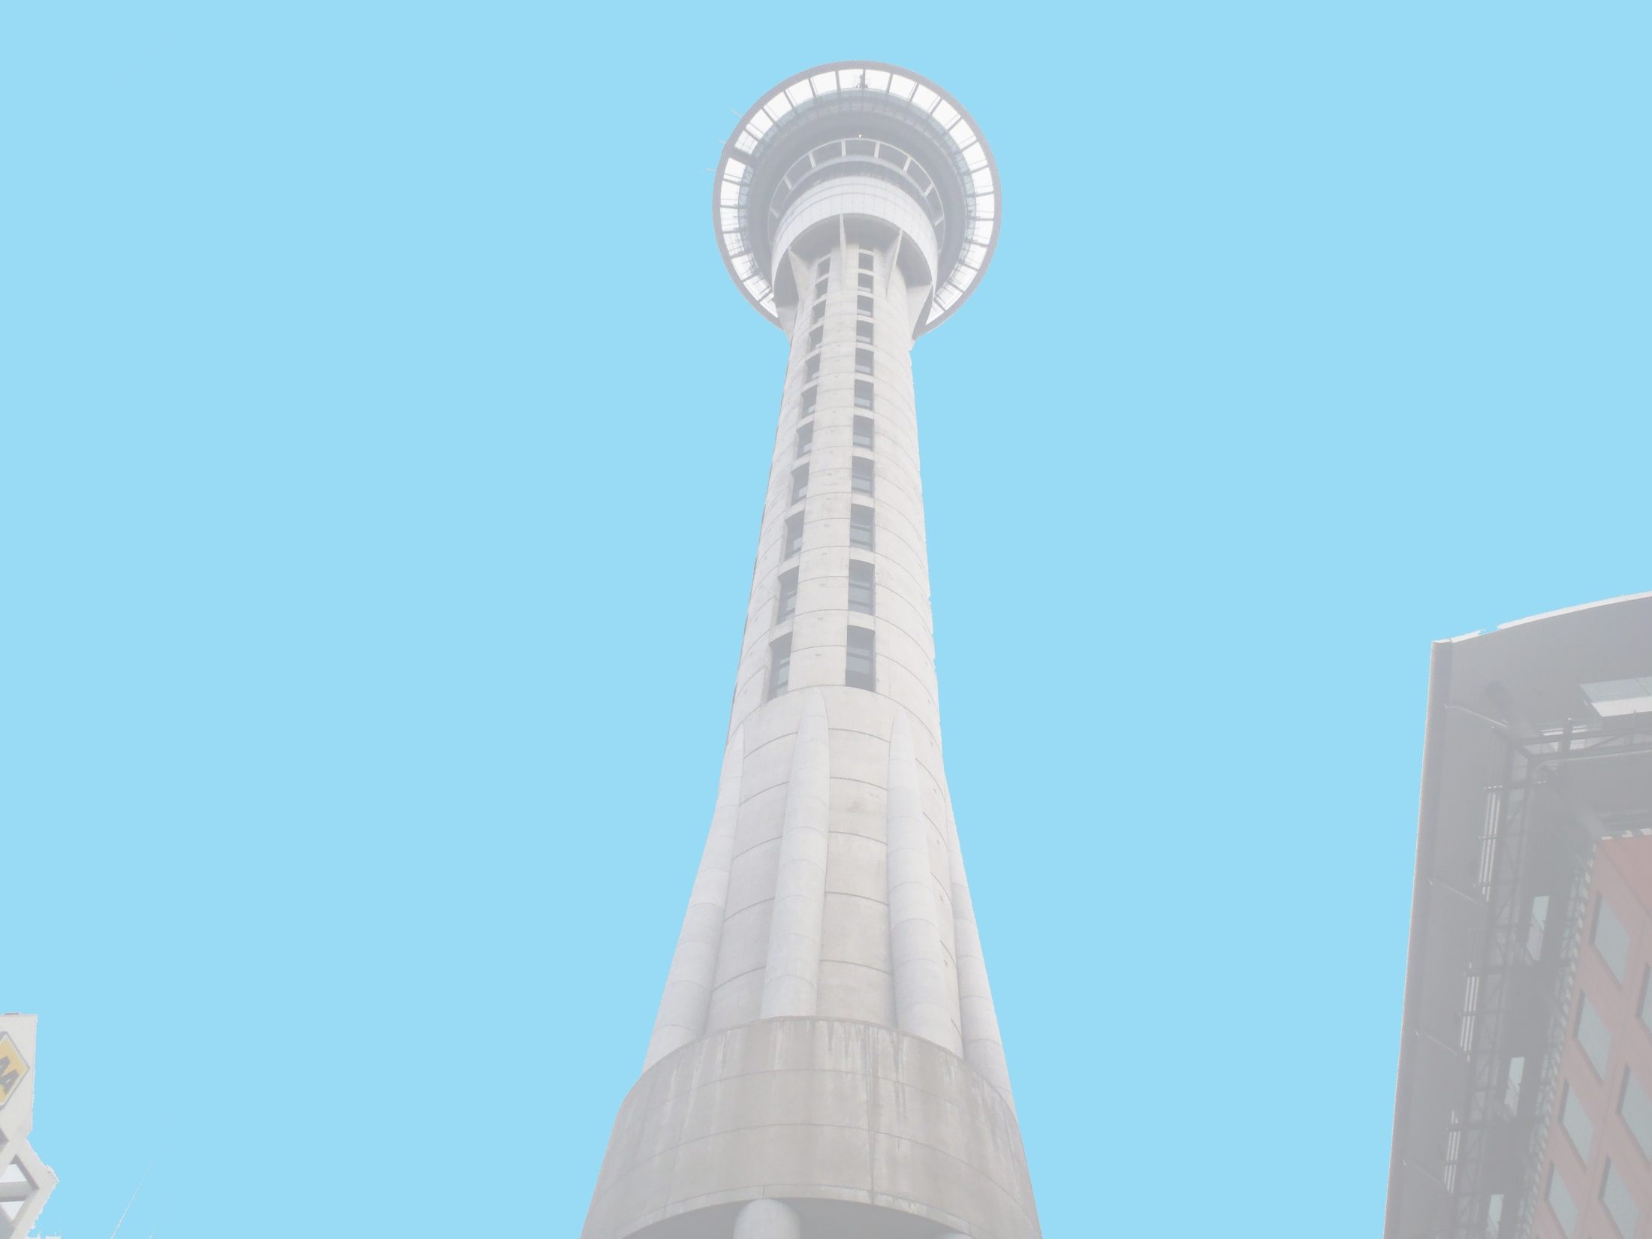


Anthony Adams
Securing of Unreinforced Masonry Parapets
The University of Auckland, New Zealand
Host Mentors: Dmytro Dizhur & Liam Wotherspoon
UCSD Mentor: Lelli Van Den Einde
July 10th 2013

Slide 2
Experiment
Multiple two leaf parapets, secured using common retrofits of the area and experimentally validated retrofits, will be dynamically loaded on a Shake table to provide experimental data of their effectiveness in a dynamic setting.
Test both experimentally validated and industry accepted retrofits for URM parapets to see which methods are the most effective.
Goals

Slide 3
Securing of URM parapets
Initial “pull-out” laboratory tests were determined to be inconclusive due to our testing procedure. We have devised a new plan of action for testing and are currently preparing the brick specimens for more accurate and controlled static and dynamically loaded “pull-out” tests.
I also had my first exposure to the Data Acquisition system that we will be using during the Parapet testing
Initial data processing of the output from the “pull-out” tests.

Slide 4
Christchurch
We flew down to Christchurch to collect mortar samples from some of the remaining Unreinforced buildings from the time period.
Looked at retrofitted parapets that survived the quake.
Visited Erickson’s Bridge that he is modeling which is currently under construction.
Got to see what is left of the city and the remaining damage around town. AMAZING

Slide 5
Next Week
Static and Dynamic Pull Out tests will be completed and analyzed.
I will be inducted at the new lab at east campus where the shake table will be built.
Finalize accelerometer placement along the parapet and base of the shake table.
Start the building process for both the parapets and the shake table.

Slide 6
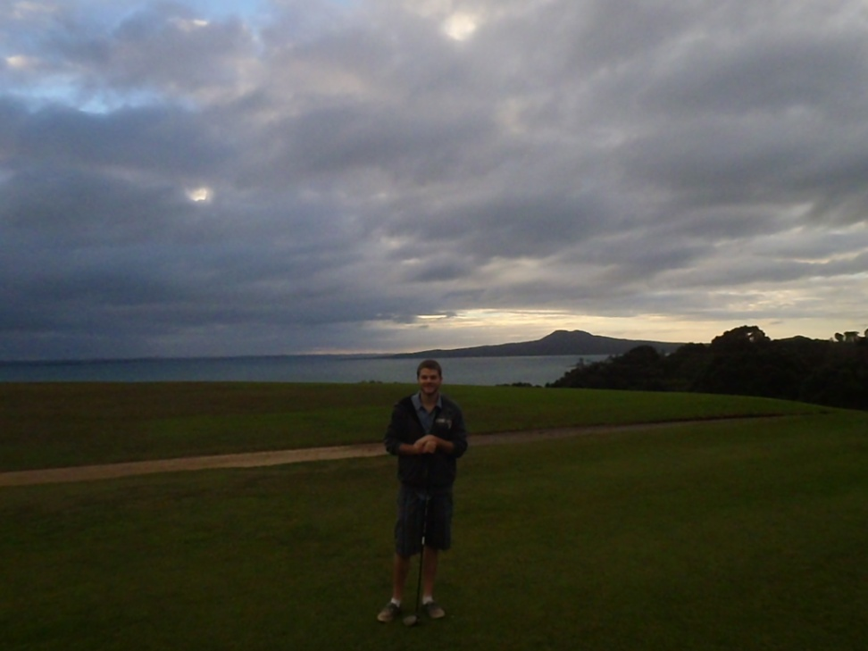
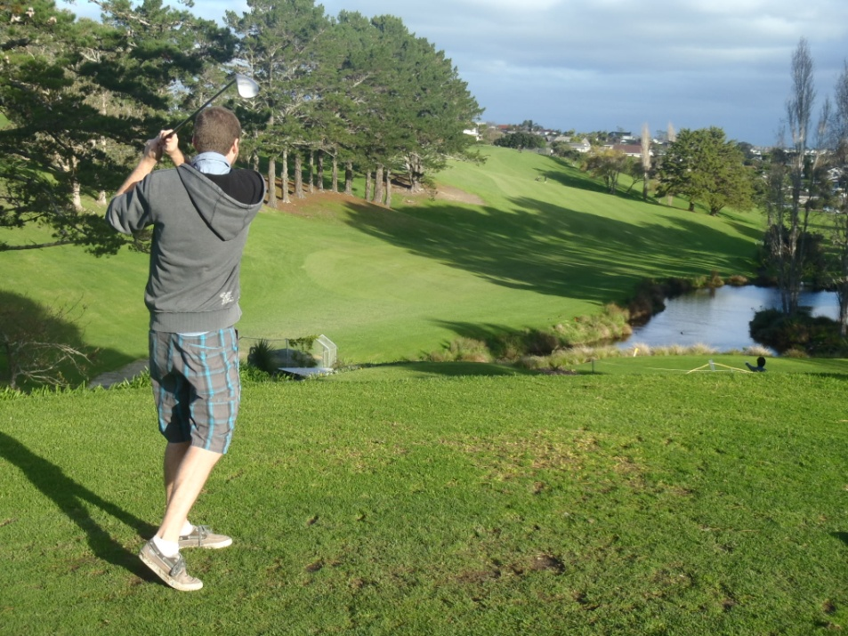
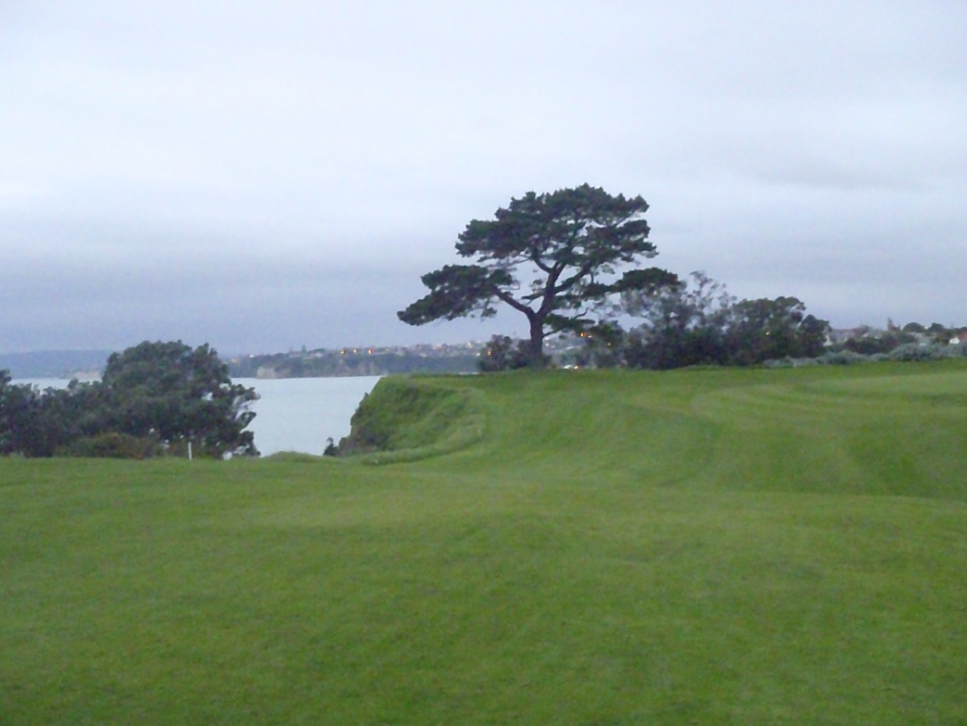
Howick Golf Course

Slide 7
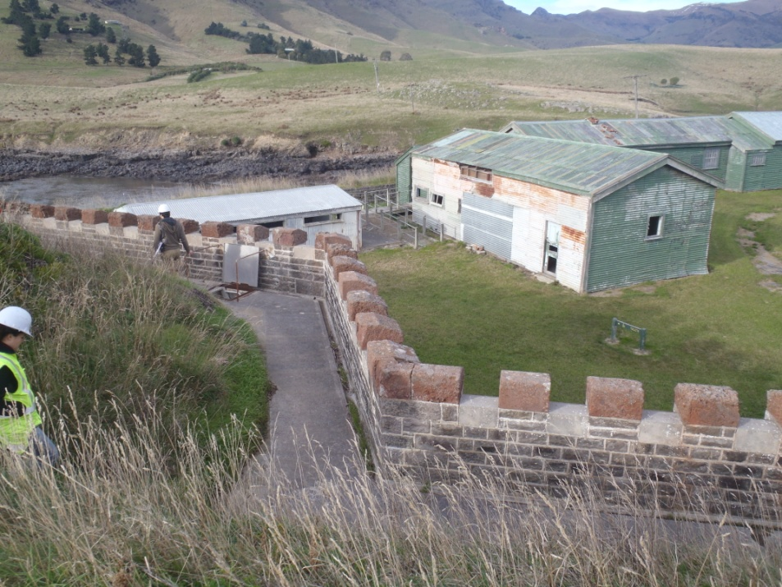
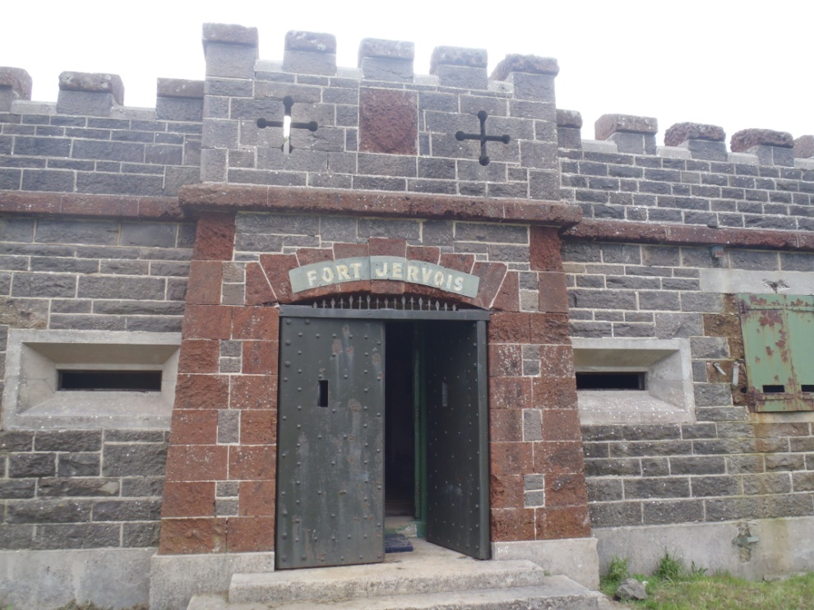
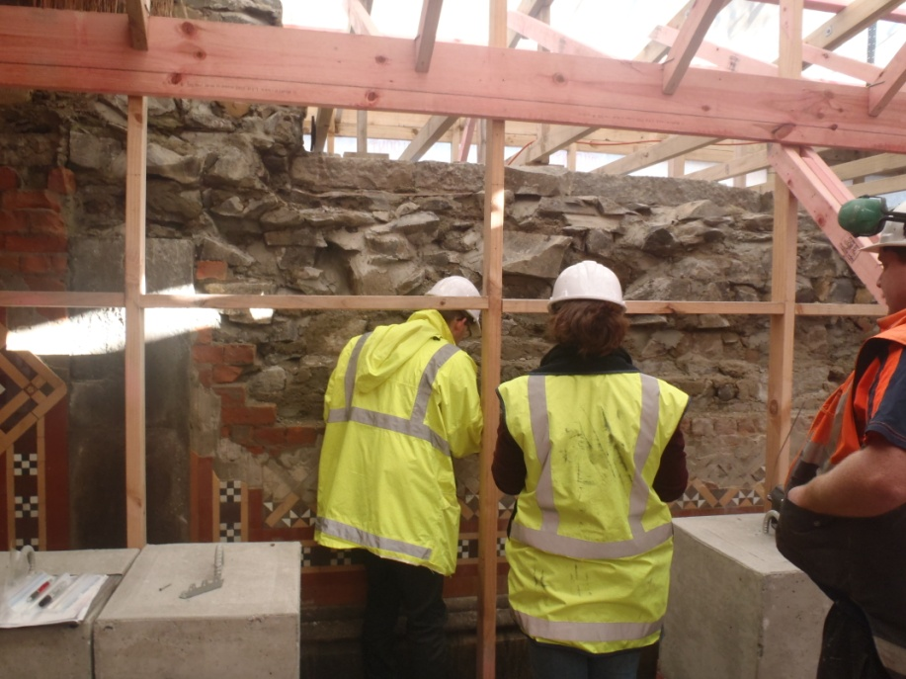
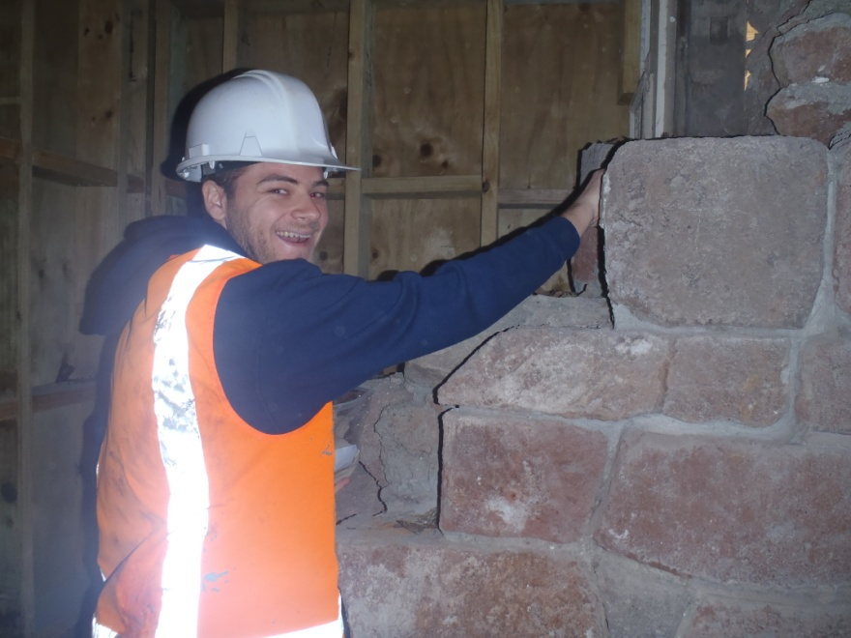
Christchurch (Collecting Samples)
Fort Jervois, Mortar, concrete, and Stone Samples
Church Near CBD of Christchurch, Collecting Mortar

Slide 8
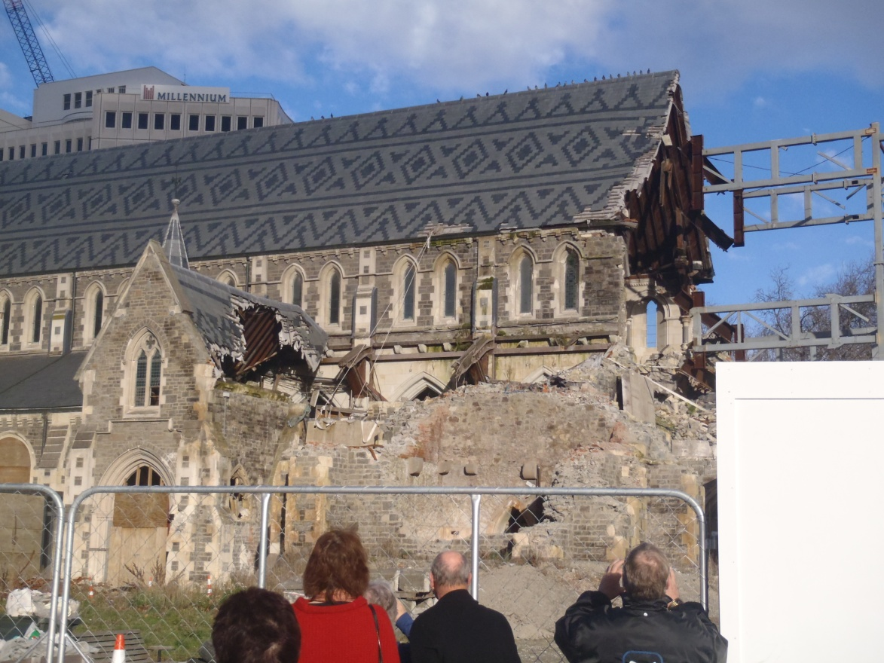
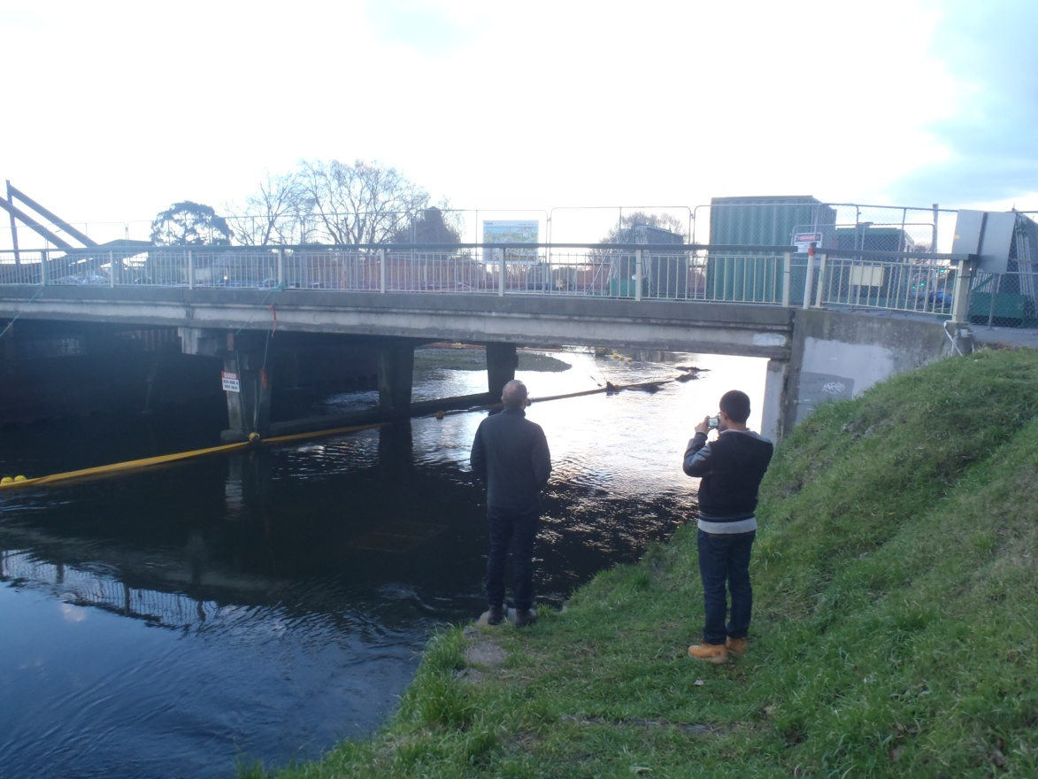
Christchurch
Christchurch Cathedral Damage
Avondale Road bridge
(Erickson’s Modeling Project)

