Slide 1
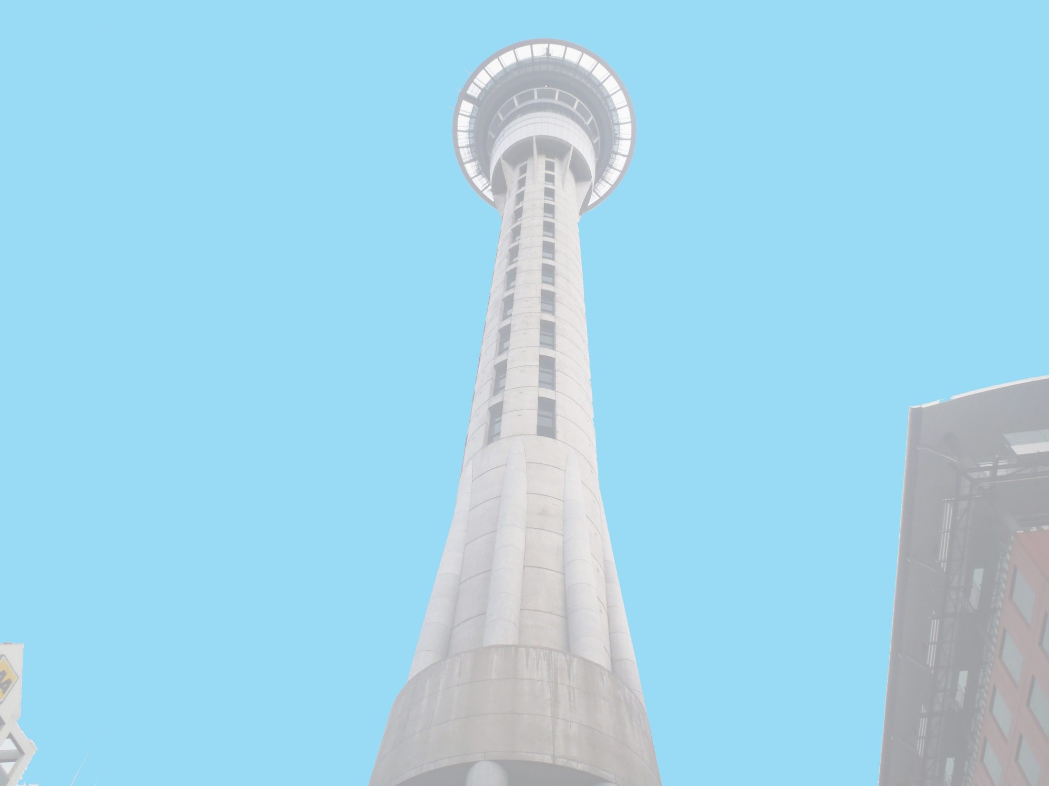



Anthony Adams
Securing of Unreinforced Masonry Parapets
The University of Auckland, New Zealand
Host Mentors: Dmytro Dizhur & Liam Wotherspoon
UCSD Mentor: Lelli Van Den Einde
July 17th 2013

Slide 2
Experiment
Multiple two leaf parapets, secured using common retrofits of the area and experimentally validated retrofits, will be dynamically loaded on a Shake table to provide experimental data of their effectiveness in a dynamic setting.
Test both experimentally validated and industry accepted retrofits for URM parapets to see which methods are the most effective.
Goals

Slide 3
Securing of URM parapets
Created a simplified computer model of an unsupported parapet using Working Model to assist with accelerometer placement and give us something to compare our observations with.
Moved most of the bricks to the Shake Table location.
2 Parapets were constructed by a contractor and are curing.
More complications occurred during the dynamic pull-out tests with the nut stripping the bolt on impact easy fix for next week. Hopefully

Slide 4
Next Week
Static and Dynamic Pull Out tests will be completed and analyzed.
Finalize accelerometer placement along the parapet and base of the shake table.
Gather the materials for the Retrofits.
Get more bricks from demolished URM buildings.

Slide 5
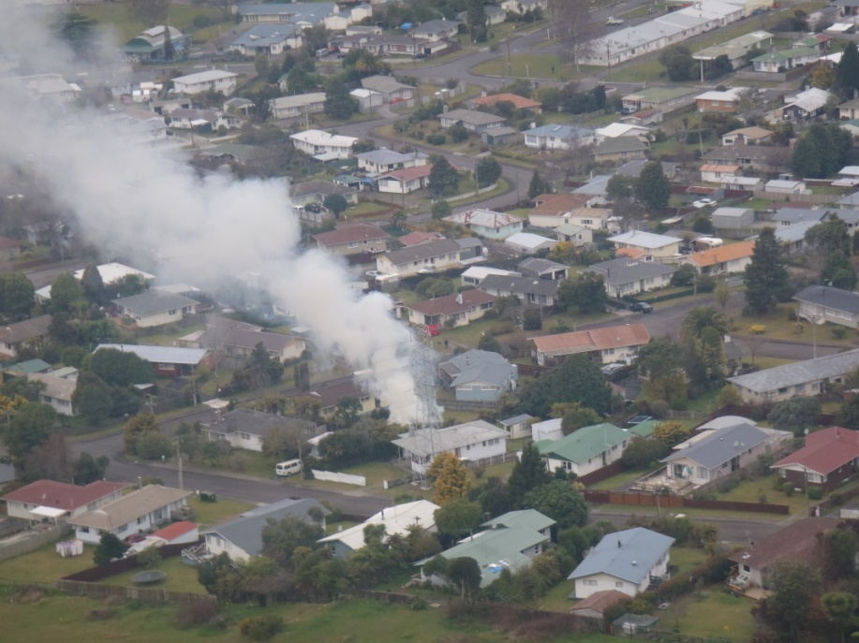
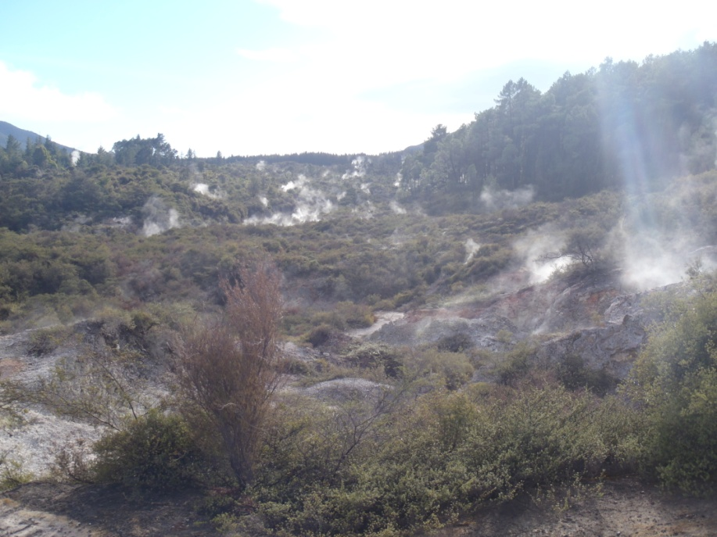
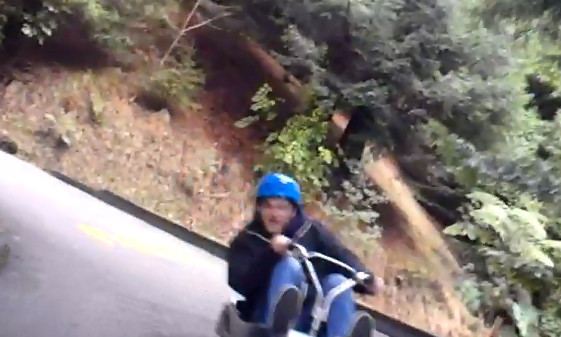
Rotorua
House with volcanic vent in backyard...
Vents all over the mountains and in the city. The smell of Sulfur never ends.
Luging at Skyline

Slide 6
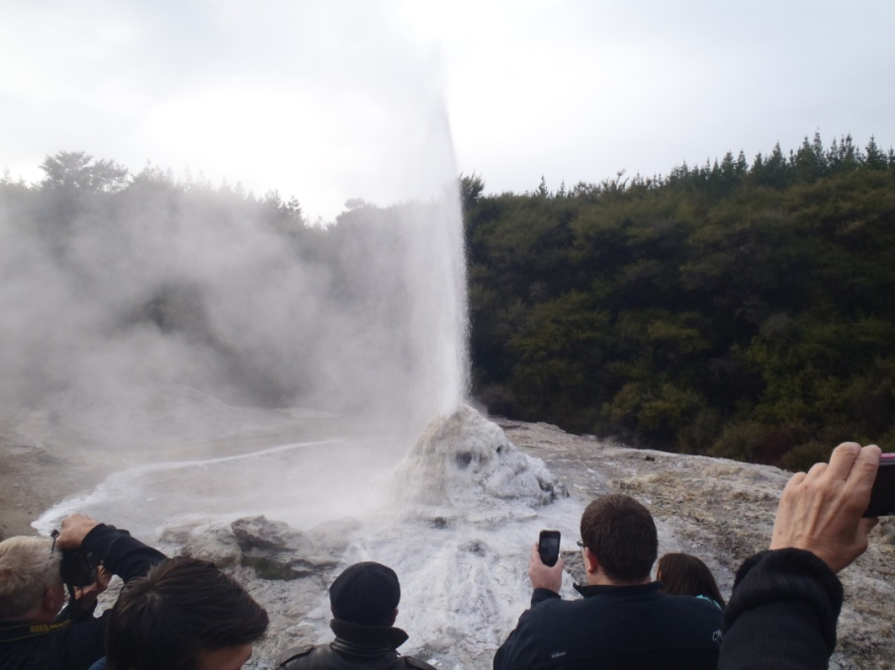
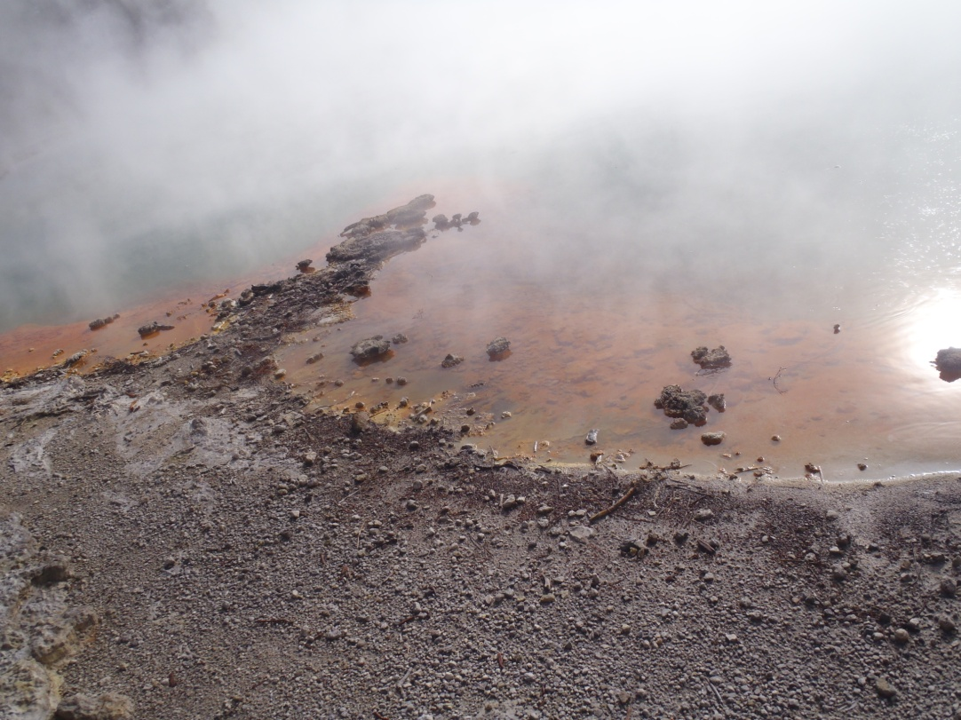
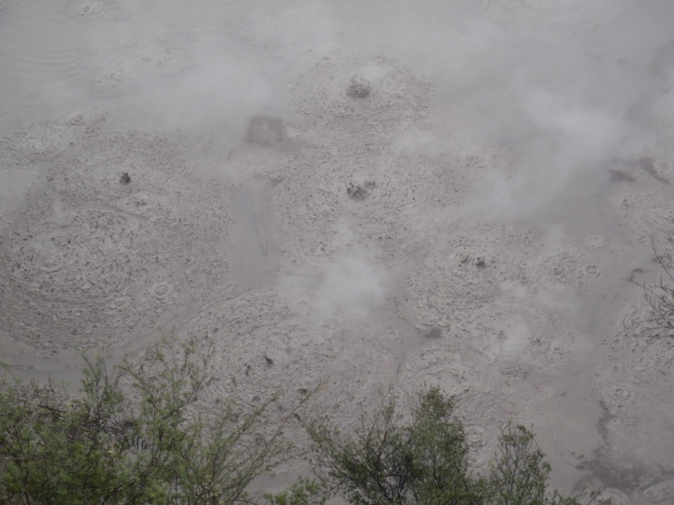
Rotorua
Lady Knox Geyser
Bubbling Mud and Colorful Lakes at Wai-O-Tapu Geothermal Wonderland

Slide 7
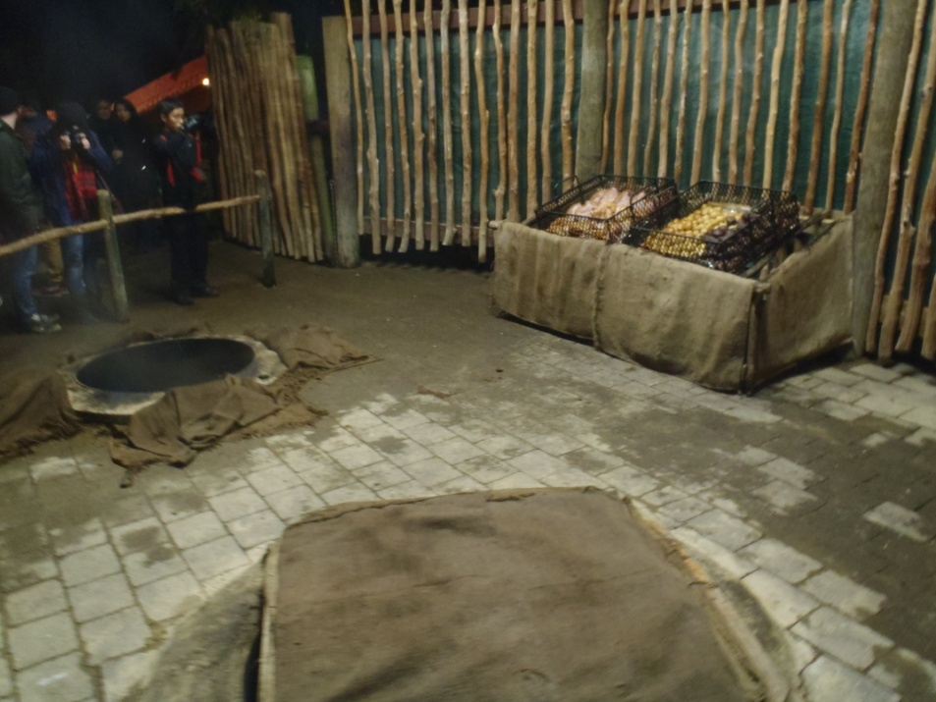
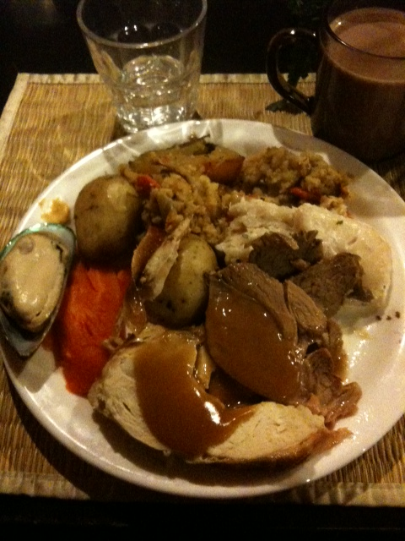
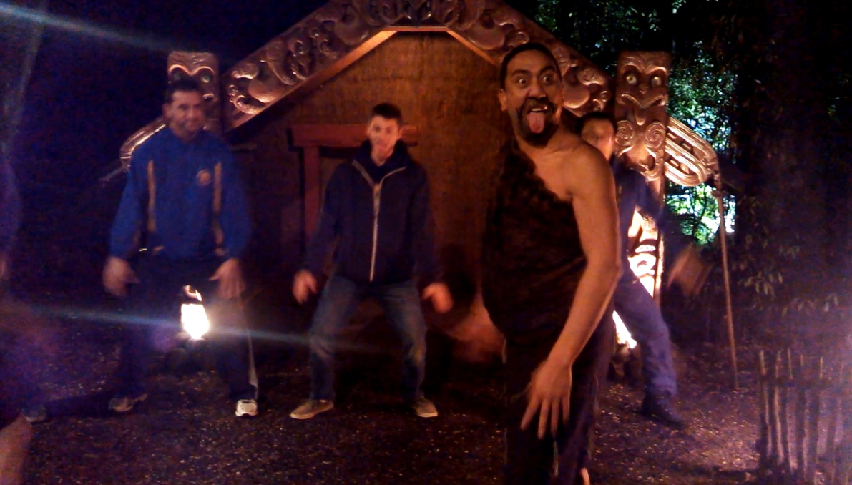
Tamaki Maori Village
Our food was prepared in an underground oven. Ate an oyster for the first time.
Me Learning the Maori Haka dance. One of many activities I was chosen for. Made the experience that much better!

Slide 8
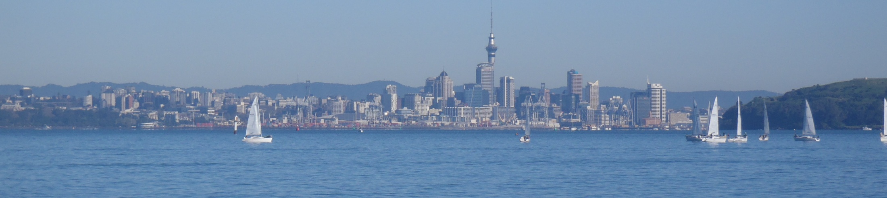
Acknowledgements
Thank you to everyone who has made this life changing experience possible!!!
Auckland Mentors: Liam Wotherspoon, Dmytro Dizhur
UCSD Mentor: Lelli Van Den Einde
PRIME: Gabriele Wienhausen, Peter Arzberger

