Slide 1
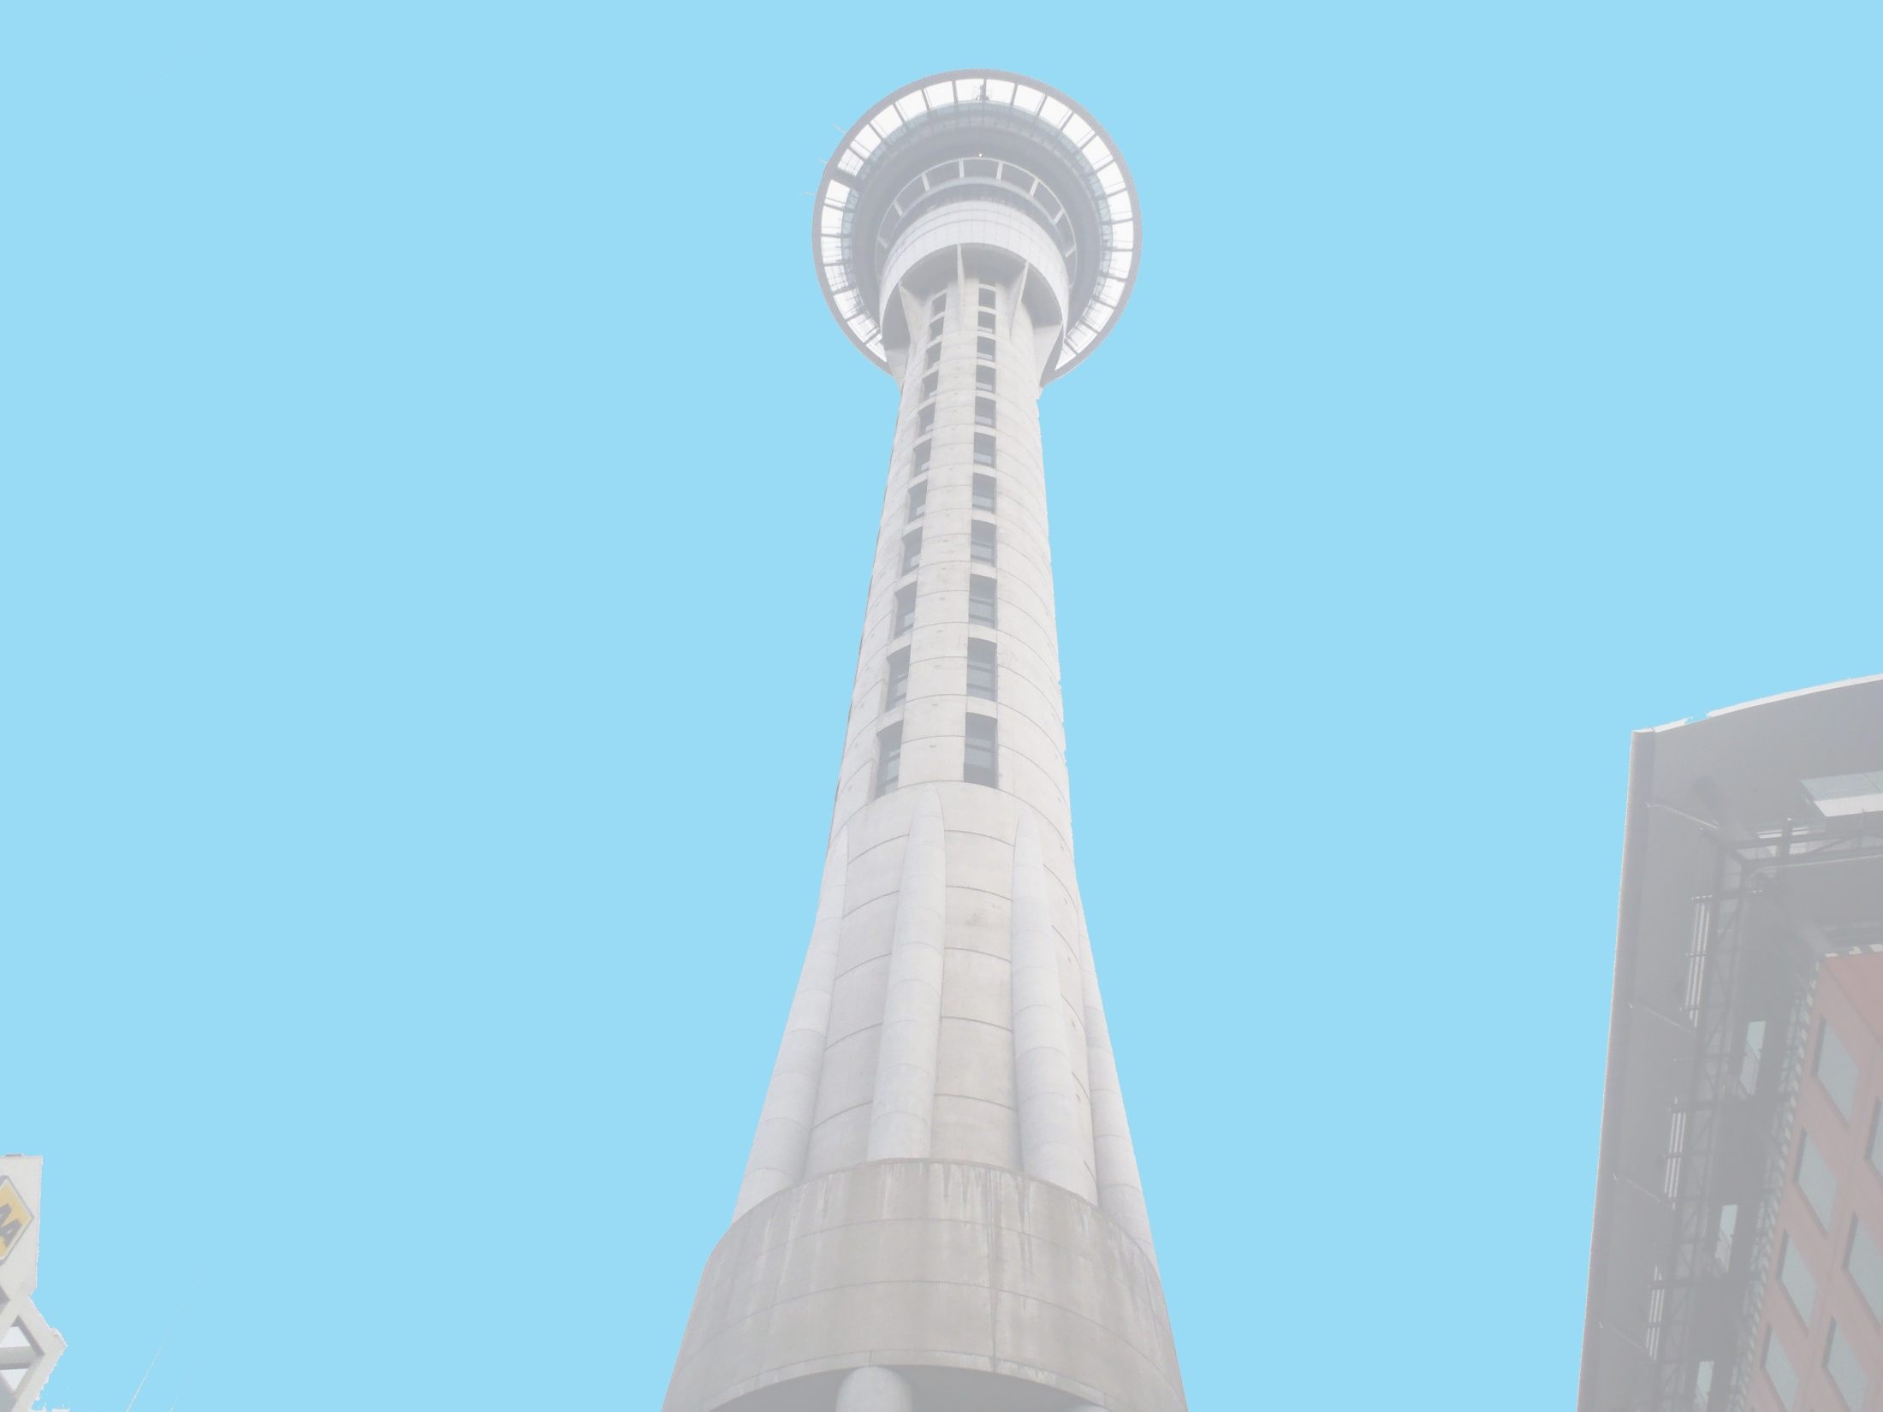



Anthony Adams
Securing of Unreinforced Masonry Parapets
The University of Auckland, New Zealand
Host Mentors: Dmytro Dizhur & Liam Wotherspoon
UCSD Mentor: Lelli Van Den Einde
July 31th 2013

Slide 2
Experiment
Multiple two leaf parapets, secured using common retrofits of the area and experimentally validated retrofits, will be dynamically loaded on a Shake table to provide experimental data of their effectiveness in a dynamic setting.
Test both experimentally validated and industry accepted retrofits for URM parapets to see which methods are the most effective.
Goals

Slide 3
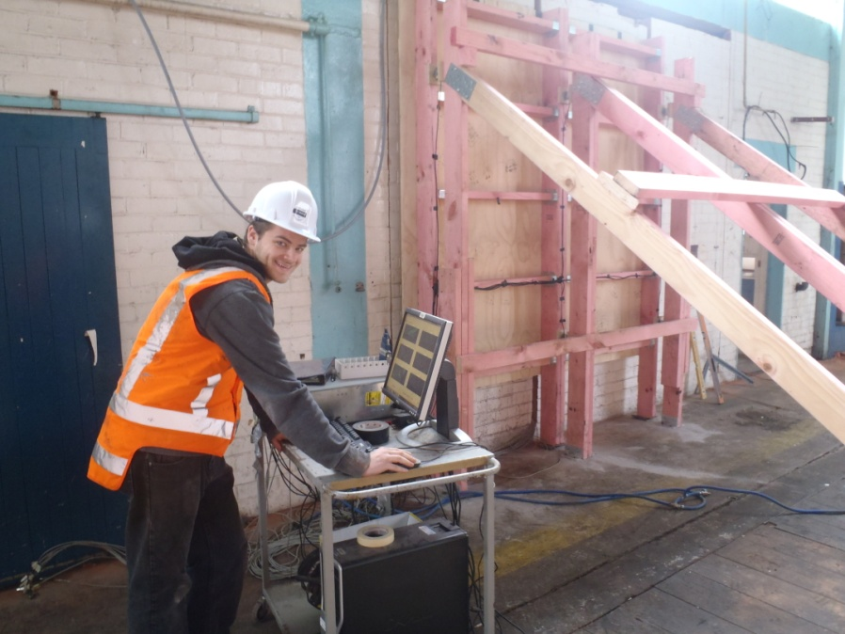
Securing of URM parapets
Testing of Masonry walls in One-Way Bending and Two-Way bending were completed on an existing building set for demolition due being deemed as Seismically unsafe.
Different Ties were used to connect the two leafs of the masonry wall. We will see their results after data processing.
Finished the Pull-Out testing project.

Slide 4
Next Week
Continue updating the Working Model of the parapet and attach the different retrofits that we will be testing.
Construction of the Parapet Shake Table.
Data processing from the Masonry Wall testing.

Slide 5
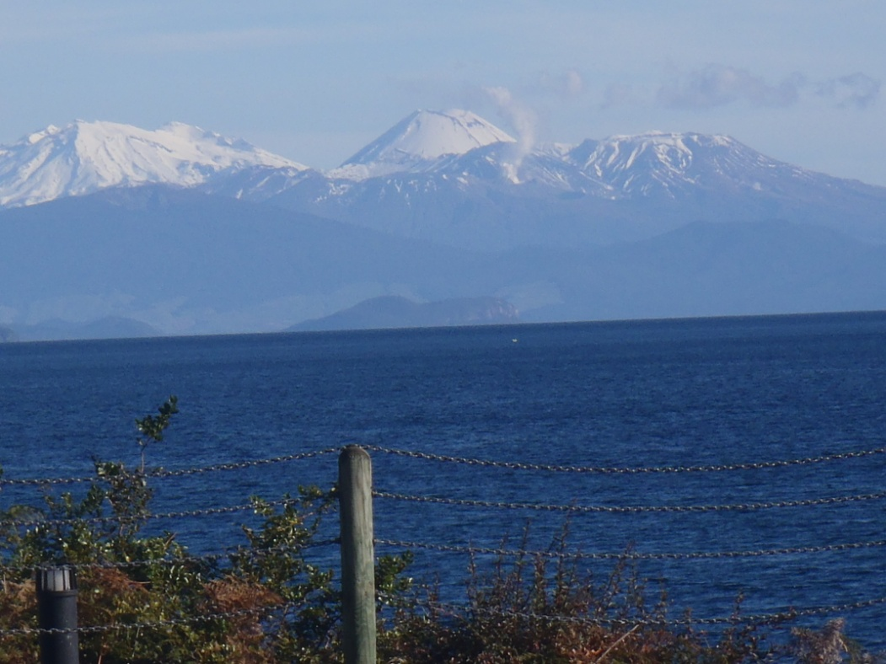
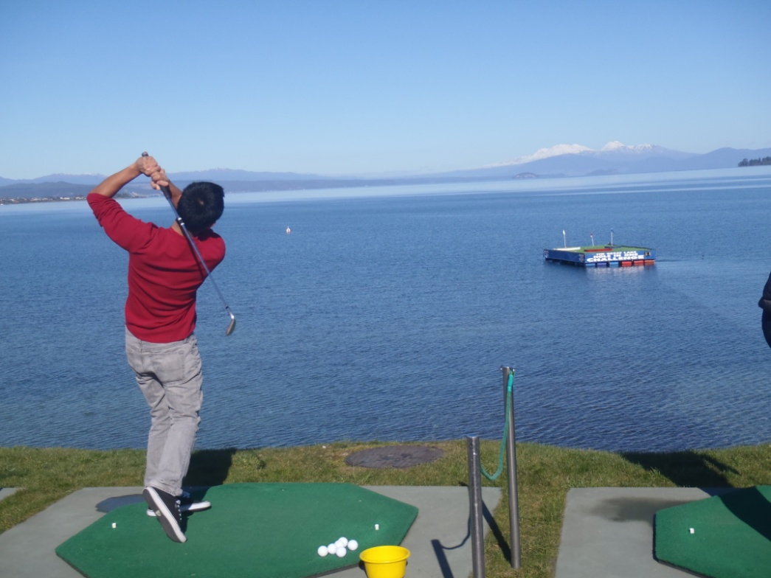
Taupo
Erupting Volcano Across Lake Taupo →
My favorite city so far!
← Hole in one challenge trying to win $10,000, or a free Skydive!

Slide 6
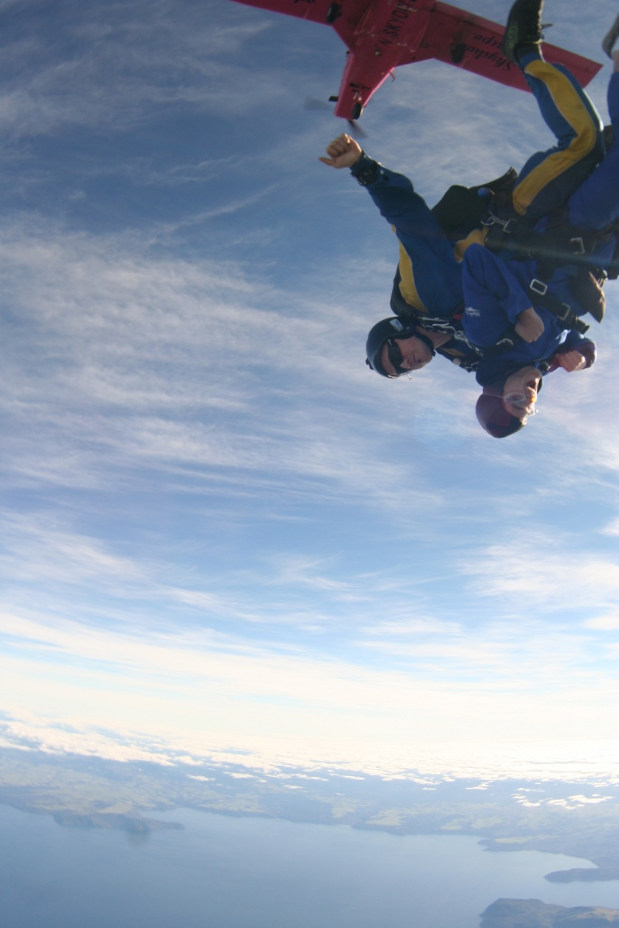
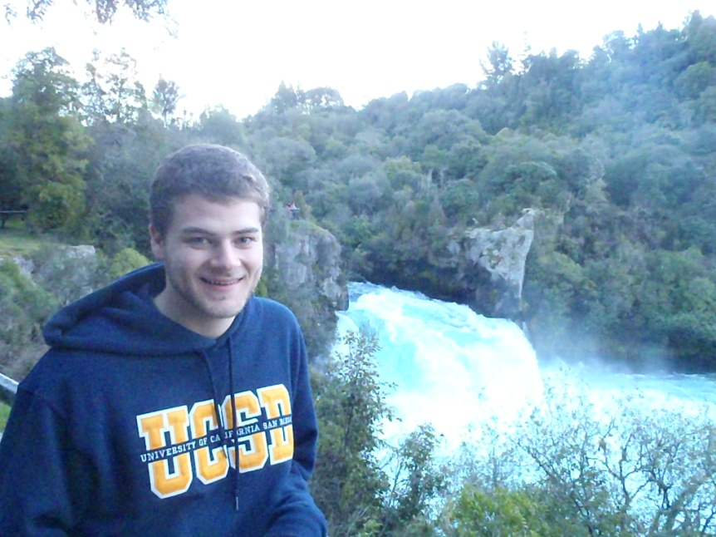
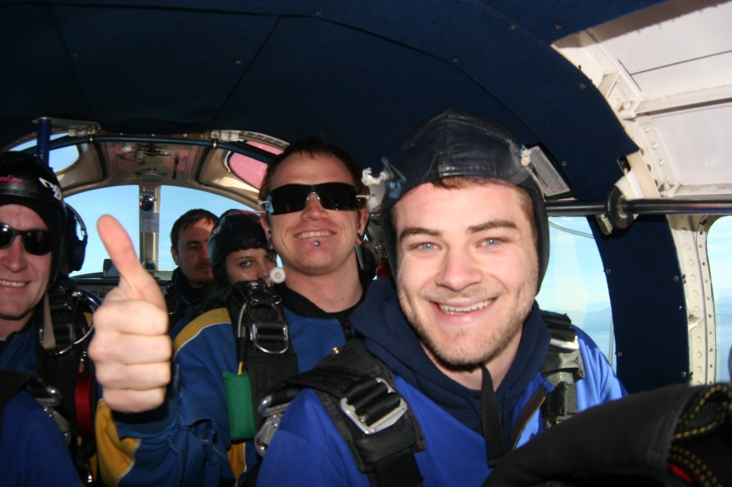
Taupo
Huka Falls →
200,000 Liters of water per second
Skydiving! 15,000 Ft.

Slide 7
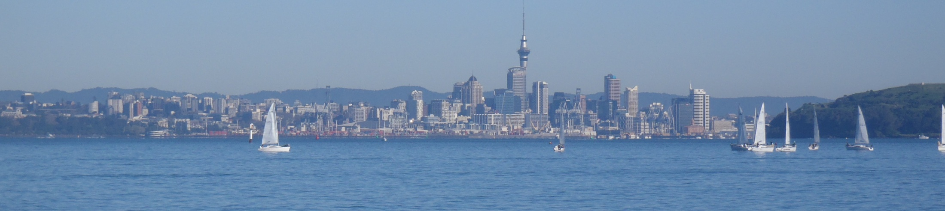
Acknowledgements
Thank you to everyone who has made this life changing experience possible!
Auckland Mentors: Liam Wotherspoon, Dmytro Dizhur
UCSD Mentor: Lelli Van Den Einde
PRIME: Gabriele Wienhausen, Peter Arzberger

