Slide 1
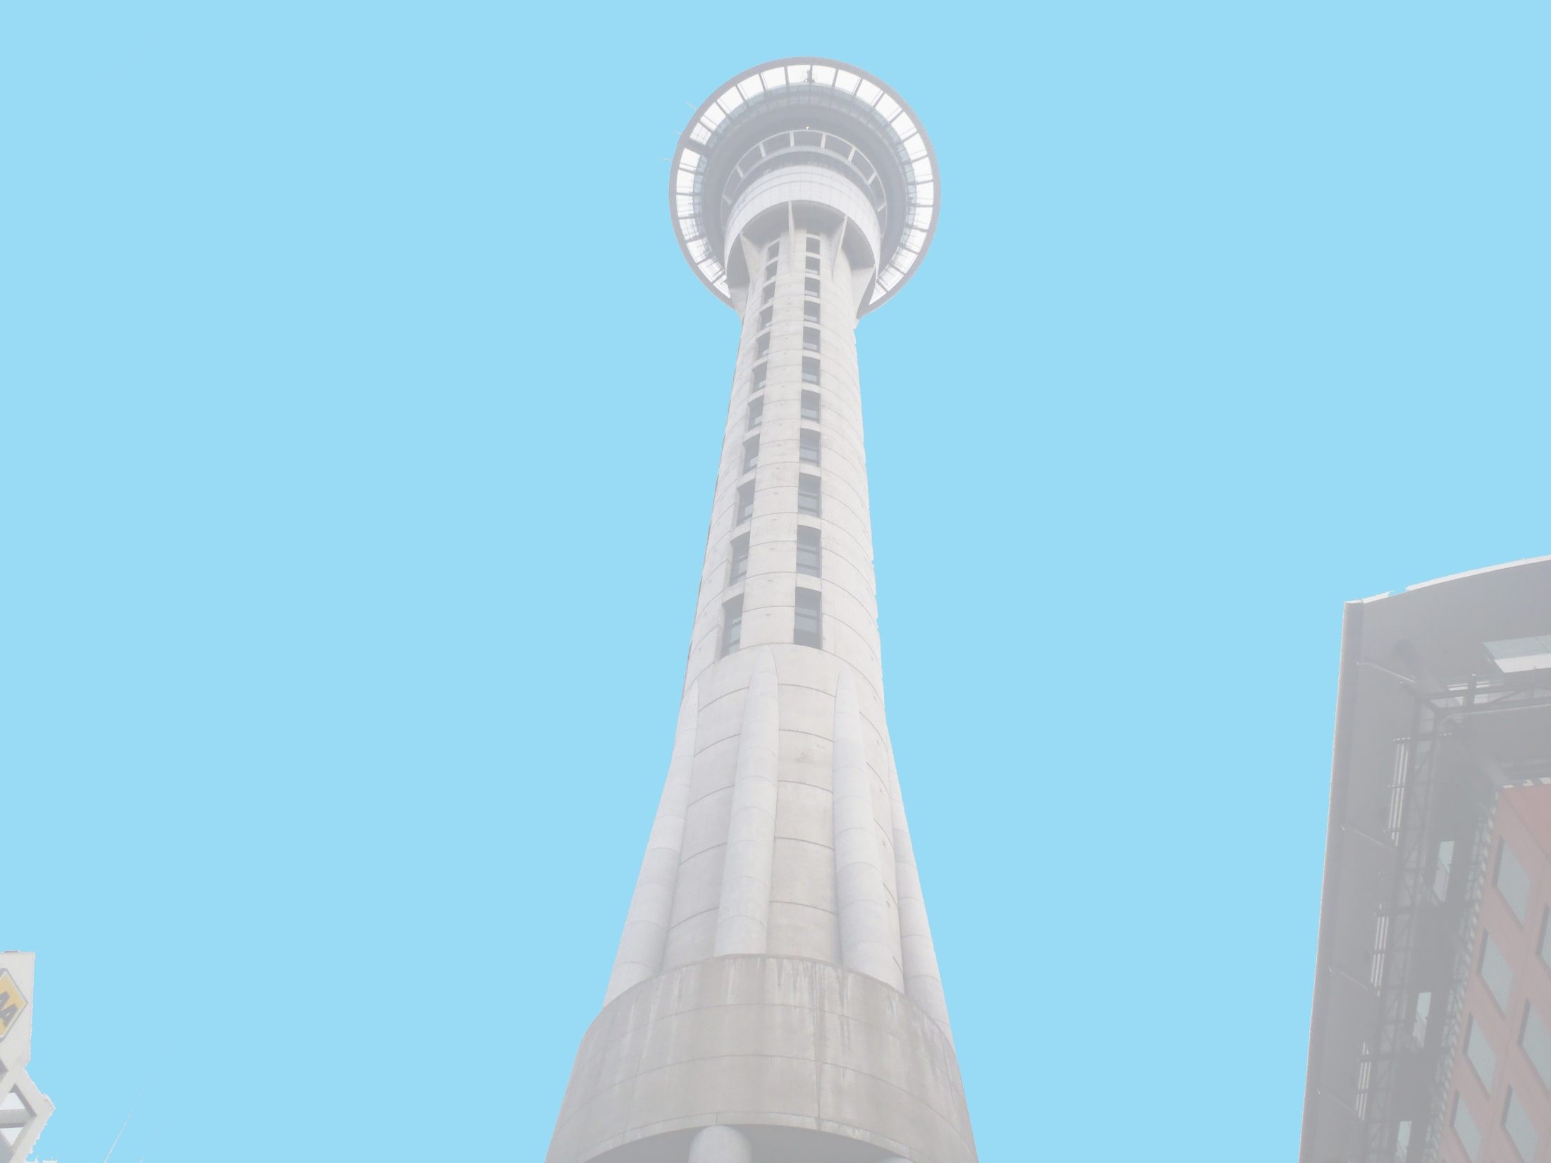



Anthony Adams
Securing of Unreinforced Masonry Parapets
The University of Auckland, New Zealand
Host Mentors: Dmytro Dizhur & Liam Wotherspoon
UCSD Mentor: Lelli Van Den Einde
Aug 14th 2013

Slide 2
Experiment
Multiple two leaf parapets, secured using common retrofits of the area and experimentally validated retrofits, will be dynamically loaded on a Shake table to provide experimental data of their effectiveness in a dynamic setting.
Test both experimentally validated and industry accepted retrofits for URM parapets to see which methods are the most effective.
Goals

Slide 3
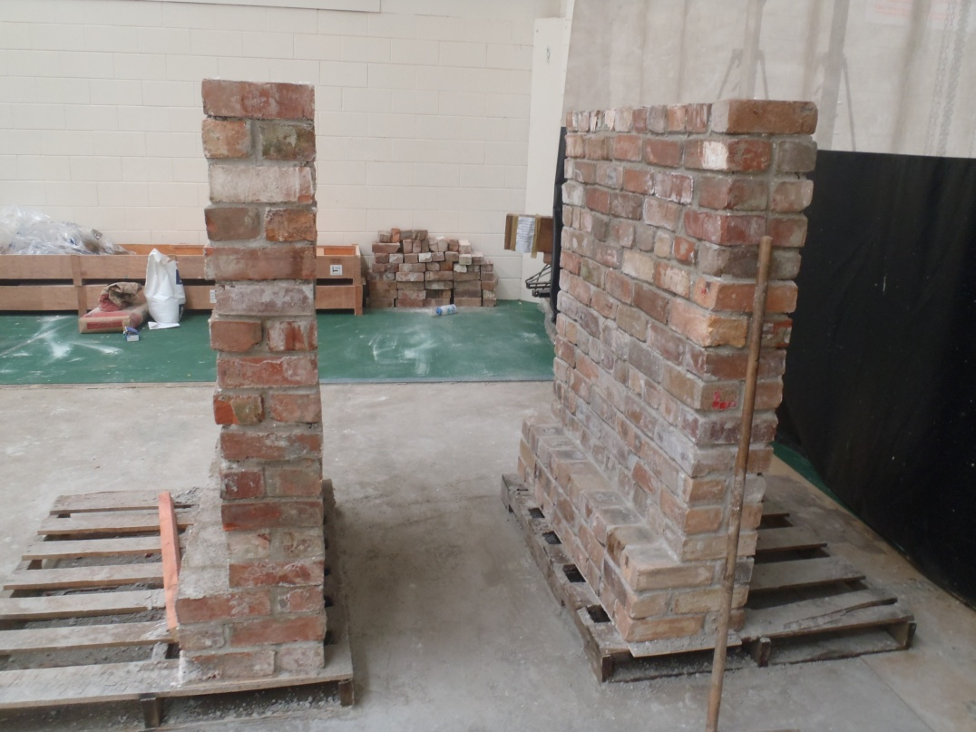
Securing of URM parapets
Finishing the report on the Victoria st. testing.
Making adjustments to the shake table.
Began wrapping up other small projects

Slide 4
Next Week
Continue updating the Working Model of the parapet and attach the different retrofits that we will be testing.
Finish report for Victoria Street Masonry Wall testing.
Once the fly wheel arrives, attach the motor to the shake table and prepare for testing.

Slide 5
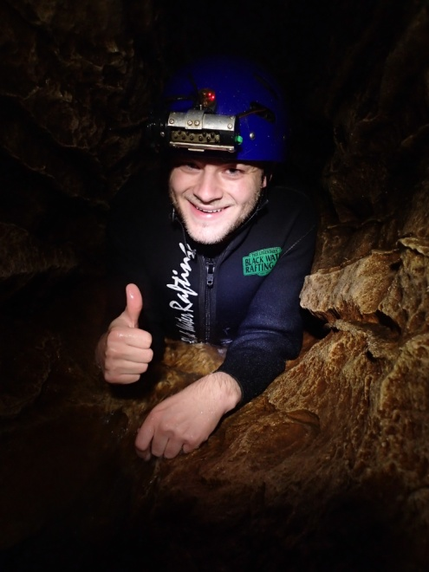
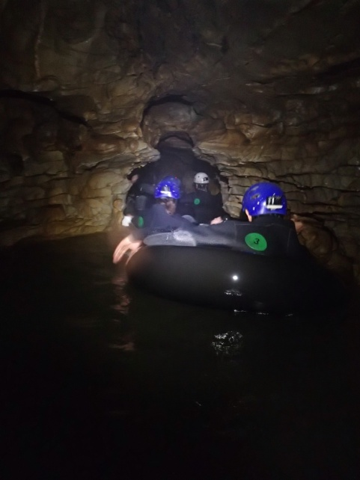
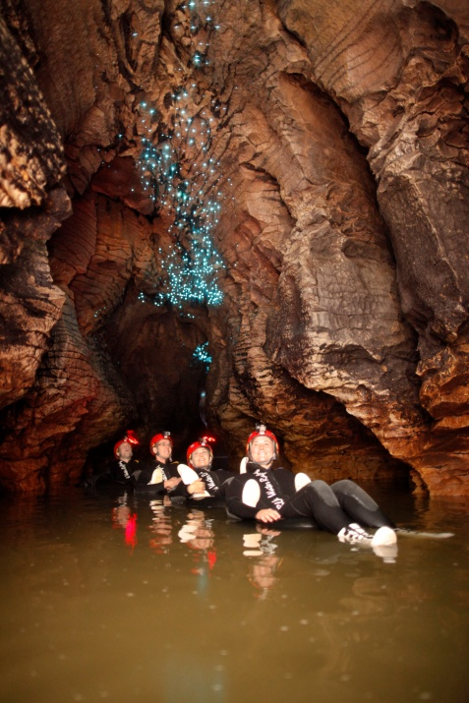
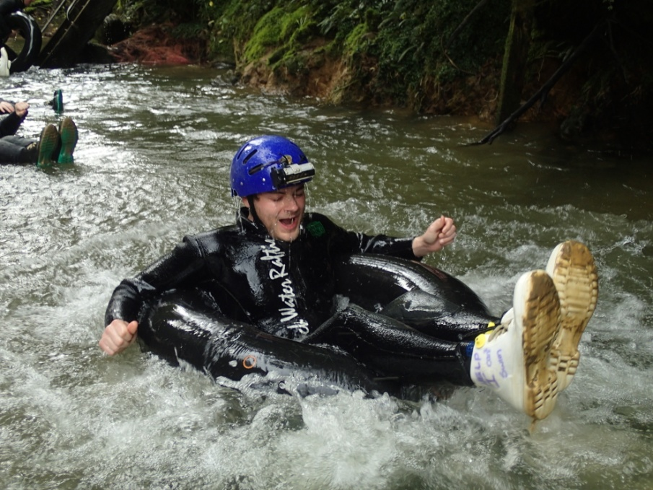
Waitomo Black Water Rafting
Went tubing on a river inside of the Waitomo Caves. “Glowworms” all over the ceiling, jumped off small waterfalls, crawled through some small passageways, it was really cool!
This is a promo shot but I wanted to show the glowworms, amazing sight, like looking at the stars from 150 feet under ground.

Slide 6
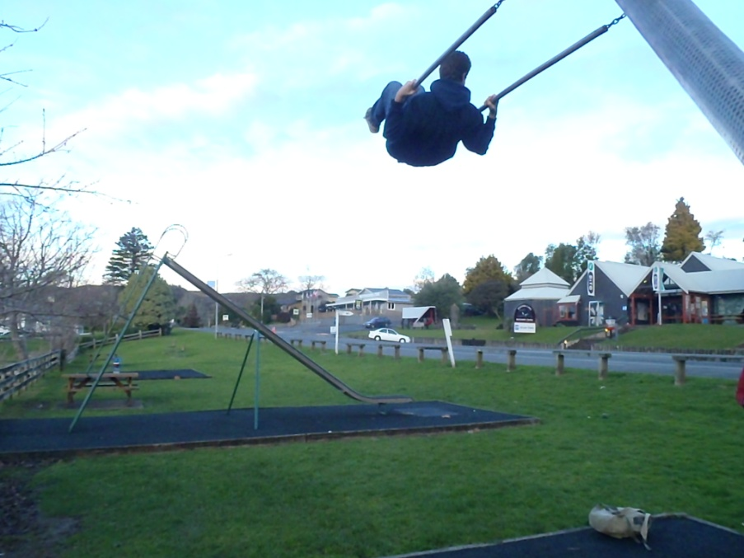
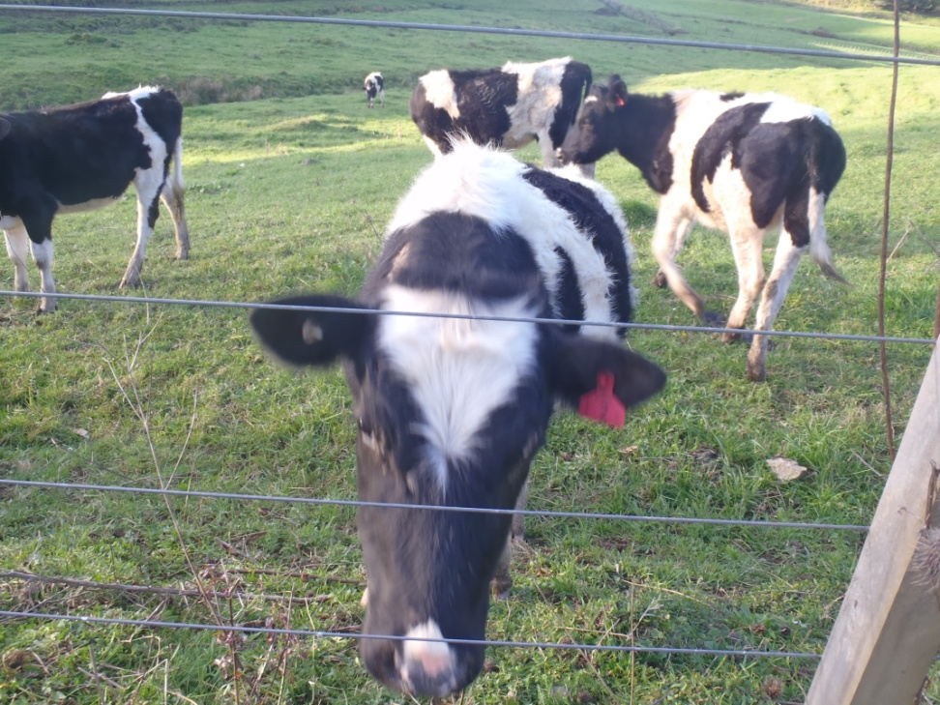
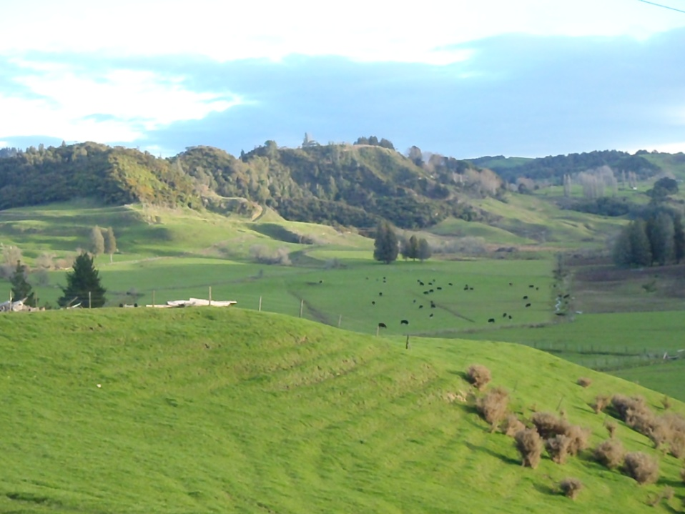
New Zealand’s natural beauty

Slide 7
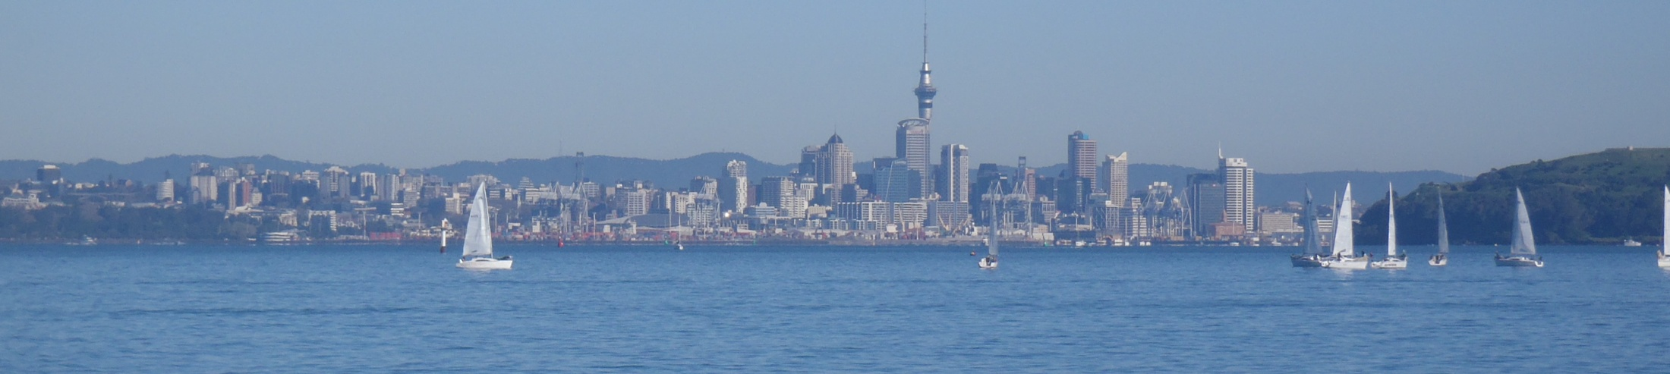
Acknowledgements
Thank you to everyone who has made this life changing experience possible!
Auckland Mentors: Liam Wotherspoon, Dmytro Dizhur
UCSD Mentor: Lelli Van Den Einde
PRIME: Gabriele Wienhausen, Peter Arzberger

