Slide 1
Structure Investigation of Fam20C, A Golgi Casein Kinase
Sharon Grubner
National Taiwan University
Weekly report - June 26th, 2013

Slide 2
My Research Project
The broad aim of this research project is to investigate the structure and function of a unique secreted Golgi casein kinase, FAM20C.
Mutations in FAM20C lead to osteoclerotic bone dysplasia in humans, also known as Raine syndrome.
Raine syndrome is characterized by ectopic calcification which increases bone density and often causes death in neonatal stages.
Studying the structure and specifically the ATP binding pocket of FAM20C would allow to better understand its function and better control it for experimental purposes, and perhaps for a later drug discovery project.

Slide 3
What I have accomplished this week…
Set up and ran all the necessary programs and tools on my personal laptop, gained access to the supercomputer in Texas, connected through VPN to the computer at Amaro’s lab, as well as the computer in NTU. (Not as easy as it sounds with a PC)
Ran an entire week of free dynamics simulations- restarted every 24 hours from the last step.
Practiced using AutoDock with a different and more simple protein than Fam20C.
Read papers about clustering, Fam20C function and structure, and other tools I may use later on.
My progress is being updated on a daily basis and shared with my mentors on Evernote.

Slide 4
Goals for the Next Week
In the next week I intend to finish running the first free dynamics simulation (~200ns).
While the other 2 simulations are running, analyze the variation in bond lengths of specific amino acid residues in the ATP binding pocket of FAM20C.
The above will be conducted using the .dcd file from the first simulation in VMD.
Continue practicing AutoDock with different proteins, such as PKA with staurosporine.
Read about other tools/methods I will use later on for my project, such as: steered molecular dynamics, umbrella sampling.

Slide 5
The next slides may explain why I love Taiwan so much…

Slide 6
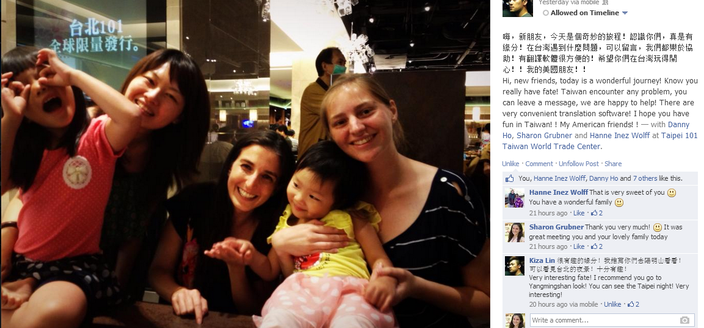
The people in Taiwan are very friendly :)

Slide 7
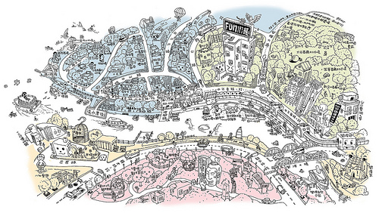
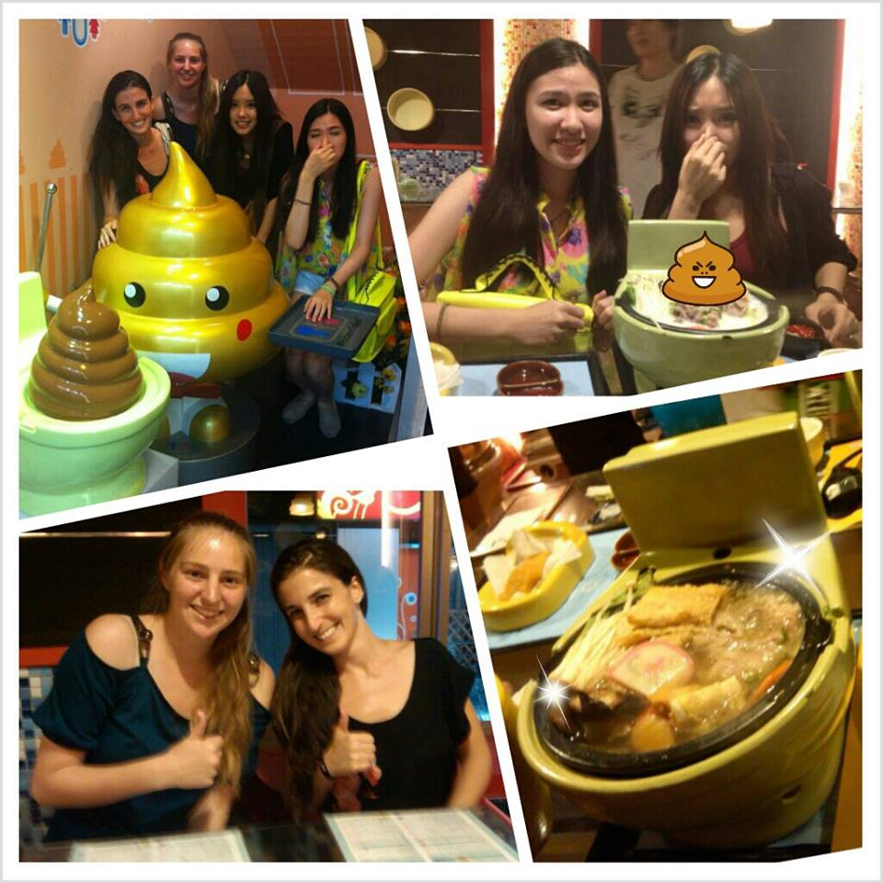
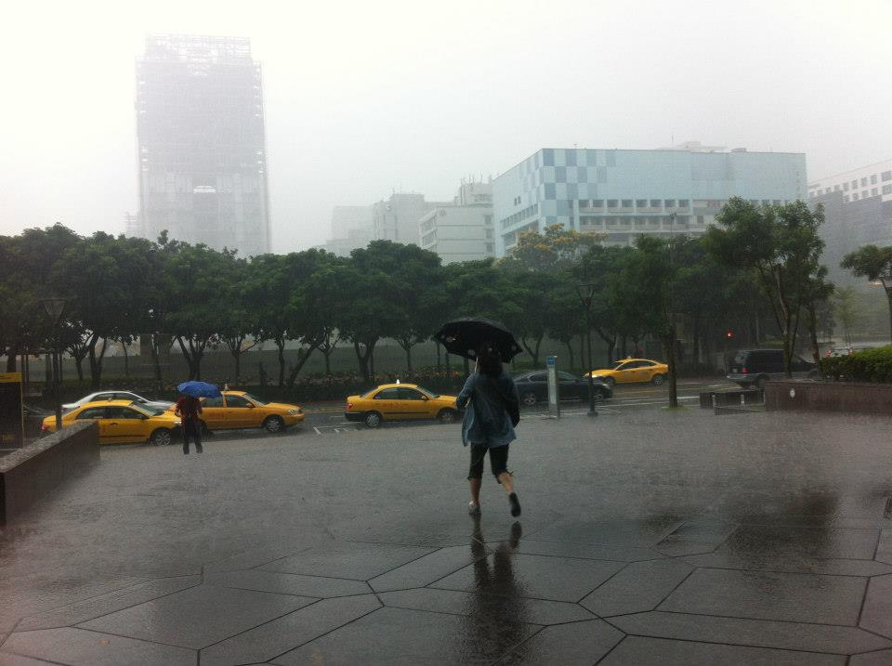
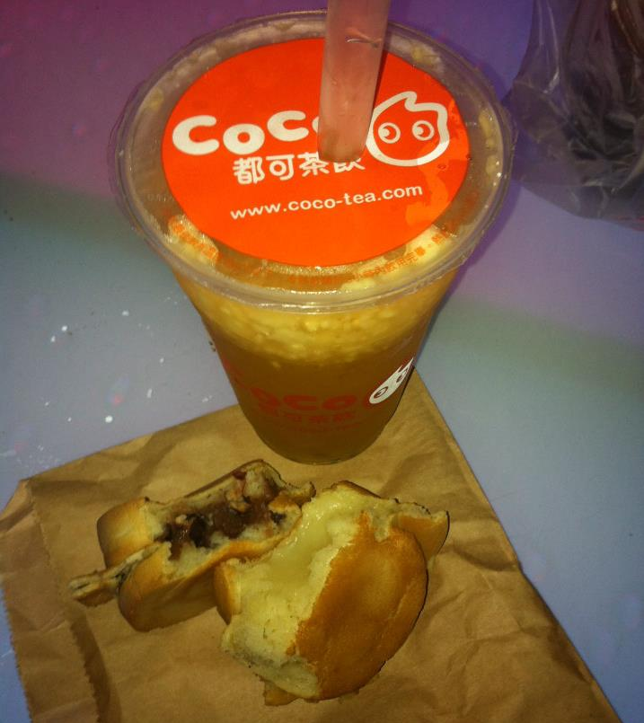
Our new Taiwanese friend, who is a graphic designer, shared one of his drawings with us…
Our daily treat
We forgot to take our umbrellas that day
Interesting dinner at the Modern Toilet restaurant with two NTU students

