Slide 1
Installation and Integration of Virtual Clusters onto Pragma Grid
NAIST Nara, Japan
Kevin Lam 07/10/13

Slide 2
Week 2: Setbacks and Reinstallation
Originally allocated hard drive space was too small. There was no way to add to the pre-existing space. The only option was to do a clean wipe of the hard drive while saving the ISO images of the OS’s.
A new OS was installed. All four virtual machines were reconfigured using ISO images.
A few problems involving SSH, internet, and network bridging were fixed.
Dock6 was installed on each virtual machine despite initial problems.

Slide 3
Coming Up Next Week
DOCK test runs need to be done. There are currently problems using the mpirun command due to having no output.
Both grid and amber need to be tested. A method of separating both these tests needs to be done since mpirun only runs jobs according to the program set—which is DOCK in this case.
We will continue looking into how to integrate our virtual cluster into the NAIST clusters.

Slide 4
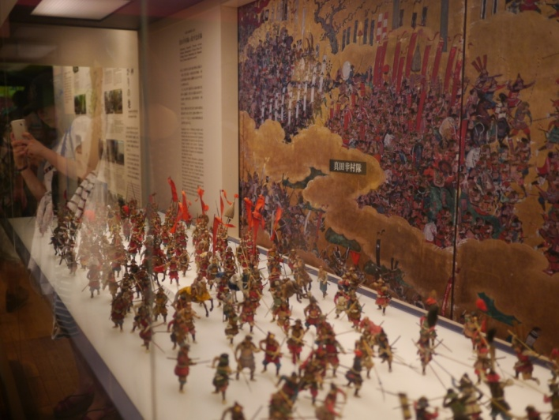

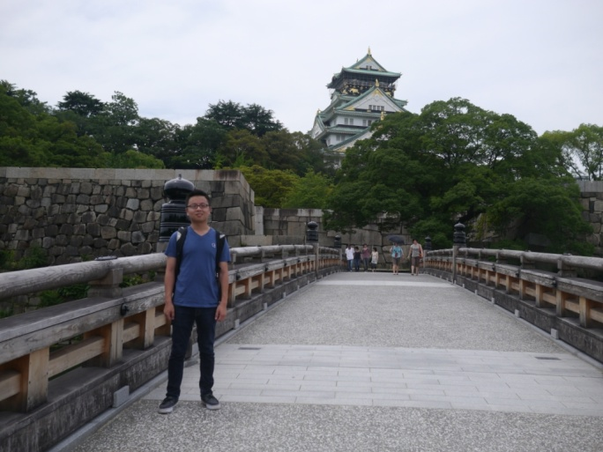
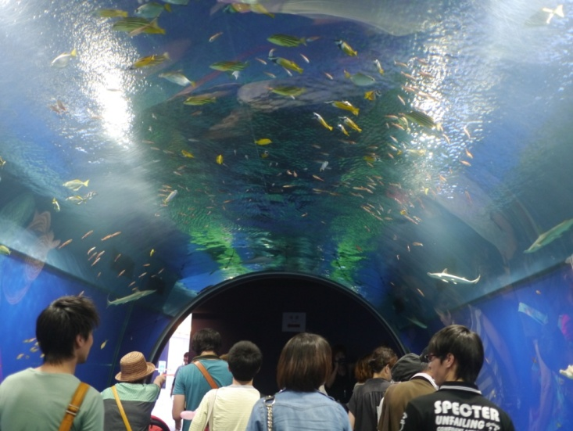
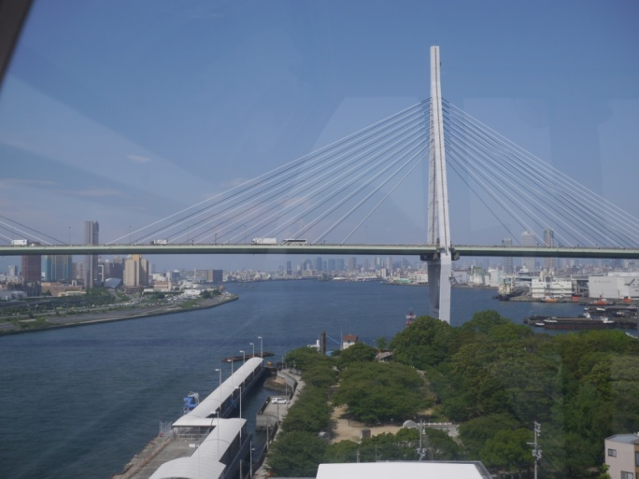

Exploring the Culture

Slide 5
Acknowledgements
I would like to thank
The graduates, professors, and assistant professors in our lab for being welcoming and helpful.
Dr. Haga for his guidance and providing us with this opportunity.
Professor Ichikawa for all the time he spent helping us whether with questions or about Japan.
PRIME staff for organizing this trip and making it possible.
NAIST for providing the accommodations.
UCSD.

