Slide 1
Installation and Integration of Virtual Clusters onto Pragma Grid
NAIST Nara, Japan
Kevin Lam 07/17/13

Slide 2
Week 5: Finishing the Tests
There was a problem with assigning different tasks to each virtual machine. The cause seemed to stem from Open MPI not being compatible with Dock6.
MPICH, another implementation of MPI, was installed and used instead.
firewall problem which prevented jobs from being sent out was declared a non-issue. It would be taken down for local cluster usage. During and after the integration onto public clusters, a solution would be devised.
Dock6.2 was upgraded to Dock6.6, the newest version.
In order to determine the variability in results, Dock6.6 and Dock6.2 were run using the compounds from the Dock5 test suite.

Slide 3
Week 5: Finishing the Tests (Continued)
A previous prime student, Wen-wai, did research on virtual clusters. Her tests compared the results from running docking simulations on physical clusters against the results from running them on her virtual clusters.
Our results from running the same proteins on Dock6.6 were compared to the results from the physical clusters.
MPICH and Dock6.6 were compatible. They were able to run on all of the virtual machines. Different tasks were also assigned to individual machines.

Slide 4
Results
Zinc ID |  | Wen-Wai's Results
 | Dock 6.6 Results (Grid) | nacona | komolongma | ocikbpra | aurora | cafe01 | tea01
ZINC01848623 | -34.026436 | -35.2521 | -34.4409 | -35.0997 | -34.4409 | -34.4409 | -34.4409
ZINC02083231 | -44.266804 | -42.2036 | -46.1498 | -41.4461 | -43.9064 | -43.9064 | -43.9064
ZINC02456177 | -37.730396 | -36.0761 | -37.1865 | -37.2845 | -37.1865 | -37.1865 | -37.1865
ZINC02458587 | -37.829681 | -37.0460 | -37.0550 | -36.8695 | -37.0550 | -37.0550 | -37.0550
ZINC02503026 | -44.439392 | -47.7727 | -46.2988 | -46.5274 | -46.2988 | -46.2988 | -46.2988
ZINC02537757 | -39.424751 | -42.4642 | -41.2761 | -39.5110 | -41.2761 | -41.2761 | -41.2761
ZINC02578134 | -36.839134 | -36.7535 | -37.4258 | -37.3485 | -37.4258 | -37.4258 | -37.4258
ZINC02596543 | -36.78804 | -34.7700 | -34.0362 | -34.0989 | -34.0362 | -34.0362 | -34.0362
ZINC02617573 | -48.245319 | -42.5656 | -44.0922 | -44.8222 | -42.4202 | -42.4202 | -42.4202
ZINC02641177 | -37.118263 | -34.4492 | -38.3643 | -38.3523 | -38.3643 | -38.3643 | -38.3643
ZINC02834453 | -41.892967 | -45.3393 | -40.6925 | -41.2453 | -45.7385 | -45.7385 | -45.7385

Slide 5
Results
PDB Code | Dock 5 Published | Dock 6.2 Test | Dock 6.6 Test | Dock 5 Published | Dock 6.2 Test | Dock 6.6 Test
 | Grid |  |  | Amber
1A28 | -55.51 | -49.88 | -51.58 | -53.91 | -53.85 | -53.03
1ABE | -37.50 | -36.81 | -34.54 | -43.79 | -44.32 | -41.83
1ABF | -37.96 | -31.90 | -33.37 | -43.56 | -43.87 | -39.73
1ACJ | -42.28 | -40.30 | -42.34 | -42.28 | -40.42 | -42.51
1ACM | -68.42 | -67.29 | -66.22 | -74.76 | -75.40 | -70.85
1AI5 | -29.88 | -29.06 | -29.12 | -31.53 | -31.39 | -29.65
1AOE | -41.32 | -41.21 | -41.49 | -42.08 | -42.04 | -41.60
1AQW | -26.56 | -26.41 | -23.04 | -27.64 | -27.58 | -25.96
1AZM | -45.53 | -56.85 | -56.24 | -47.84 | -63.09 | -61.68
1BYG | -55.29 | -53.01 | -46.29 | -59.05 | -59.03 | -48.17
1C5C | -62.27 | -63.44 | -61.22 | -62.95 | -64.02 | -62.31
1C5X | -47.85 | -48.66 | -48.85 | -50.95 | -50.97 | -50.62
1C83 | -61.75 | -60.96 | -61.71 | -62.95 | -63.09 | -59.08
1CBX | -92.87 | -92.15 | -94.00 | -94.82 | -82.36 | -61.80
1CIL | -55.43 | -67.16 | -64.10 | -56.49 | -75.83 | -72.82
2GBP | -39.83 | -26.45 | -31.40 | -49.57 | -49.63 | -46.71
2H4N | -62.59 | -60.94 | -61.22 | -66.48 | -66.19 | -62.97
2MCP | -28.22 | -28.31 | -28.69 | -32.74 | -32.51 | -30.84
2PCP | -41.77 | -36.30 | -32.52 | -40.03 | -39.41 | -37.85
2PK4 | -25.28 | -25.01 | -24.67 | -27.92 | -27.68 | -26.77
3GPB | -49.89 | -44.36 | -46.15 | -55.99 | -56.05 | -51.69
3HVT | -43.32 | -36.92 | -42.51 | -44.97 | -44.96 | -42.13
4AAH | -46.15 | -43.54 | -50.37 | -51.07 | -56.38 | -47.65
4LBD | -72.63 | -71.37 | -72.79 | -73.05 | -73.89 | -72.20
5ABP | -33.62 | -32.18 | -36.01 | -48.02 | -48.49 | -48.01

Slide 6
Coming Up Next Week
The results need to be evaluated to ensure that the tests are precise if not accurate.
As soon as that is done, the virtual cluster can be moved to the NAIST cluster.
The firewall issue will then need to be fixed.

Slide 7
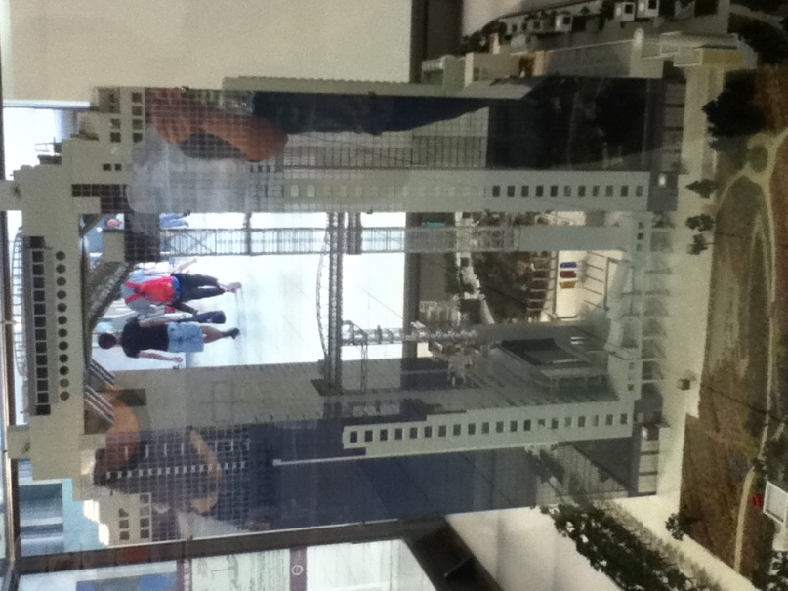

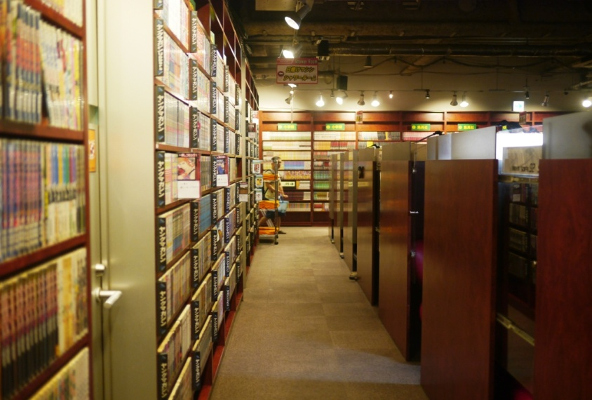
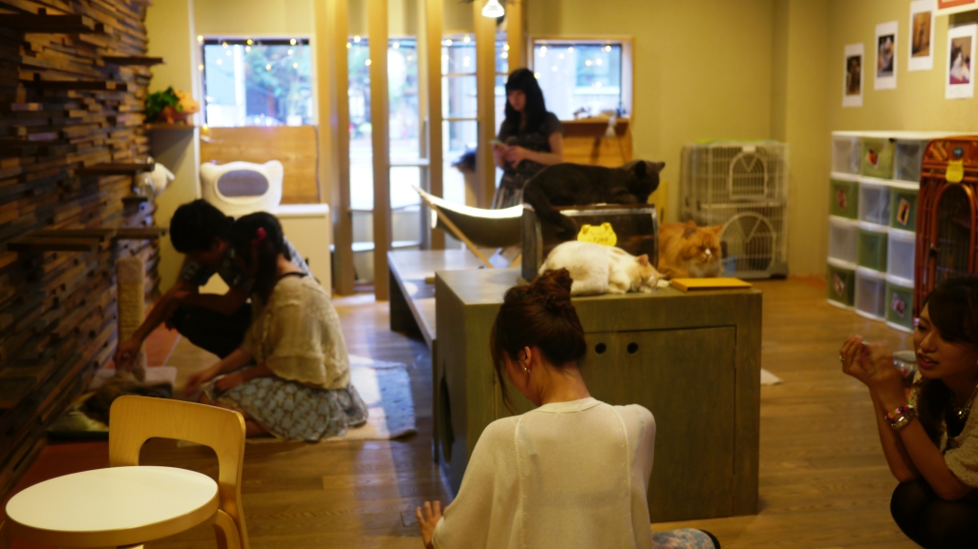
Exploring the Culture

Slide 8
Acknowledgments
UCSD + PRIME
Dr. Jason Haga
Dr. Gabriele Wienhausen
Dr. Peter Arzberger
Teri Simas
Tricia Taylor
Jim Galvin
Wen-wai Yim
Olivia Yang
Joshua Wei
Host Institute (NAIST)
Dr. Kohei Ichikawa
Dr. Hajimu Iida
Funding
JASSO
National Science Foundation

