Slide 1
Installation and Integration of Virtual Clusters onto Pragma Grid
NAIST Nara, Japan
Kevin Lam 07/31/13

Slide 2
Week 6: Getting in Contact
Deployment of the VMs were discussed with the PRAGMA administrator through Skype. Details about the VMs were exchanged such as machine bit size, hard disk space needed, memory usage, and the type of programs used. It was decided that we would upload the VMs onto our Rocks account where they would be retrieved. After they have been uploaded onto Gfarm, we would see if there are any issues with deploying them.
Masternode/Slavenode1 (machine 32 bit, os 32 bit, CentOS 5.9, gcc 4.1.2, and Dock 6.2) was uploaded.
An issue was encountered regarding the inability to use the virsh command to acquire an .xml file of the VM image, but it was resolved. Also there was a problem with the image files being corrupted during transfer. We had to repackage them into .gz files.

Slide 3
Week 6: Getting in Contact (Continued)
There was a problem with mpirun on the VM Sailboat. The issue lies with the GNU C library. It could possibly be due to CentOS 5.9 lacking GLIBC version 2.7.
Test suite was run for both Sailboat and Master VMs using Dock 6.2. The results were compared for 4 VMs containing different specifications.
We’ve come to the conclusion that a 32 bit OS, regardless of machine bit, gave us results closest to Wenwai’s developer results. Although our results did not match up closely with our developer results.
A different gcc could have made a difference, but in our case it didn’t. This could be because our gcc was a change from 4.1.2 to 4.7.7 whereas Wenwai’s gcc change was from 3.4.6 to 4.1.2 (a more significant change).

Slide 4
Week 6: Getting in Contact (Results)
VM Tests
Machine bit |  | 32 | 64 | 64 | 64 |  | 64
OS bit |  | 32 | 32 | 64 | 64 |  | 64
CentOS |  | 5.9 | 5.2 | 5.9 | 6.4 |  | 6.4
gcc |  | 4.1.2 | 4.1.2 | 4.1.2 | 4.7.7 |  | 4.4.7
Dock Version |  | 6.2 | 6.2 | 6.2 | 6.2 |  | 6.6
 | Developer's 6.2 | Masternode | Master | Sailboat | CentOS1 | Developer's 6.6 | CentOS5
 |  | Slavenode1 |  | Kayak
ZINC00158751 | 138.113892 | 138.11386 | 138.113861 | 138.114029 | 138.114029 | -13.890112 | -13.890112
ZINC00157960 | 21535.20898 | 21535.20898 | 21535.20898 | 21535.30859 | 21535.30859 | -17.022007 | -17.022007
ZINC00158442 | 52.565872 | 52.56588 | 52.56588 | 52.565788 | 52.565788 | -0.554128 | -0.554128
ZINC00013564 | -9.400209 | 10.801939 | 10.801939 | -9.400218 | -9.400218 | -15.287382 | -15.287382
ZINC01555236 | - | 503.249725 | 503.249725 | 1800544512 | 1800544512 | - | -
ZINC00150863 | 21.139147 | 21.139143 | 21.139143 | -12.467216 | -12.467216 | -13.396927 | -13.396927
ZINC00152265 | 19.053925 | 30.238361 | 30.238361 | 30.238028 | 30.238028 | -15.236704 | -15.236704
ZINC00157111 | -15.522114 | -12.916615 | -12.916615 | -12.916644 | -12.916644 | -14.073079 | -14.073079
ZINC00157152 | -10.13739 | -10.137384 | -10.137384 | -10.137392 | -10.137392 | -15.55584 | -15.55584
ZINC00157402 | 168513.7031 | 168513.625 | 168513.625 | 168506.4063 | 168506.4063 | -15.105305 | -15.105305
ZINC00157467 | -8.706671 | -8.706671 | -8.706671 | -8.706783 | -8.706783 | -14.412565 | -14.412565

Slide 5
Coming Up Next Week
It is possible the 32 bit VM will be incompatible with the Fiji cluster. If this happens, a different VM will need to be uploaded to be tested (possibly VMs Master or CentOS1).
We will be assisting the site administrators in changing the network configurations assuming the deployment scripts do not work.

Slide 6


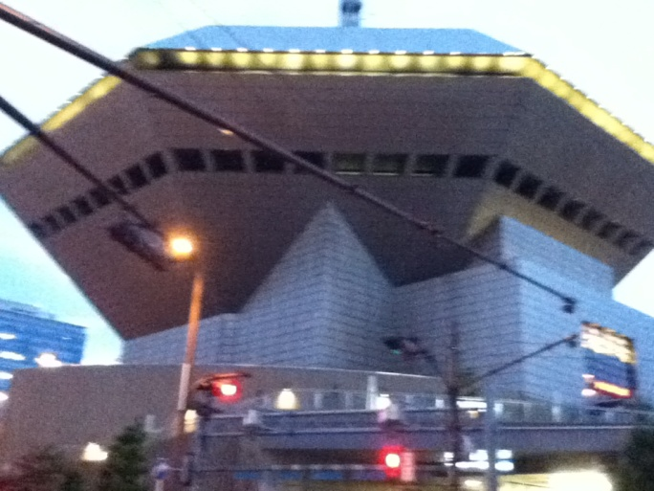

Exploring the Culture

Slide 7
Acknowledgment
UCSD + PRIME
Dr. Jason Haga
Dr. Gabriele Wienhausen
Dr. Peter Arzberger
Teri Simas
Tricia Taylor
Jim Galvin
Wen-wai Yim
Olivia Yang
Joshua Wei
Nadya Williams
Host Institute (NAIST)
Dr. Kohei Ichikawa
Dr. Hajimu Iida
Funding
JASSO
National Science Foundation

