Slide 1
Installation and Integration of Virtual Clusters onto Pragma Grid
NAIST Nara, Japan
Kevin Lam 08/13/13

Slide 2
Week 7: Deployment
The PRAGMA administrator uploaded our 32 bit virtual machines Masternode and Slavenode1 onto the Rocks server. Our Rocks accounts were also linked with the virtual machines.
This was initially uploaded to see if there were any changes that were necessary in order to ensure the machines were running properly.
The virtual hard disk space was expanded from 8GB to 30GB. A user account, duck1, was created on both machines. Dock and MPICH were tested to see whether it would run.
The changed virtual machine along with the necessary .xml file were sent back to the PRAGMA administrator to be reuploaded.

Slide 3
Coming Up Next Week
We are waiting for results from the PRAGMA administrator. If all things go as planned, 2 machines will be uploaded onto Rocks and 2 machines will be uploaded onto non-UCSD clusters.
N2N will need to be setup as soon as the machines are all uploaded.
Power point presentation for the lab needs to be done.

Slide 4


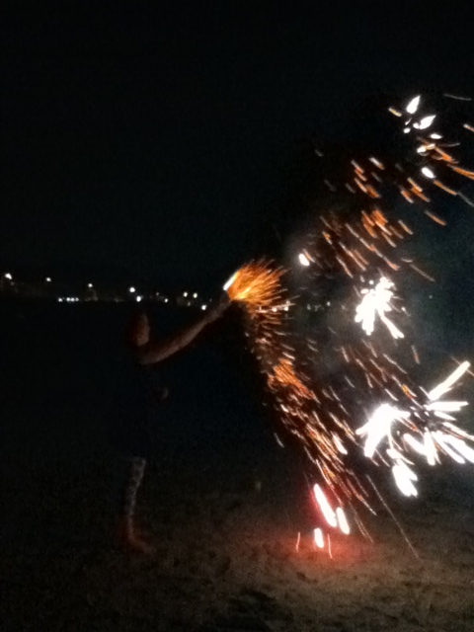
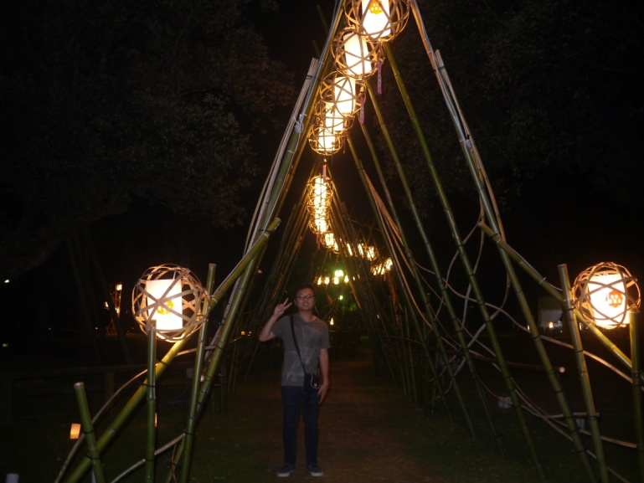

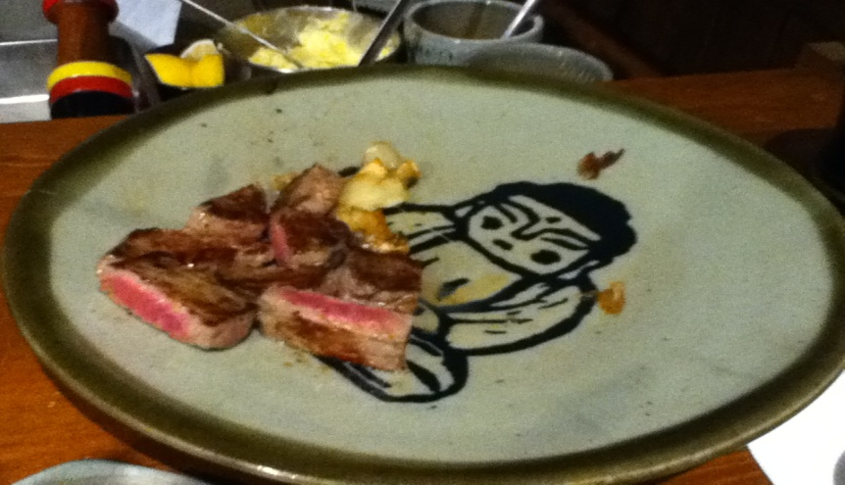
Exploring the Culture

Slide 5
Acknowledgment
UCSD + PRIME
Dr. Jason Haga
Dr. Gabriele Wienhausen
Dr. Peter Arzberger
Teri Simas
Tricia Taylor
Jim Galvin
Wen-wai Yim
Olivia Yang
Joshua Wei
Nadya Williams
Host Institute (NAIST)
Dr. Kohei Ichikawa
Dr. Hajimu Iida
Funding
JASSO
National Science Foundation

