Slide 1
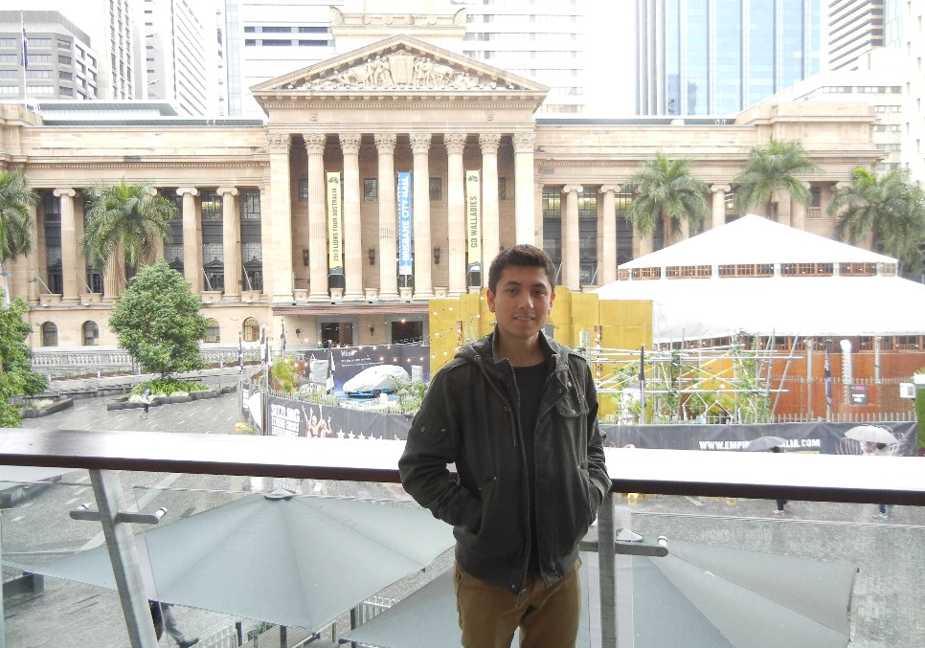
Fabian Lema
W1
Remote Monitoring of Android Devices*
University Of Queensland, Australia
*I’m not set on the title of the project

Slide 2
Remote Monitoring of Android Devices*
W1
The purpose of this project is to use the INCA Software to automatically and periodically monitor services on remote Android devices.

Slide 3
Remote Monitoring of Android Devices*
W1
To date advance:
Prior Departure
SL4A package installed in Android device
Application that starts a service built in Java (App)
INCA Python modules are installed in the Android Device in UQ
Communication between Python scripts and App through Broadcasts achieved

Slide 4
Remote Monitoring of Android Devices*
W1
Objectives to meet within the next week
Check if it is possible to run simple INCA reporters on the Android device
The reporters should test simple data from the services once this is achieved the next step is to send this information to the INCA server

Slide 5

Cultural side
W1
Brisbane is a melting pot, there are several different cultures interacting with each other.
The city is very new, and it is possible to see that it is undergoing rapid development.

Slide 6
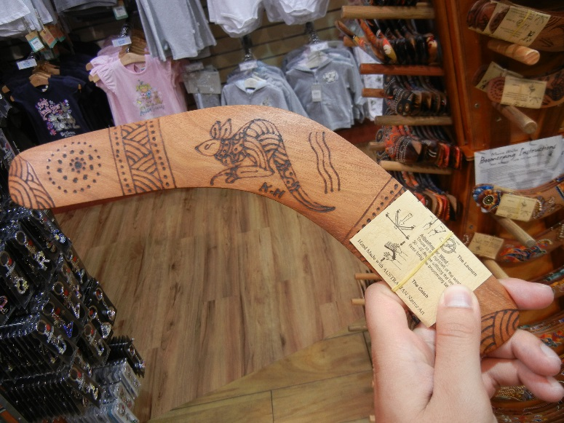


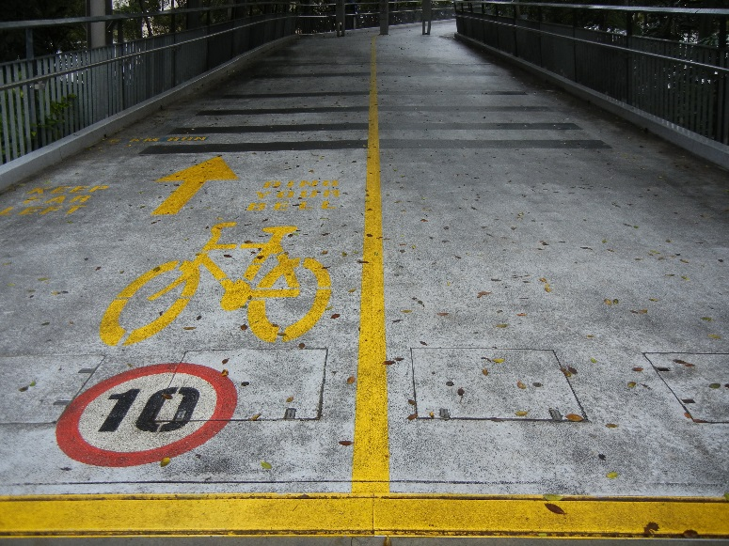
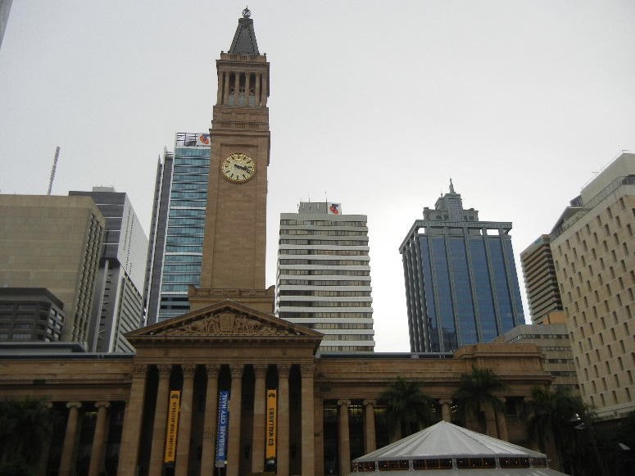
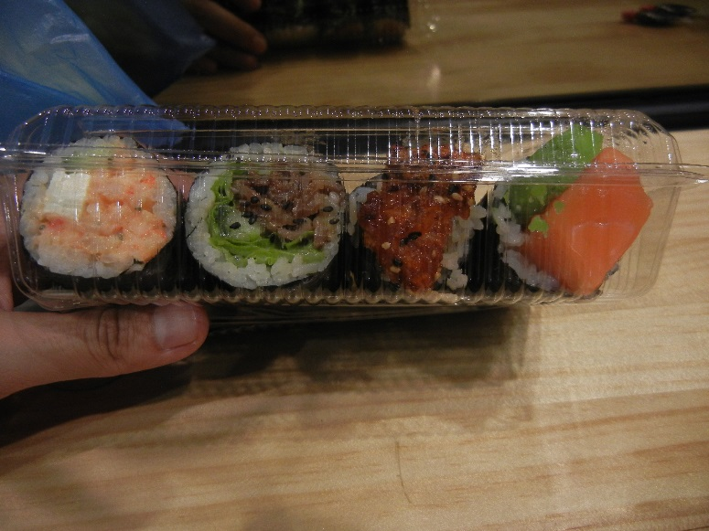
Cultural side
W1

