Slide 1


Investigation and modeling of the Avondale Bridge in Christchurch, New Zealand
Erickson Nguon
University of Auckland, New Zealand
June 10, 2013

Slide 2
Project Overview
The objective of this project is to investigate and model bridges, specifically the Avondale Bridge in Christchurch. The bridge suffered severe structural damage following the 2011 Christchurch Earthquake.
To create computer generated models of the bridges in SAP2000 with loadings that reflect the Christchurch Earthquake and with this model we can validate it by comparing the data from the model and the actual earthquake.

Slide 3
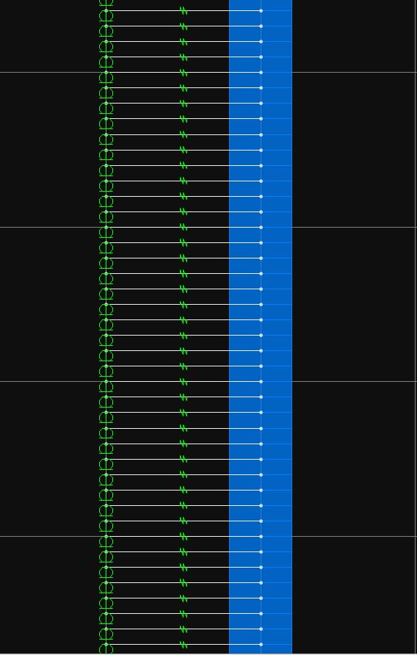
Recent Progress
Began modelling the south abutment and pile of the Avondale Bridge in SAP2000
Defined the nodes of the abutment and pile model, degrees of freedom, cross-sections of abutment and pile, and attached spring links resembling the soil
Figure 1:SAP2000 model of the abutment and pile with
springs connecting both the abutment and pile.

Slide 4
Projected Progress
Meet with Liam to review my recent progress of the model bridge
Progress on modelling the north abutment of the bridge

Slide 5
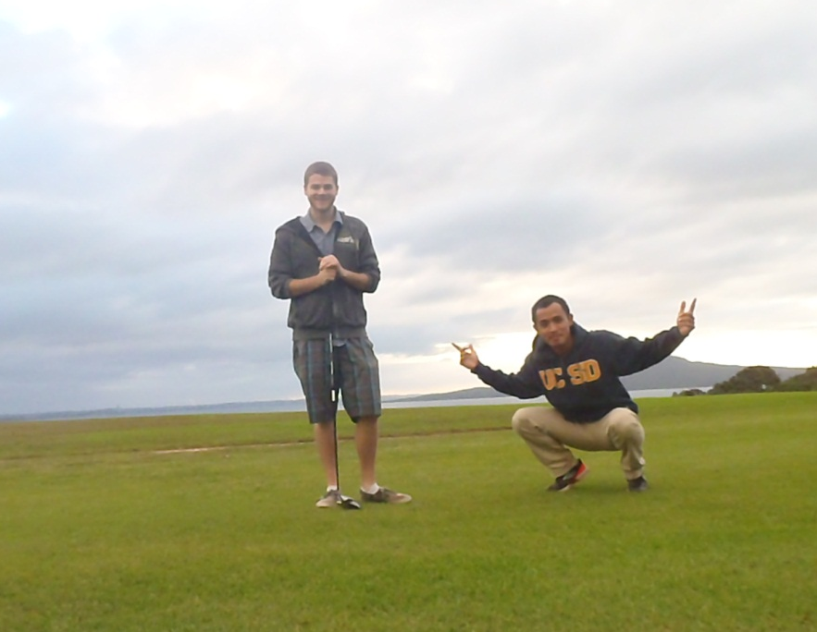
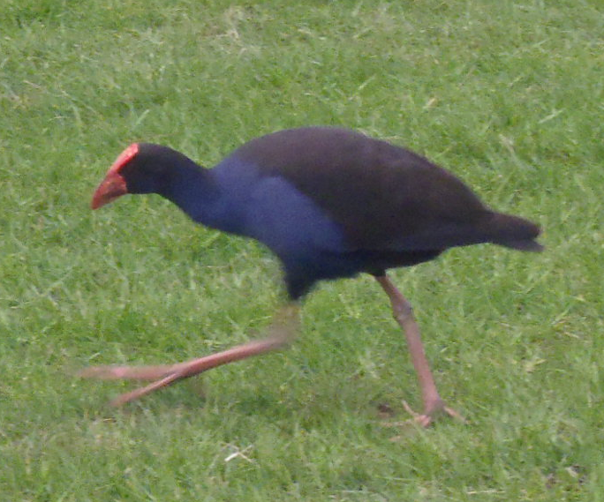
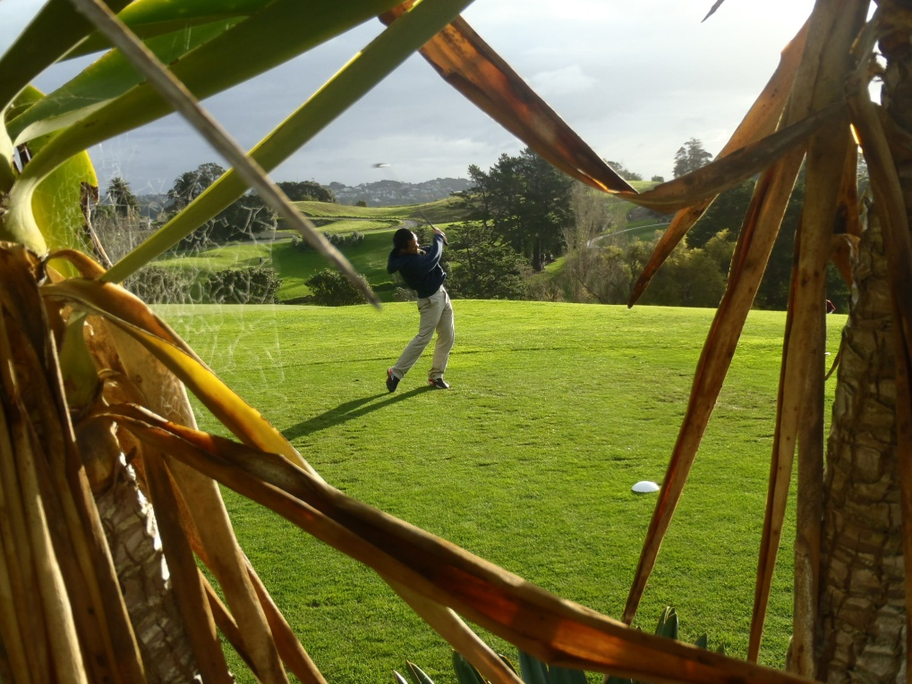
Howick Golf Course

Slide 6
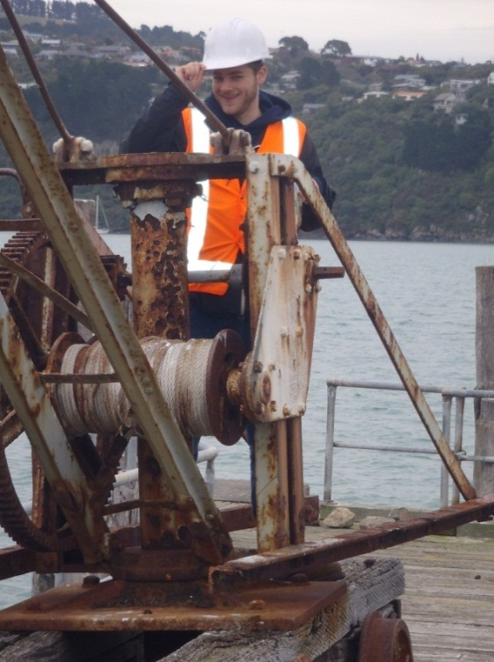
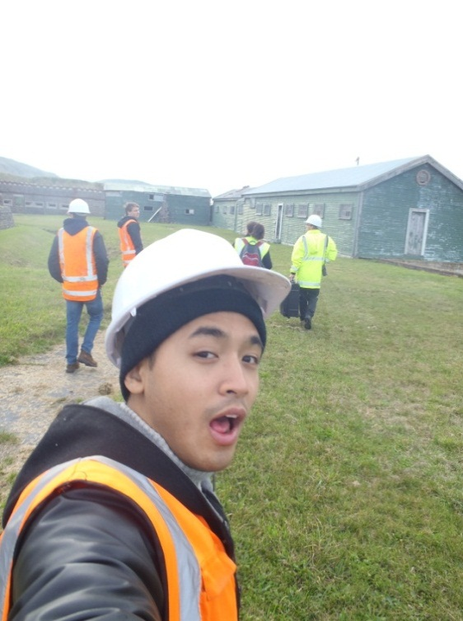
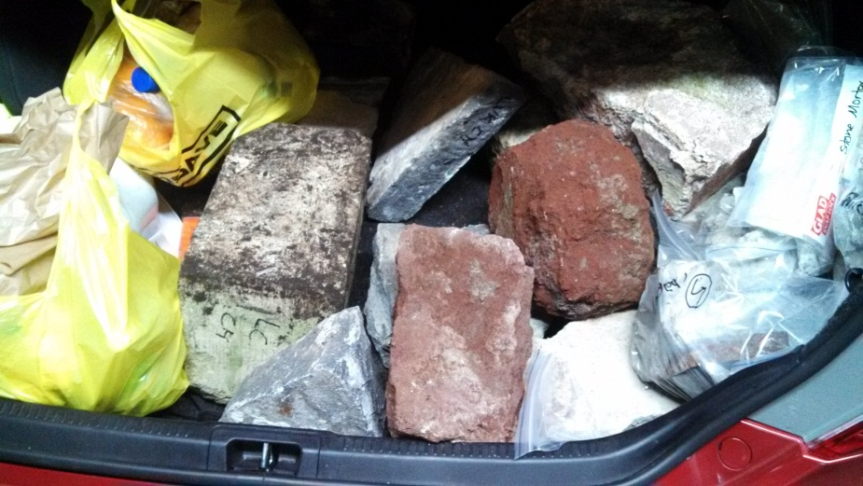
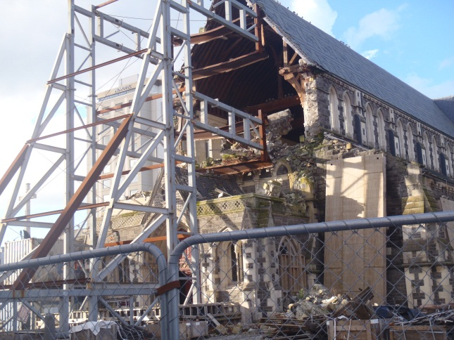
Christchurch
Dmytro, Marta, Tony, and I flew down to Christchurch to extract stone and mortar samples from various structures.
We extracted samples from a chapel, church/graveyard, St. Lukes, Arts Centre of Christchurch, and Fort Jervois.
Captain Adams
The Team: Tony, engineer from URS, Marta, Dmytro, and Erickson
Trunk load of stone, concrete, and mortar samples
A cathedral post earthquake

Slide 7
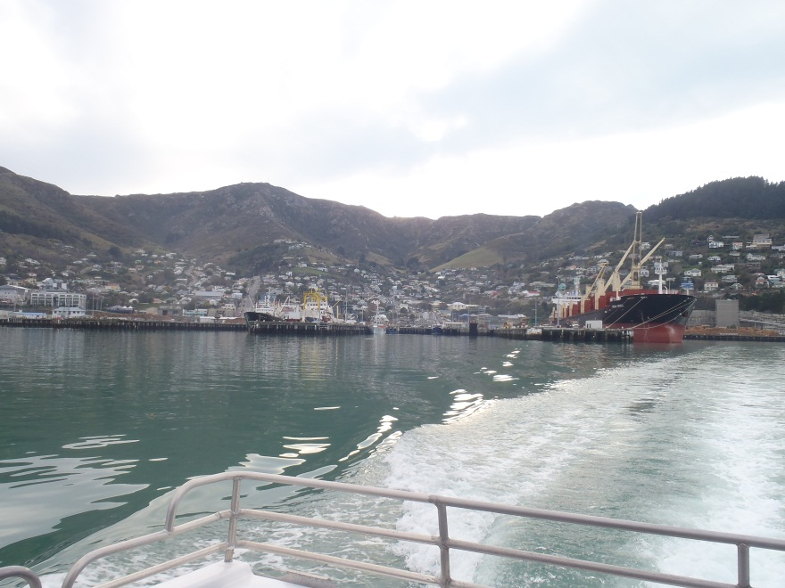
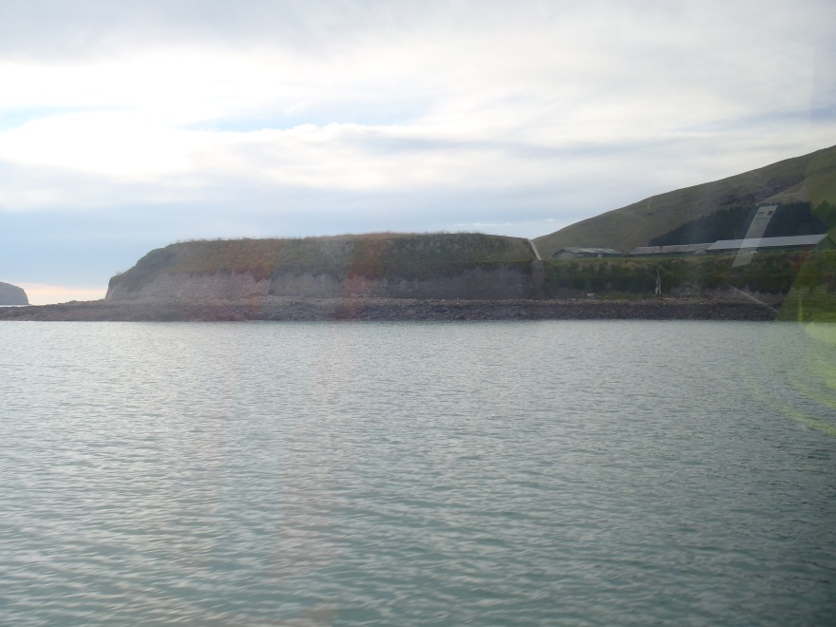
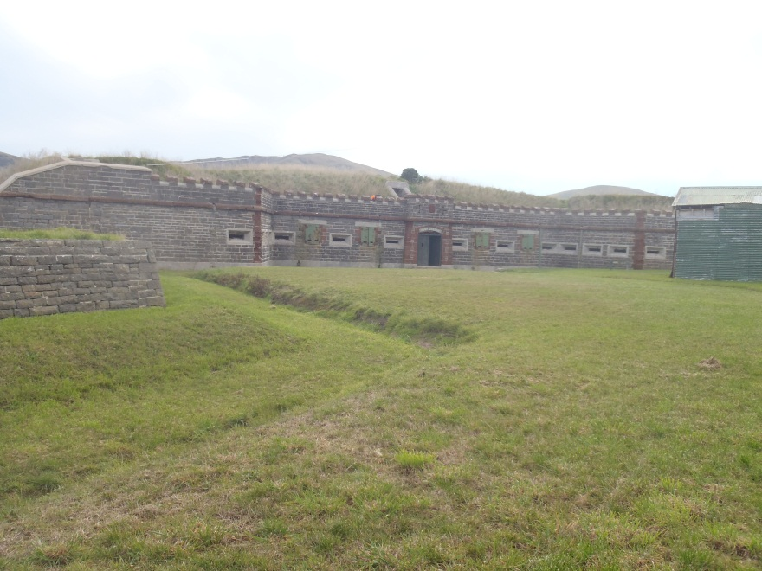
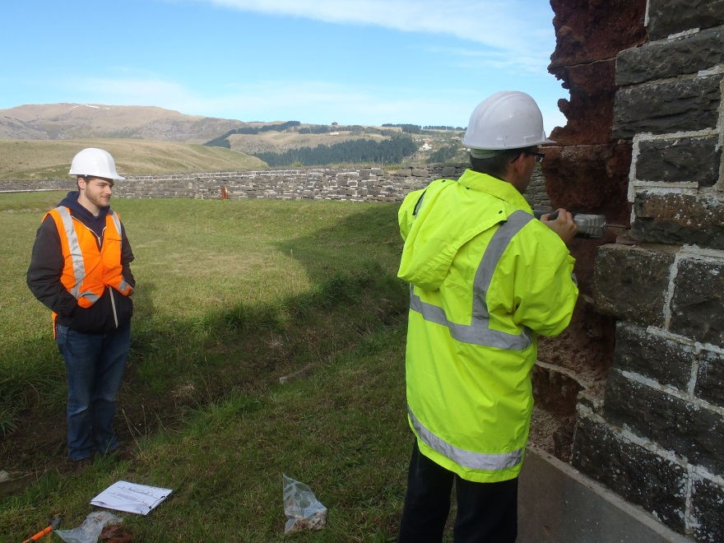
Leaving Lyttleton Port
Arriving at Fort Jervois to extract stone and mortar samples
Fort Jervois
Dmytro extracting mortar samples from Fort Jervois

Slide 8
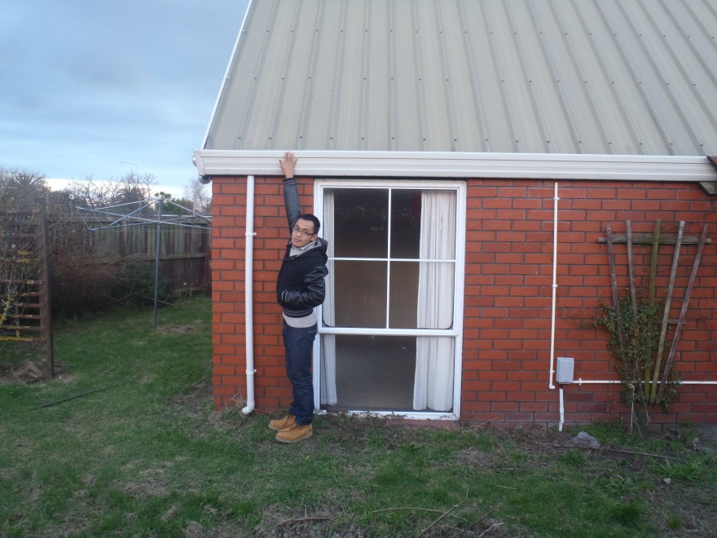
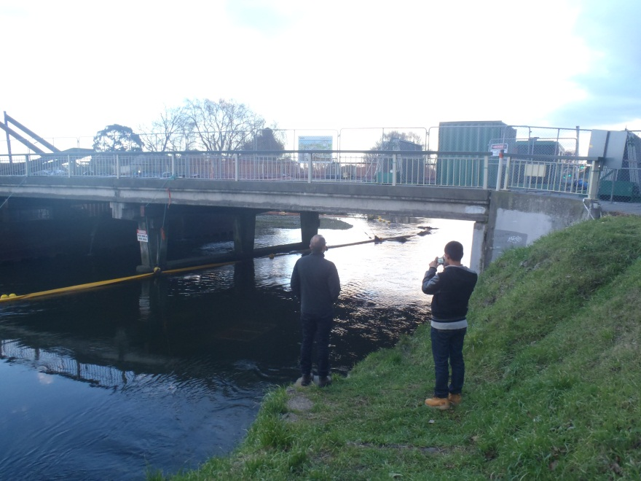
House near Avondale Bridge that sunk into the soil due to liquefaction. The gutter on the roof was only about 7 feet.
Avondale Bridge north abutment; the south abutment is under construction

