Slide 1


Week 4: Investigation and modeling of the Avondale Bridge in Christchurch, New Zealand
Erickson Nguon
University of Auckland, New Zealand
July 24, 2013

Slide 2
Project Overview
The objective of this project is to investigate and model bridges, specifically the Avondale Bridge in Christchurch. The bridge suffered severe structural damage following the 2011 Christchurch Earthquake.
To create computer generated models of the bridges in SAP2000 with loadings that reflect the Christchurch Earthquake and with this model we can validate it by comparing the data from the model and the actual earthquake.

Slide 3
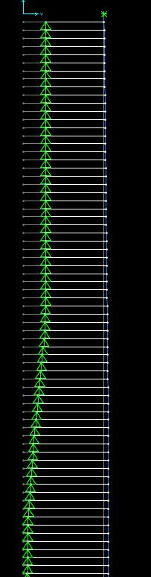
Recent Progress
Adjust force-displacement values for each spring according to their yield strength
Defined hinges for the model
Ran an analysis of the model and ran into issues with moments far exceeding the hinge yield moments.
Figure 1: Displacements results shown from the analysis

Slide 4
Projected Progress
Address moment issues
Run analysis and check all potential issues: Geometry, Constraints/Restraints, Hinges & Moment Curvature, Soil Springs, and Displacement
Meet with Liam to review my recent progress of the model bridge

Slide 5
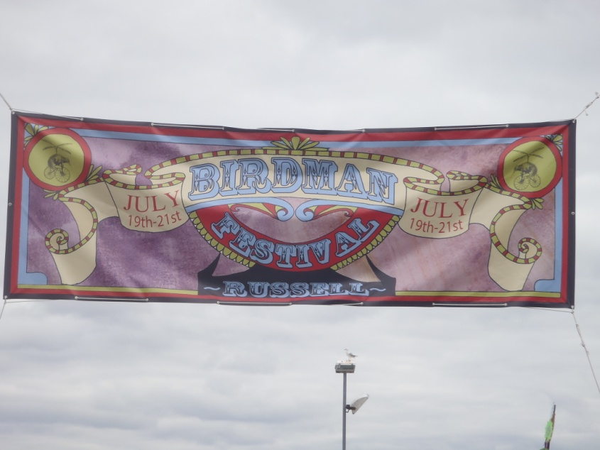
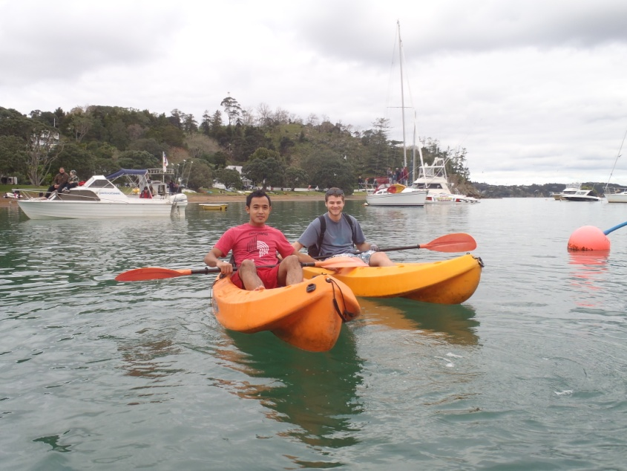
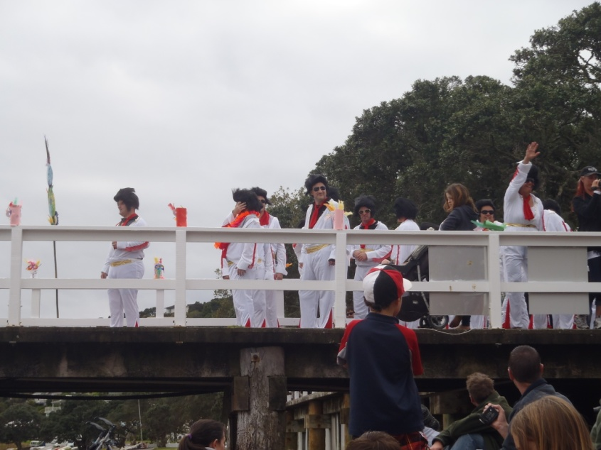
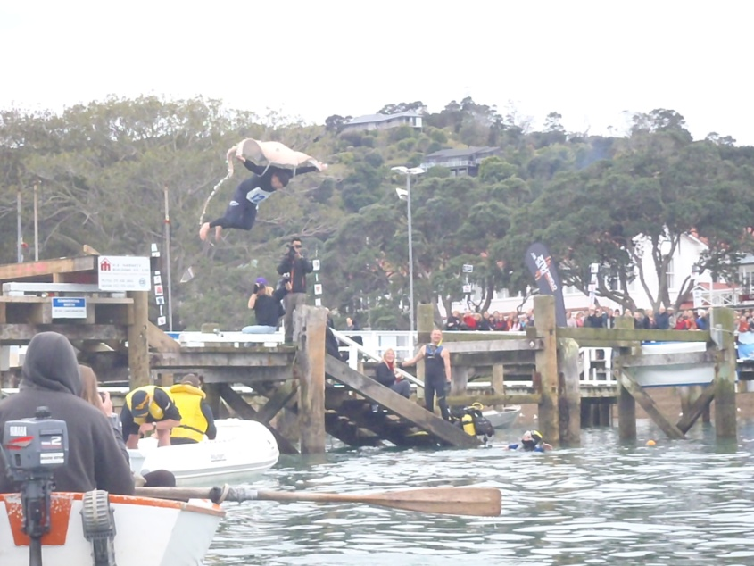
Russell Birdman Festival
Birdman Festival in Russell
Tony and I Kayaking to Russell to watch the festival
People dressed up as Elvis. They danced to Burning Love then jumped as far as they can into the water
A man dressed up as a sting ray trying to jump 7meters to win $1000 NZD

Slide 6
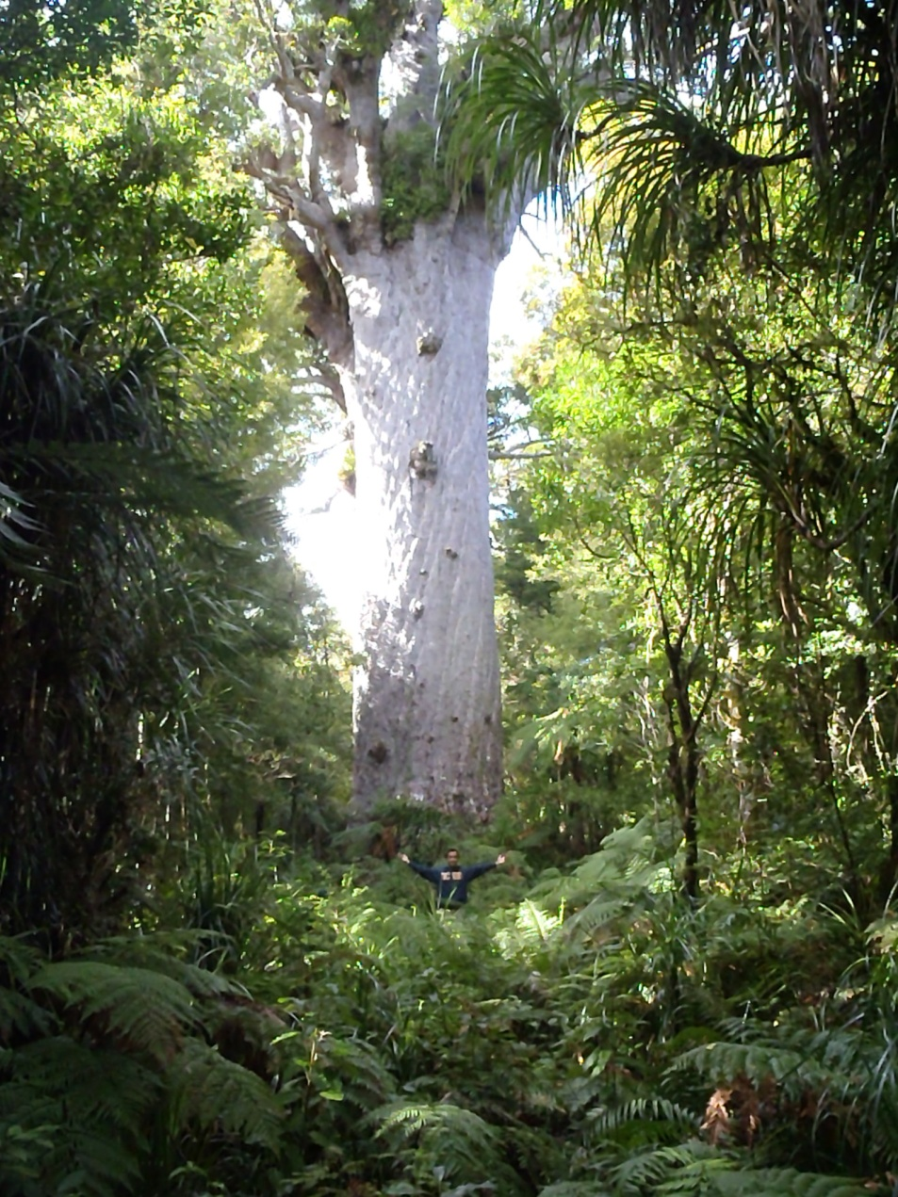
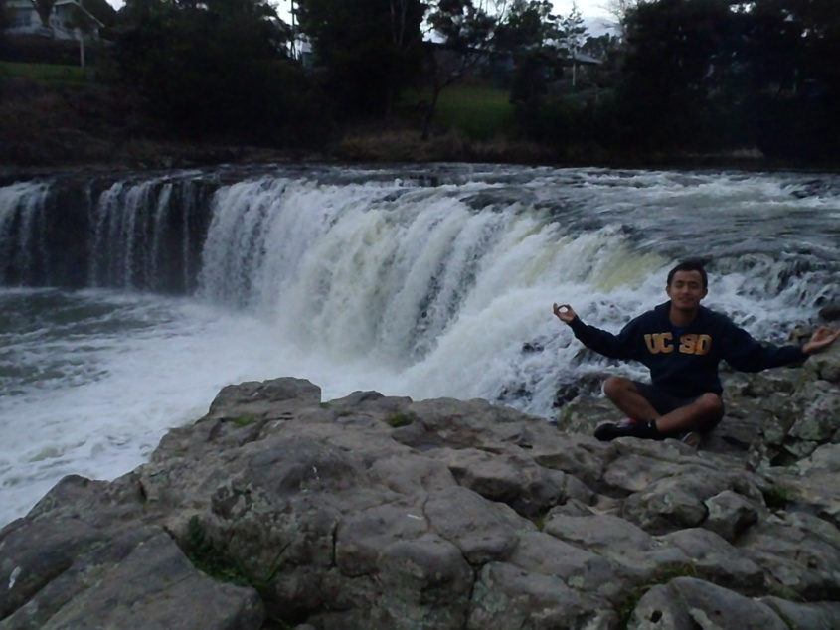
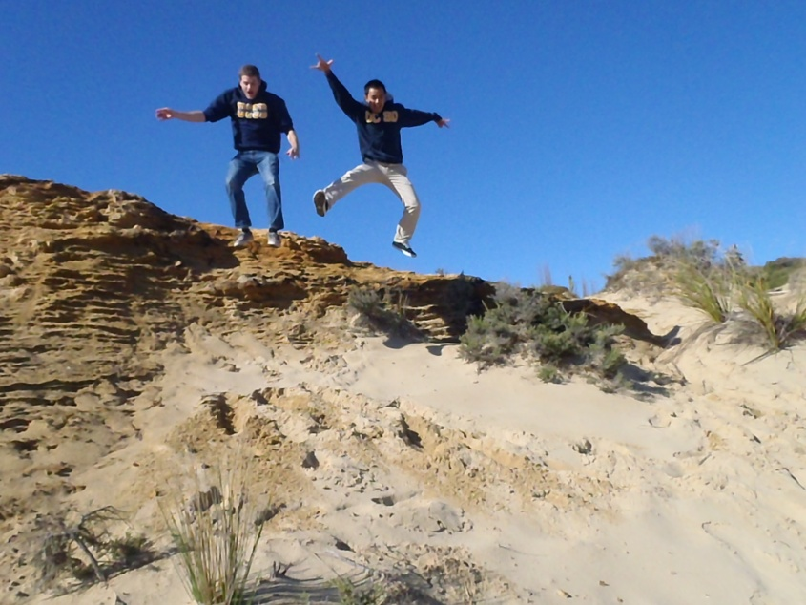
Paihia and Waipoua
Meditating at Haruru Falls
Widest Tree in New Zealand, Tane Mahuta-The Lord of the Forest

Slide 7
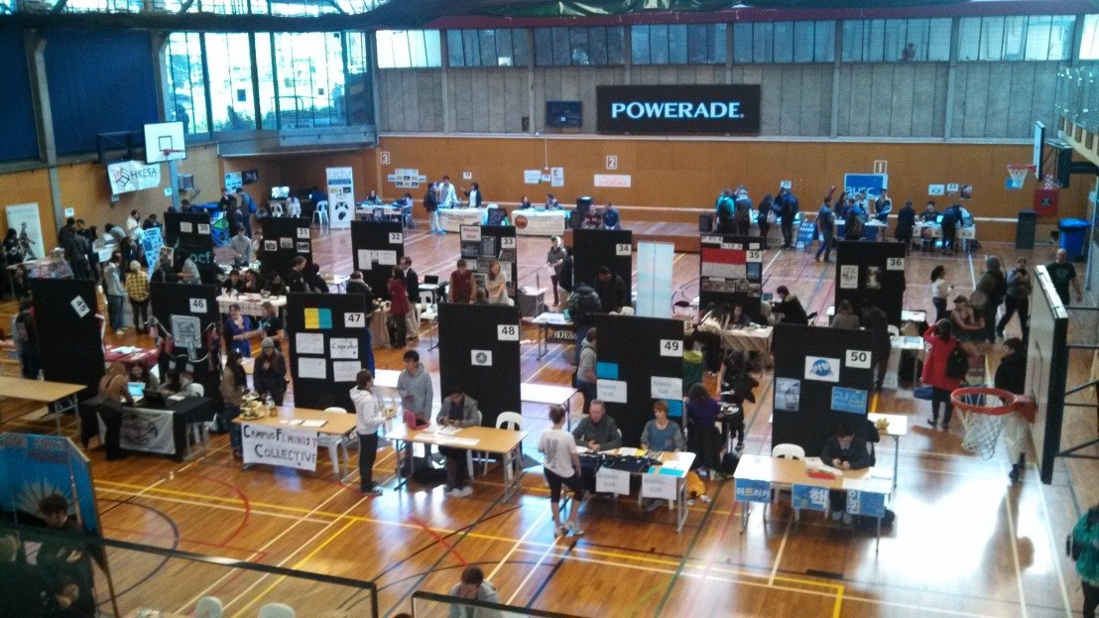
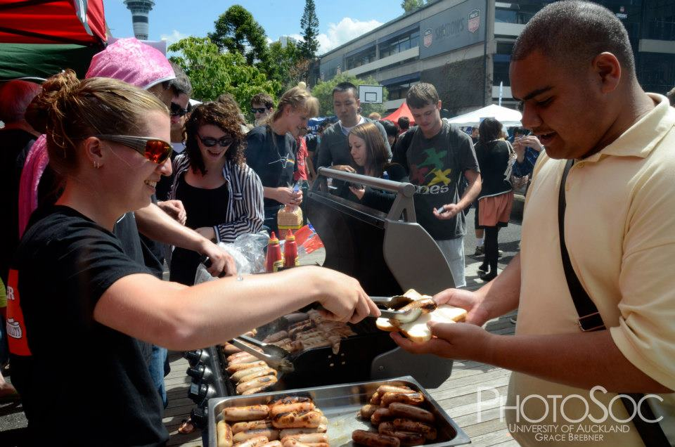
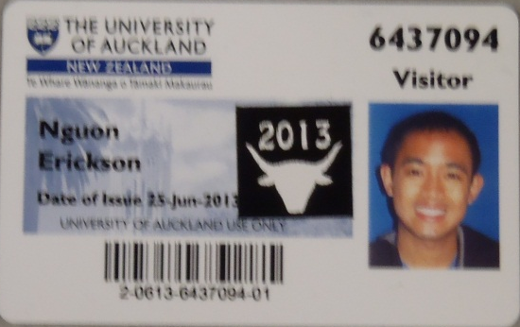
Back from Winter Break
Student Organization Showcase
Meat Club!!!! Where the members eat meat!
Meat Club 2013 Sticker!

Slide 8

Acknowledgments
Thank you to:
PRIME: Peter Arzberger, Gabriele Wienhausen, Teri Simas
UCSD Mentor: Lelli Van Den Einde
UofA: Liam Wotherspoon, Dmytro Dizhur

