Slide 1


RESPONSE OF BRIDGES DUE TO LIQUEFACTION INDUCED LATERAL SPREADING
Erickson Nguon
University of Auckland, New Zealand
August 14, 2013

Slide 2
Project Overview
The objective of this project is to investigate and model bridge responses due to liquefaction induced lateral spreading. Specifically the Avondale Bridge in Christchurch will first be investigated.
A computer generated Ruaumoko model of the bridges will be created under a displacement loading similar to the soil displacements investigated on-site. With the model the results will be validated with the actual results of the bridge.
After the model is validated sensitivity testing will be conducted.

Slide 3
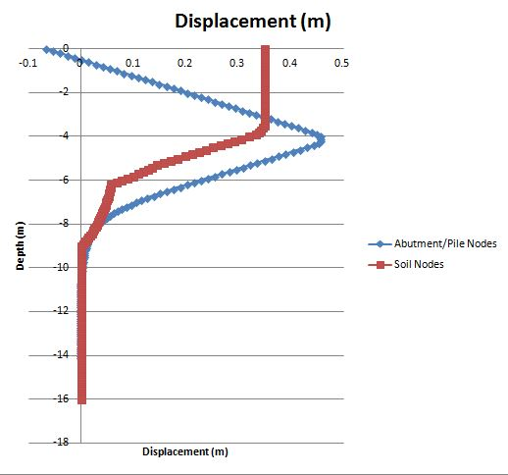
Recent Progress
The stiffness values first calculated are posing an issue on the model and are now currently being recalculated through a different soil-structure method.
The displacements of the abutment/pile exceeds the soil displacement and that does not make sense.
Figure 1: The displacement of the abutment/pile shown here exceeds the soil displacements and that should not be occurring. The issue is believed to be with the soil-spring stiffness values.

Slide 4
Projected Progress
This coming week I will assist Liam with soil testing in Hawera, Taranaki. We will be conducting surface wave testing to determine their velocity profiles by inducing a propagating wave.
Attempt to solve the stiffness issue by calculating it through different methods.

Slide 5
Thus far
I learned a lot in this program, but I have also ran into a lot of walls in the model which have caused a lot of problems and potentially preventing me from fully completing my intended project. Running into these problems were expected and are a part of the learning process of the research field.
What I have learned so far is how to use Ruaumoko and SAP2000 and have also learned how to use batch files and Excel macros to supplement my data from Ruaumoko/SAP2000.

Slide 6
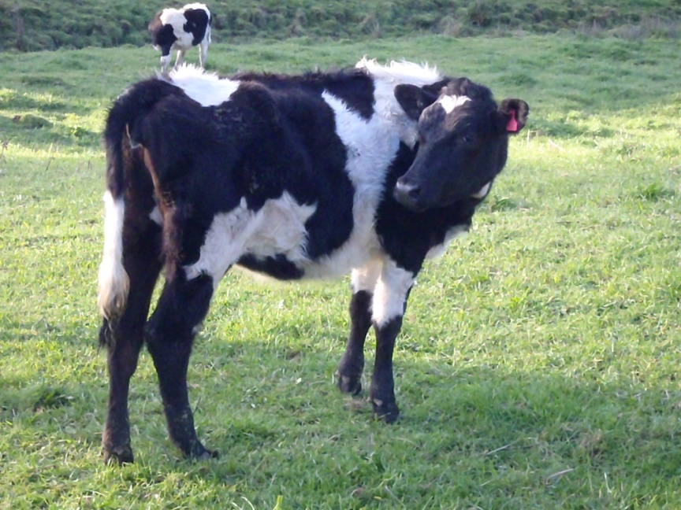
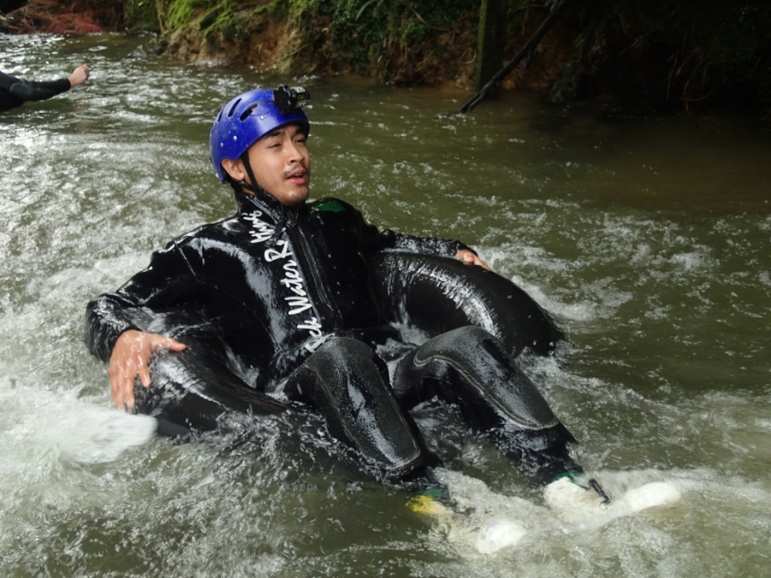
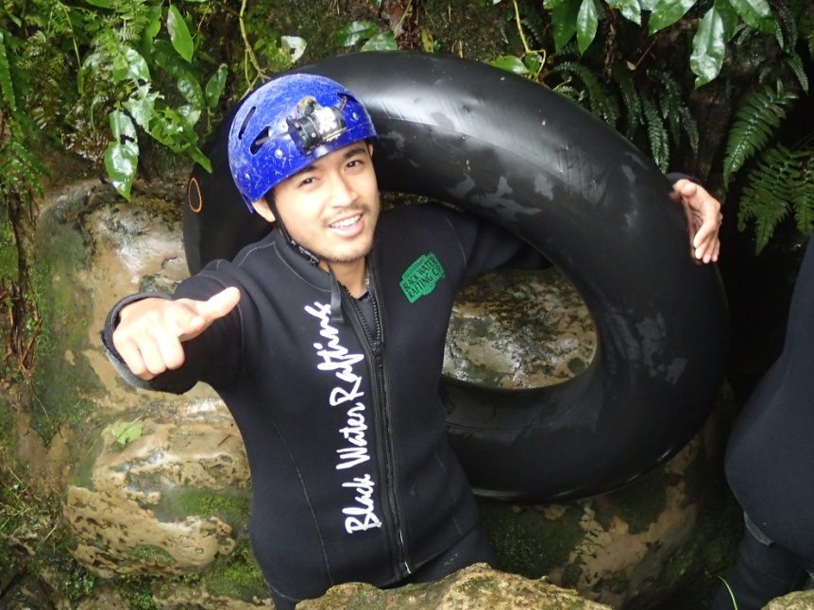
Waitomo Caves
These pictures were taken just outside of the Waitomo Caves. Waitomo meaning “many caves” in Maori. There were glow worms in the caves, but we couldn’t get a good picture of them. They were something you’d appreciate more in person anyways.

Slide 7

Acknowledgments
Thank you to:
PRIME: Gabriele Wienhausen, Peter Arzberger, Teri Simas
UCSD Mentor: Lelli Van Den Einde
UofA: Liam Wotherspoon, Dmytro Dizhur

