Slide 1
Thinh Nguyen
Material Manipulation Using the Leap Motion
Osaka University
July 3, 2013

Slide 2
Proposed Research
Exploring the uses of the Leap Motion device to use finger gestures to manipulate (via creation, destruction, movement of) virtual matter. Goal is to come up with an intuitive and easy way for anyone to interact with the virtual matter by just hovering their hands in above the leap motion device, without the use of any keyboard ques.

Slide 3
Current Progress
Set up development environments on lab machine and personal laptop. Set up base classes to manipulate a lathe object. Cleaned up hand visualization code.

Slide 4
Next Week
Set up bounding spheres for finger tip objects. Begin working on geometry destruction/ movement code. Map geometry destruction/movement based on finger bounding spheres and finger locations.

Slide 5

Coin purses from local shopping store

Slide 6
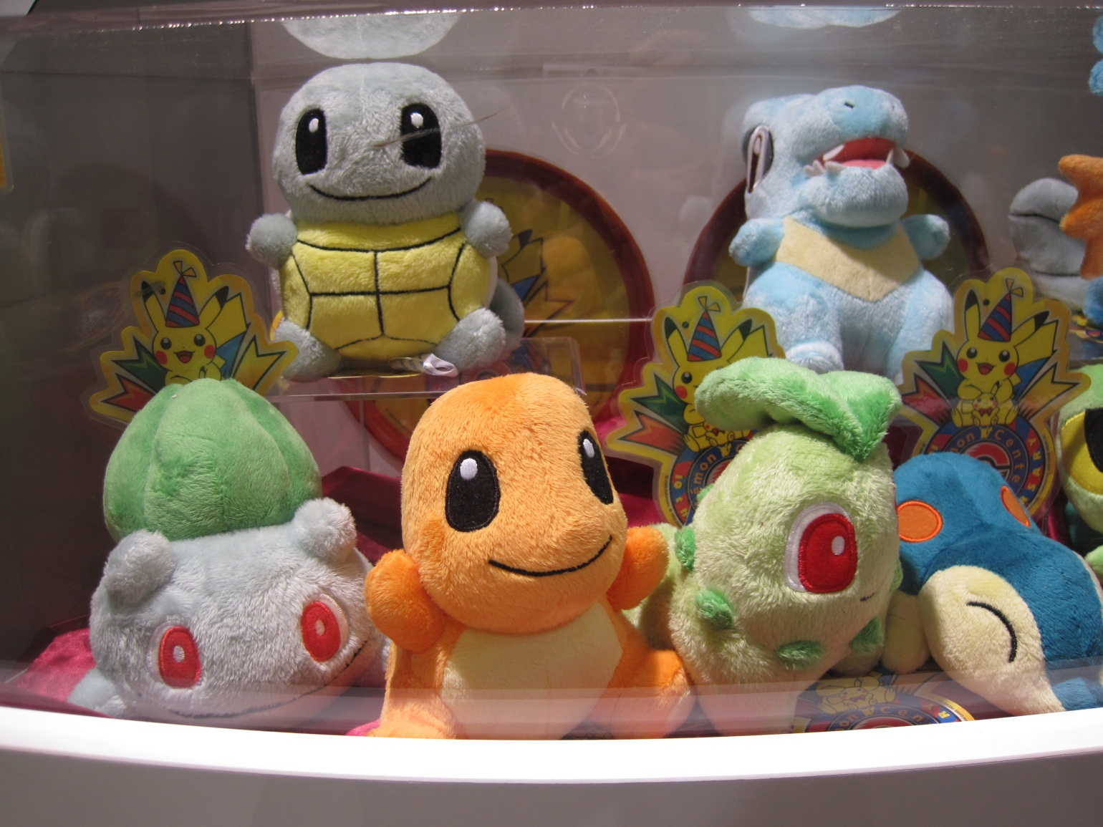
Plushies from Pokemon center

Slide 7
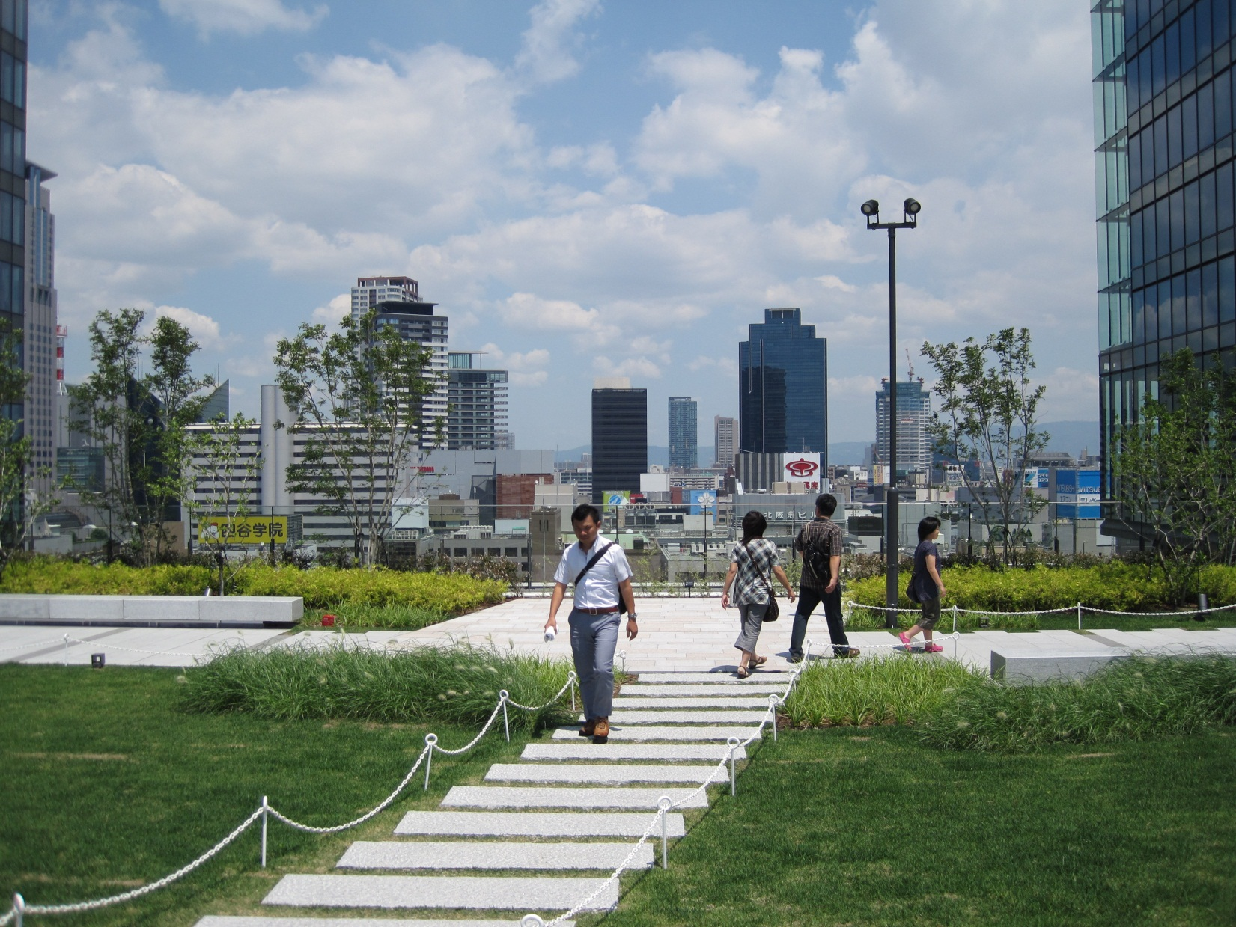
View from a garden on the 9th floor of a skyscraper in the middle of Umeda

