Slide 1
Thinh Nguyen
Material Manipulation Using the Leap Motion
Osaka University
July 17, 2013

Slide 2
Current Progress
Deformed surface materials using a ray casted technique. Runtime is smooth with <8 fingers being raycasted onto the meshes.
Accuracy is very good when fingers in normal horizontal positions. Bad for when user instinctively tries to rotate hand vertically, also bad when user tries to move a hand object on top of another hand object.
Currently geometry is only being scewed outwards (Faces only as well).

Slide 3
Current Progress Continued.
Geometry moves outward based on the finger raycaster (right now simply negates the finger ray and pulls face of geometry outwards towards that location).
Made a new finger base class and a variety of functions to decouple fingers and hand objects, to make gesture recognition easier and possibly hand independent if need be.

Slide 4
Next Week
Finish inward face geometry manipulations. Clean up and comment a lot of the current code, come up with a better system for debugging the javascript.
Increased complexity of ongoing code is making debugging javascript quite a pain.
Afterwards trying to come up with a way to actually add/subtract vertices (not just use existing vertices, IE: not just dealing with surfaces purely).

Slide 5
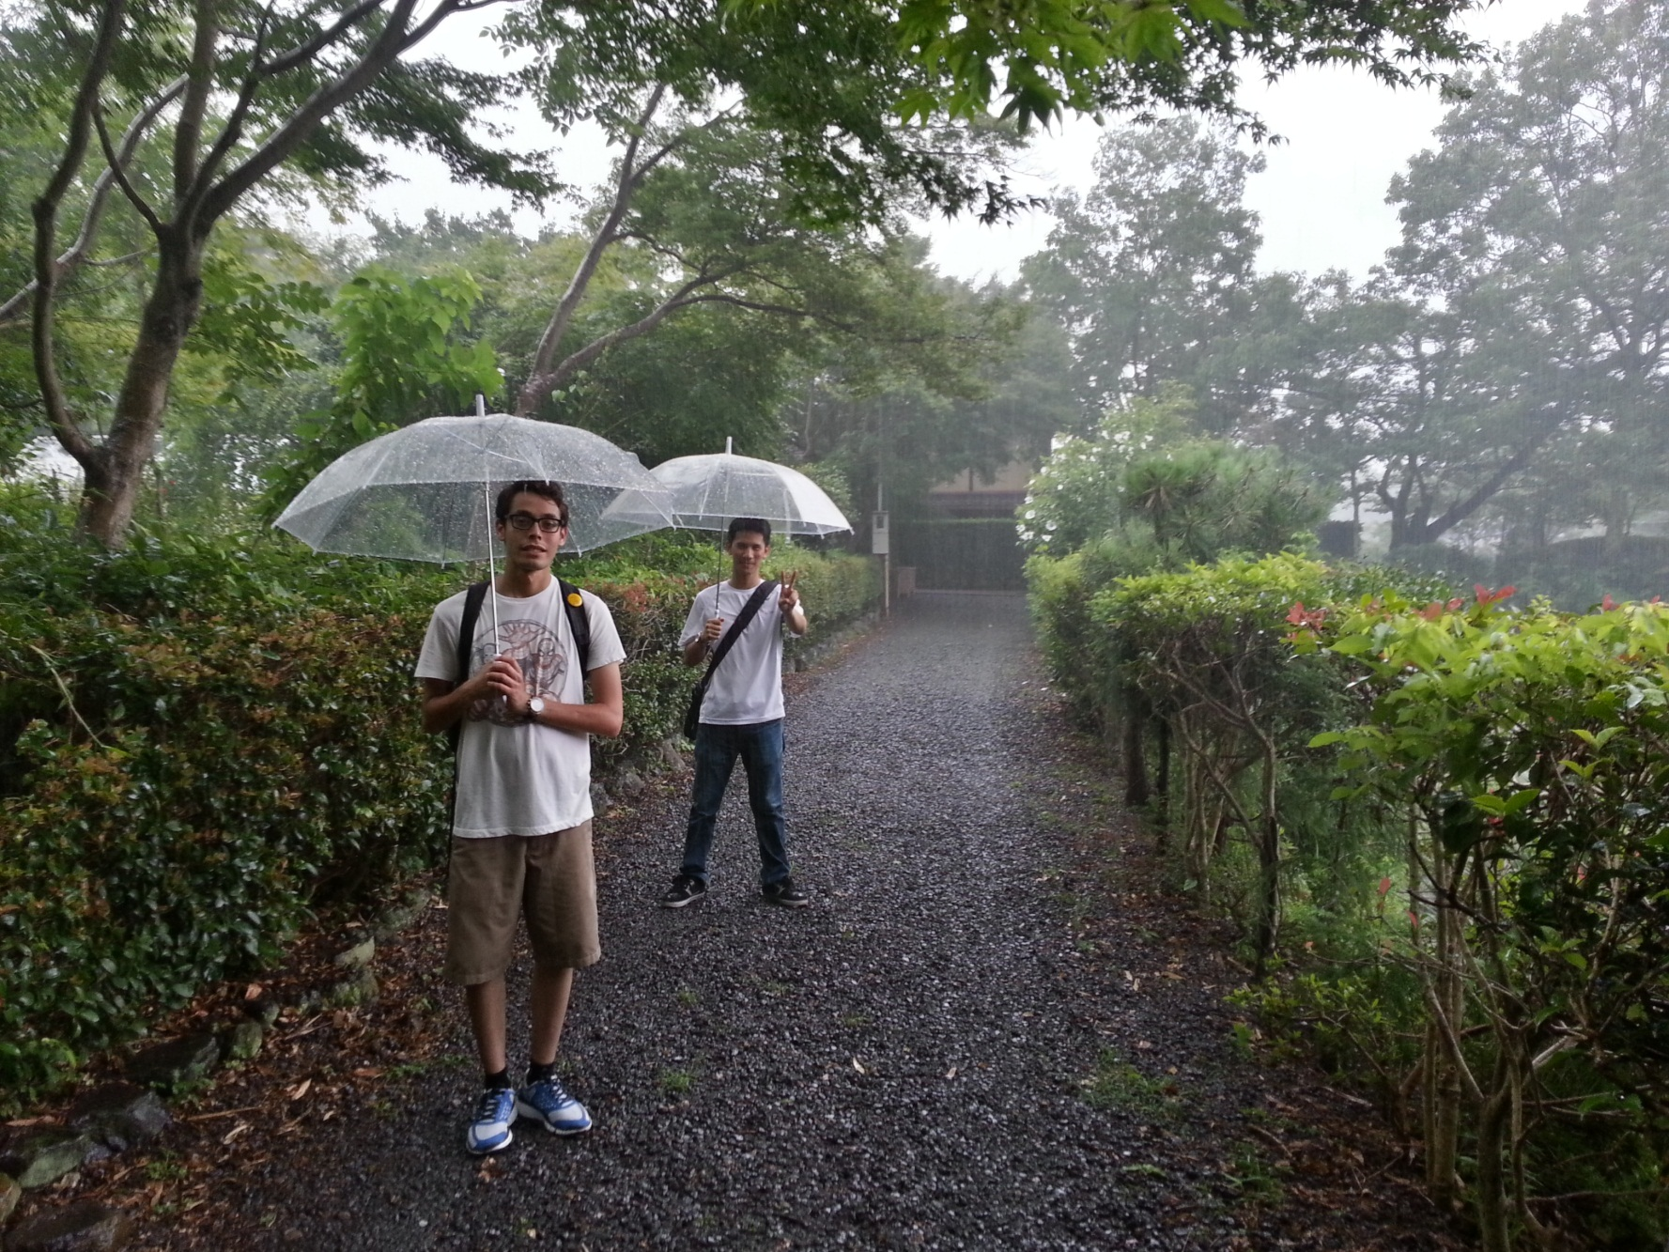
Torrential downpour near Ayashiyama

Slide 6
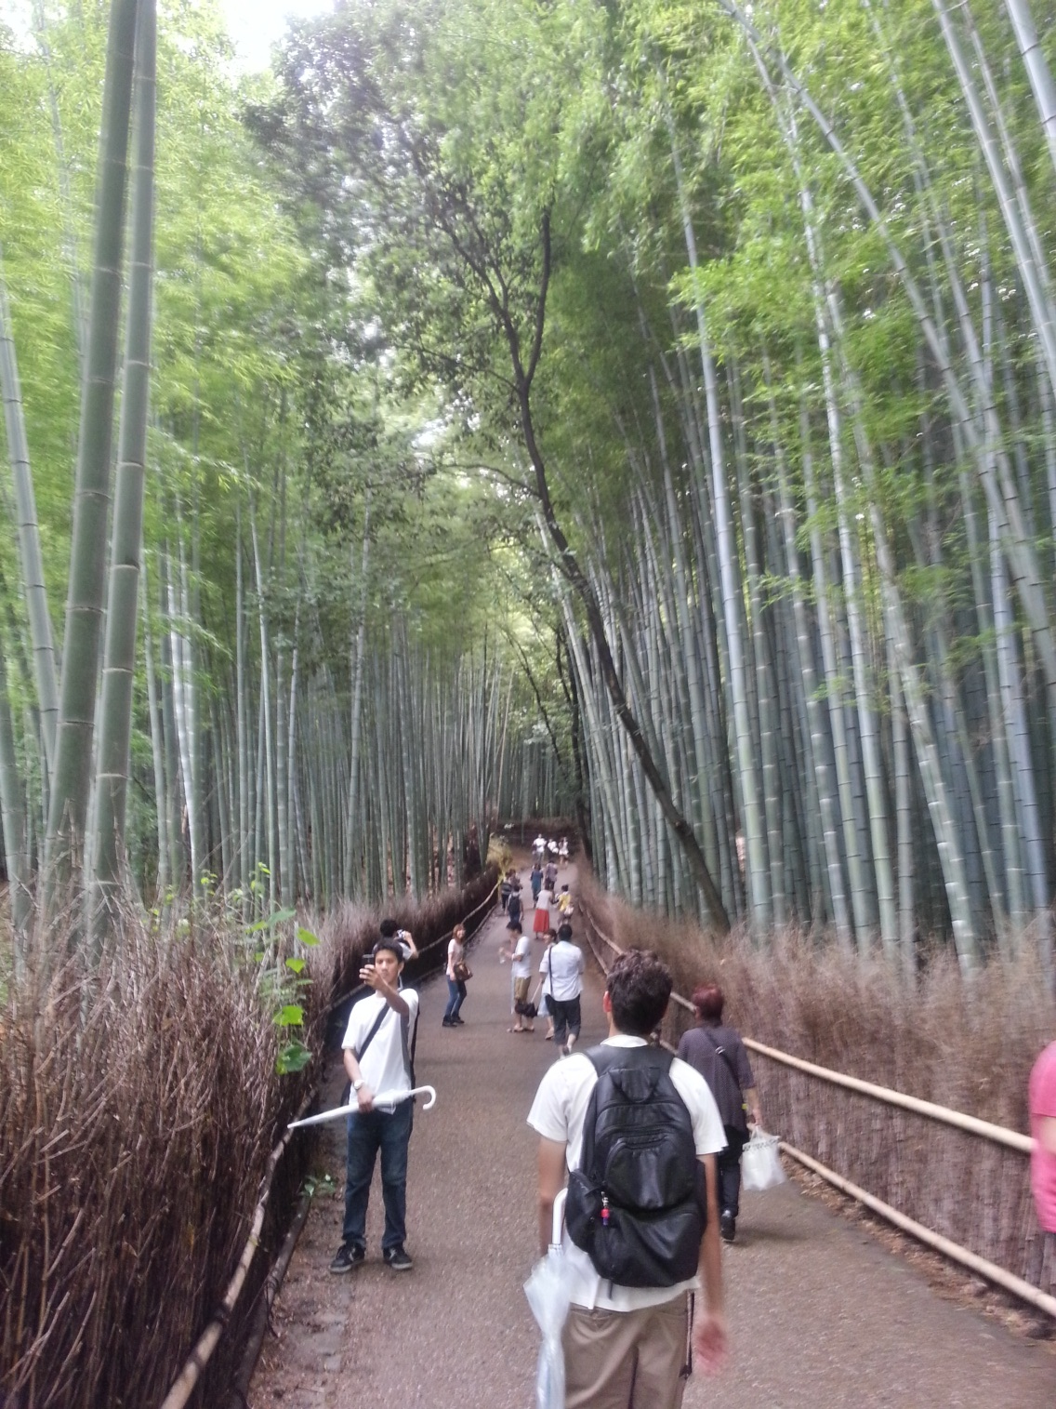
Bamboo Grove

Slide 7
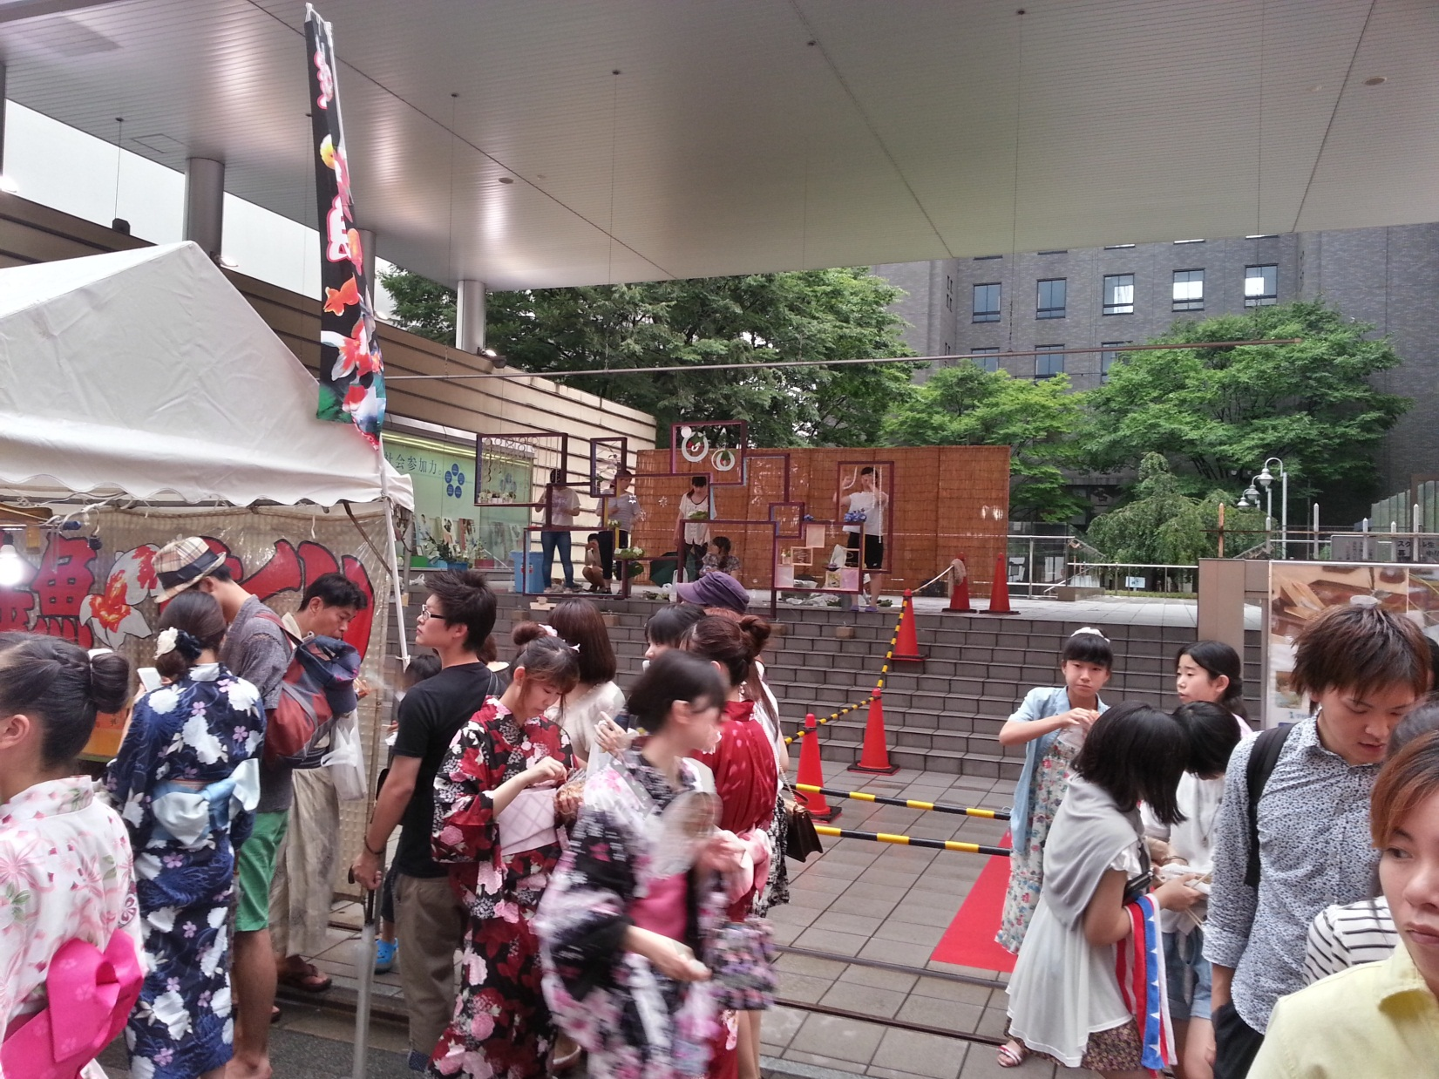
Gion Matsuri Festival

Slide 8
Special Thanks to:
Jurgen Schulze – UCSD Mentor
Kiyoshi Kiwokawa – Osaka Mentor
Gabriele Wienhausen, Peter Arzberger, Teri Simas, Jason Haga, Prime Staff
Ledell Family

