Slide 1
Thinh Nguyen
Material Manipulation Using the Leap Motion
Osaka University
July 31, 2013

Slide 2
Current Progress
Mode selection using the keyboard. Decided using more than 5 raycasters was going to be too computationally intensive.
Stuck with 5 ray casters on the right hand and screen manipulations with the left hand.
Keyboard shortcuts for changing between modes. (Currently just inward and outward).
Circle gestures to control the camera rotations.

Slide 3
Current Progress Continued.
Face coupling (neighboring faces will change with the main face).
Read up on some tessellation techniques.

Slide 4
Next Week
Actually code the tessellation for faces that are pulled out for very long distances.
Get better camera manipulation gestures for the left hand (possibly a flying option instead of a static viewpoint).

Slide 5
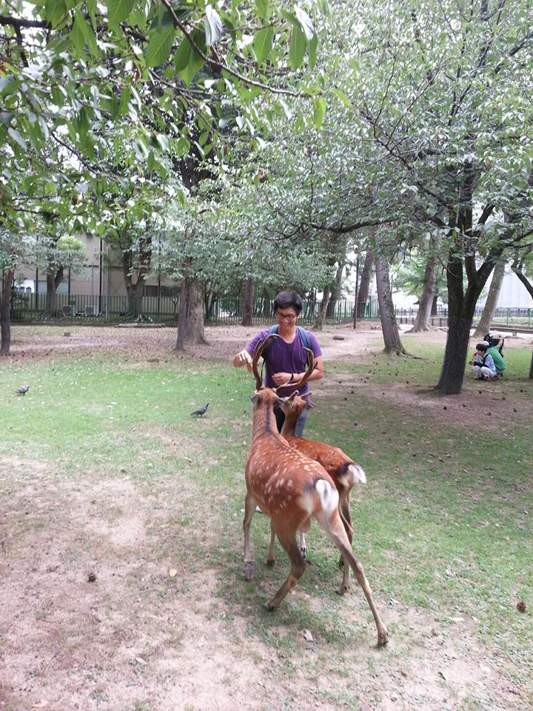
Feeding deer in Nara

Slide 6
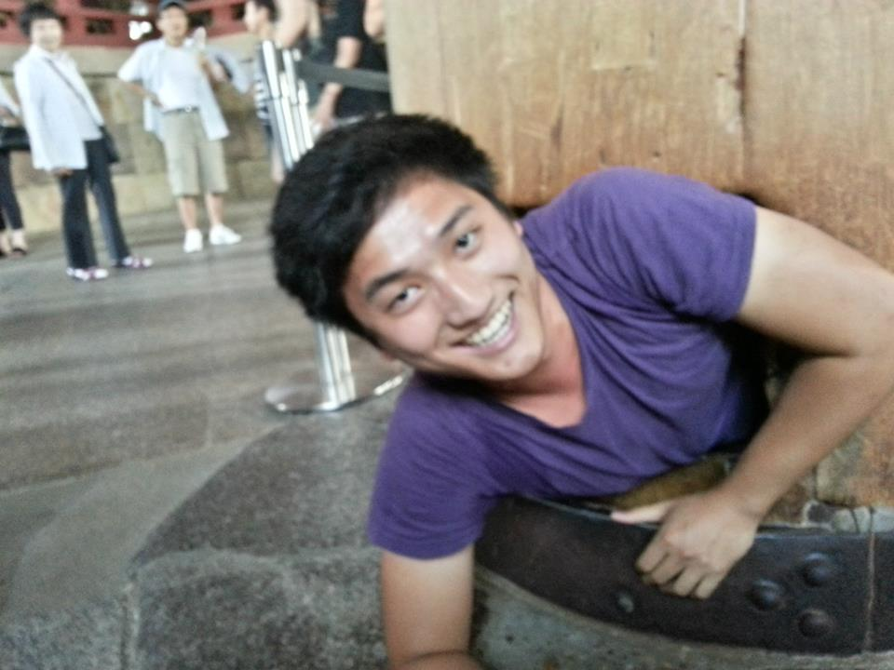
Going through the tree trunk hole in Todaji Temple

Slide 7
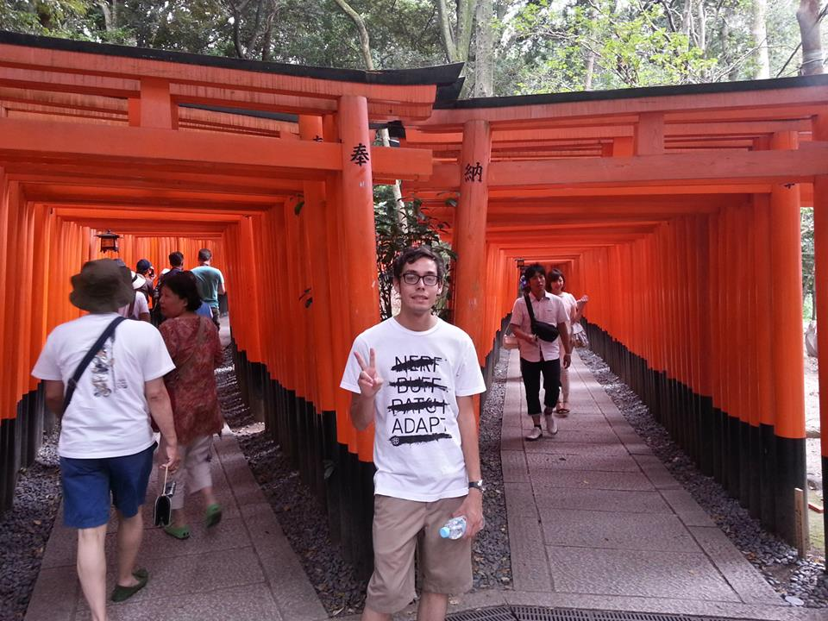
Going through the gates at Fujimi inari

Slide 8
Special Thanks to:
Jurgen Schulze – UCSD Mentor
Kiyoshi Kiwokawa – Osaka Mentor
Gabriele Wienhausen, Peter Arzberger, Teri Simas, Jason Haga, Prime Staff
Ledell Family

