Slide 1
Informatics Tools for Biodiversity Data Conversion
Kittinan Ponkaew
VisLab, Osaka
7/3/2013

Slide 2
Overview
Aggregate all sorts of data from different departments in SDNHM into a single database
Develop a common schema
Develop tools for future use
Everything is going well!

Slide 3
Week 1 Progress
Setup development environment at the lab
Developed script to read/write excel files
Finished testing conversion process for Entomology DB
Finalized conversion process for Ent DB

Slide 4
Plans for Week 2
Write documentation for Entomology DB conversion
Resume Herpetology DB construction
Wait for Paleo and Botany Data

Slide 5
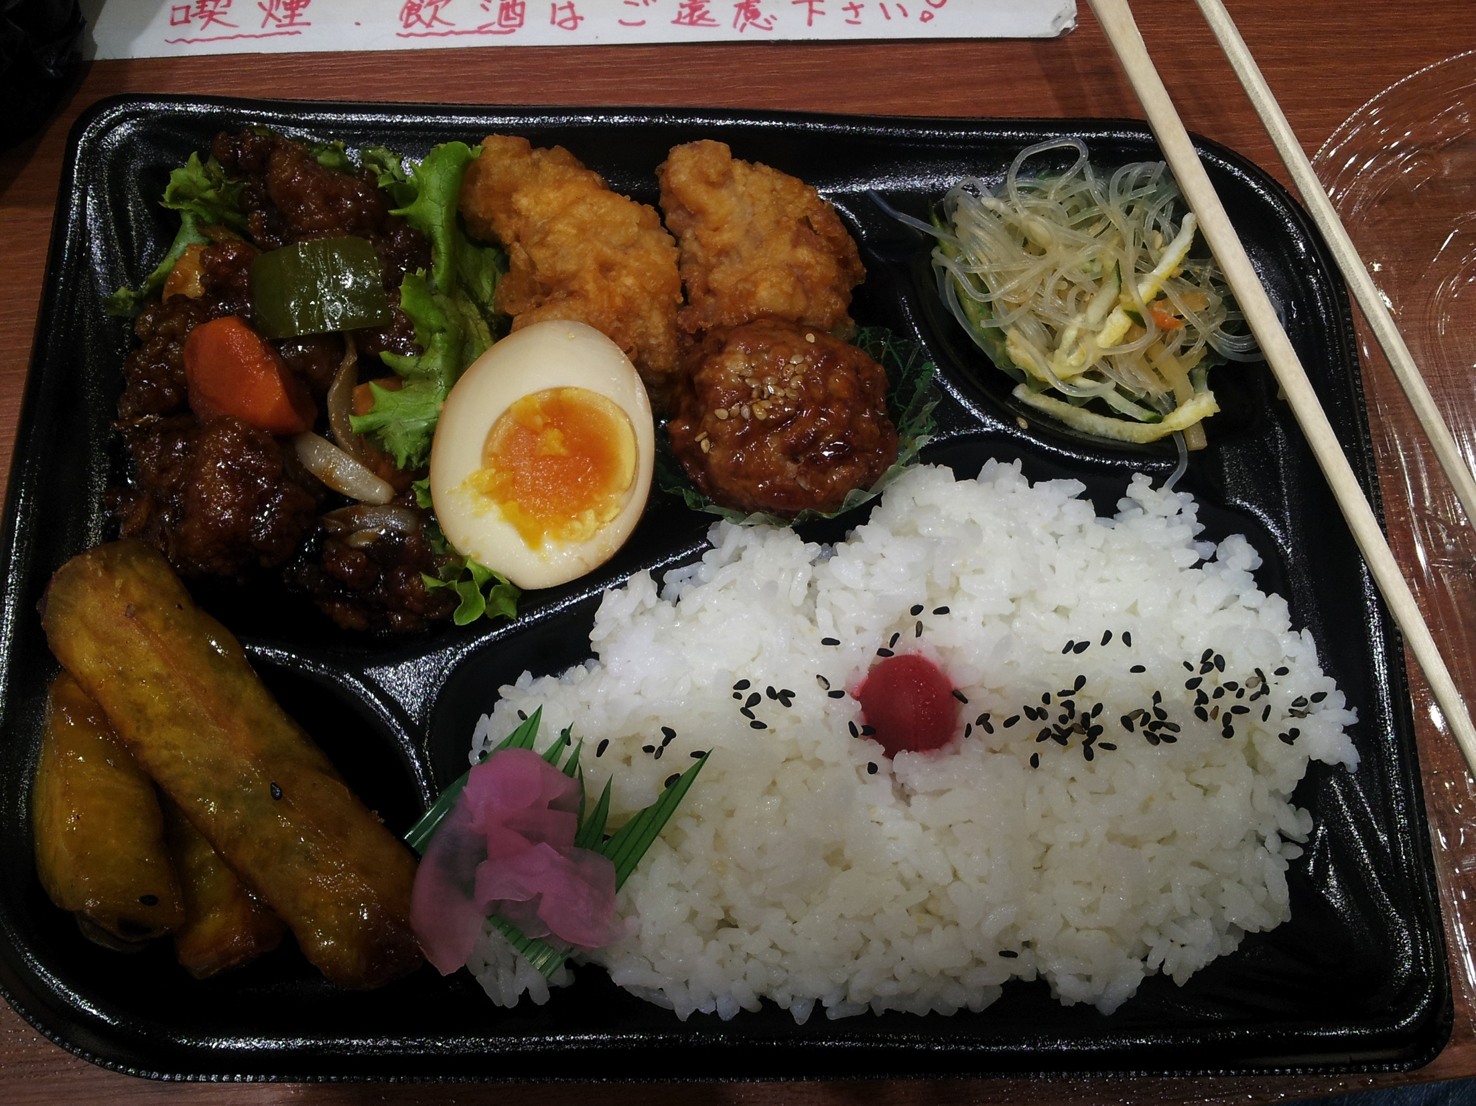
Cultural Exploration
お弁当

Slide 6
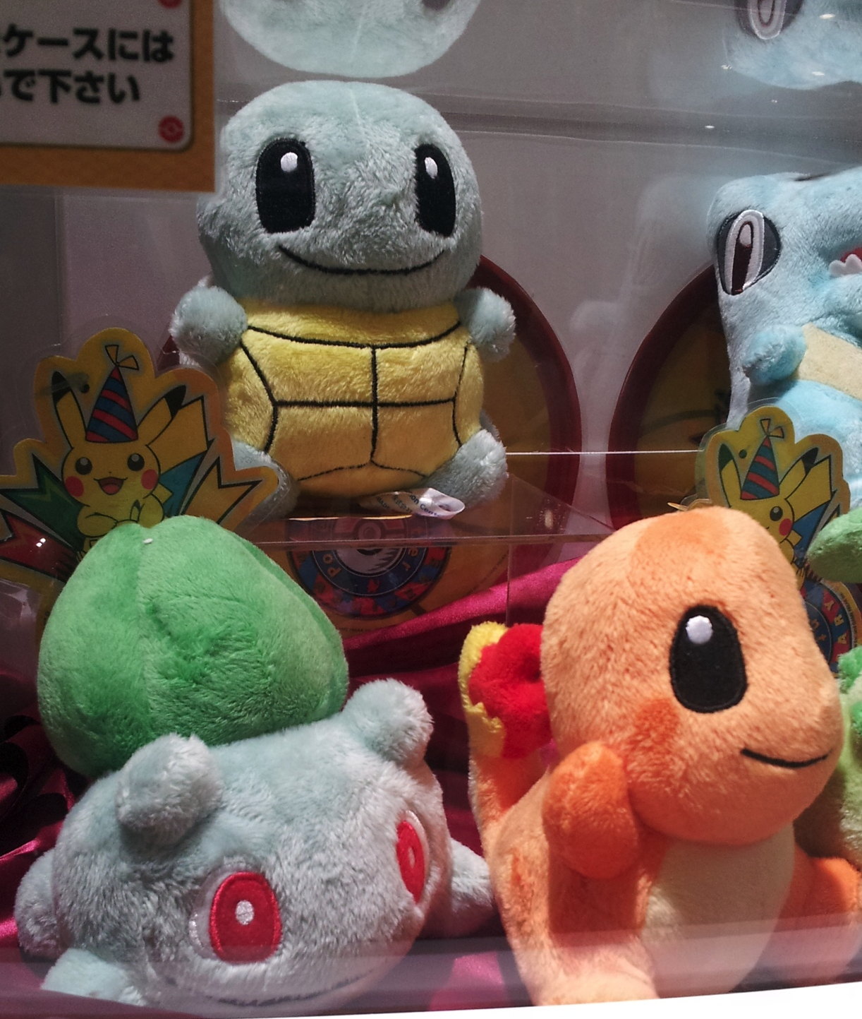
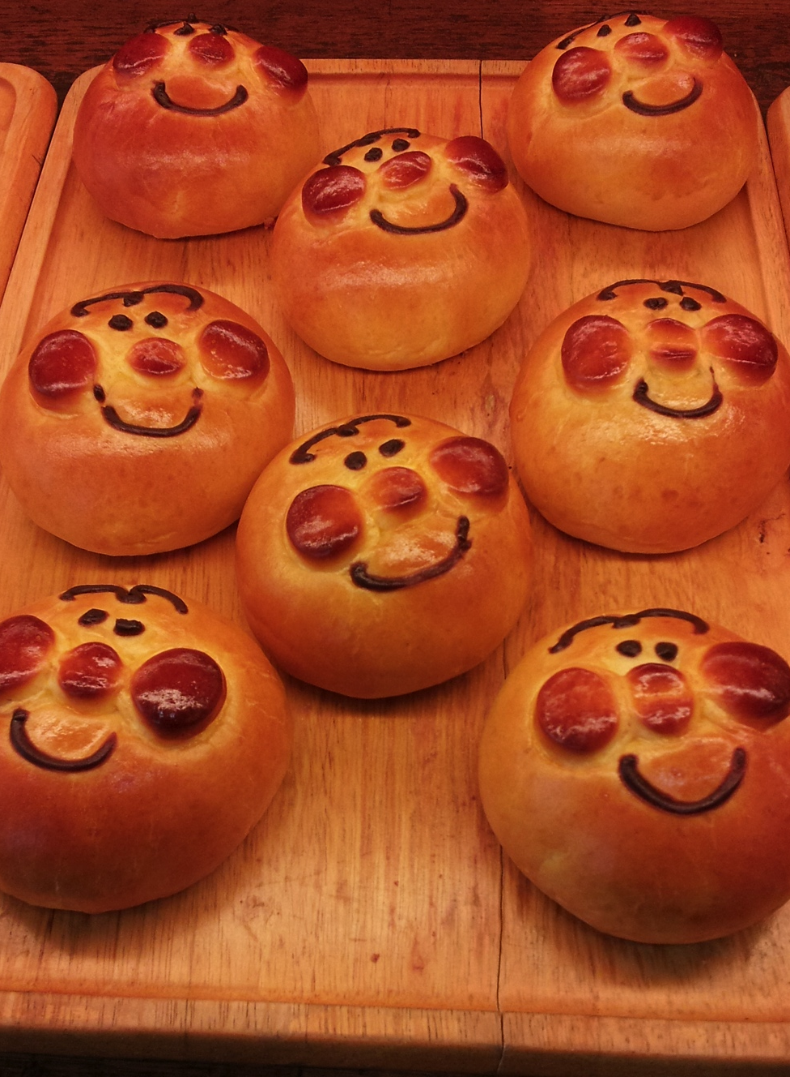
Cultural Exploration 2
Pokemon at the pokemon center. So cute!!!!!
Bakeries everywhere.

Slide 7
Acknowledgement
Dr. Jason Haga
Dr. Shinji Shimojo
PRIME
NICT
Balboa Park Online Collaboration
PRIME alumna Haley Hunter-Zinck
NSF

