Slide 1
Informatics Tools for Biodiversity Data Conversion
Kittinan Ponkaew
VisLab, Osaka
7/10/2013

Slide 2
Week 2 Progress
Extracted uncorrupt date information for mammals and birds Access database
Started on scripts for combining catalog numbers and dates with the corresponding entries
Setup plans for the remaining data

Slide 3
Plans for Week 3
Write documentation for using scripts for birds and mammals DB
Test scripts and import into Specify
Finish documenting on entomology database

Slide 4
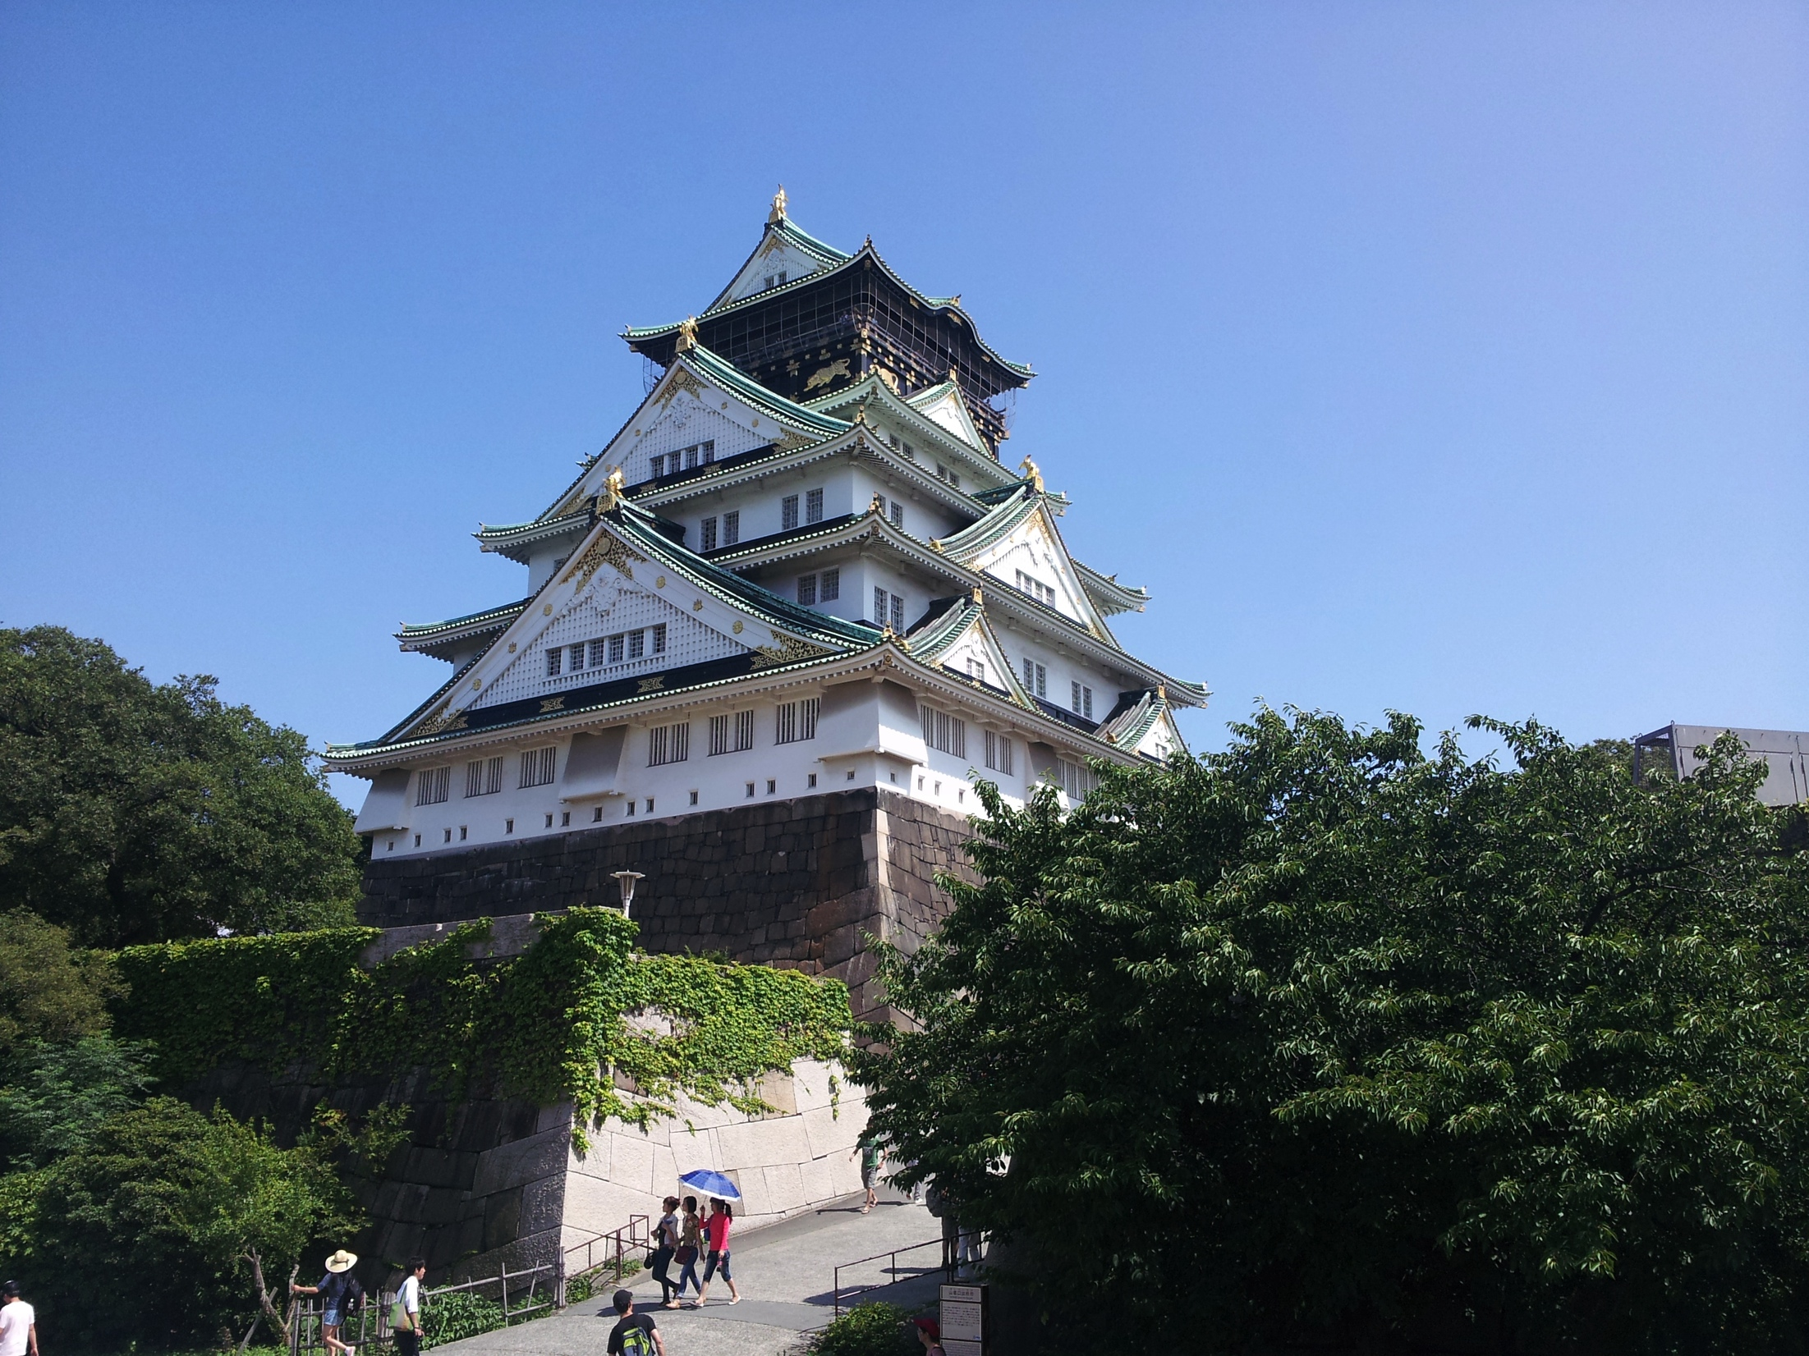
Cultural Exploration
Osaka Castle.

Slide 5
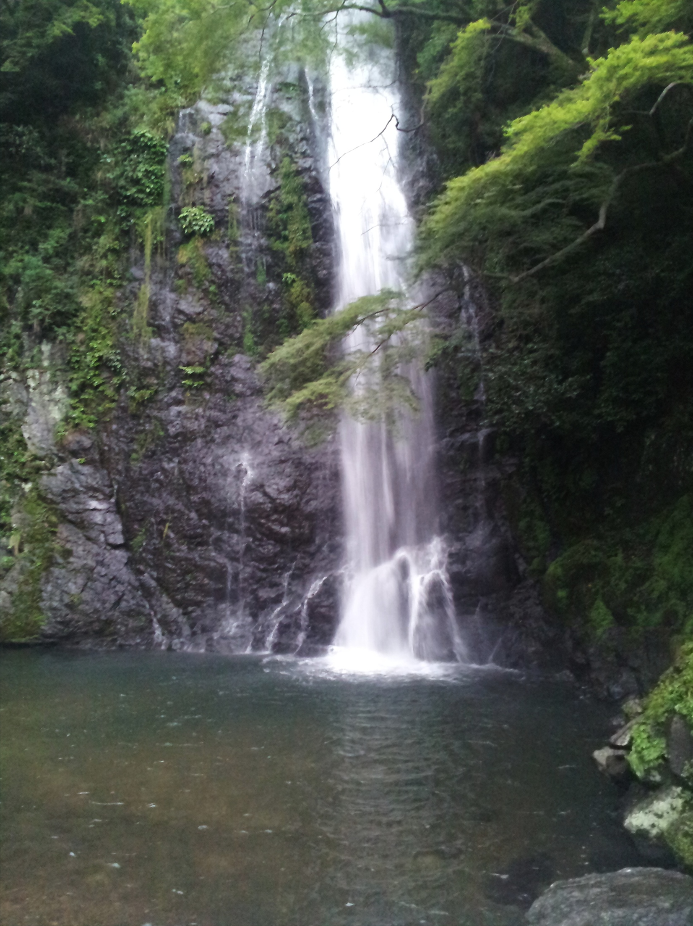
Cultural Exploration 2
Waterfall in 箕面.

Slide 6
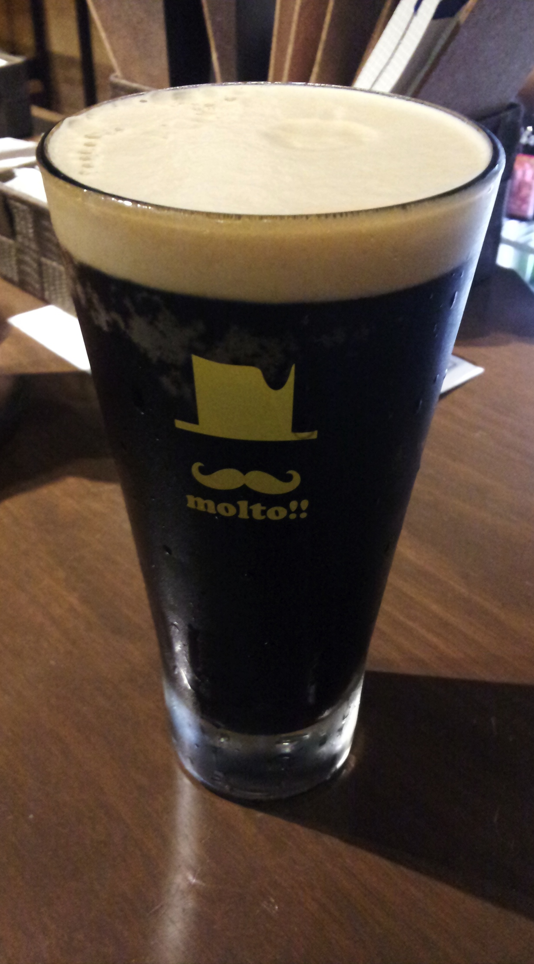
Cultural Exploration 3
After a day of hard work and exploration,
which is every day.
Draft beer from local brewery in 箕面

Slide 7
Acknowledgement
Dr. Jason Haga
Dr. Shinji Shimojo
PRIME
NICT
Balboa Park Online Collaboration
PRIME alumna Haley Hunter-Zinck
NSF

