Slide 1
Informatics Tools for Biodiversity Data Conversion
Kittinan Ponkaew
VisLab, Osaka
7/17/2013

Slide 2
Week 3 Progress
Extracted information from botany database
Script works with botany database now, data can be uploaded easily
Updates from Specify website

Slide 3
Plans for Week 4
Combine paleo specimen and stratigraphy data
Test scripts for birds and mammals
Test web portal

Slide 4
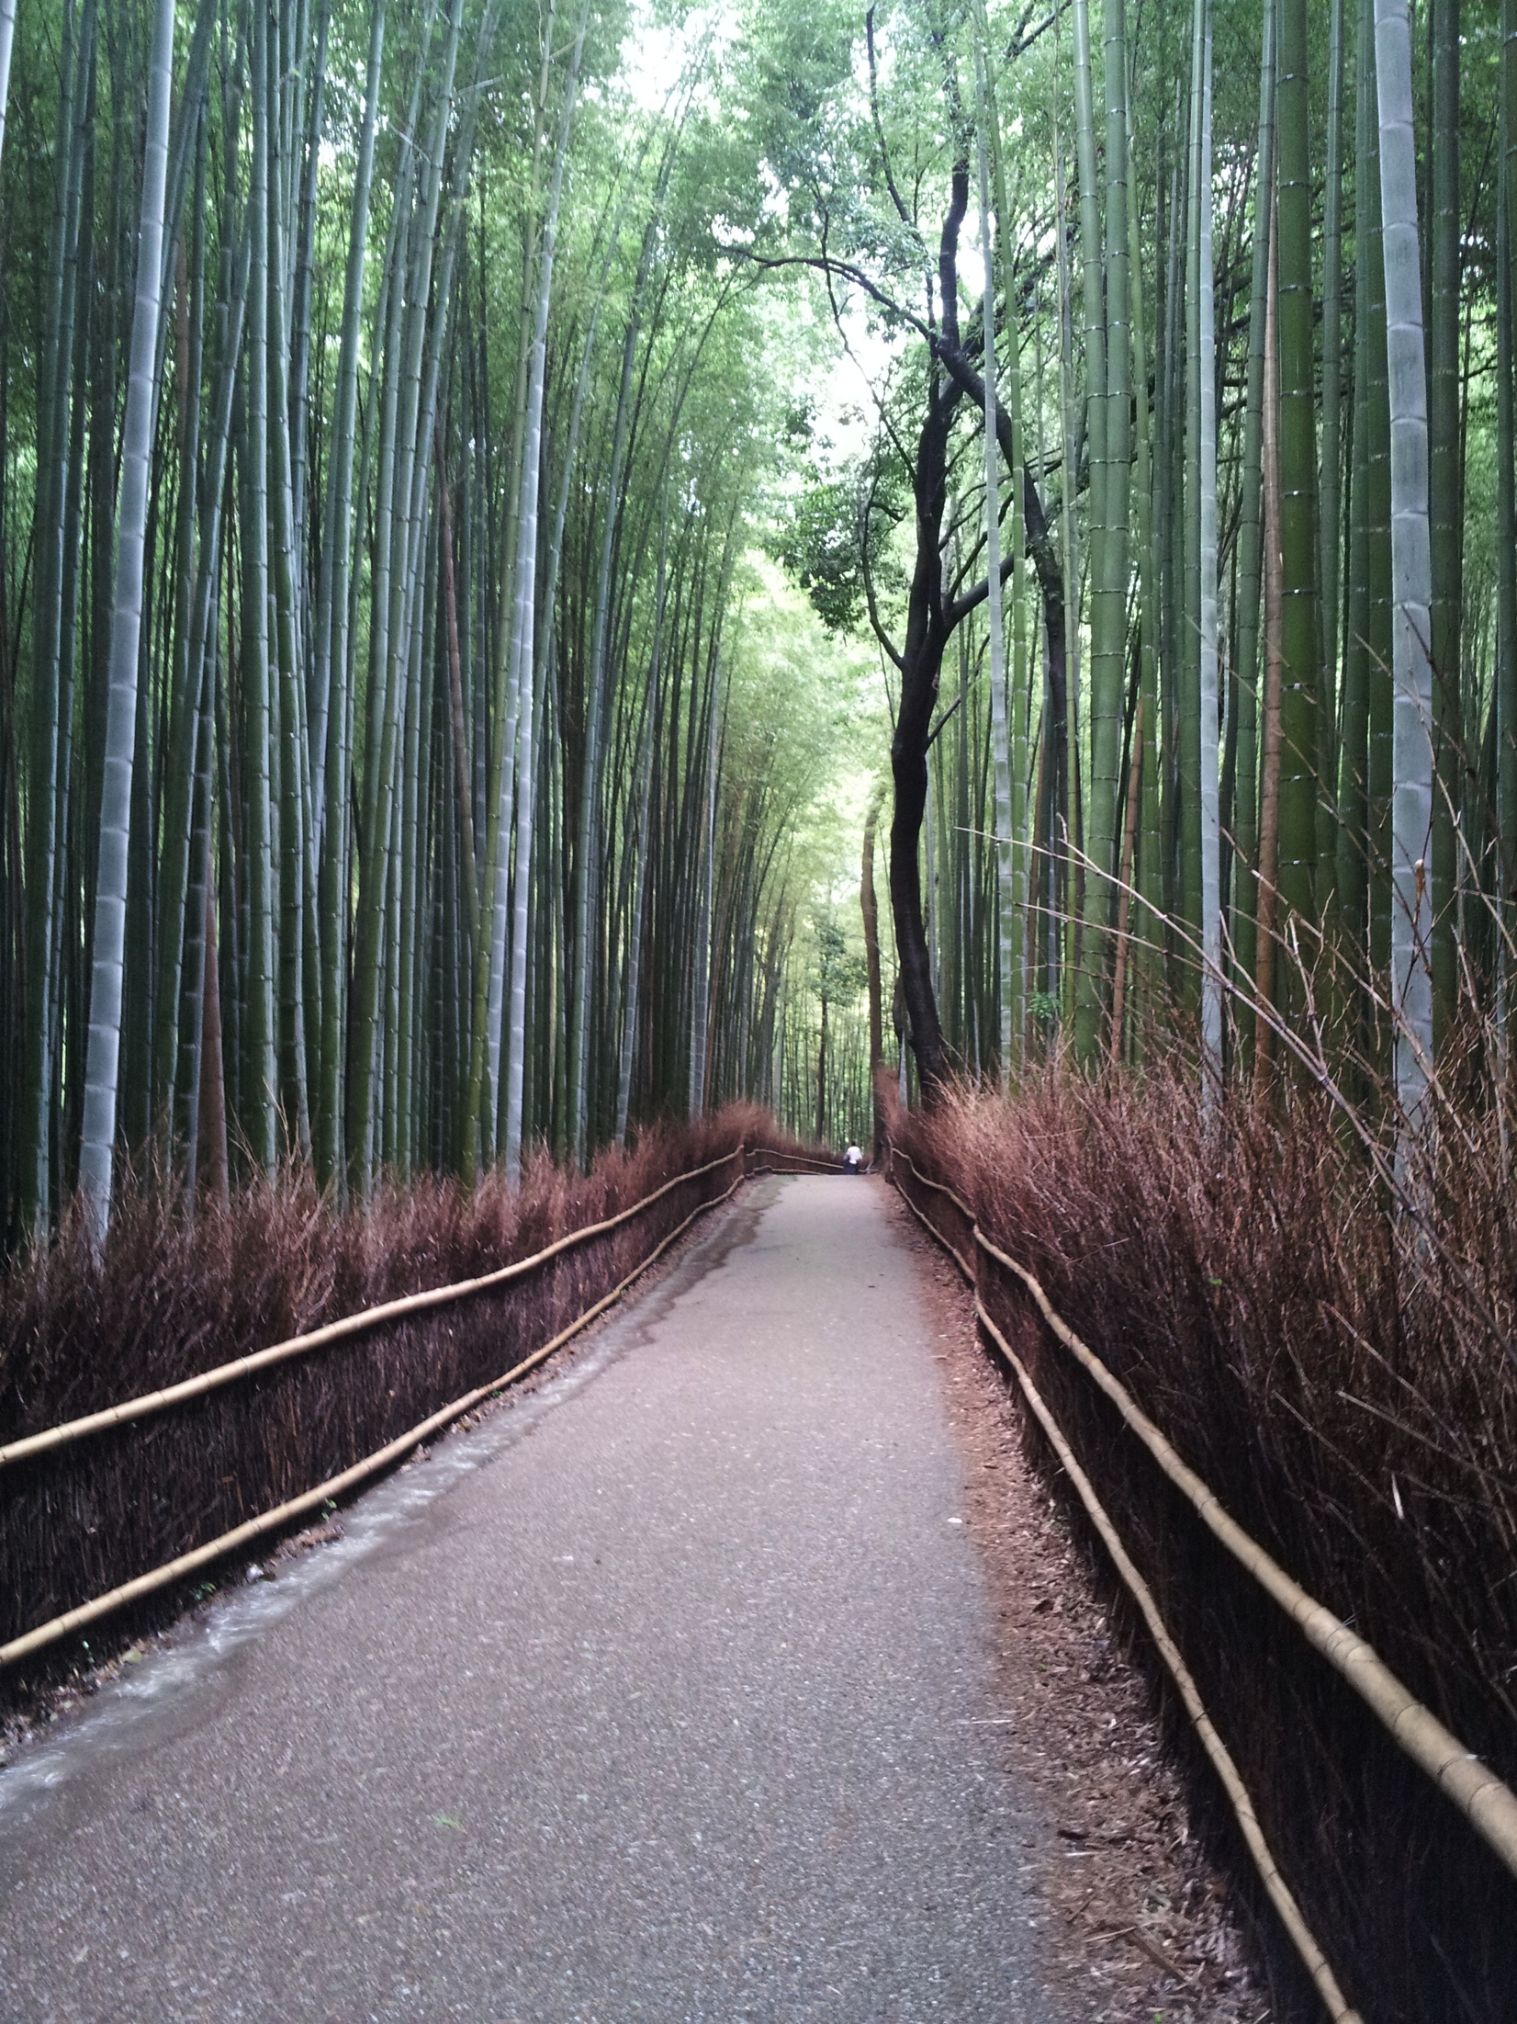
Cultural Exploration
The famous bamboo forest in Kyoto.

Slide 5
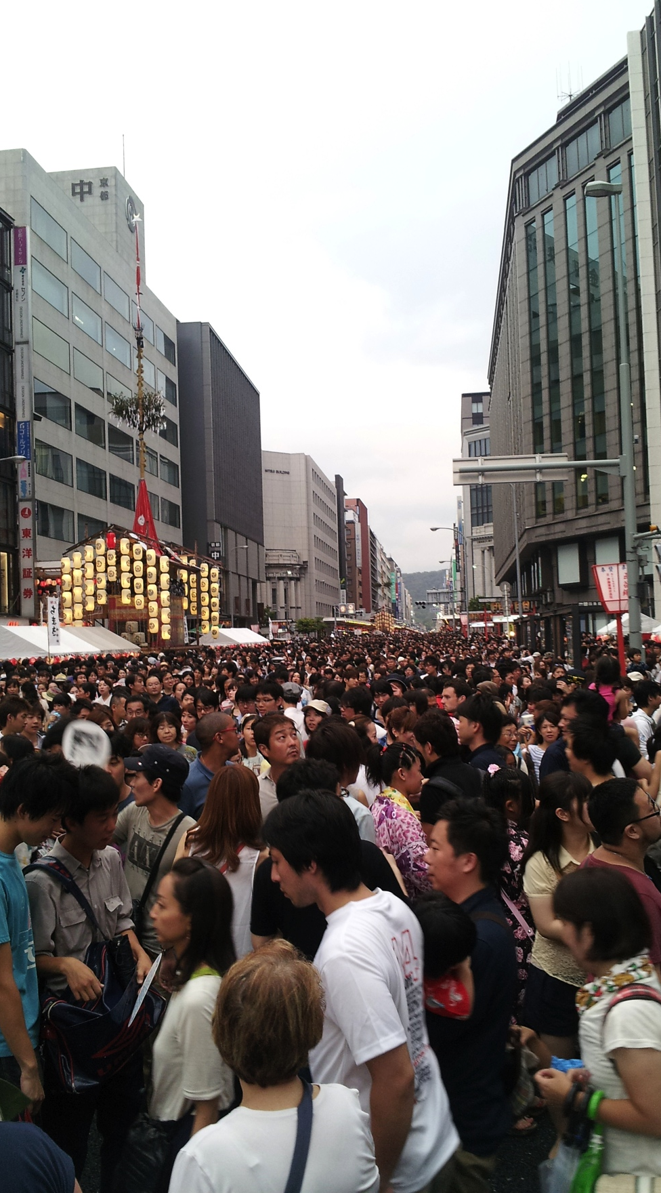
Cultural Exploration 2
Gion Festival in Kyoto. So many people.

Slide 6
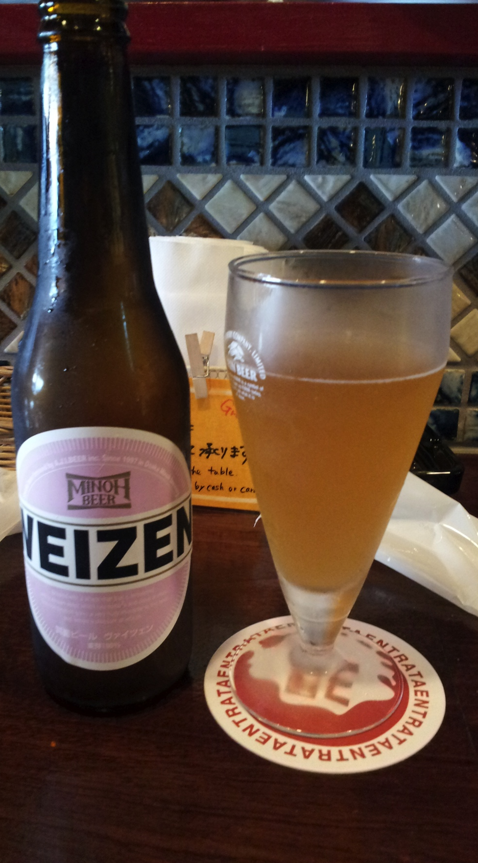
Cultural Exploration 3
Beer from the local brewery.
Tourist trap. They charged us
a fee that we had no idea what
it was for.

Slide 7
Acknowledgement
Dr. Jason Haga
Dr. Shinji Shimojo
PRIME
NICT
Balboa Park Online Collaboration
PRIME alumna Haley Hunter-Zinck
NSF

