Slide 1
Jesus Rios
Japanese Friendship Garden Mobile Tour
7/17/2013
VisLab Osaka, Japan

Slide 2
Progress Update
Implemented Android “Up” button functionality across app
Added Map UI screen to app
Tweaked the detailed information Riddle UI screen

Slide 3
Next week’s plan
Set up PlaceStickers with app for initial testing
More UI tweaks (Need to make sure it looks good!)
Revise PlaceSticker app integration

Slide 4
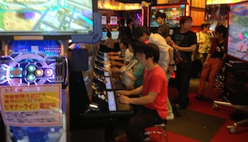
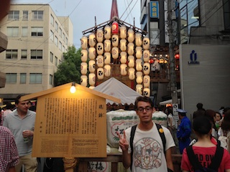
Arcade! Everyone was playing a multiplayer Gundam game
Festival float!!

Slide 5
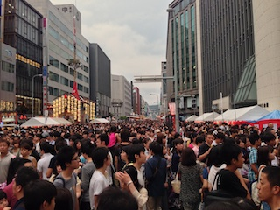
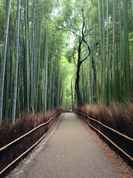
Really packed festival! Could hardly get around…
Bamboo forest in Kyoto. Beautiful scenery

Slide 6
Acknowledgements
University of California, San Diego (UCSD)
Dr. Jason Haga
Dr. Peter Arzberger
Dr. Gabriele Wienhausen
Teri Simas
National Institute of Information and Technology (NICT)
Dr. Shinji Shimojo
Takata Tomoaki
Balboa Park Online Collaborative (BPOC)
Vivian Haga
Christina DePaolo
Japanese Friendship Garden
Marisa Espinosa
Luanne Kanzawa
Information Services International – Densu Ltd. (iSiD)
PRIME alumna Haley Hunter-Zinck
National Science Foundation (NSF)

