Slide 1
Jesus Rios
Japanese Friendship Garden Mobile Tour
7/24/2013
VisLab Osaka, Japan

Slide 2
Progress Update
UI Home screen adjustments
(Fixed image placements and borders in between)
Changed app icon
(Created a new icon using Japanese Friendship Logo)
Added Riddle information and formatted text across different pages
Tested PlaceSticker distance and changed signal sensitivity on PlaceSticker detection

Slide 3
Next week’s plan
Adapt UI to work with multiple screen sizes
Add and format missing map image
Create/find icons for the rest of the pages
Create missing pages, Credits and Coupons
More PlaceSticker testing

Slide 4
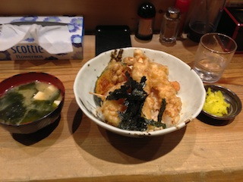
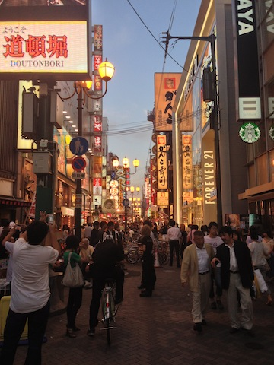
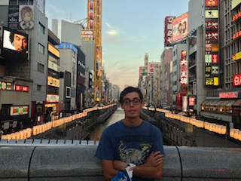

Slide 5
Acknowledgements
University of California, San Diego (UCSD)
Dr. Jason Haga
Dr. Peter Arzberger
Dr. Gabriele Wienhausen
Teri Simas
National Institute of Information and Technology (NICT)
Dr. Shinji Shimojo
Takata Tomoaki
Balboa Park Online Collaborative (BPOC)
Vivian Haga
Christina DePaolo
Japanese Friendship Garden
Marisa Espinosa
Luanne Kanzawa
Information Services International – Densu Ltd. (iSiD)
PRIME alumna Haley Hunter-Zinck
National Science Foundation (NSF)

