Slide 1
Jesus Rios
Japanese Friendship Garden Mobile Tour
8/8/2013
VisLab Osaka, Japan

Slide 2
Progress Update
Map of the Garden added to the app
Additional Info page for when the user solves a Riddle added
Added phone feedback (vibration)
Formatted individual Riddle’s haiku text
Demo testing in lab (No problems encountered)

Slide 3
Next week’s plan
Standardize all text (make it pretty)
Include “Help” information to assist the user with navigating through the app
Add music clip to each stop (Ambient noises that can help the user locate the Riddle)
Visual feedback when a user solves a riddle (animations)
Add Sumi-e art paintings and their credits to the app

Slide 4
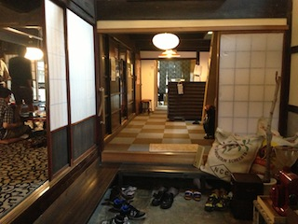
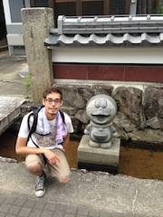
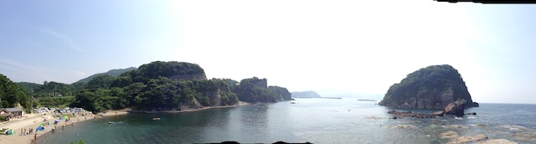

Slide 5
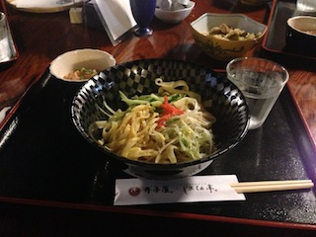
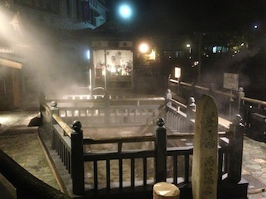

Slide 6
Acknowledgements
University of California, San Diego (UCSD)
Dr. Gabriele Wienhausen
Dr. Jason Haga
Dr. Peter Arzberger
Teri Simas
National Institute of Information and Technology (NICT)
Dr. Shinji Shimojo
Takata Tomoaki
Balboa Park Online Collaborative (BPOC)
Vivian Haga
Christina DePaolo
Wesley Hsu
Japanese Friendship Garden
Marisa Espinosa
Marisa Takeuchi
Luanne Kanzawa
Information Services International – Densu Ltd. (iSiD)
PRIME alumna Haley Hunter-Zinck
National Science Foundation (NSF)

