Slide 1
Configuration and Deployment of a scalable virtual machine cluster for molecular docking
Nara Institute of Science and Technology, Nara Prefecture, Japan
Karen Rodriguez
7/10/2013

Slide 2
Overview
Virtual machines (VMs) have been observed to yield molecular docking results that are far more consistent than those obtained from a grid configuration.
Inhomogeneous results obtained from a grid are thought to be due to physical differences in the cluster’s components. This is eliminated by creating and networking cloned VMs.
This study’s objectives consist of constructing a clustered VM environment that is scalable according to job demand and which yields consistent dock results.
This system is to be tested, packaged, and deployed on the PRAGMA grid. This will provide sufficient computing resources to perform a full-scale docking project of large protein databases.

Slide 3
Week 2:
Fixed dock-install issues.
Dealt with network issues with the help of Ichikawa-sensei.
Due to unforeseen storage issues, had to wipe the lab computer and reinstall OS, KVM but backed up VMs such that we wouldn’t have to start from scratch.
Added a fifth VM and designated it as the master node; others are slaves.
MPI is up and running, host machine is able to SSH log into slave nodes without password prompt.

Slide 4
Future Plans
MPI appears to run grid-based dock, but we are not sure yet because nothing happens. Need to modify scripts to make sure that the correct inputs are being used and try to get some feedback from this process.
Run a dock test run on virtual cluster, compare results with those obtained from running the same protein on PRAGMA clusters.
Look into documents provided by Ichikawa-sensei on cluster packaging and uploading to NAIST server.

Slide 5



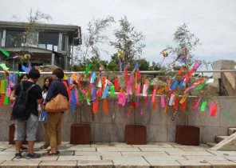
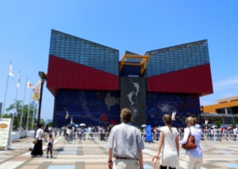



This Week: Osaka!

Slide 6
Acknowledgments
Mentors
Dr. Jason Haga, UC San Diego Bioengineering
Dr. Kohei Ichikawa, Nara Institute of Science and Technology
UCSD PRIME Program
Teri Simas
Jim Galvin
Dr. Gabrielle Wienhausen
Dr. Peter Arzberger
Tricia Taylor
Funding
NAIST
Japanese Student Services Organization (JASSO)
PRIME
PRIME alumna Haley Hunter-Zinck
National Science Foundation

