Slide 1
Configuration and Deployment of a scalable virtual machine cluster for molecular docking
Nara Institute of Science and Technology, Nara Prefecture, Japan
Karen Rodriguez
7/24/2013

Slide 2
Overview
Virtual machines (VMs) have been observed to yield molecular docking results that are far more consistent than those obtained from a grid configuration.
Inhomogeneous results obtained from a grid are thought to be due to physical differences in the cluster’s components. This is eliminated by creating and networking cloned VMs.
This study’s objectives consist of constructing a clustered VM environment that is scalable according to job demand and which yields consistent dock results.
This system is to be tested, packaged, and deployed on the PRAGMA grid. This will provide sufficient computing resources to perform a full-scale docking project of large protein databases.

Slide 3
Week 4:
Enabled MPICH (an MPI-based application necessary for job distribution to nodes) on master and slave VMs. Performed necessary configurations for proper execution.
Tested MPICH+Dock job runs; all jobs were distributed as desired, output automatically compiled, and results were not found to be different from MPI+Dock or Dock-alone test runs.
Dock 6.4 was installed and tested. Results were compared to developer’s scores from the Dock Test Suite (using Dock 5) and last week’s results (using Dock 6.2).
Not much of a difference between 6.4 and 6.2, but both differ similarly from 5.
Tested an older version of the Dock Test Suite’s results against those published in Grid Heterogeneity in In-silico Experiments: An Exploration of Drug Screening Using DOCK on Cloud Environments (Yim et al.)

Slide 4
Future Plans
Have yet to find a firewall configuration that will allow MPICH to run (have done without for now).
Need to verify that results with current gcc compiler version are accurate enough for our purposes. If not, will need to downgrade operating system and compiler.
Once dock results are as desired, cluster will be packaged into an image that we can upload to the local (NAIST) server.
Implementation of Amazon elastic cloud service will follow in order to make cluster scalable according to demand.

Slide 5


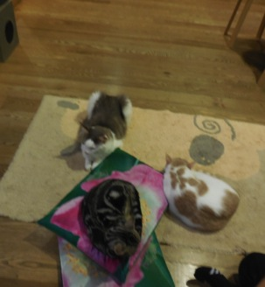

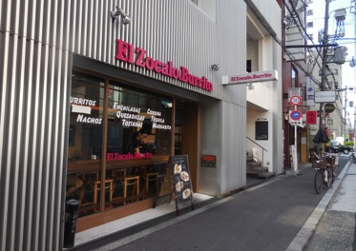
Osaka 2.0

Slide 6
Acknowledgments
Mentors
Dr. Jason Haga, UC San Diego Bioengineering
Dr. Kohei Ichikawa, Nara Institute of Science and Technology
UCSD PRIME Program
Teri Simas
Jim Galvin
Dr. Gabrielle Wienhausen
Dr. Peter Arzberger
Tricia Taylor
Funding
NAIST
Japanese Student Services Organization (JASSO)
PRIME
PRIME alumna Haley Hunter-Zinck
National Science Foundation

