Slide 1
Configuration and Deployment of a scalable virtual machine cluster for molecular docking
Nara Institute of Science and Technology, Nara Prefecture, Japan
Karen Rodriguez
8/7/2013

Slide 2
Overview
Virtual machines (VMs) have been observed to yield molecular docking results that are far more consistent than those obtained from a grid configuration.
Inhomogeneous results obtained from a grid are thought to be due to physical differences in the cluster’s components. This is eliminated by creating and networking cloned VMs.
This study’s objectives consist of constructing a clustered VM environment that is scalable according to job demand and which yields consistent dock results.
This system is to be tested, packaged, and deployed on the PRAGMA grid. This will provide sufficient computing resources to perform a full-scale docking project of large protein databases.

Slide 3
Week 6:
Continued working with PRAGMA administration to upload VM (CentOS 5.9, gcc 4.1.2, Dock 6.2). However, some problems may arise because this is a 32-bit machine & OS. Most VM’s on PRAGMA are 64-bit.
Since we are not sure if this will work, built another VM (Sailboat) with the same configurations, but in 64-bit OS and architecture. However Sailboat does not work as expected, as Dock test scores do not match and MPICH cannot be enabled due to missing parts of compiled library.
Another option was to build a VM (Master) with CentOS 5.9, gcc 4.1.2, and Dock 6.2. It has a 64-bit structure (to fit PRAGMA standards) but 32-bit OS (to match correct test scores). Test scores seem to be just as accurate the machines we originally wanted to use; this is the primary backup if those do not work.
CentOS5 scores (with Dock 6.6) seem to match developer’s scores but we are not too sure about docking outputs viewed on Chimera. This will be a second alternative if it can be figured out.

Slide 4
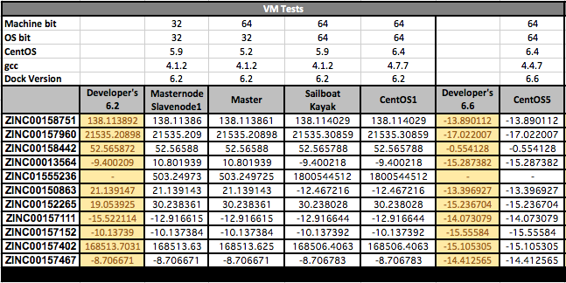
Week 6:
Table of docking Results: Machine bit does not seem to make as much of a difference as OS bit. Masternode and Slavenode1 are currently being processed for uploading to PRAGMA. Master and CentOS5 are backups should the 32-bit VMs not work.

Slide 5
Future Plans
Continue working with PRAGMA administration to upload Masternode and Slavenode1 (32-bit OS on 32-bit machines).
Virtual machine images have been provided. Now we are waiting until they can be uploaded to Gfarm pool.
Once the images have been uploaded, they need to be retrieved at their respective sites. This will be done initially with a deployment script similar to those published on the PRAGMA wiki, and the process will be customized as needed in consultation with administrators of remote clusters.
Masternode will be moved to the Rocks cluster such that the network can be controlled from the server in San Diego. Slavenode copies will be distributed to remote clusters that can support KVM.
Machines will be networked utilizing VPN’s N2N service.

Slide 6
Acknowledgments
Mentors
Dr. Jason Haga, UC San Diego Bioengineering
Dr. Kohei Ichikawa, Nara Institute of Science and Technology
UCSD PRIME Program
Teri Simas
Jim Galvin
Dr. Gabrielle Wienhausen
Dr. Peter Arzberger
Tricia Taylor
Funding
NAIST
Japanese Student Services Organization (JASSO)
PRIME
PRIME alumna Haley Hunter-Zinck
National Science Foundation

