Slide 1
Sensor Pod Configuration at TFRI with PRIME Week 7
Thaddeus Trinh
August 14, 2013

Slide 2
Proposed Research
To work with TFRI to help integrate new sensors into their Android sensor pod network and to deploy and test the new sensors in the field
Fuel Moisture Sensor
Solar Irradiation Sensor
Soil Moisture Sensor
Soil Drainage Gauge

Slide 3
CTD
The CTD sensor’s connectivity issues have been resolved and the CTD has been tested in the field and is working properly
Many small problems with the CTD had to be resolved
The sensor would not work with anything less than 12V, the battery being used had a little less than 12V from being used so often, the sensor is supposed to work with 5-12V though
The translators RS232 port and the RS232 shifter on the board were both female connectors, so just using a male to male gender changer would not connect them properly, doing this would connect the receive ends to each other and the transmit ends to each other, we needed to make a custom gender changer
Two of the boards that we were using to test the sensors had ports that were soldered incorrectly, so no power was being supplied

Slide 4
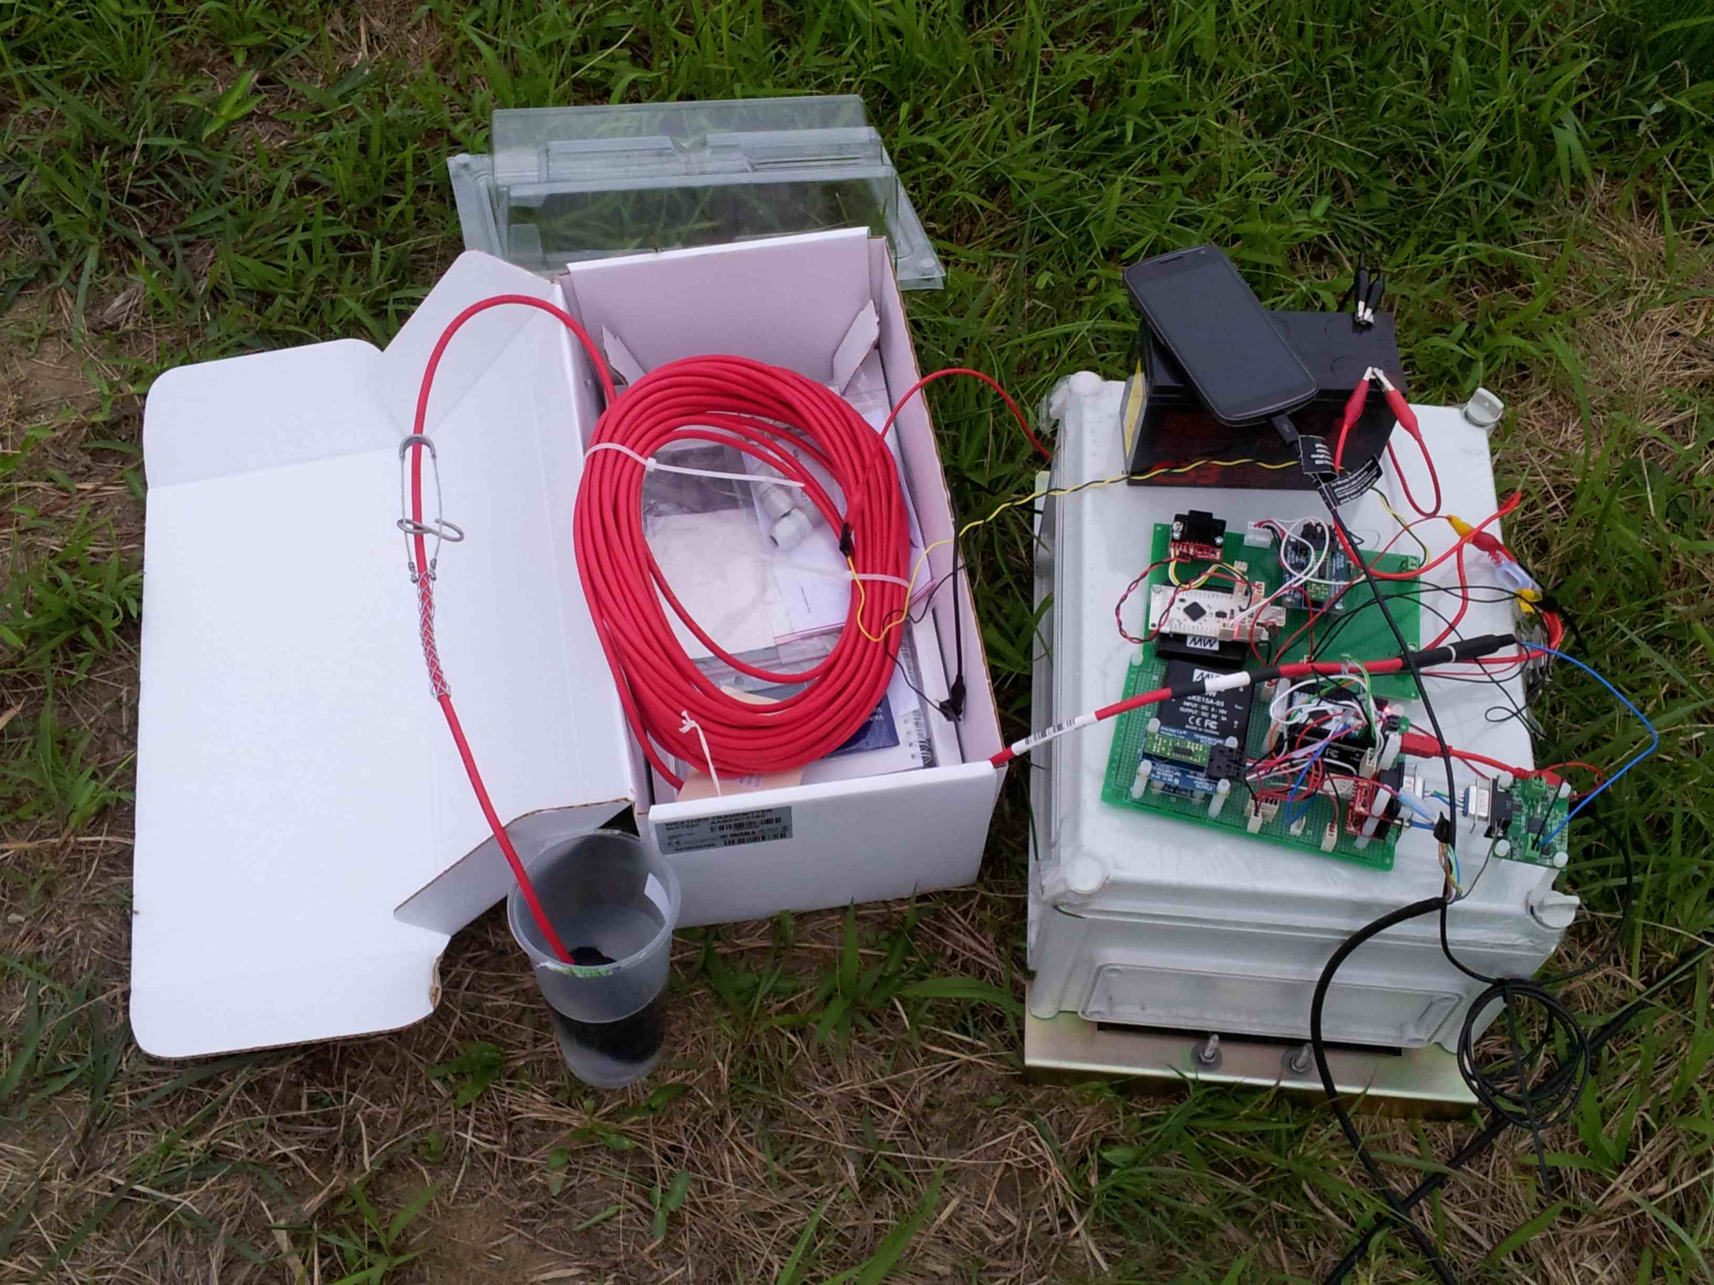
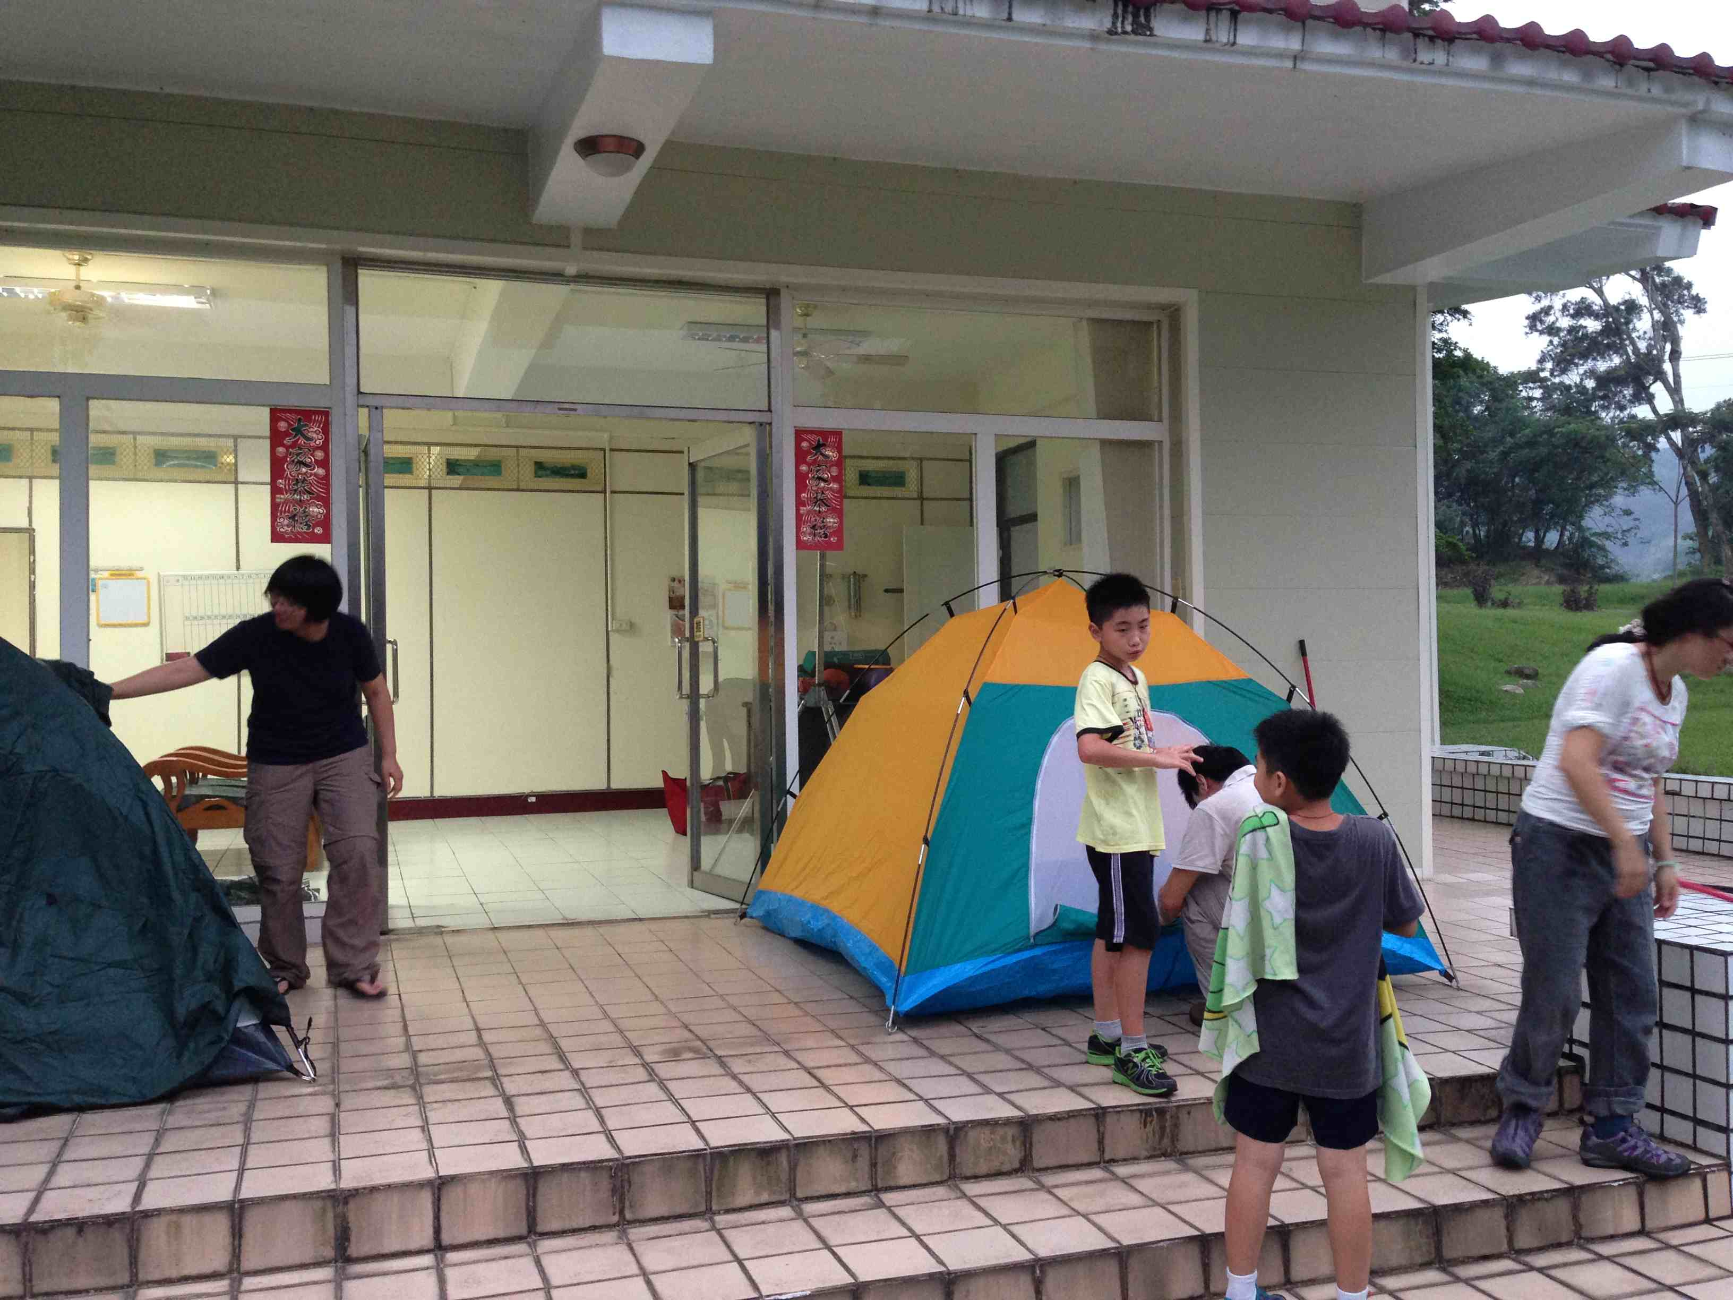
Testing CTD in the Field
L: Field sensor board set up testing R: Camping at the research facility steps

Slide 5
Plans for Next Week
FTS Fuel Stick
The LT1168 thermistor reader should be arriving
Test connecting it to the board, once that is working properly the Fuel Stick should be ready to go as I have already written the code
The LT1168 reads the resistance value of the thermistor, it gives a Voltage value to the IOIO board where we use an algorithm to convert the voltage value to a resistance, we then use the resistance value with the Steinhart-Hart Equation to evaluate temperature, finally we use the temperature in conjunction with the humidity to calculate the Fuel Stick Moisture

Slide 6
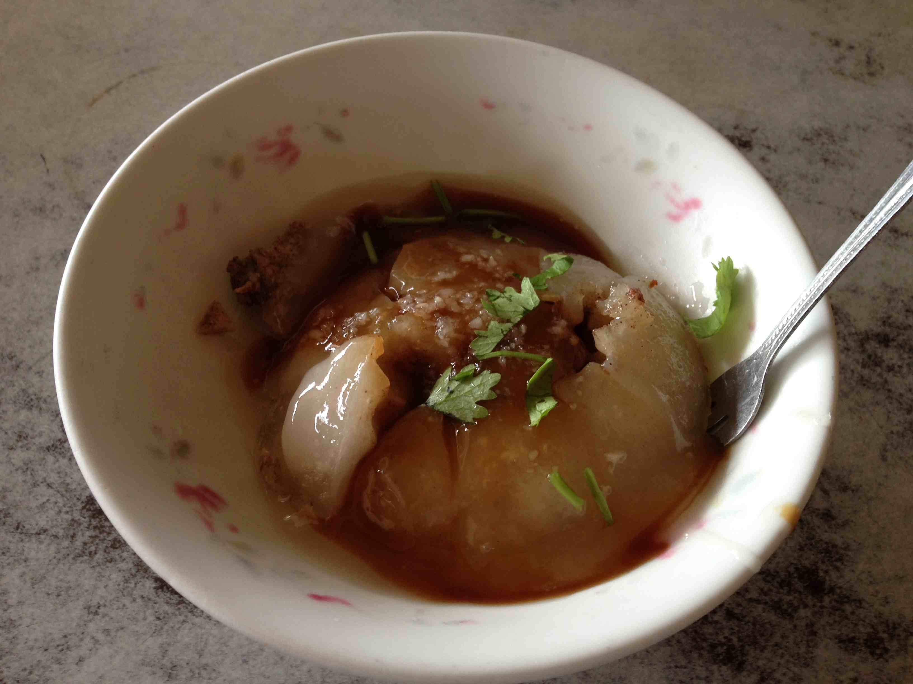
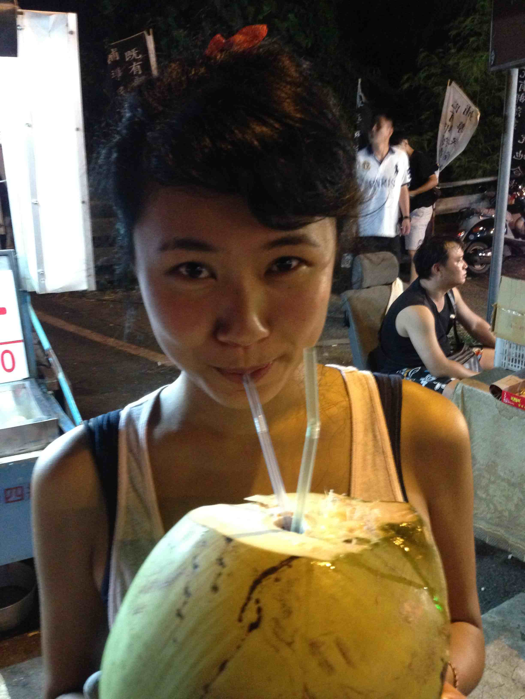
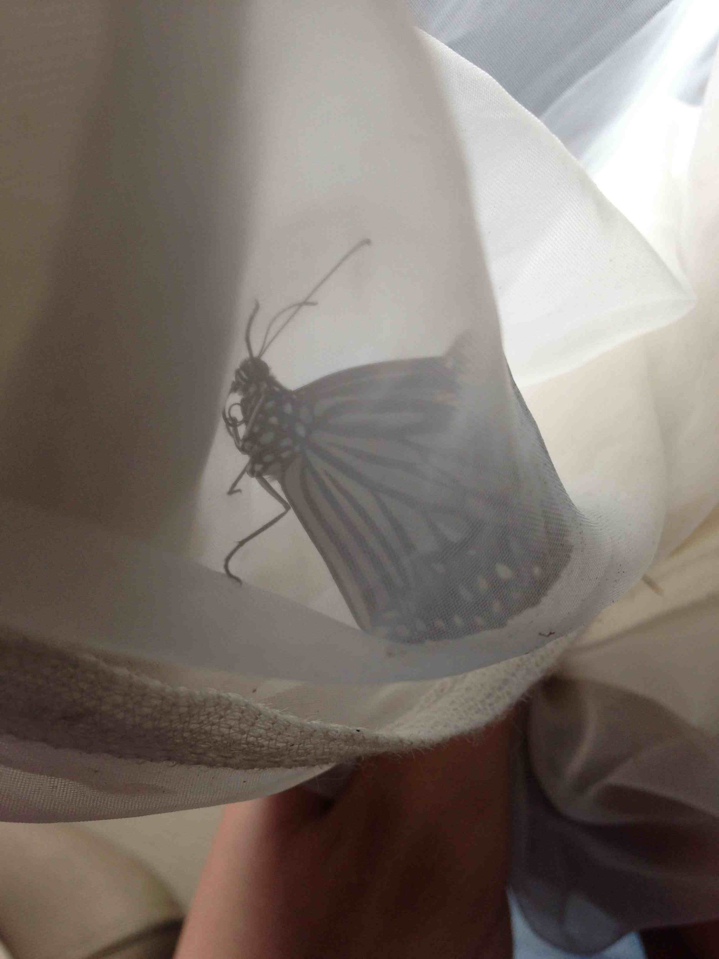
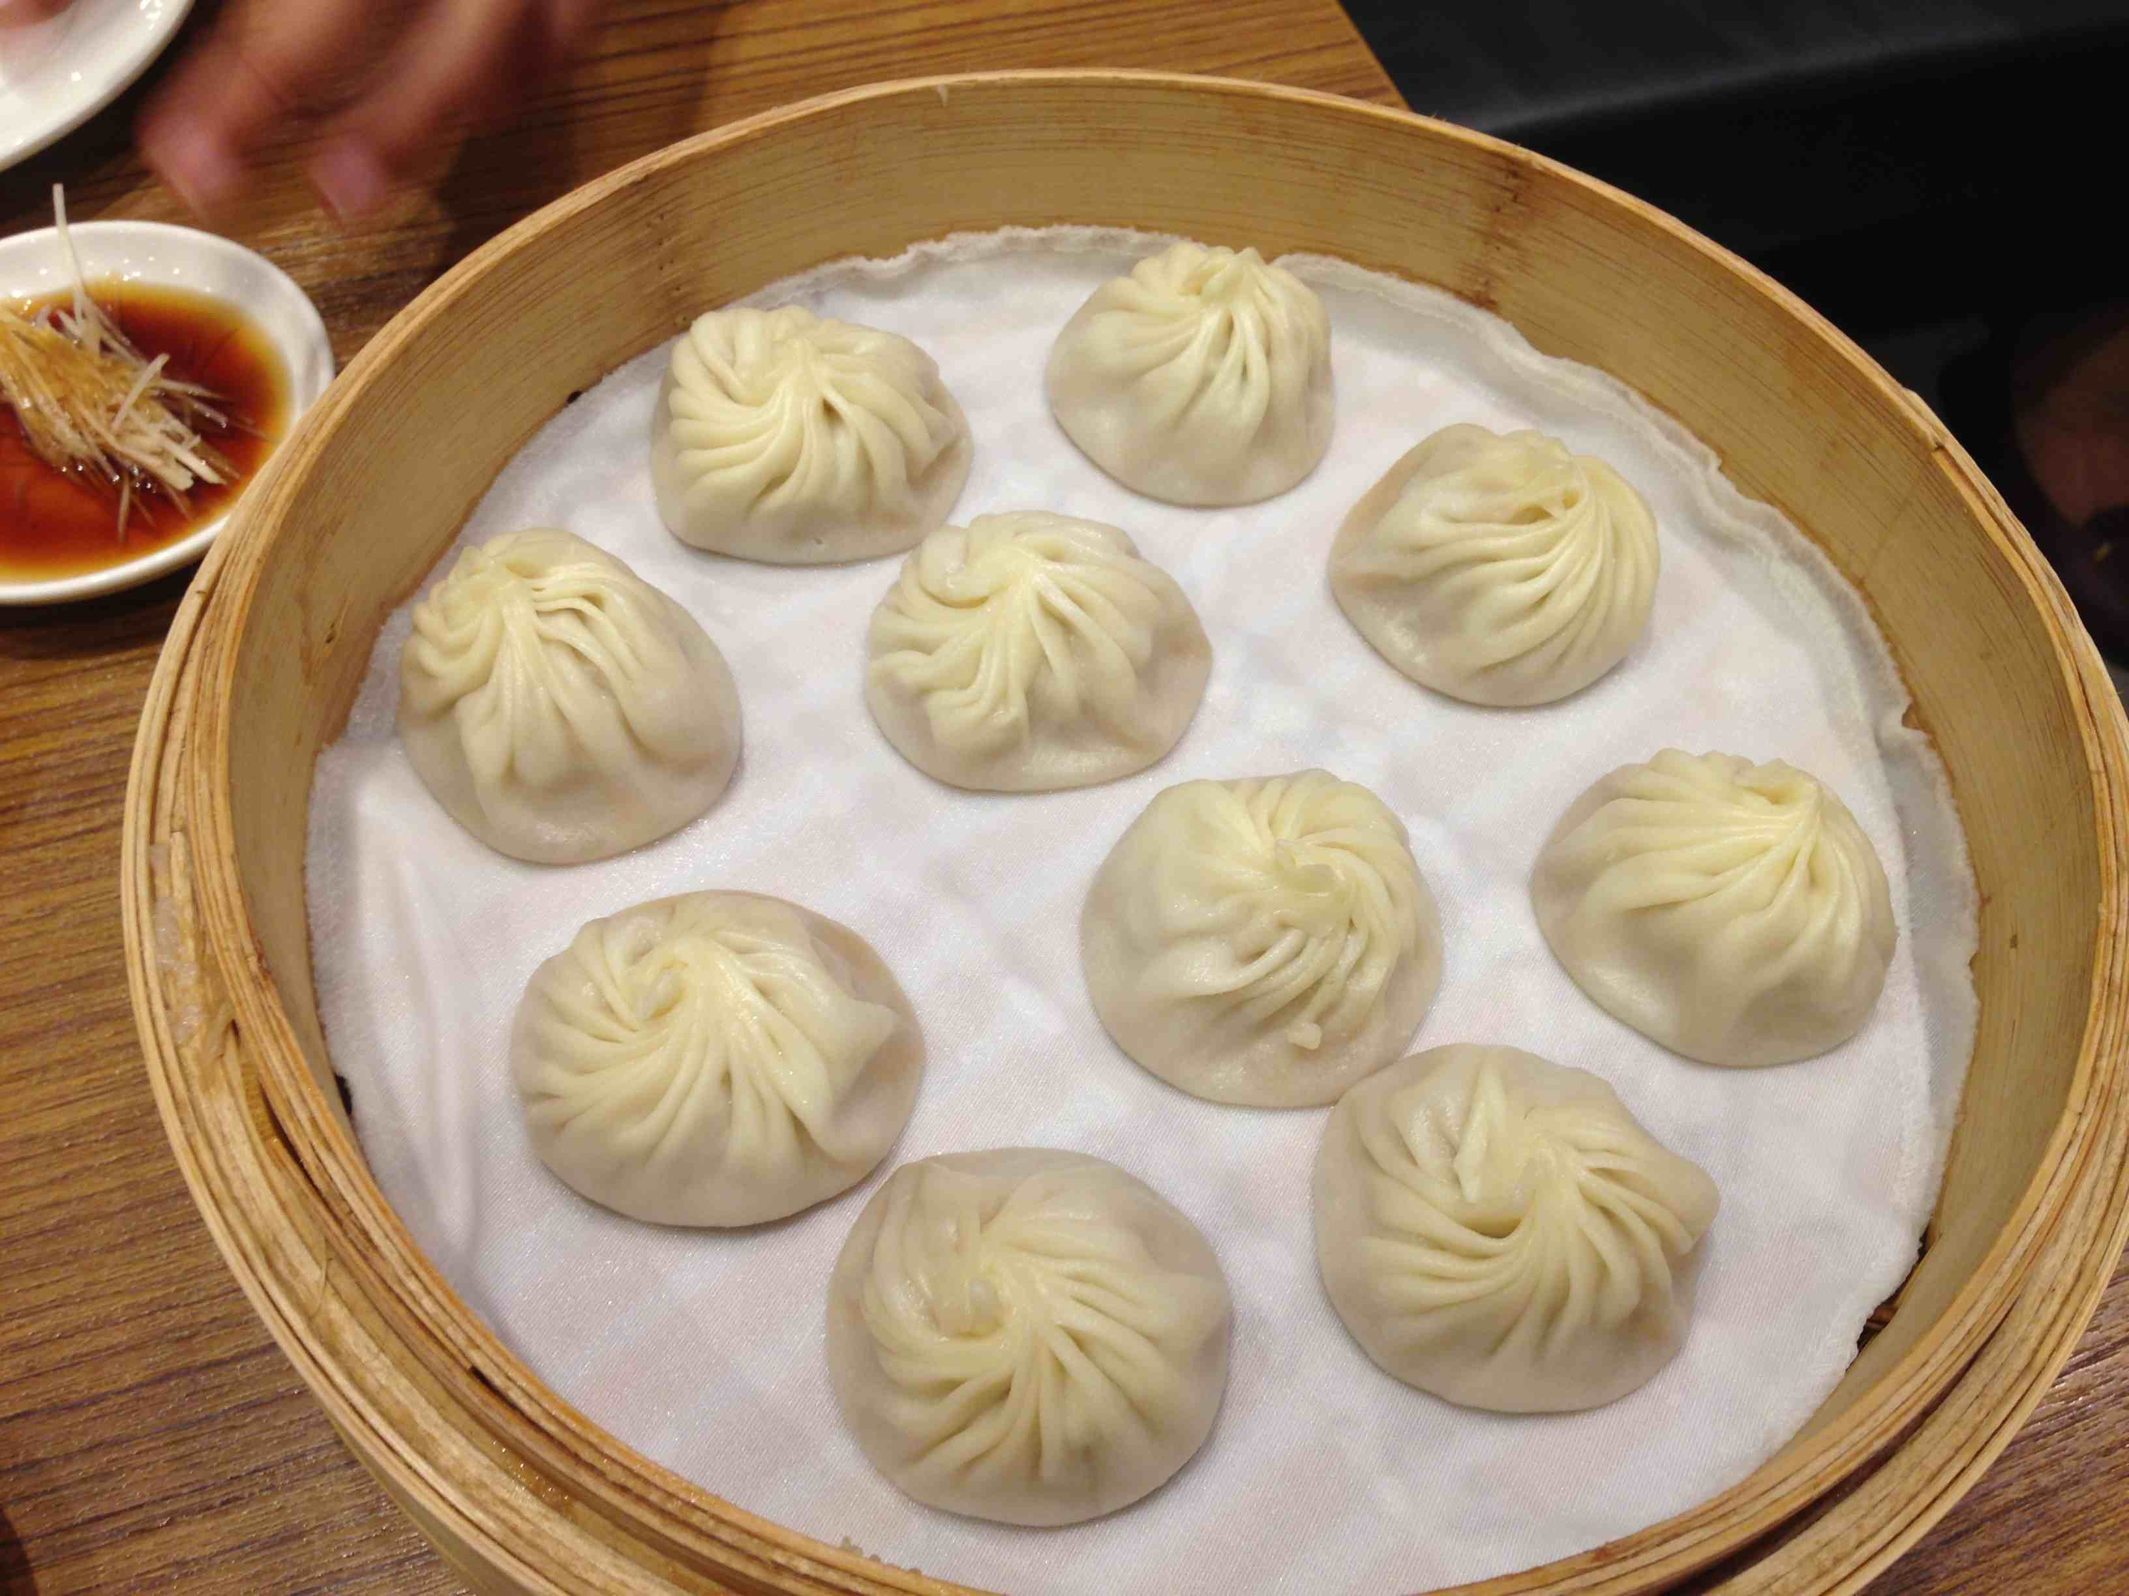
Culture
Top (L-R): Taiwanese meat ball, whole coconuts, catching butterflies in the field
Bottom: Eating Xiao Long Bao at Ding Tai Fung

Slide 7
Acknowledgements
PRIME
Gabriele Wienhausen
Peter Arzberger
Teri Simas
Tricia Taylor
Mentors
Tony Fountain (CALIT2)
Chau Chin Lin (TFRI)
Sheng-Shan Lu (TFRI)
Yu-Huang Wang (TFRI)
Peter Shin (CALIT2)

