Slide 1
Chronic Chagas Disease and Potential Natural Products
National Taiwan University
Hanne Inez Wolff
June 26th, 2013

Slide 2
Progress to Date
Read papers on crystal structures
Continued to screen TcTs crystal structures from the PDB in order to identify a good structure.
Have compared AutoDock Vina and AutoDock4 results. AutoDock4 might be a better docking tool than Vina, this might be due to the fact that Vina doesn’t consider electrostatic interactions in it’s calculations.
Have worked on a presentation which will be held tomorrow in our weekly group meetings. The presentation will be an overview of Chagas disease, my research, and a little about Denmark.

Slide 3
Next Week Goals
Identify a reasonable crystal structure and start docking Natural Products.
Perhaps explore the possibility that a secondary binding site exists on TcTS. If that’s the case, and a compound can bind to both pockets, then that will increase binding affinity drastically.
Continue to read articles.

Slide 4
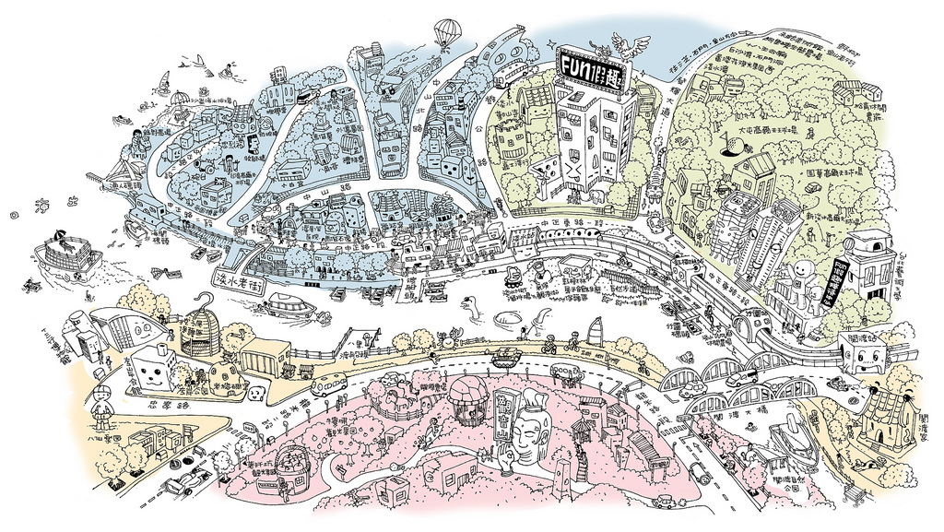
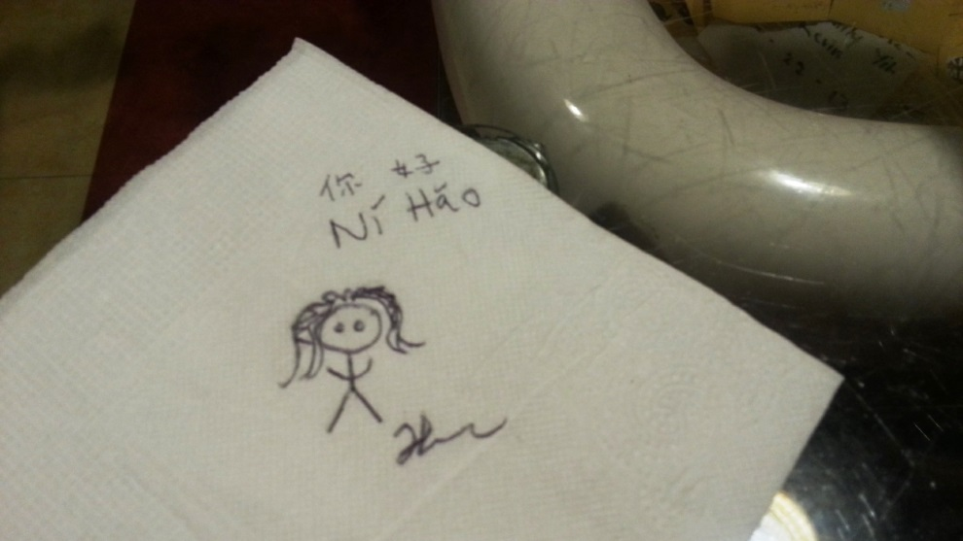
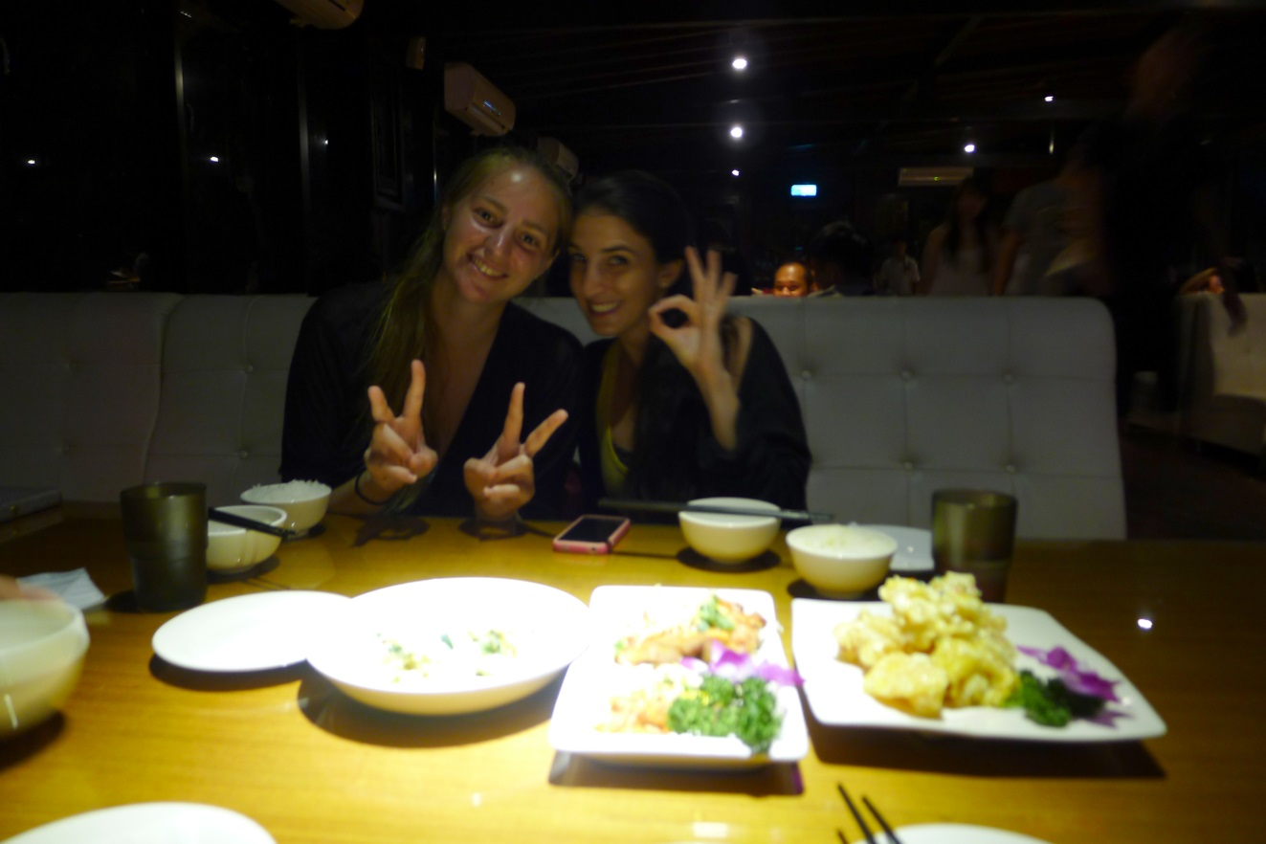

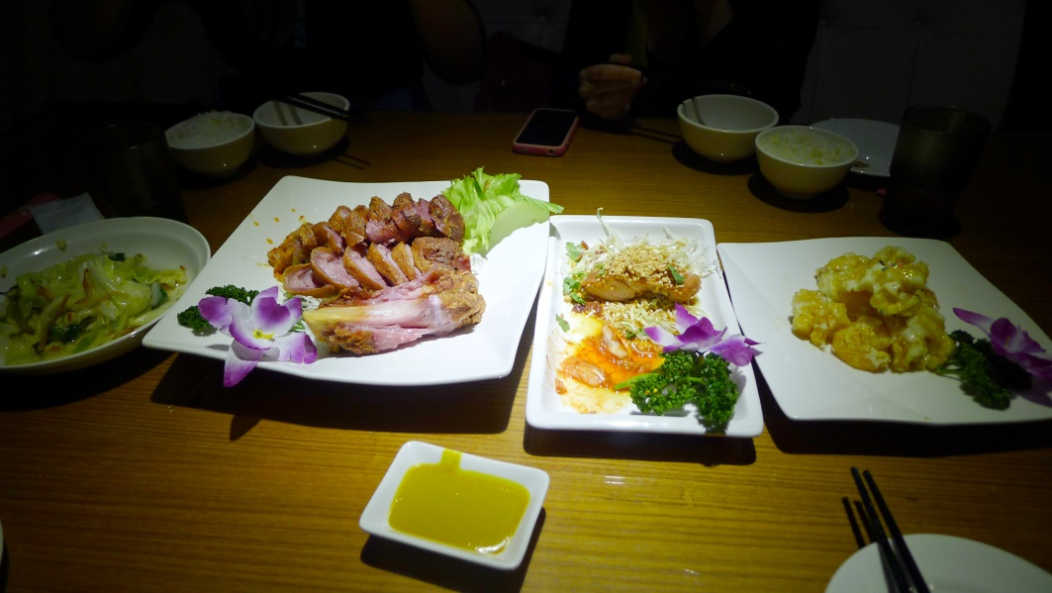
Cultural Aspect

Slide 5
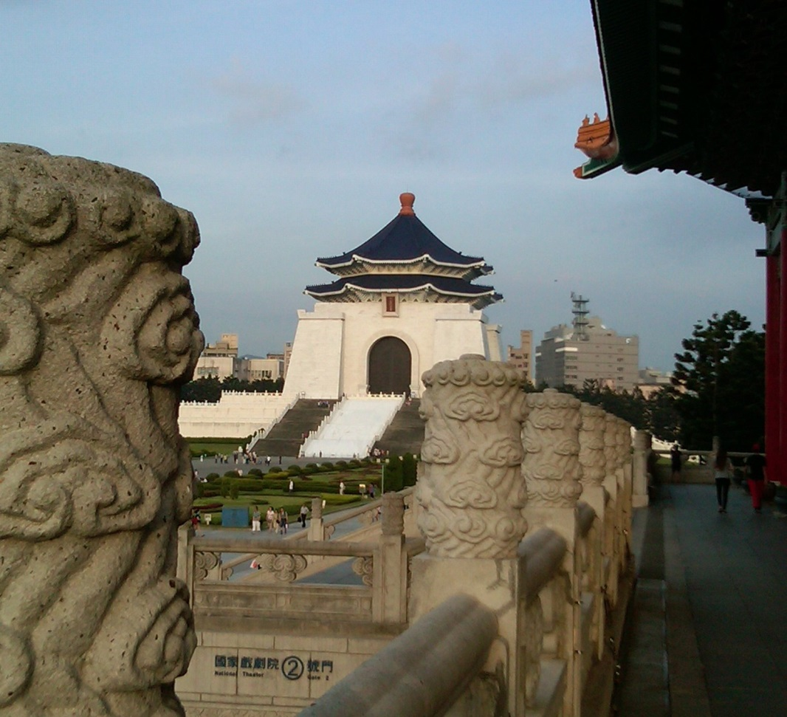
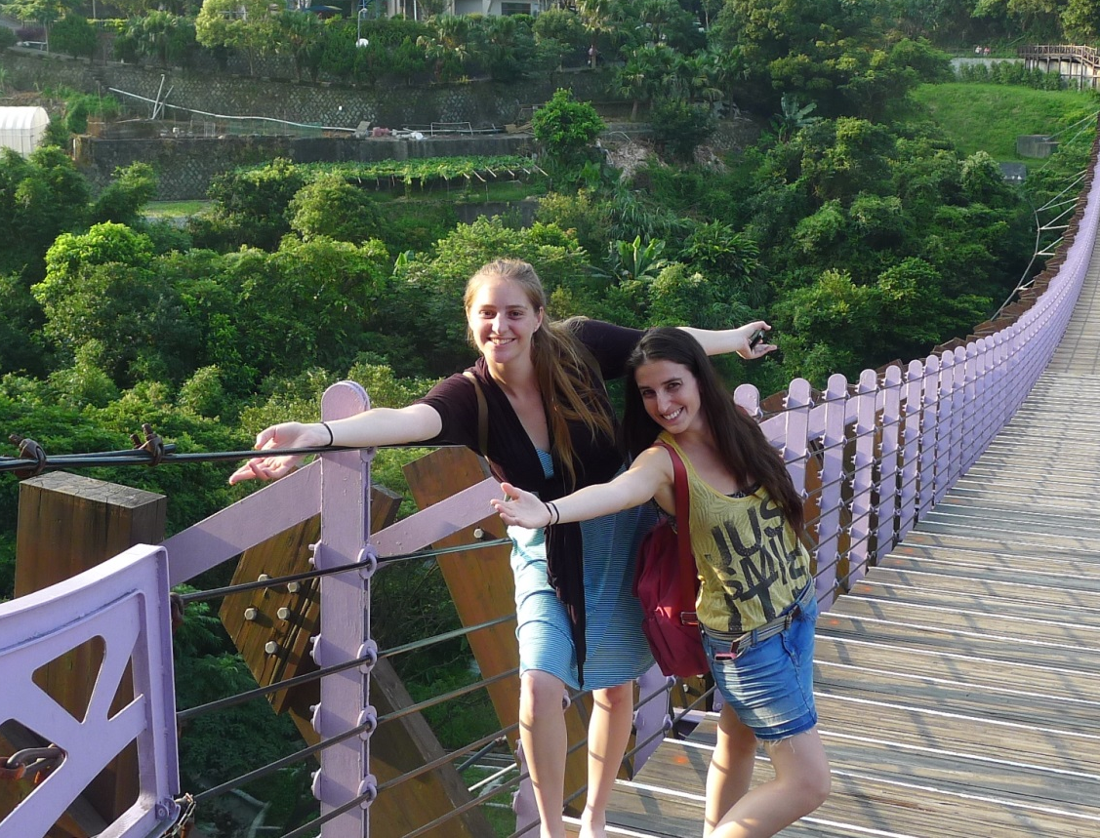

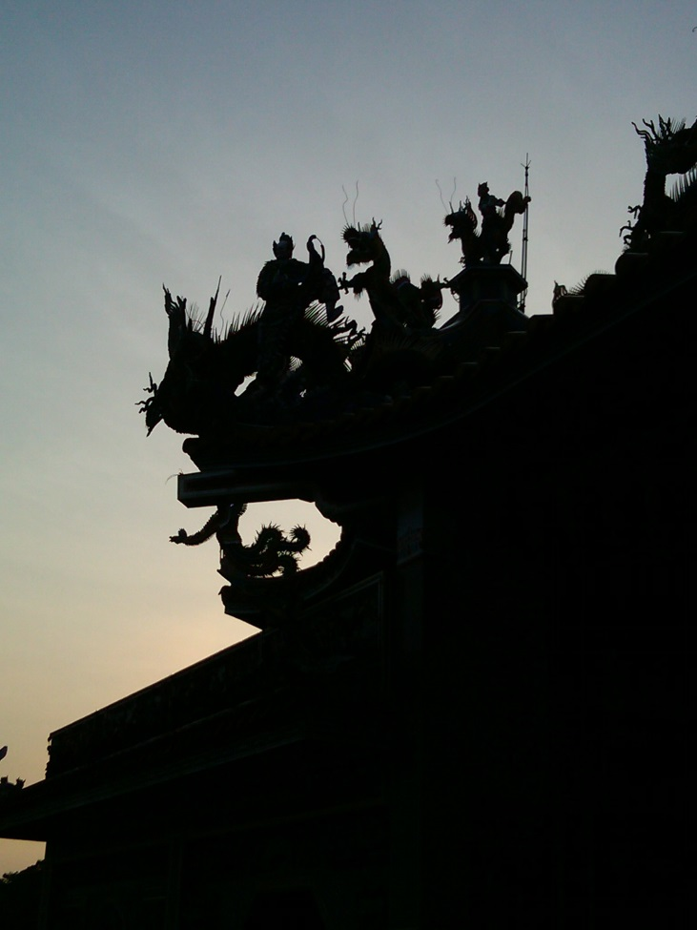
Cultural Aspect

