Slide 1
Chronic Chagas Disease and Potential Natural Products
National Taiwan University
Hanne Inez Wolff
July 10th, 2013

Slide 2
Progress to Date
Read articles
Identified a crystal structure to conduct docking on – 1S0J
Have begun to dock natural products to the 1S0J crystal structure.
Wrote a program that will rank the output from Vina in order of lowest binding affinity, and create a text file with the ranked outputs.

Slide 3
Next Week Goals
Finish Docking compounds.
Continue to read articles.

Slide 4
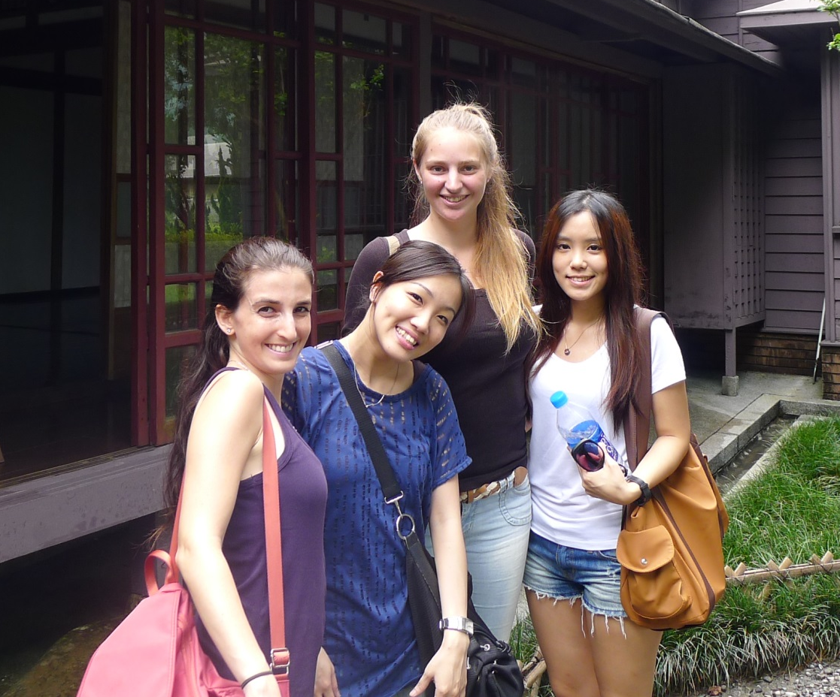
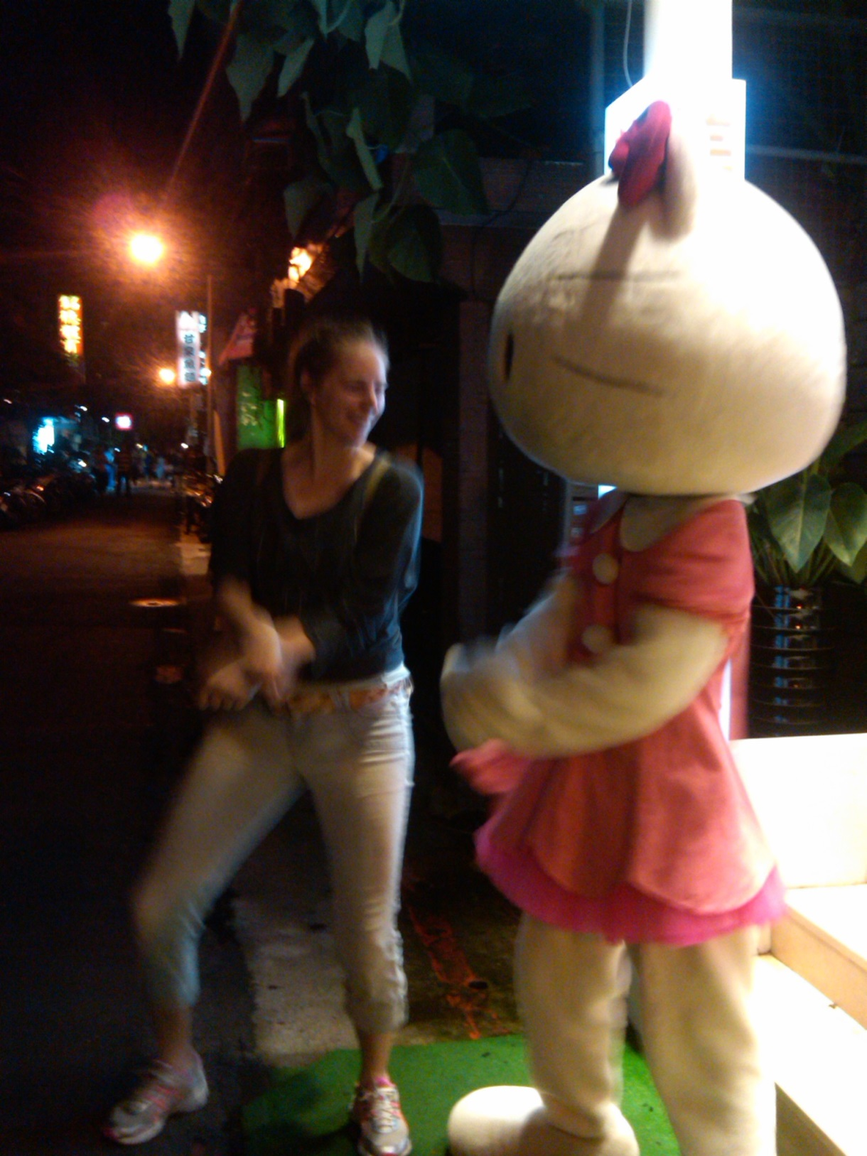
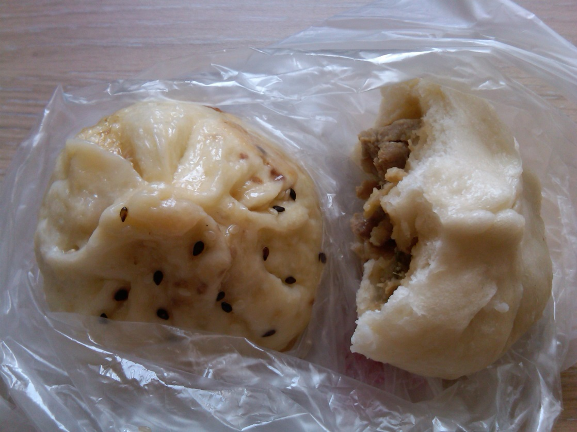
Cultural Aspect

Slide 5
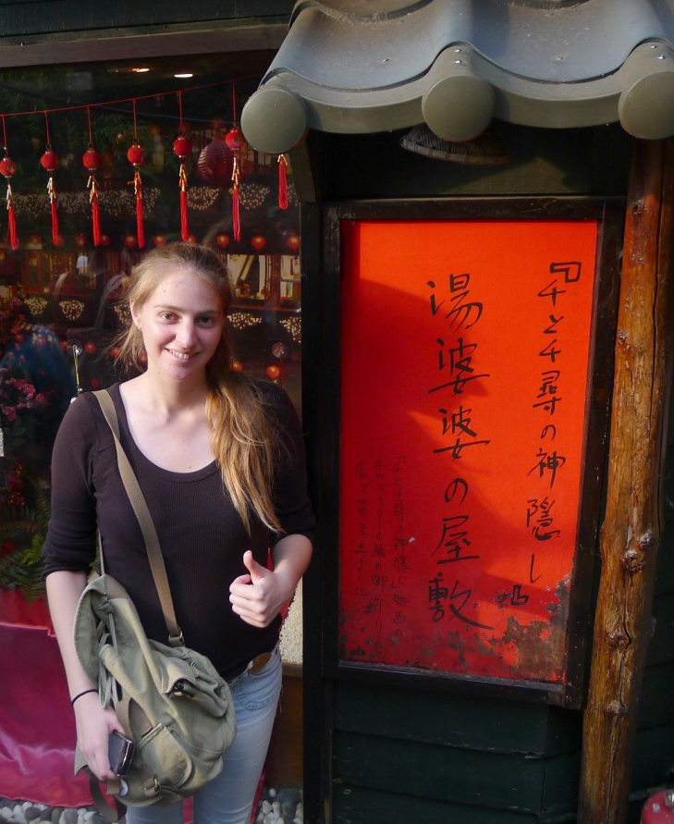
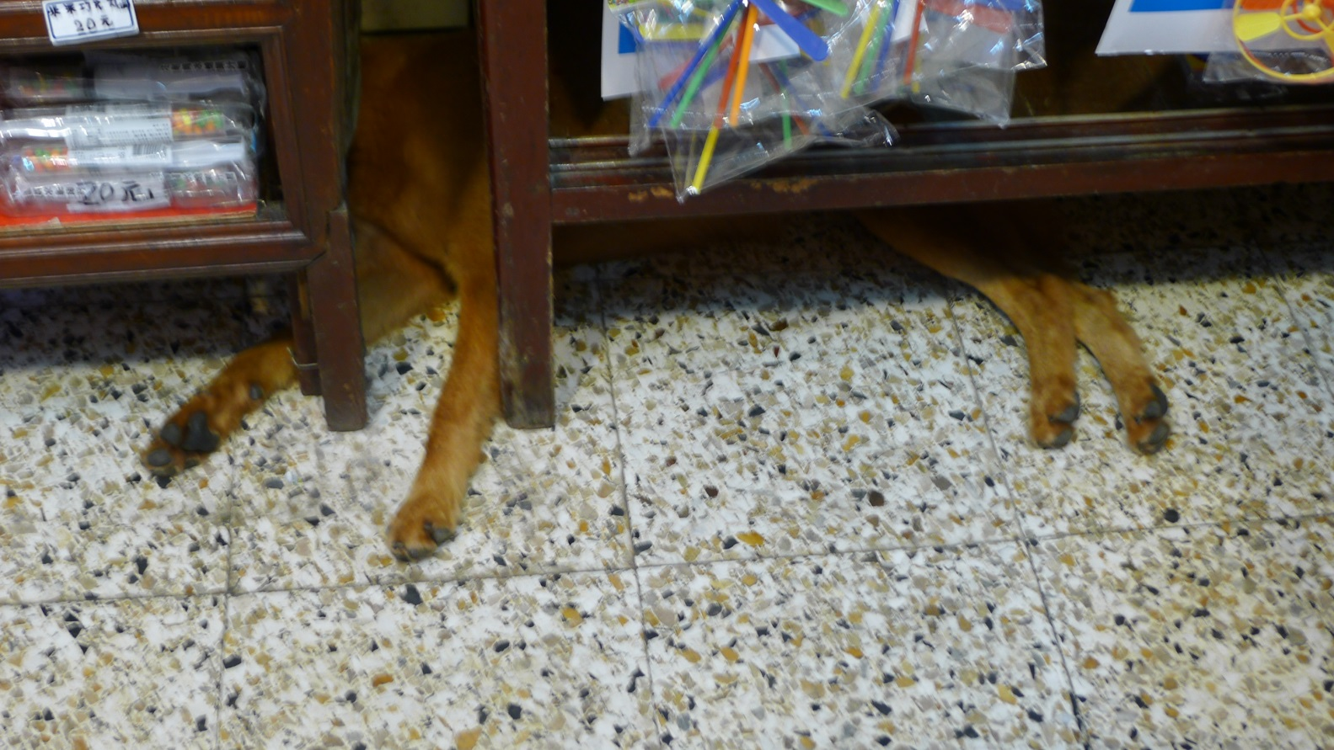
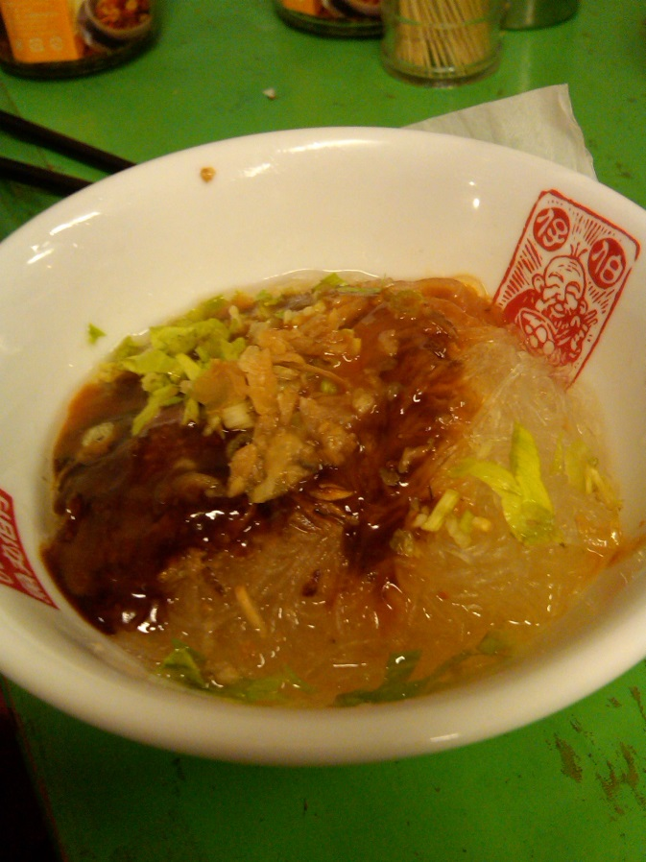
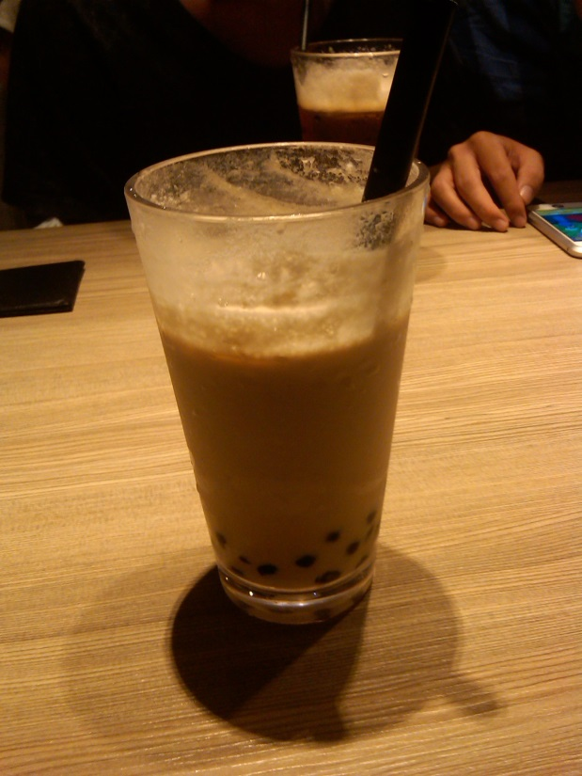
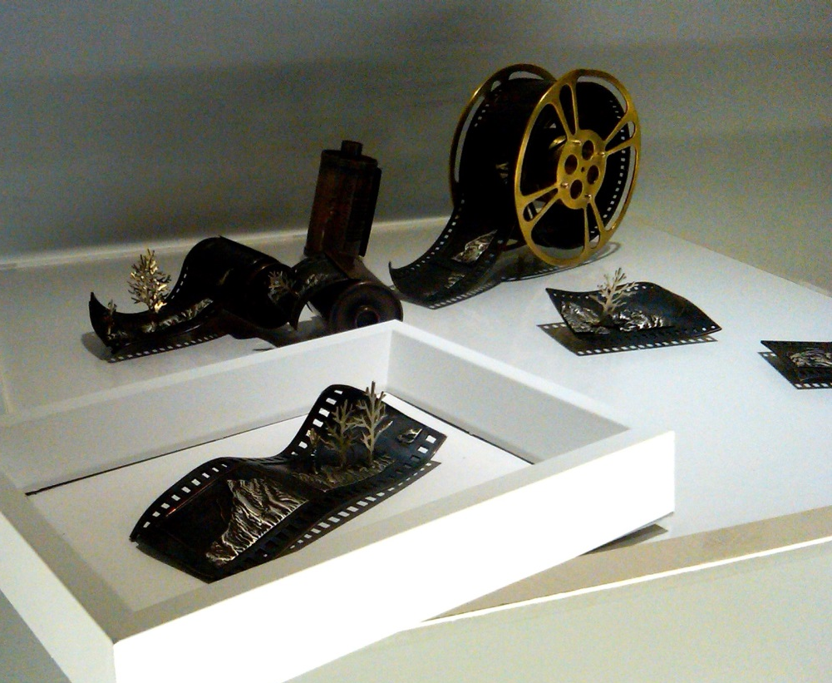
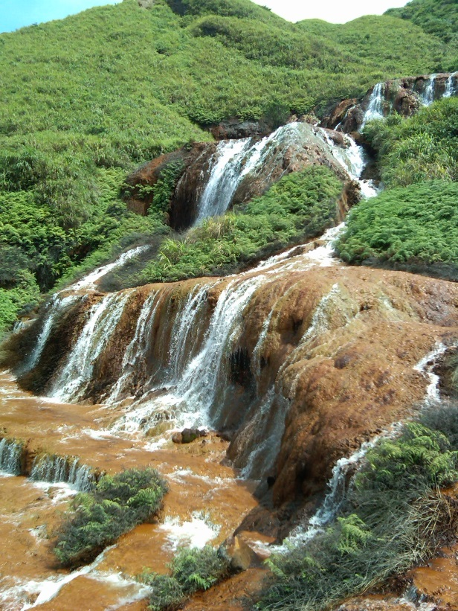
Cultural Aspect

Slide 6

Thanks to...
I would like to extend a thanks to..
Gabriele Wienhausen
Peter Arzberger
Dr. Phil Bourne
Dr. Jung-Hsin Lin
Chirag Krishna
Dr. Jung-Hsin Lin’s lab, and finally
Tosh Nomura Eureka! Foundation for making this trip possible

