Slide 1
Chronic Chagas Disease and Potential Natural Products
National Taiwan University
Hanne Inez Wolff
July 17th, 2013

Slide 2
Progress to Date
Continued to dock compounds despite the fact that some might be bad structures
Started to analyze the top ranking compounds
--------------------------------------------------------------------------------------------------------------
Rank File Name Binding Affinity
--------------------------------------------------------------------------------------------------------------
1 bisisodiospyrin_pg3_out.pdbqt -12.7
2 346_diacetoxy_pg35_out.pdbqt -12.6
3 188_Amentoflavone_pg19_out.pdbqt -12.2
4 623_pg63_out.pdbqt -11.9
5 186_Heveaflavone_pg19_out.pdbqt -11.8
6 187_PodocarpusflavoneA_pg19_out.pdbqt -11.8
7 154_TaiwanhomoflavoneB_pg16_out.pdbqt -11.7
8 189_dimethoxyAmentoflavone_pg19_out.pdbqt -11.7
9 425_22epiHippuristan11one_pg43_out.pdbqt -11.3
10 622_Pinocembrin_pg63_out.pdbqt -11.2

Slide 3
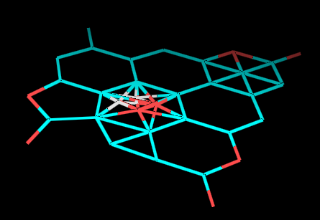
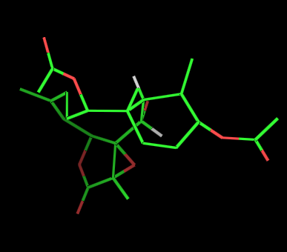
Questions Regarding #2
Structure directly converted from the Natural Product Database. Very flat.
Same structure, but redrawn using MarvinSketch. Here the structure appears to have a three dimensional structure.
NAME OF STRUCTURE: (#346 in database, located on page 35)
(1S*,2S*,5Z,7S*,8S*,9S*,10S*,11R*,12R*,13Z,17R*)-2,12-diacetoxy-8,17-epoxy-9-hydroxybriara-5,13-dien-18-one

Slide 4
Questions Regarding #2
This error indicates that there might be an issue with MarvinSketch converting the compounds from 2D to 3D, or
This problem could be linked back to the fact that some structures are erroneous in the database, and hopefully this will be resolved as soon as I get the updated compounds.
Or, the structure is actually flat, and the conversion is correct.
The dimensionality is vital to know, since it directly affects the binding affinity of the ligand to the protein.
If the structure is planar, then the affinity is -12.6 kcal/mol
Otherwise the structure has an affinity of -9.0 kcal/mol

Slide 5
Next Week Goals
I will have access to the corrected structures, and I will continue to dock natural products to ligand 1S0J.

Slide 6
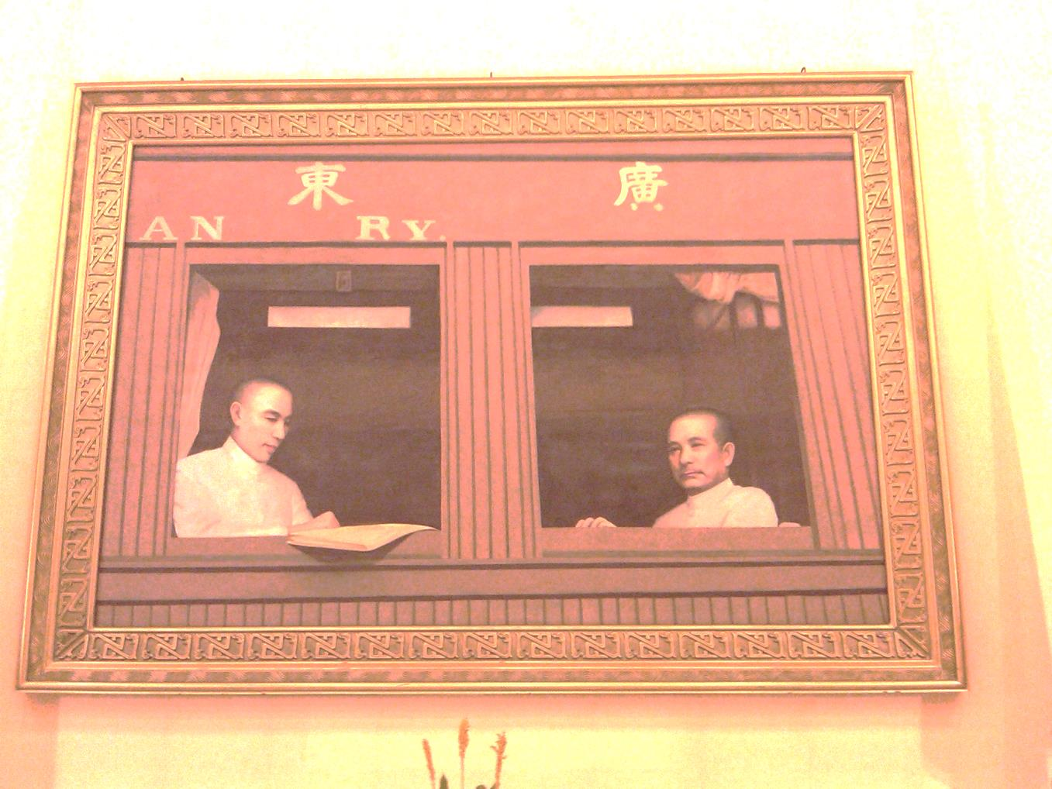
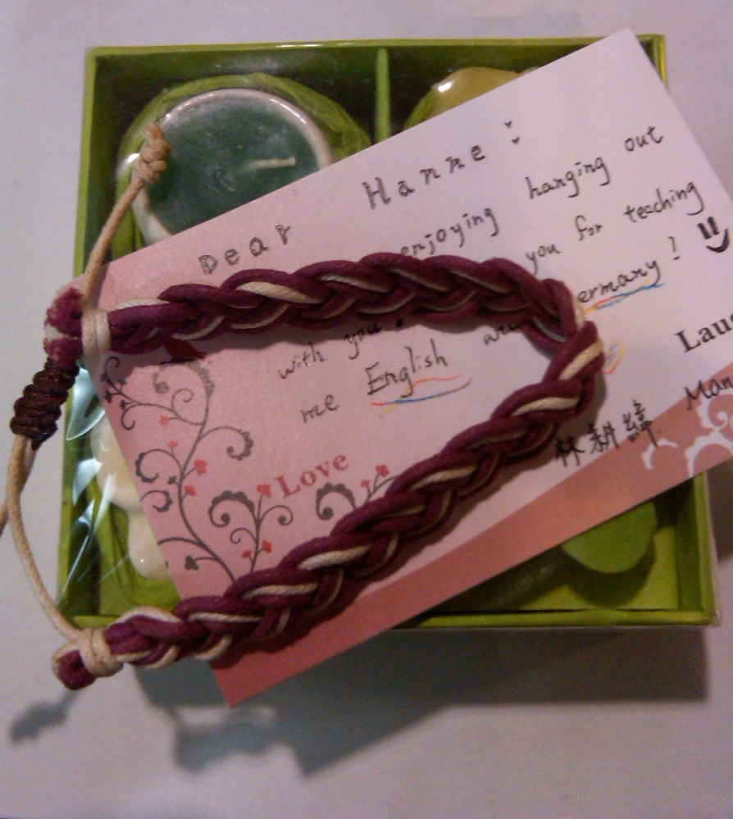
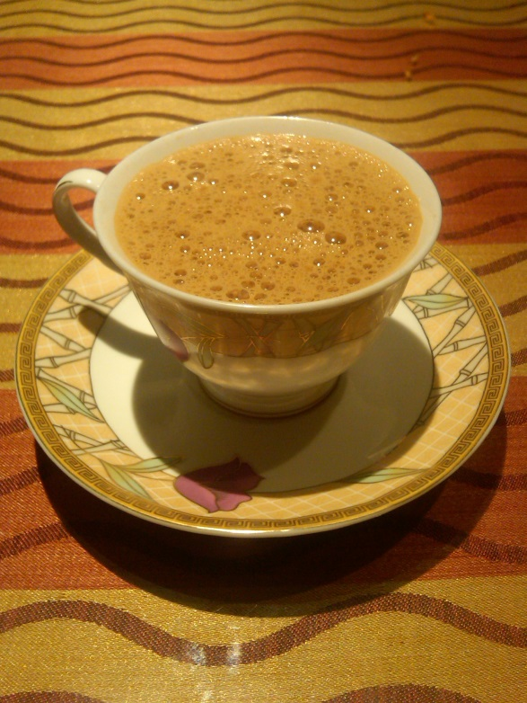
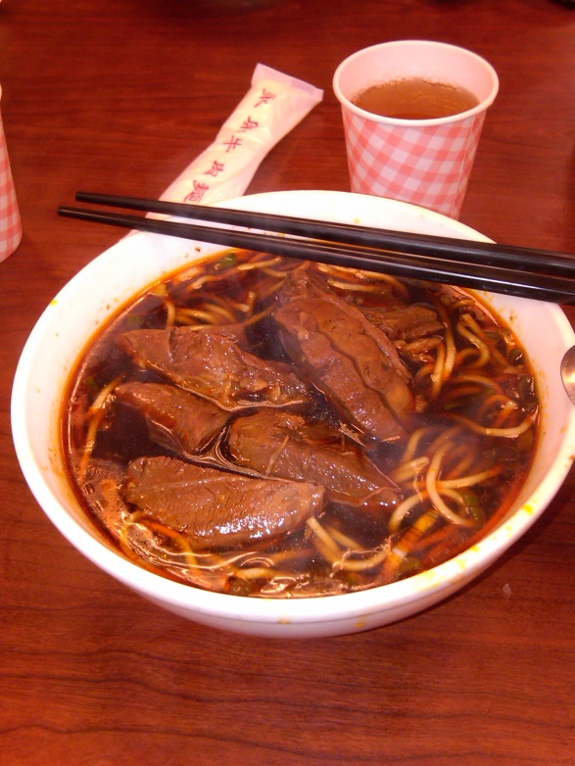
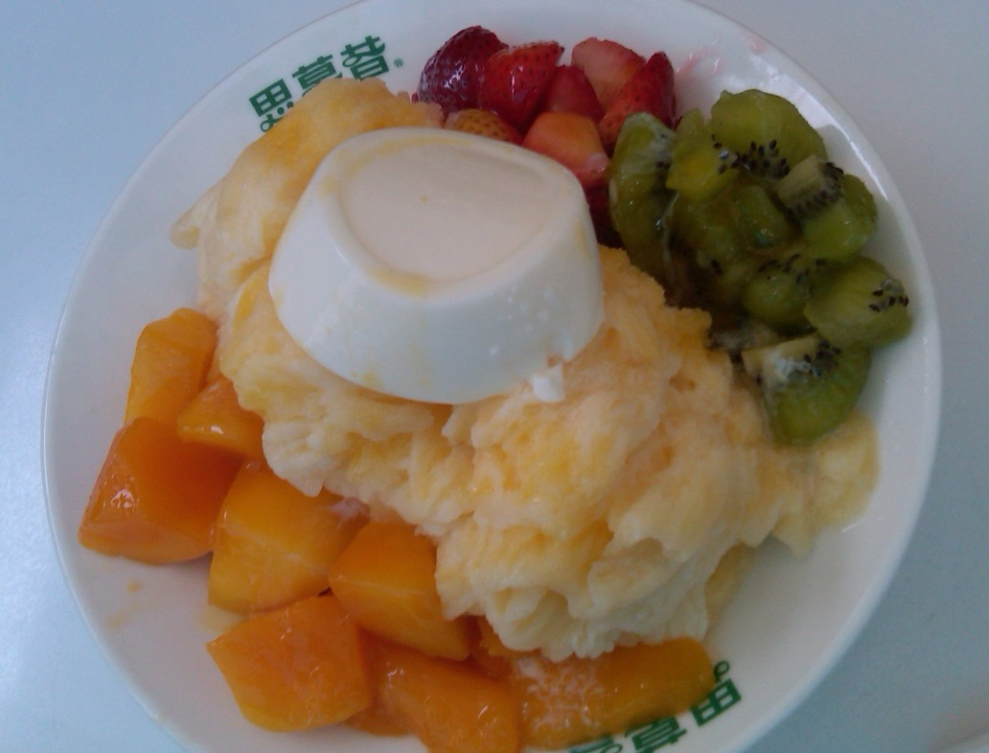
Cultural Aspect

Slide 7
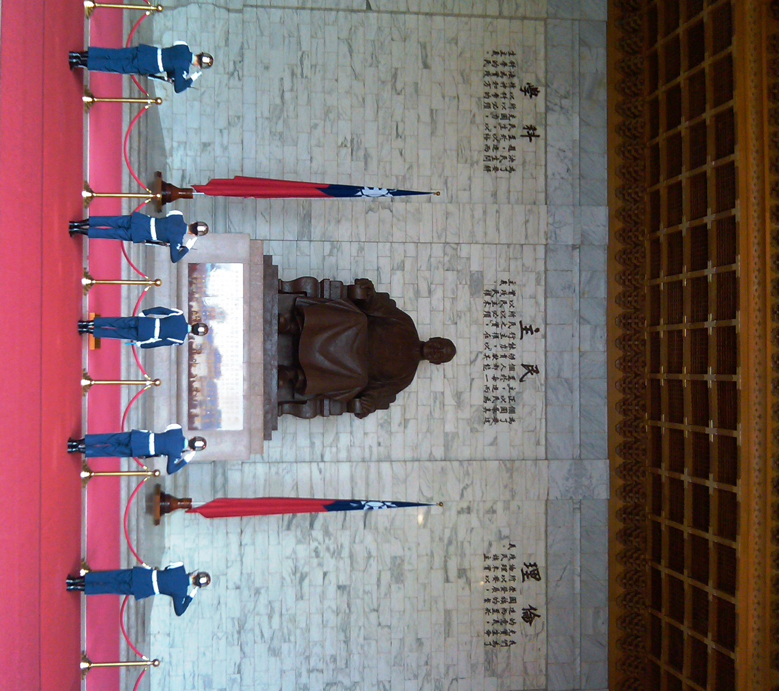
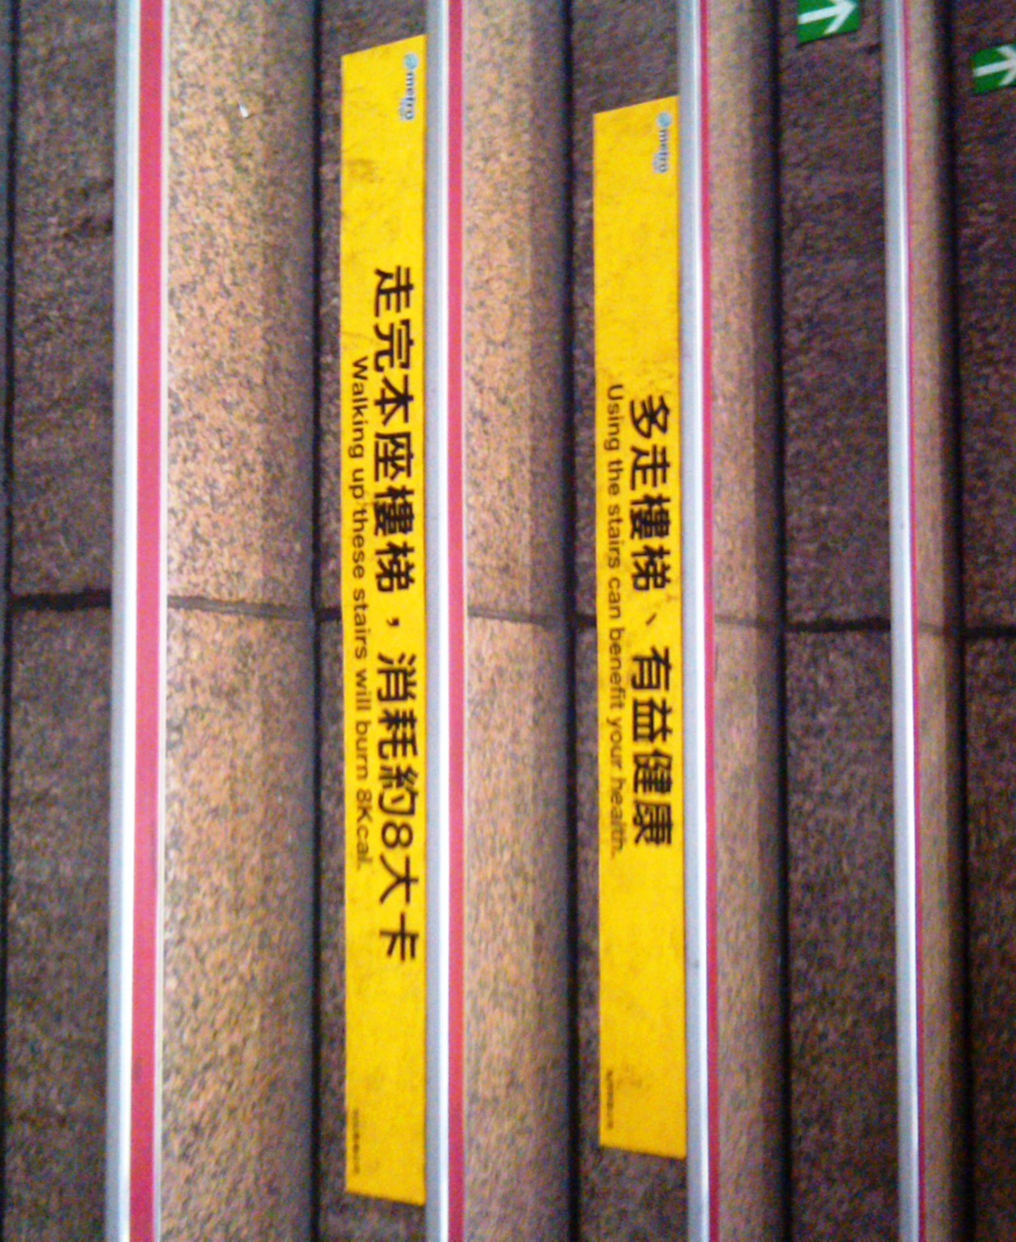
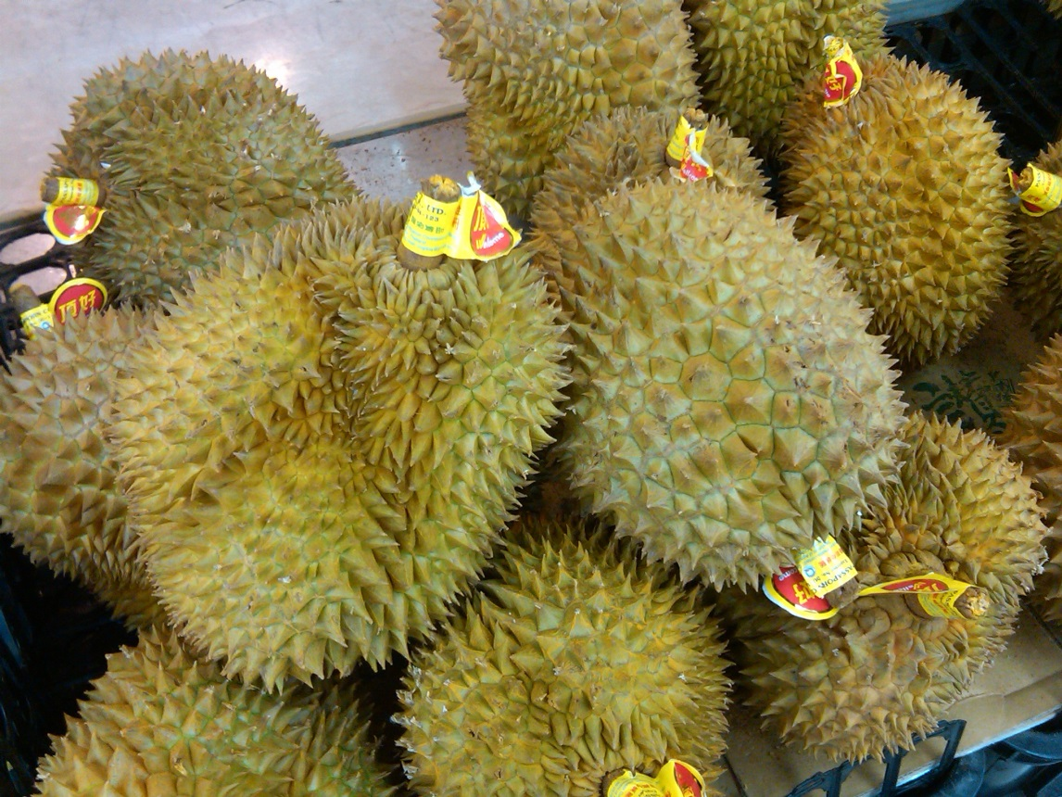
Cultural Aspect

Slide 8
I Would Like to Extend a Thanks to...
University of California, San Diego
Gabriele Wienhausen
Peter Arzberger
Dr. Phil Bourne
Chirag Krishna
National Taiwan University
Dr. Jung-Hsin Lin
Dr. Jung-Hsin Lin’s lab, and finally
Tosh Nomura Eureka! Foundation for making this trip possible

