Slide 1
Chronic Chagas Disease and Potential Natural Products
National Taiwan University
Hanne Inez Wolff
July 17th, 2013

Slide 2
Progress to Date
Completed Docking Compounds from Taiwan Natural Product Database
Top 10 Compounds for 1S0J
-------------------------------------------------------------------------------------------
Rank File Name Binding Affinity
-------------------------------------------------------------------------------------------
1 TPD.71184833541_out.pdbqt -13.6
2 TPD.91185766573_out.pdbqt -12.6
3 TPD.281010096476_out.pdbqt -12.3
4 TPD.281011317462_out.pdbqt -12.3
5 TPD.71184834376_out.pdbqt -12.2
6 TPD.281010461515_out.pdbqt -12.1
7 TPD.91186211040_out.pdbqt -12.1
8 TPD.101185345882_out.pdbqt -12.0
9 TPD.281011318172_out.pdbqt -12.0
10 TPD.281011317061_out.pdbqt -11.8

Slide 3
Progress to Date
Completed Docking Compounds from Taiwan Natural Product Database
Top 10 Compounds for 1MS8
-------------------------------------------------------------------------------------------
Rank File Name Binding Affinity
-------------------------------------------------------------------------------------------
1 TPD.91185766573_out.pdbqt -14.4
2 TPD.281010096476_out.pdbqt -13.8
3 TPD.71184833541_out.pdbqt -12.7
4 TPD.281011409415_out.pdbqt -12.4
5 TPD.281011409716_out.pdbqt -12.4
6 TPD.71184834376_out.pdbqt -12.3
7 TPD.91186211040_out.pdbqt -11.7
8 TPD.281011297903_out.pdbqt -11.6
9 TPD.281011398209_out.pdbqt -11.6
10 TPD.281011399613_out.pdbqt -11.6

Slide 4
Next Week Goals
Try to obtain compounds and perform perhaps assays on them
Keep validating the top ranking compounds with other PDB structures
Look at the validity of the results

Slide 5
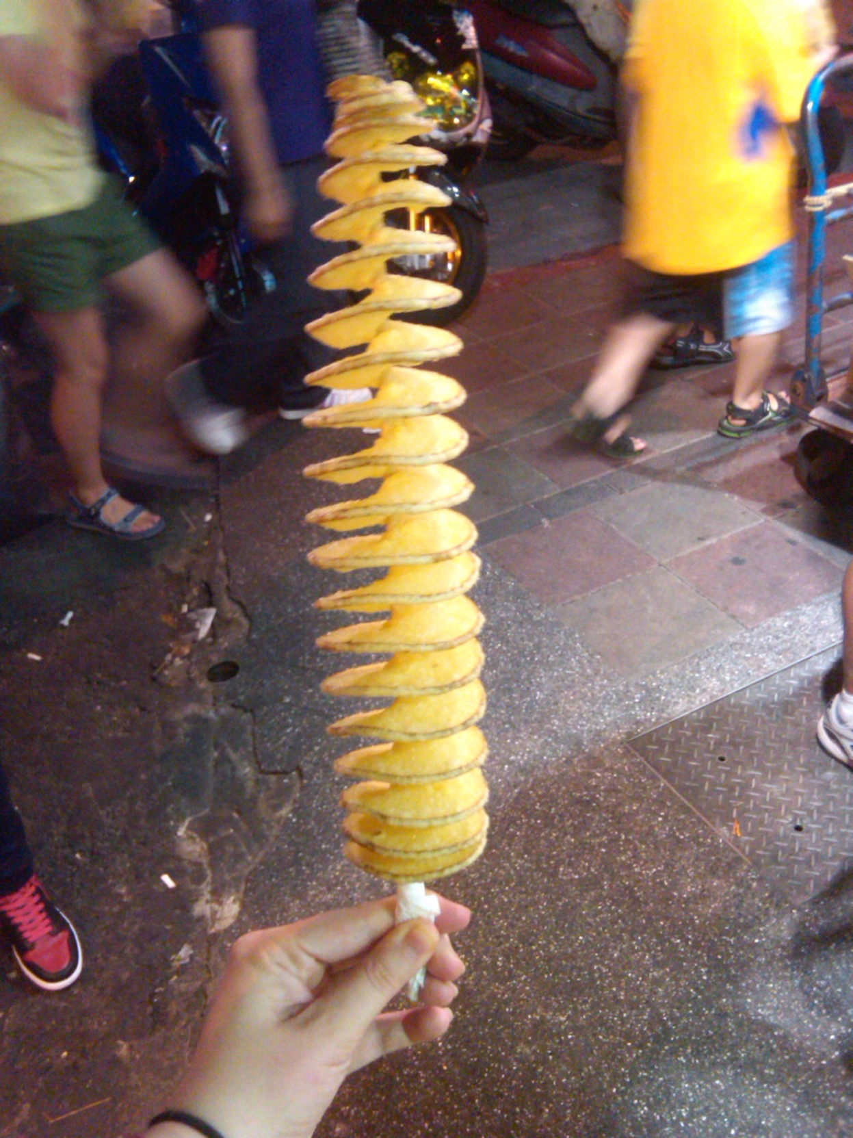
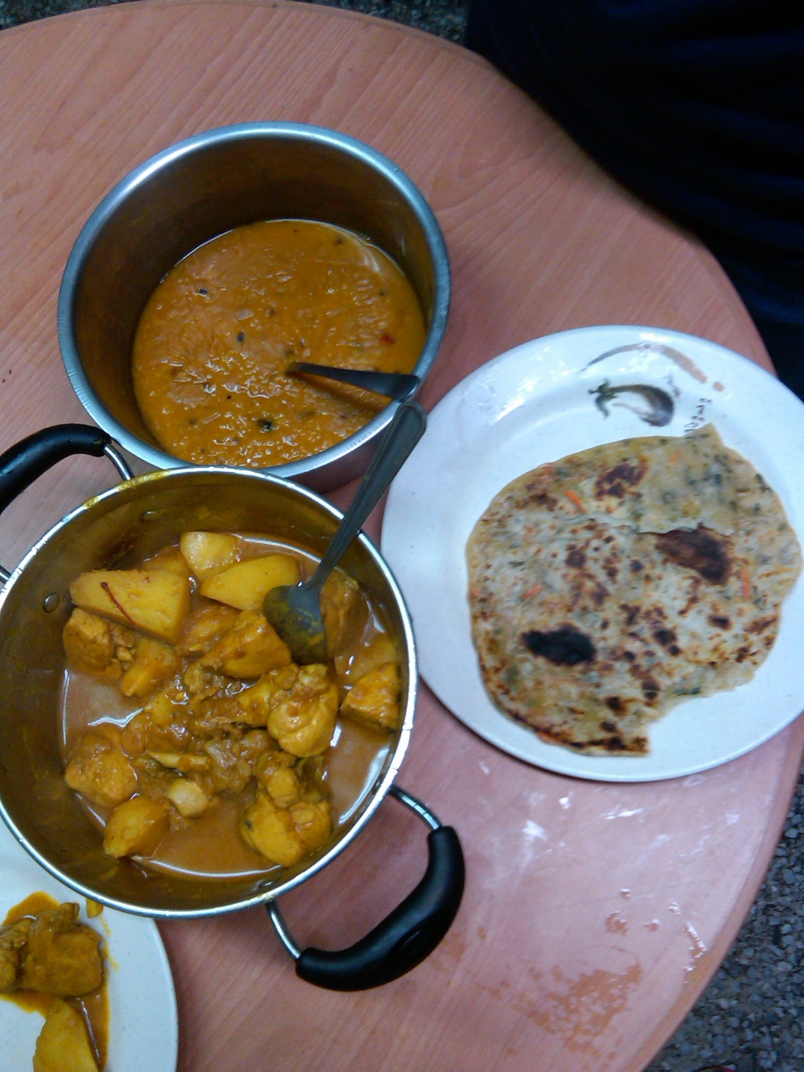
Cultural Aspect

Slide 6
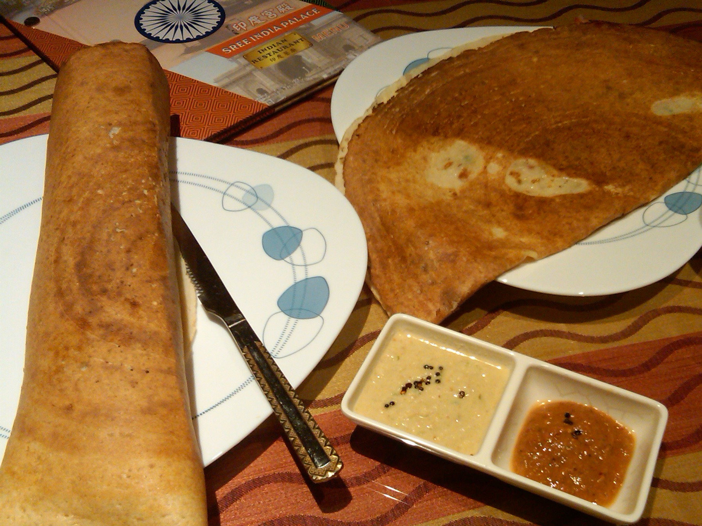
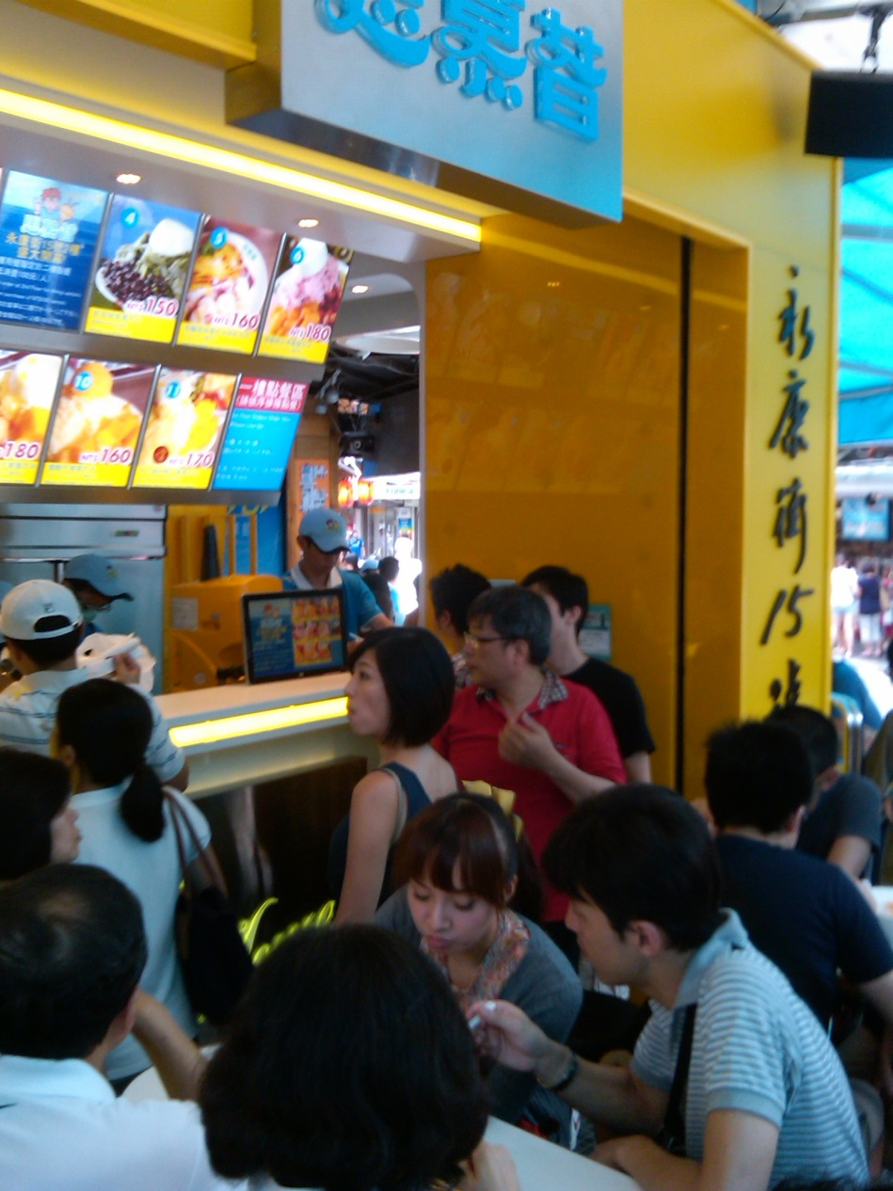
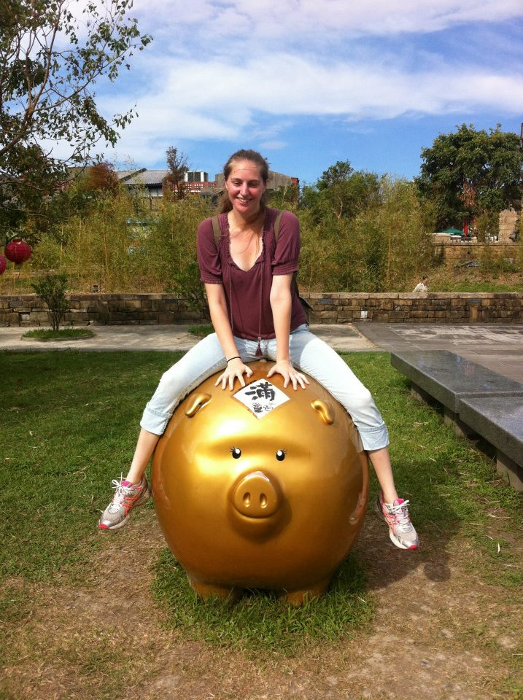
Cultural Aspect

Slide 7
I Would Like to Extend Thanks to...
University of California, San Diego
Gabriele Wienhausen
Peter Arzberger
Dr. Phil Bourne
Chirag Krishna
National Taiwan University
Dr. Jung-Hsin Lin
Dr. Jung-Hsin Lin’s lab, and finally
Tosh Nomura Eureka! Foundation for making this trip possible

