Slide 1
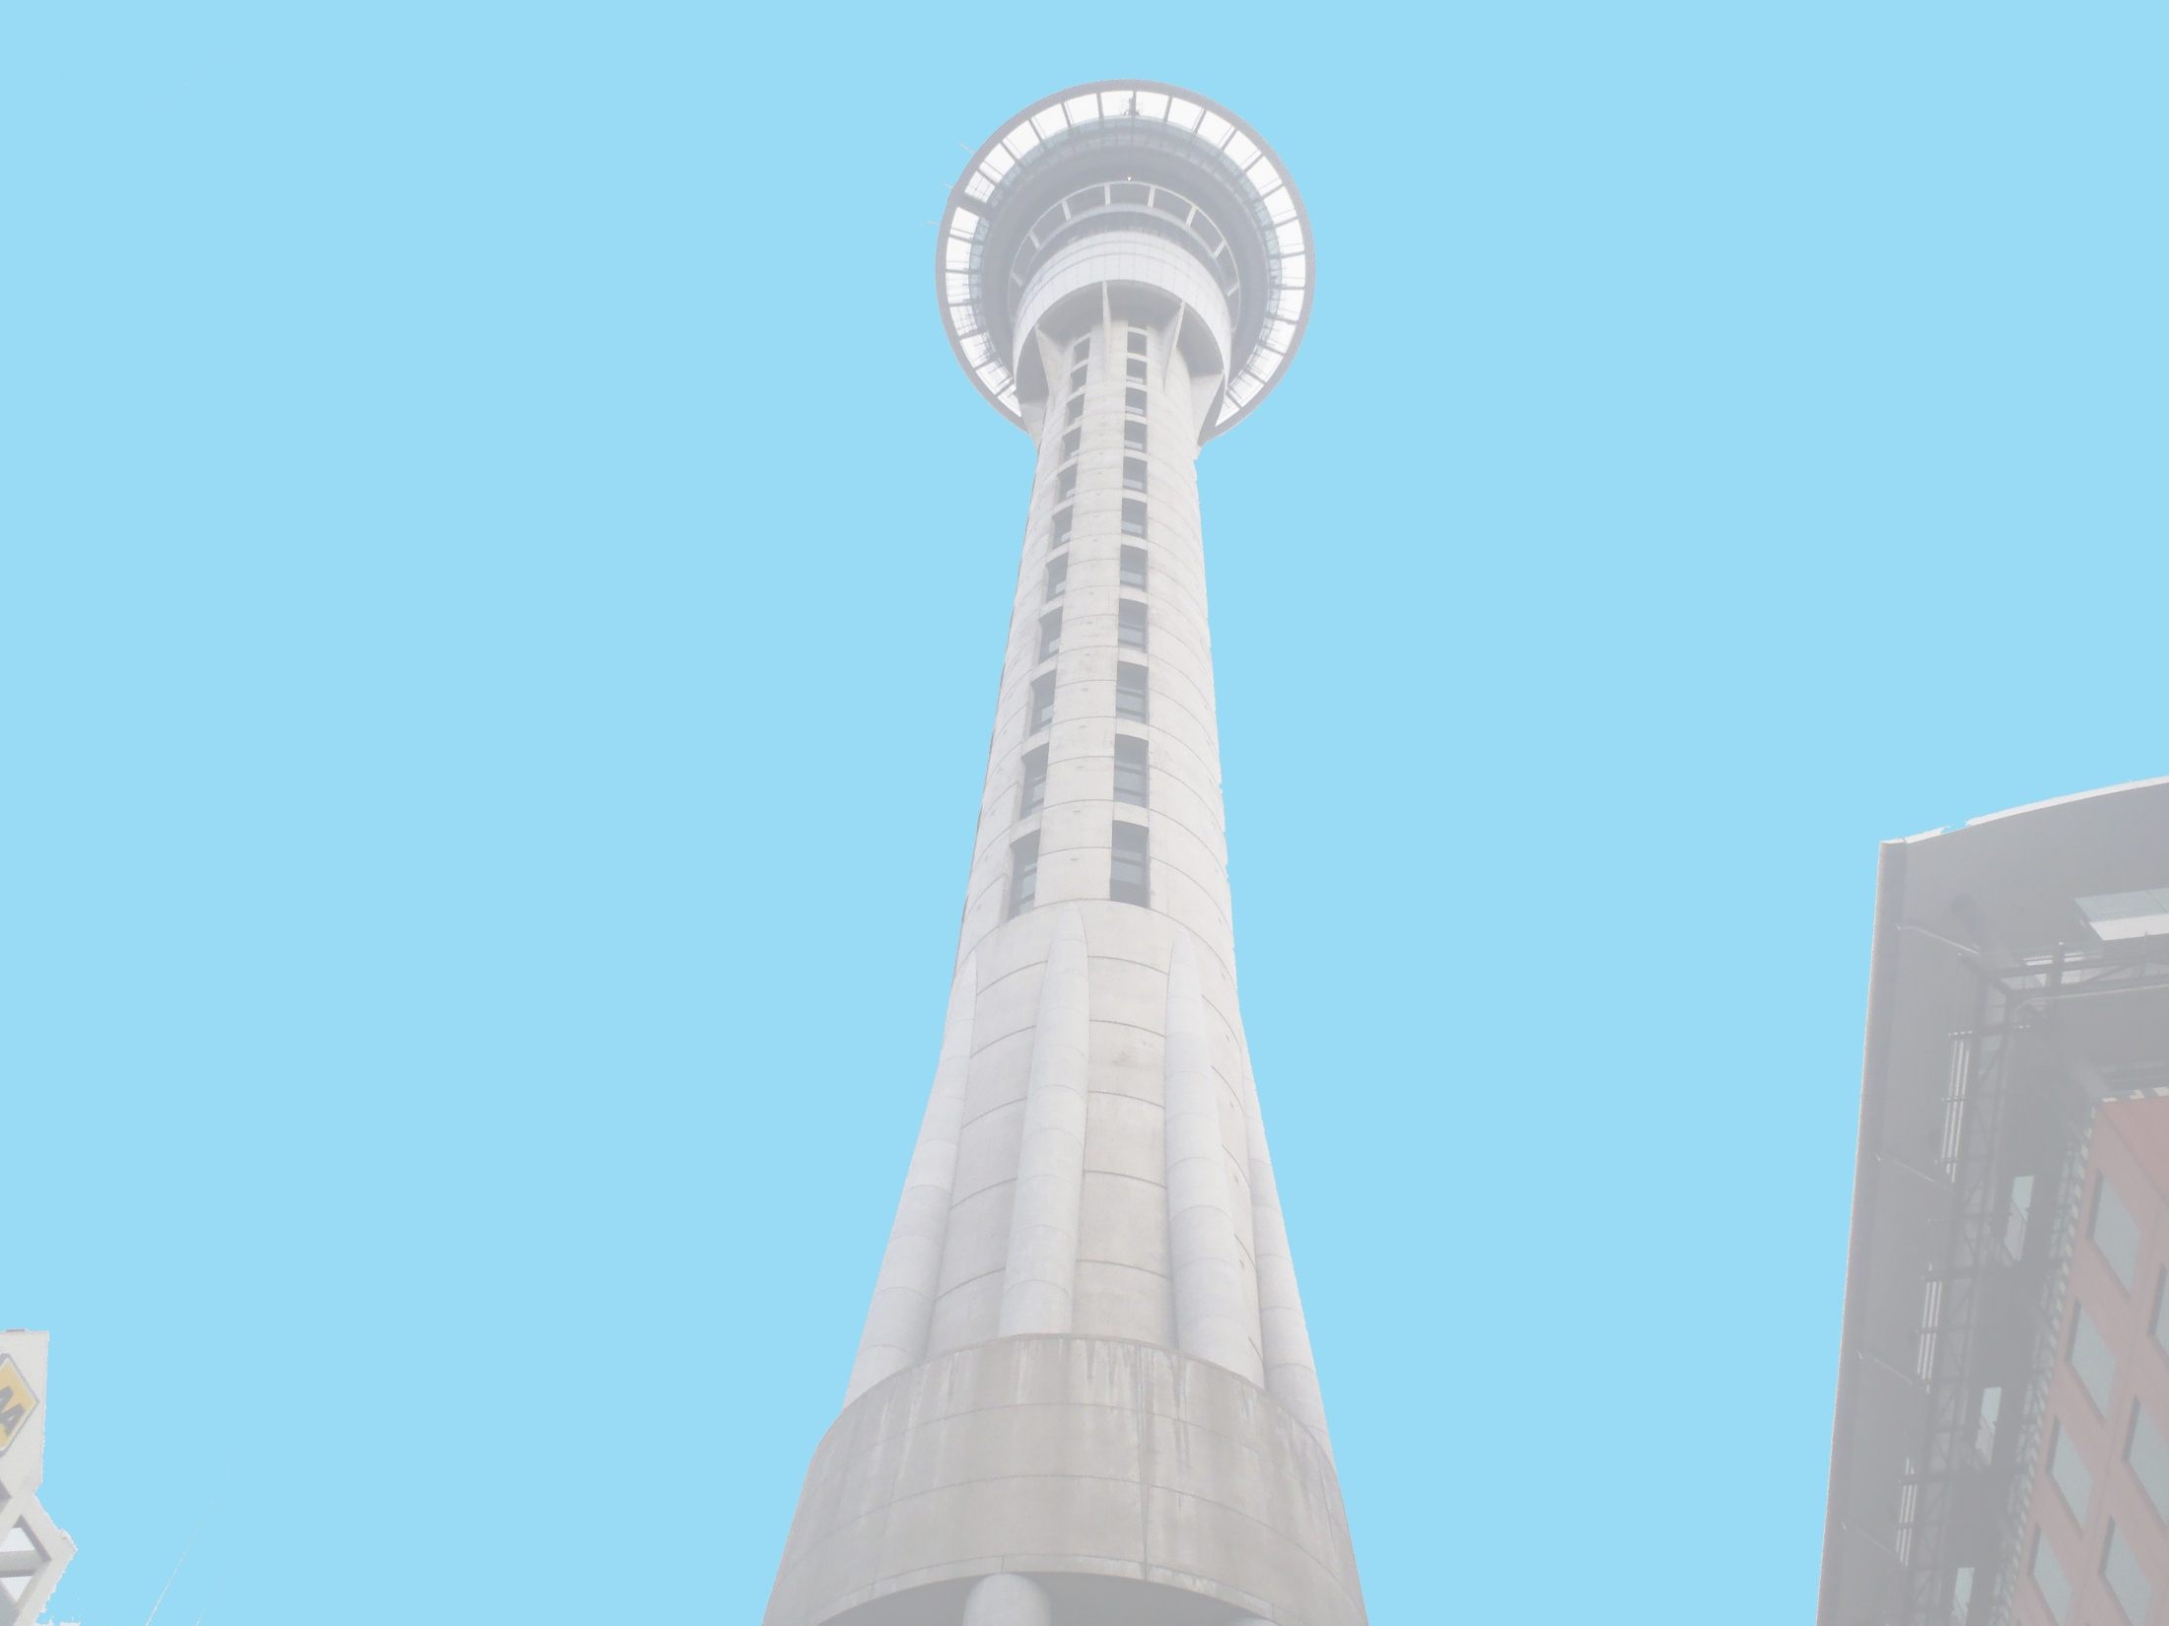


Anthony Adams
Securing of Unreinforced Masonry Parapets
The University of Auckland, New Zealand
July 3rd 2013

Slide 2
Securing of URM Parapets
URM – Unreinforced Masonry
Parapet – A cantilever wall that is typically found along the edge of a roof, bridge, or balcony. (Oxford Dictionary)
Multiple parapets, secured using common retrofits of the area, will be dynamically loaded on a Shake table to determine which retrofits are the most effective while maintaining the Historic Architecture of the building.
Experiment:

Slide 3
Progress
Currently we are at the beginning of the experimental process getting the logistics figured out.
A shake table was designed for the parapet testing and we are currently working on finding fabricators.
We are also locating bricks from the time period to build the parapets to be tested.
Initial testing of brick properties.

Slide 4
To Come
We need to come up with a way to transport the parapets from their build location onto the shake table without causing any damage to the parapet.
Another team member is working on the 3-D renderings of the Shake table for easy setup.
I am in charge of the Accelerometer placement on both the shake table and the parapet.
I need to start the data processing using Matlab scripts.
Trip to Christchurch to extract Masonry and Mortar Samples from damaged buildings.

Slide 5
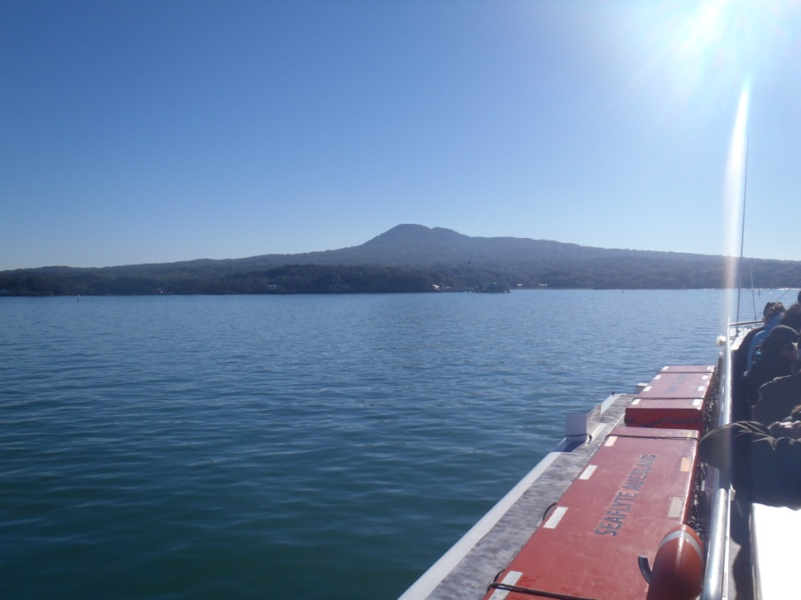
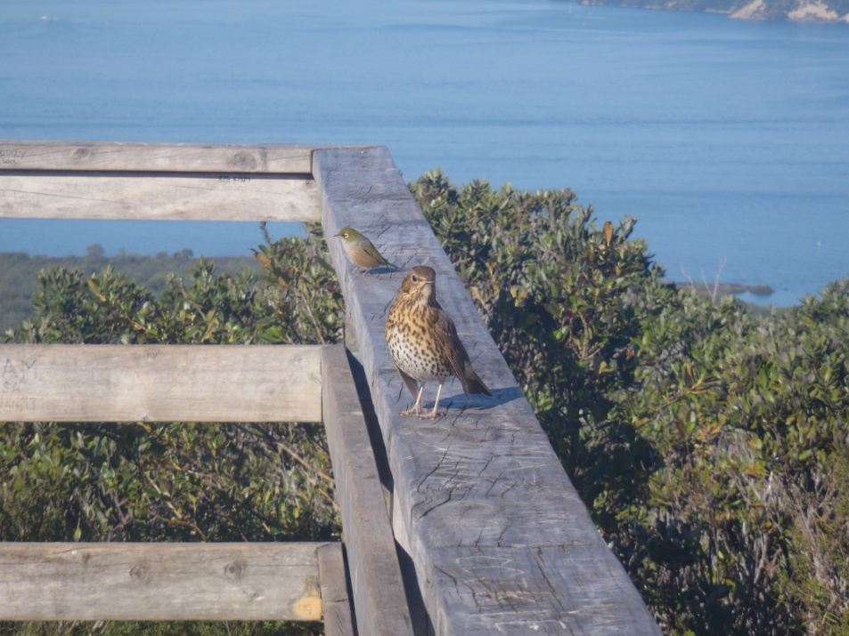
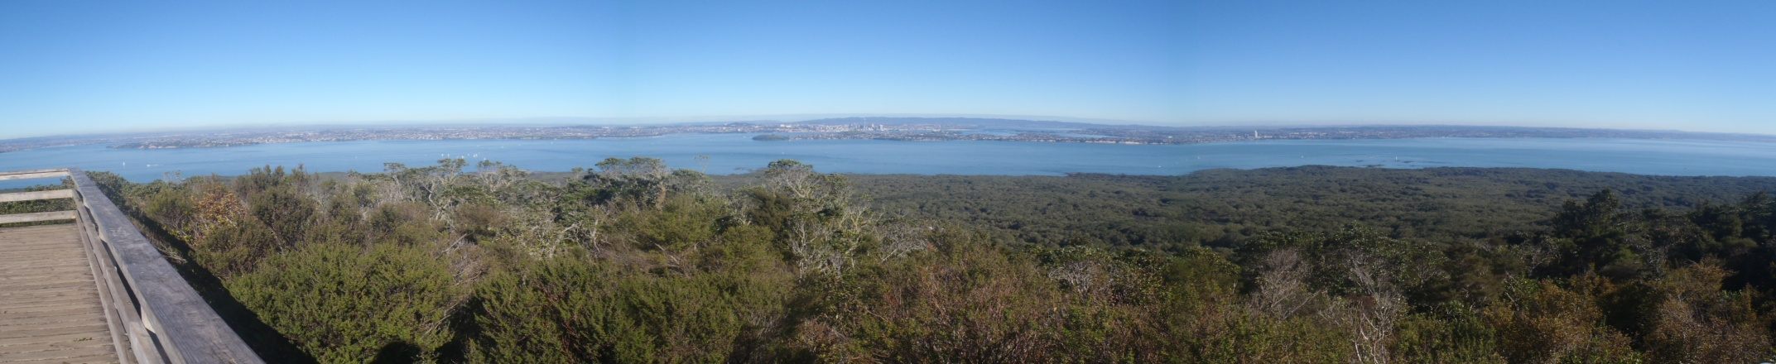
Rangitoto Island (volcano)
Rangitoto Island From Ferry (Above)
These birds would land on Your finger if you put it out. (Above)
Panorama from the top of the Volcano (Below)

Slide 6
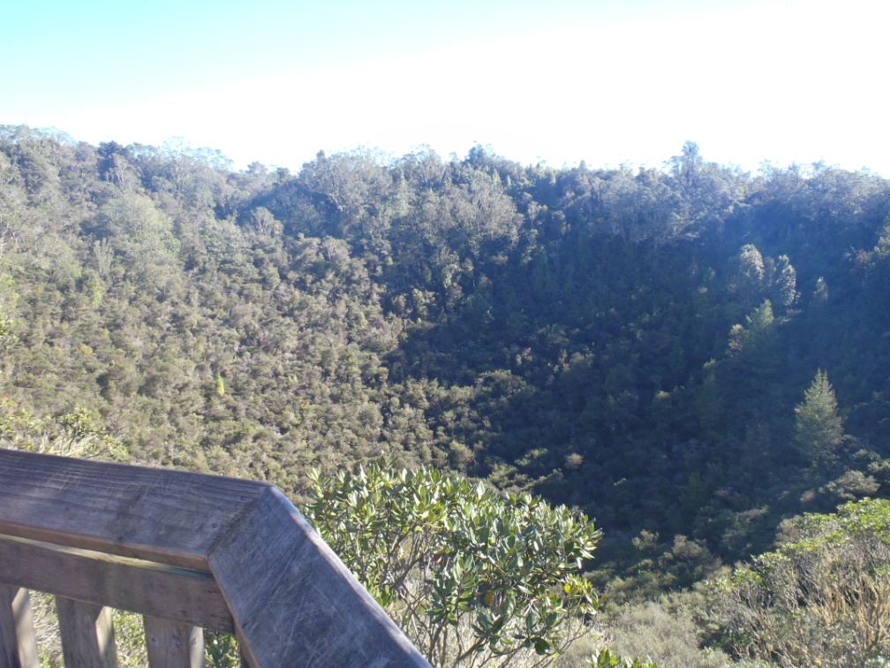
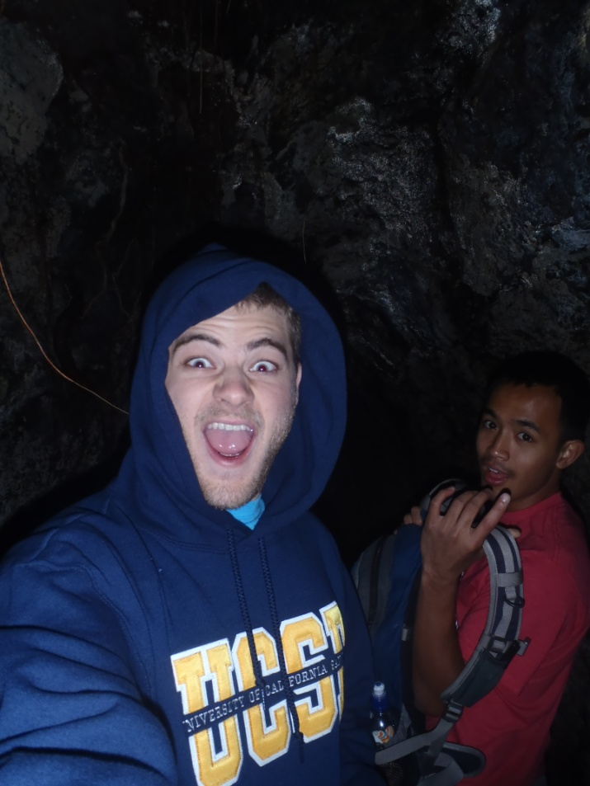
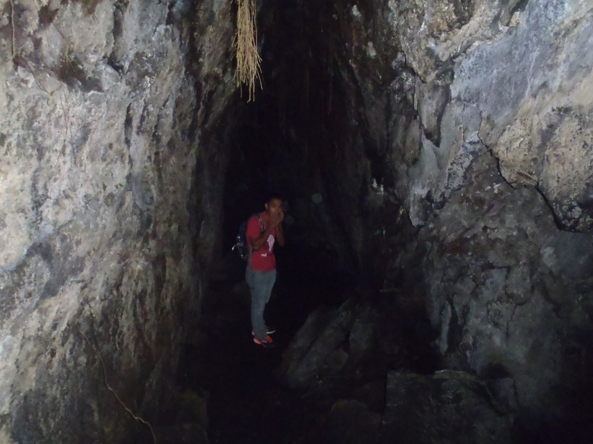
Rangitoto Cont.
Top Left: Crater of Volcano
Bottom Left and Right: Inside of a Lava Cave

Slide 7
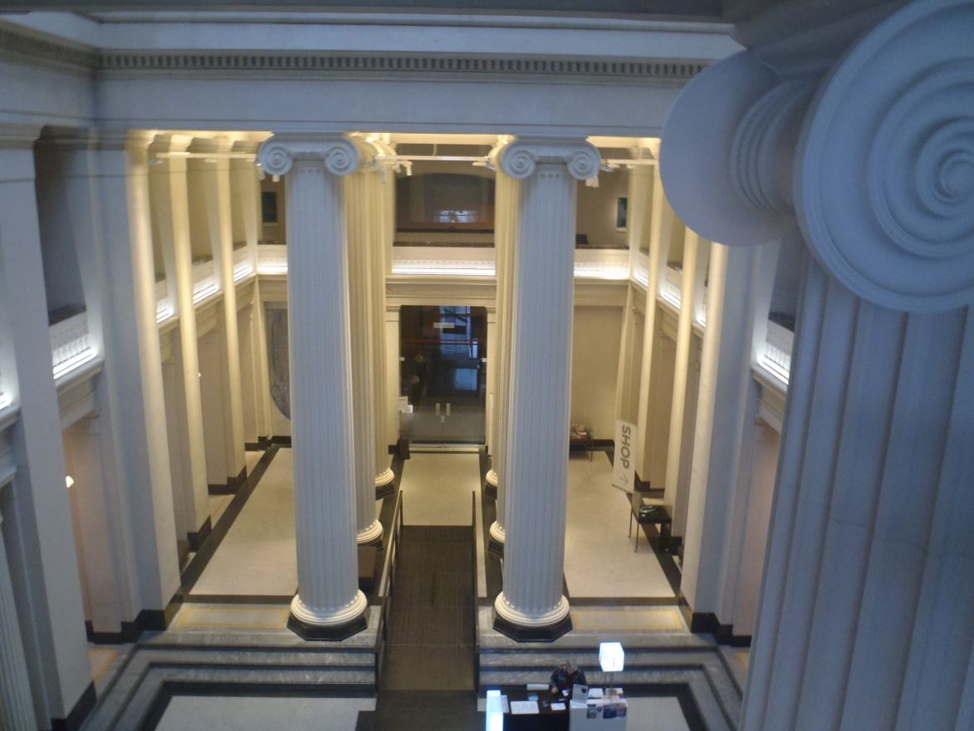
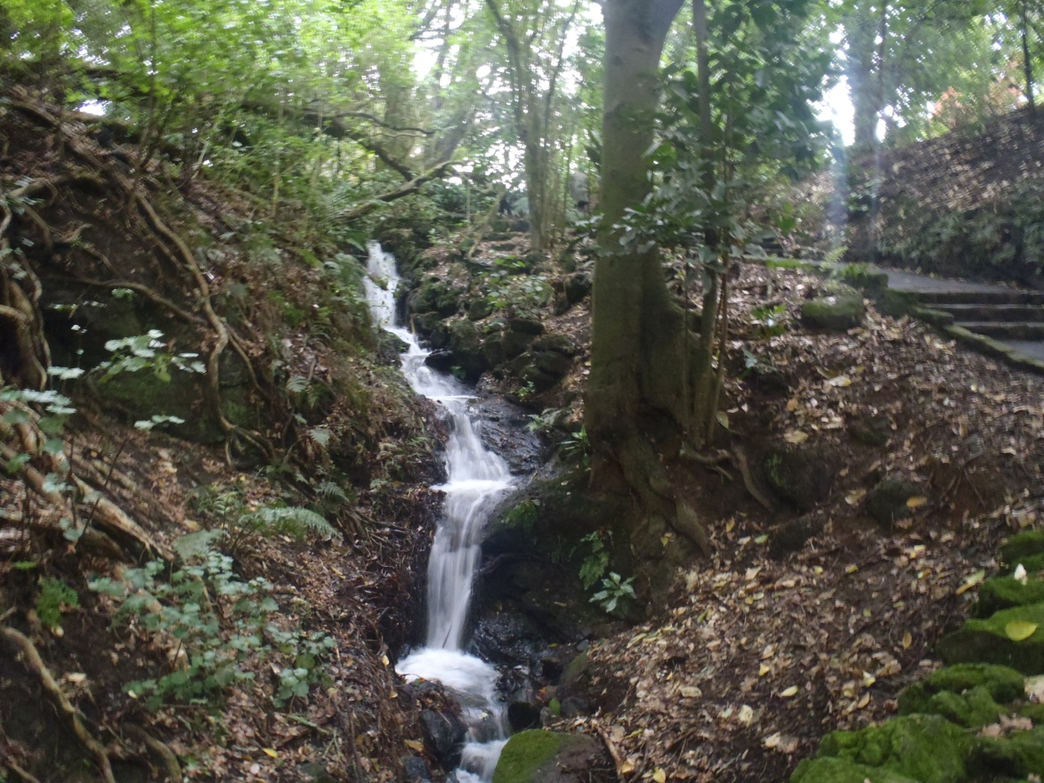
Auckland War Memorial Museum
Left: Atrium of the Museum
Right: Nature walk outside of the Museum in the Auckland Domain.

Slide 8
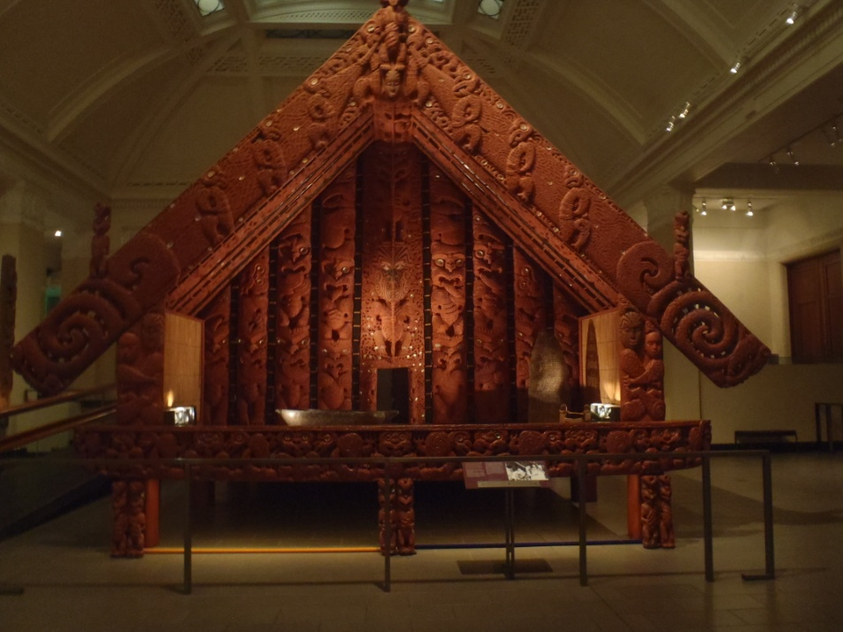
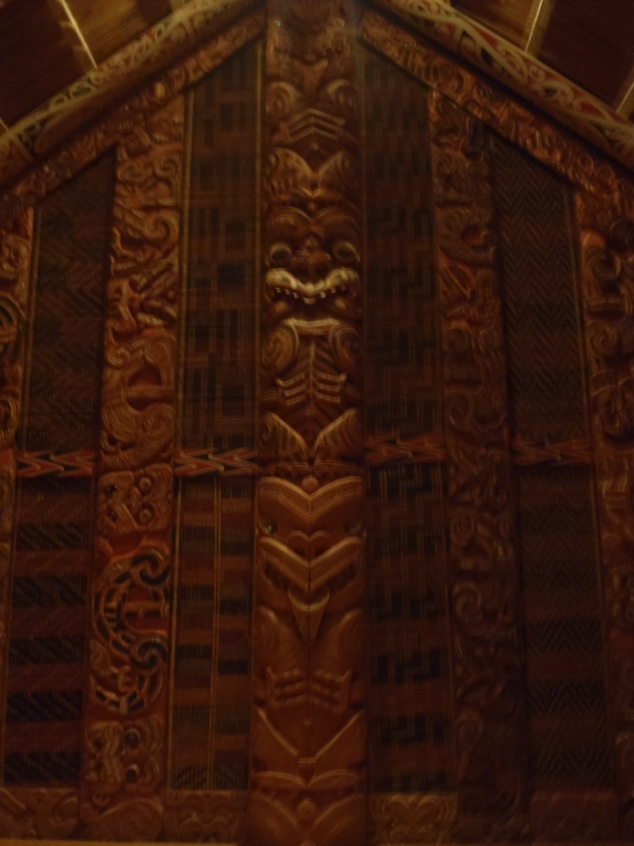
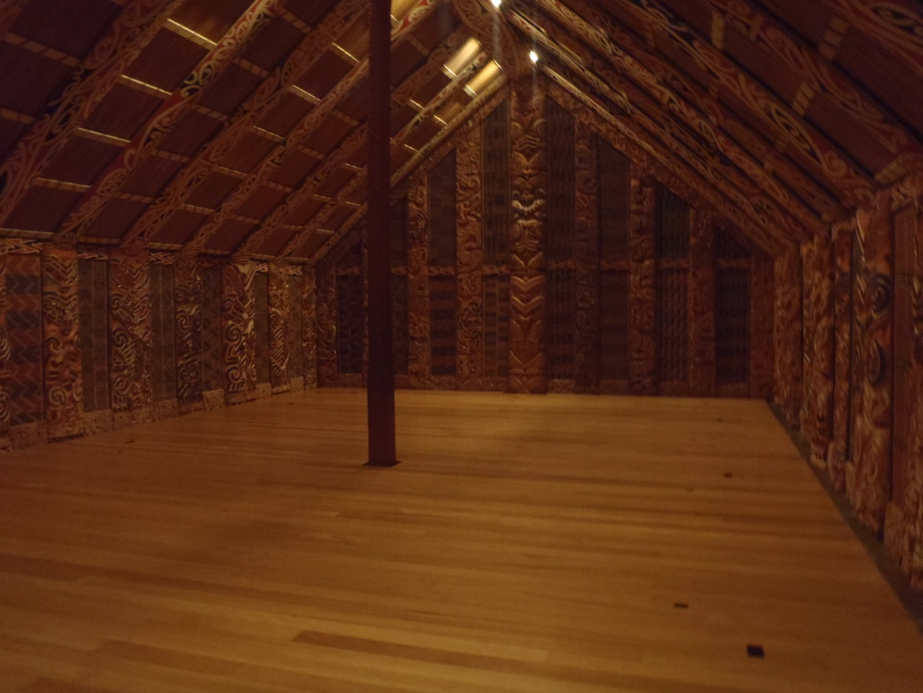
Māori Structures in Auckland War Memorial Museum
Outside and Inside of a typical Maori Hut

Slide 9
References
"Parapet." : Definition of in Oxford Dictionary (British & World English). N.p., n.d. Web. 29 June 2013.

