Slide 1
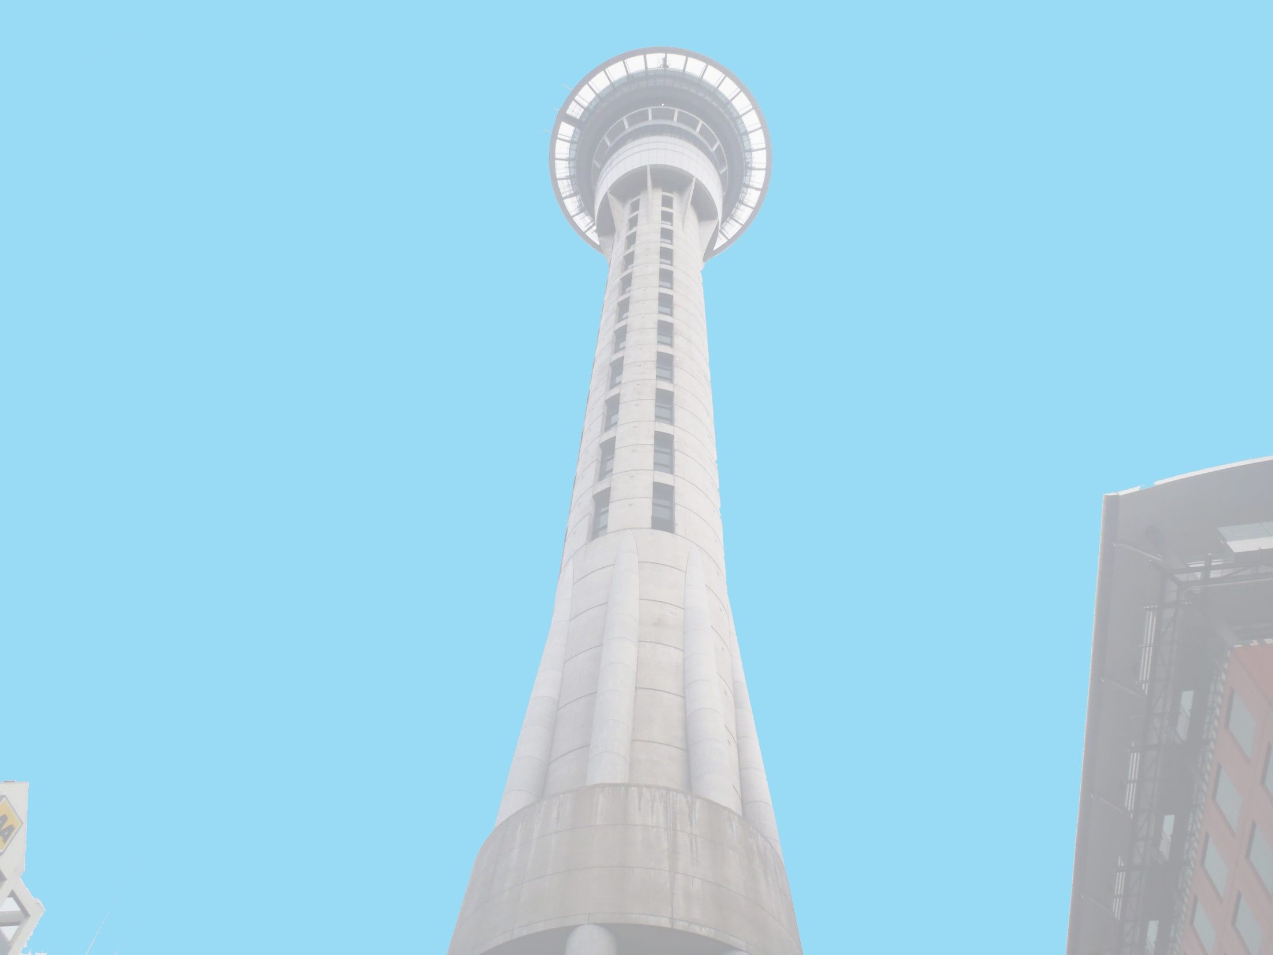



Anthony Adams
Securing of Unreinforced Masonry Parapets
The University of Auckland, New Zealand
Host Mentors: Dmytro Dizhur & Liam Wotherspoon
UCSD Mentor: Lelli Van Den Einde
July 24th 2013

Slide 2
Experiment
Multiple two leaf parapets, secured using common retrofits of the area and experimentally validated retrofits, will be dynamically loaded on a Shake table to provide experimental data of their effectiveness in a dynamic setting.
Test both experimentally validated and industry accepted retrofits for URM parapets to see which methods are the most effective.
Goals

Slide 3
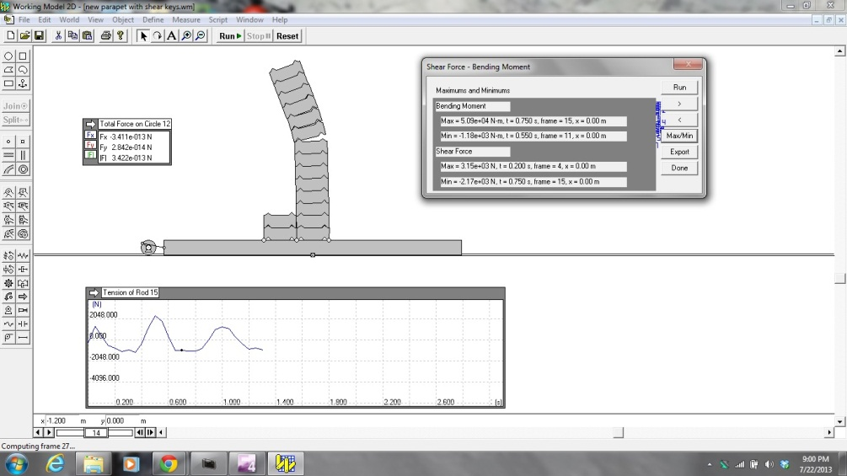
Securing of URM parapets
The computer model was made more accurate allowing for initial estimates of forces expected during loading and the expected parapet behavior.
As a group we simplified the shake table design making it cheaper and easier to construct.
Assisting with another On-Site test using large airbags to apply a uniform distributed load to a masonry wall.

Slide 4
Next Week
Test the masonry wall On-Site with the airbags.
Start building the shake table at the East Campus.
Continue updating the Working Model of the parapet and attach the different retrofits that we will be testing.
Finish pull out testing.

Slide 5
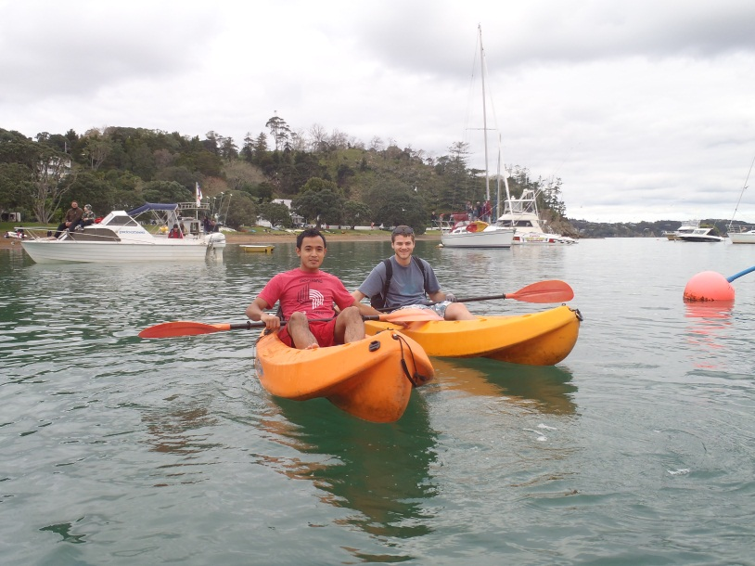
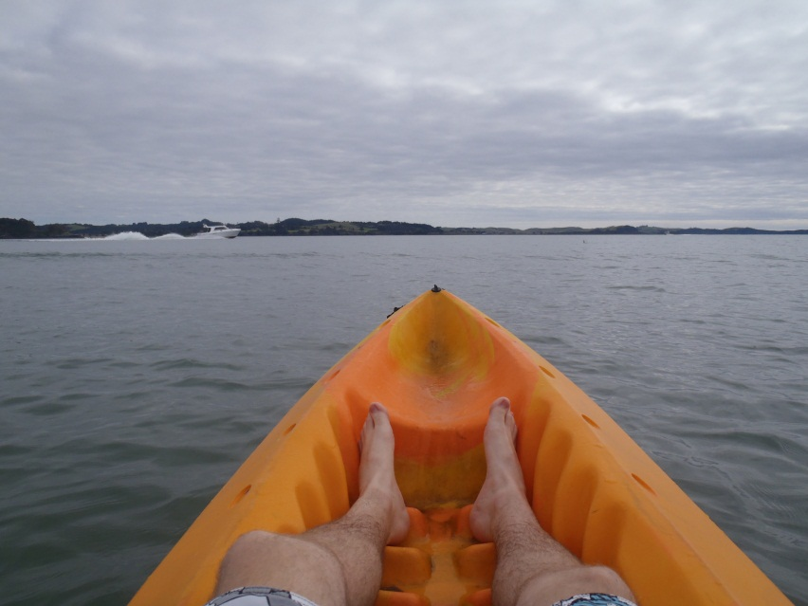
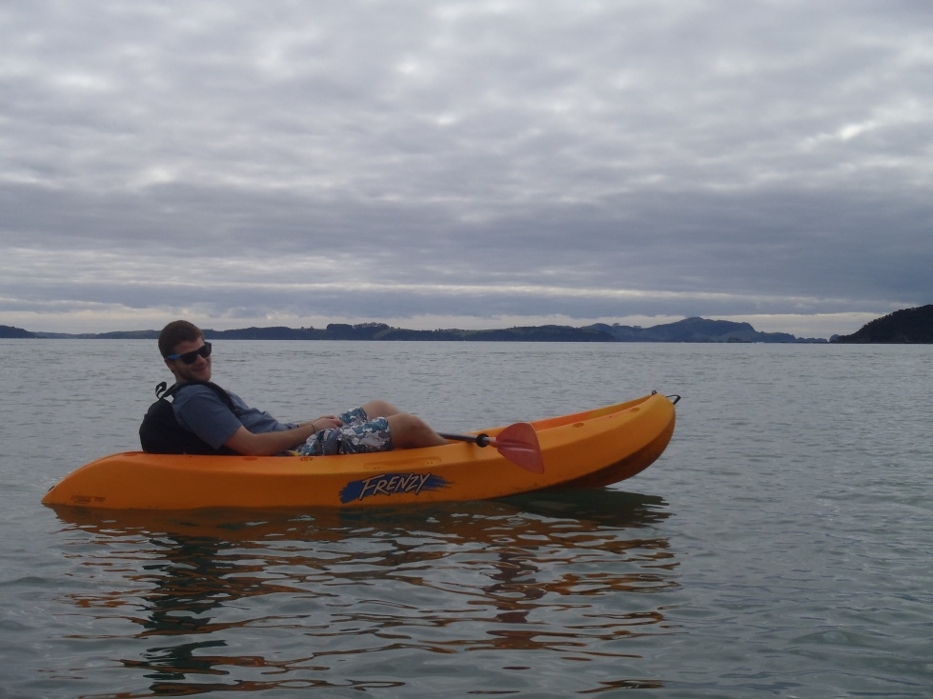
Bay of Islands - Kayaking

Slide 6
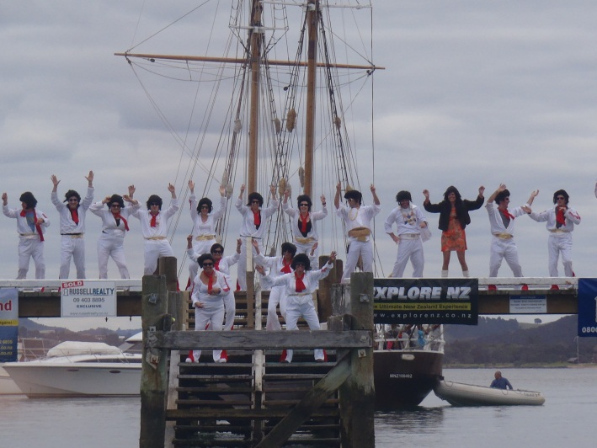
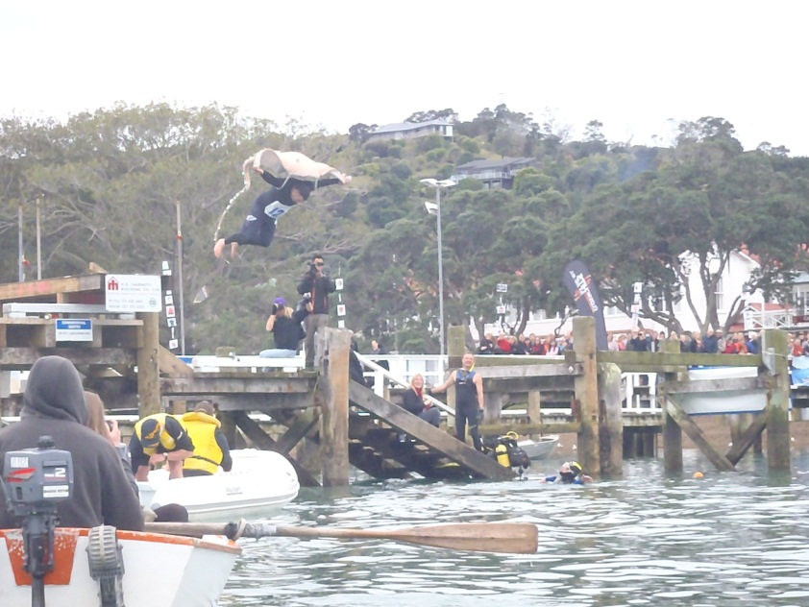
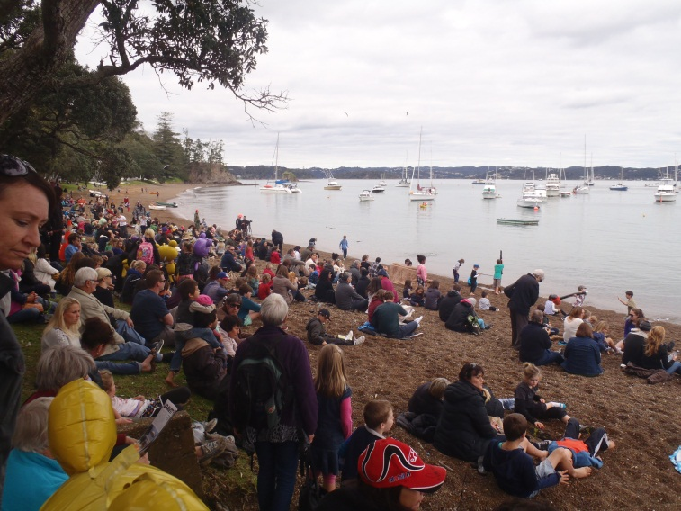
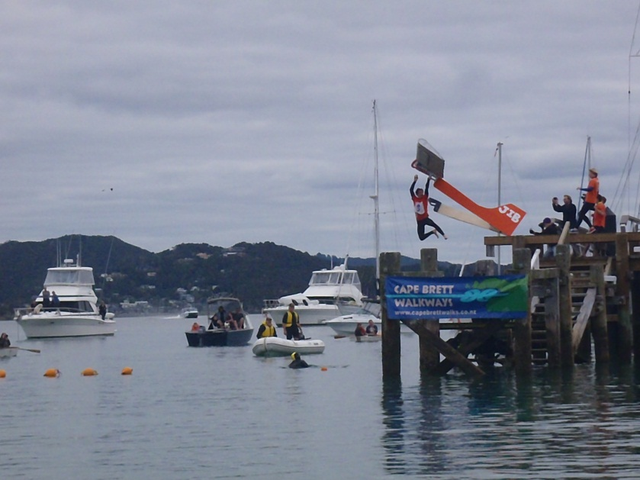
Russell Birdman Festival
Cool little festival.
Lots of people dressed up in costumes, even the ones not jumping off the Wharf.

Slide 7
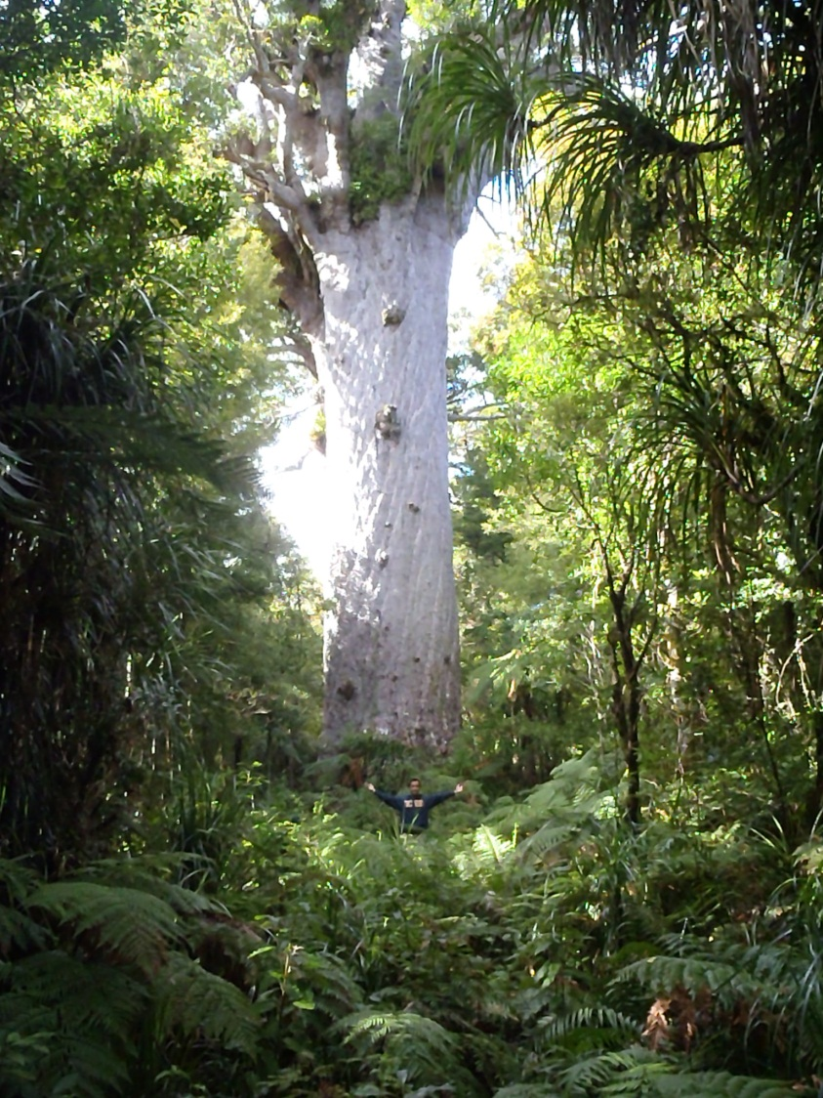
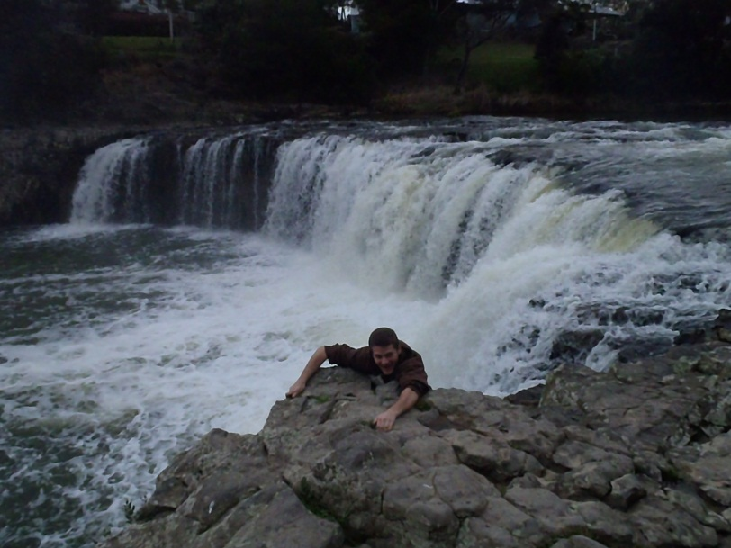
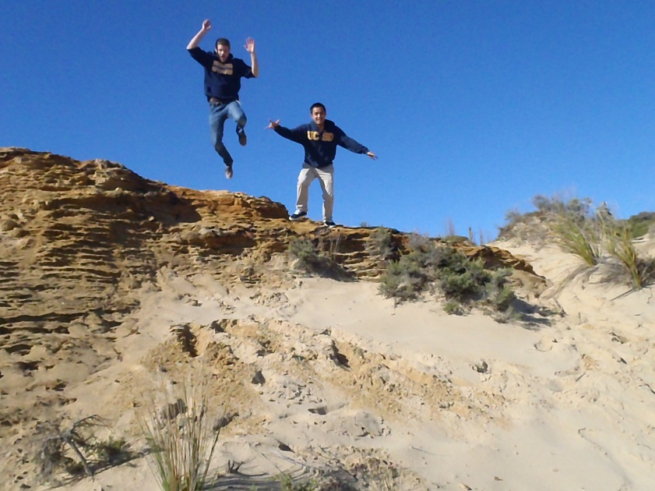
Road trip to the west side form the Paihia
Tane Mahuta The lord of the forest in Maori Culture. 13.8M trunk girth!!!
Top right -->
Biked to Haruru Falls.
Jumped around at the Arai-Te-Uru recreation reserve where the Tasman meets the Hokianga Harbour.

Slide 8
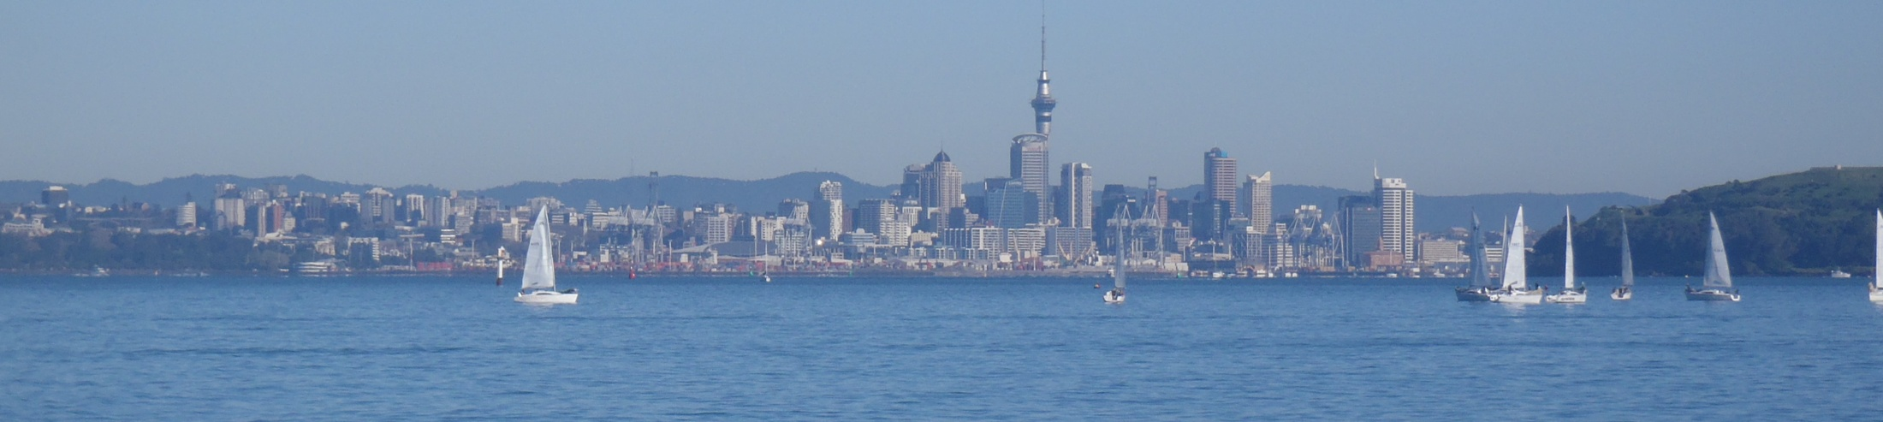
Acknowledgements
Thank you to everyone who has made this life changing experience possible!
Auckland Mentors: Liam Wotherspoon, Dmytro Dizhur
UCSD Mentor: Lelli Van Den Einde
PRIME: Gabriele Wienhausen, Peter Arzberger

