Slide 1
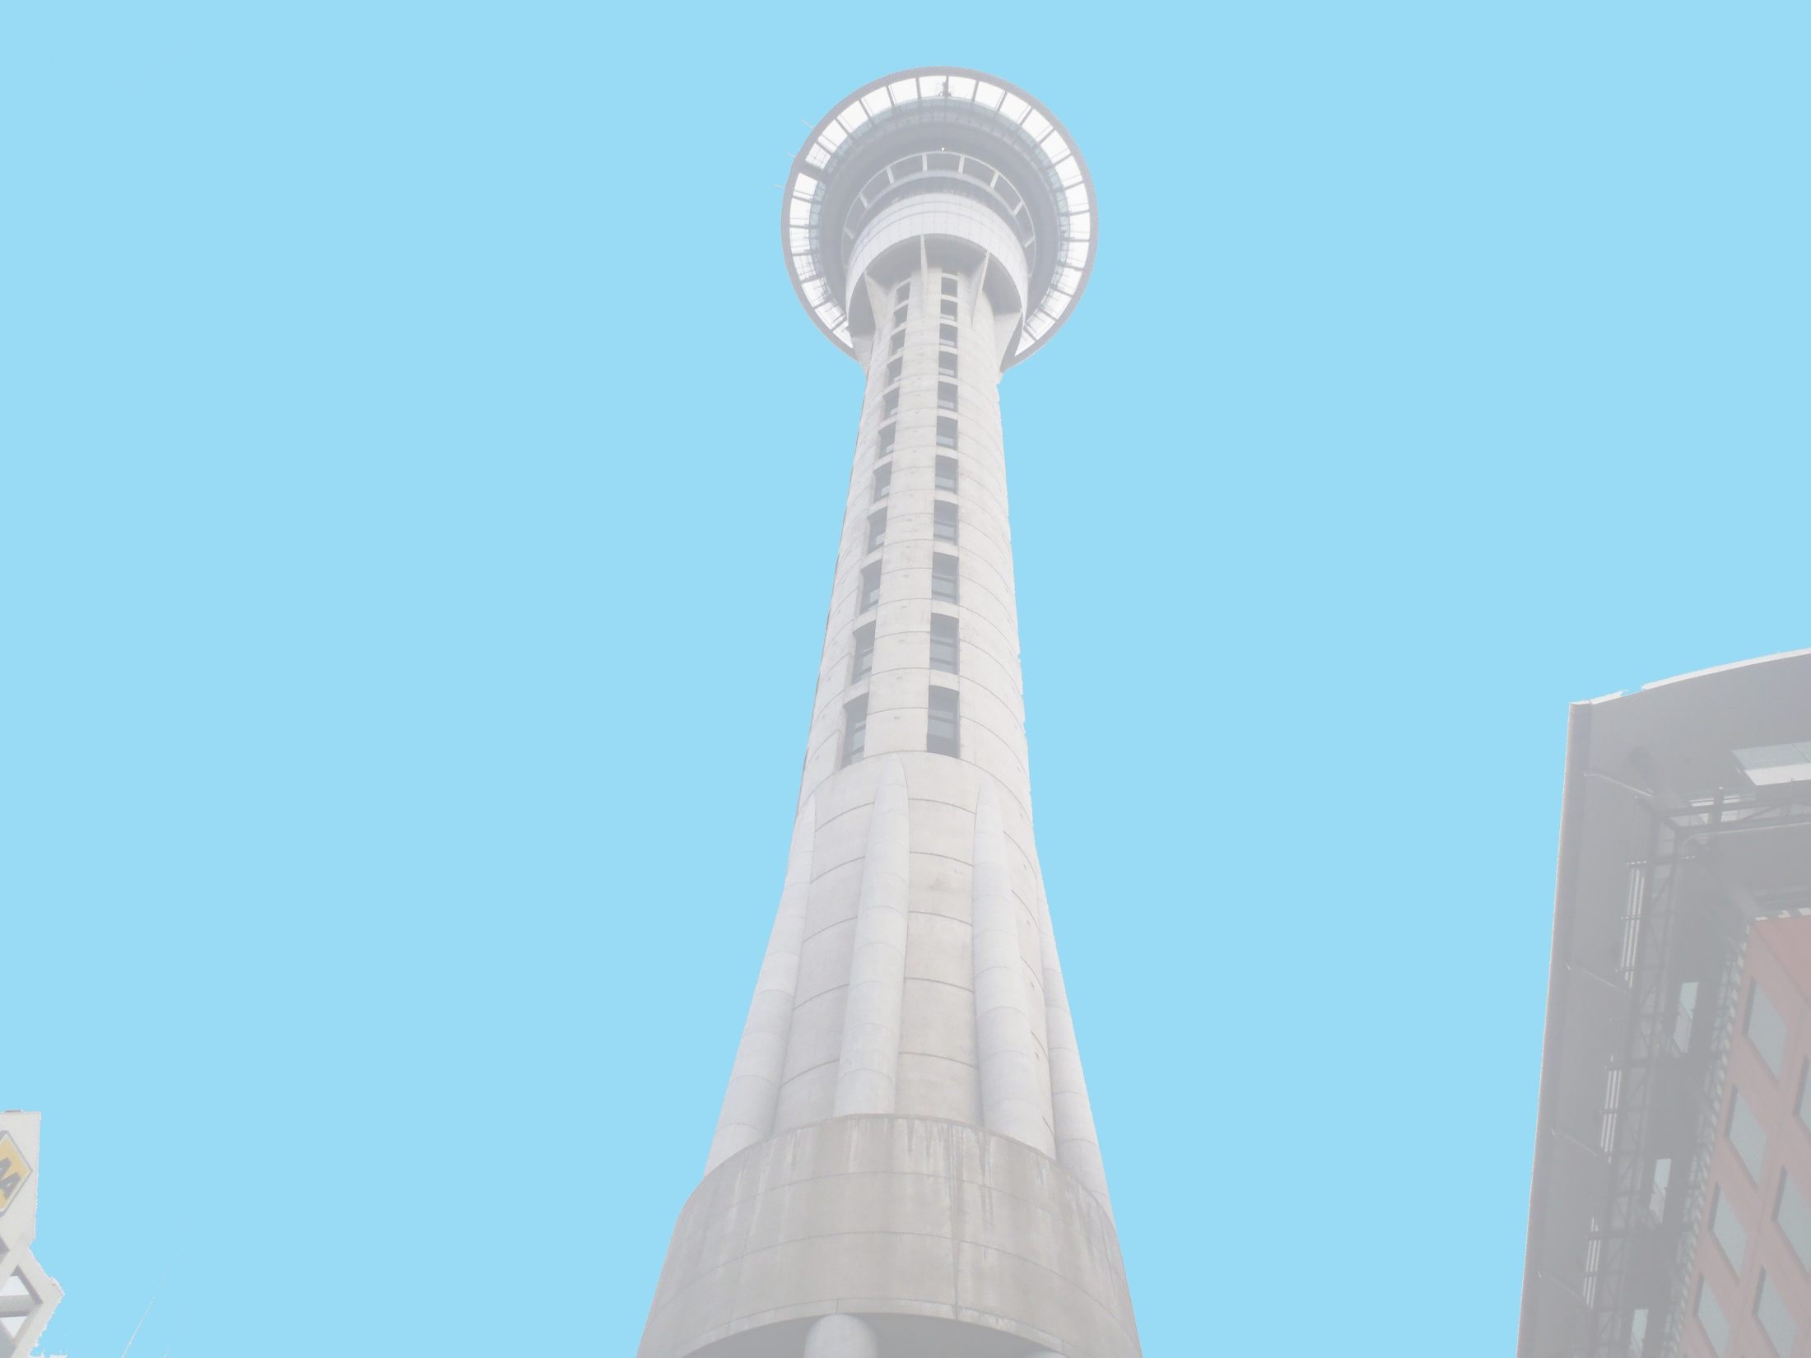



Anthony Adams
Securing of Unreinforced Masonry Parapets
The University of Auckland, New Zealand
Host Mentors: Dmytro Dizhur & Liam Wotherspoon
UCSD Mentor: Lelli Van Den Einde
Aug 7th 2013

Slide 2
Experiment
Multiple two leaf parapets, secured using common retrofits of the area and experimentally validated retrofits, will be dynamically loaded on a Shake table to provide experimental data of their effectiveness in a dynamic setting.
Test both experimentally validated and industry accepted retrofits for URM parapets to see which methods are the most effective.
Goals

Slide 3
Securing of URM parapets
Finished Building the Shake Table at the off campus facility.
2 parapets are almost done curing and are being prepared for testing.
Data Processing for the Victoria St. Masonry Wall Testing.

Slide 4
Next Week
Continue updating the Working Model of the parapet and attach the different retrofits that we will be testing.
Finish Data Processing for Victoria St..
Write a brief report for Victoria Street Masonry Wall testing.

Slide 5
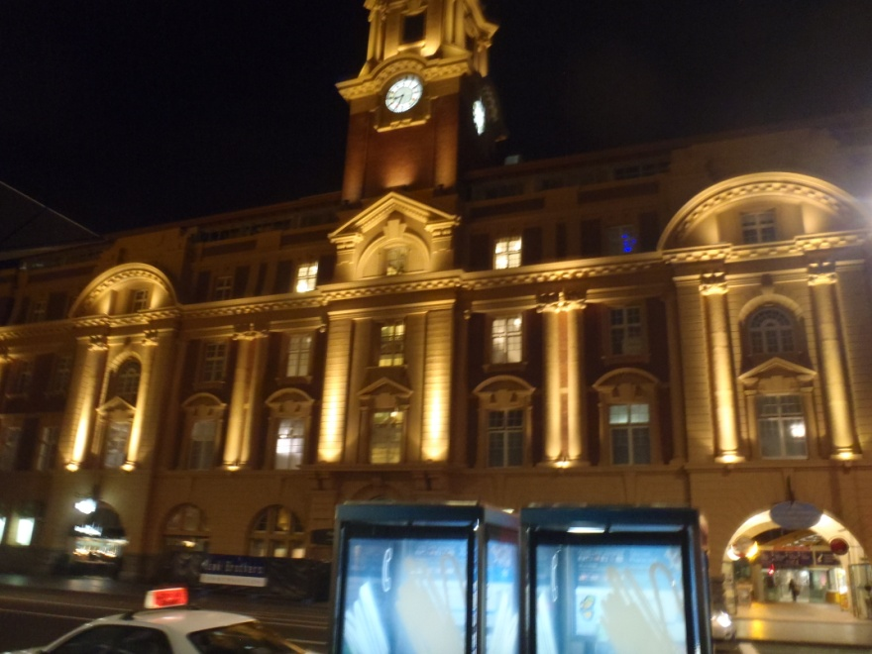
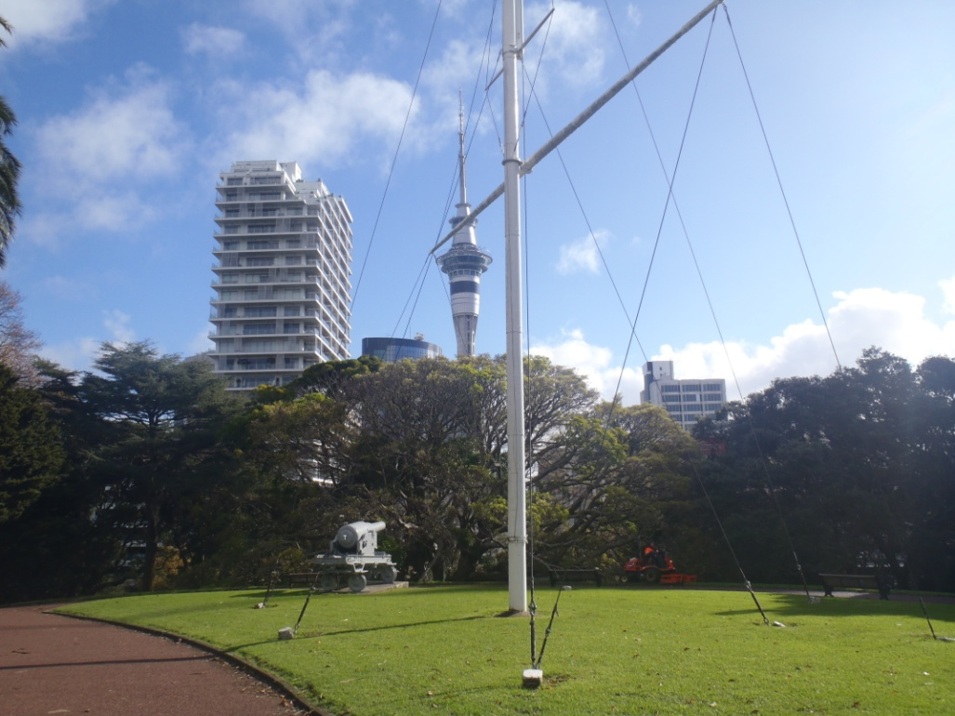
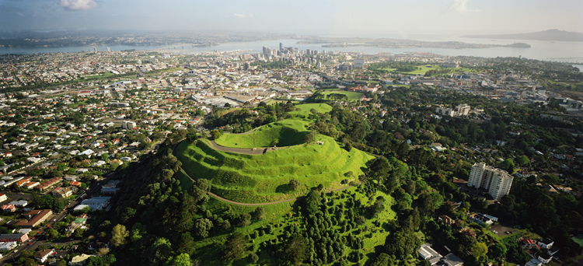
Auckland
Ferry Terminal
Albert Park
Got a lift to Mt.Eden. Forgot my Camera… 40MPH winds and cloudy anyway. Still awesome view!

Slide 6
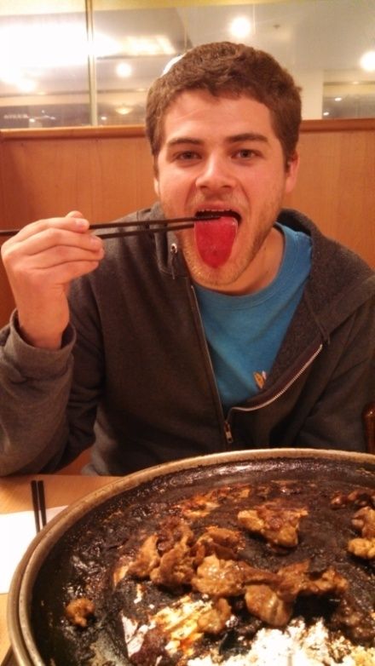
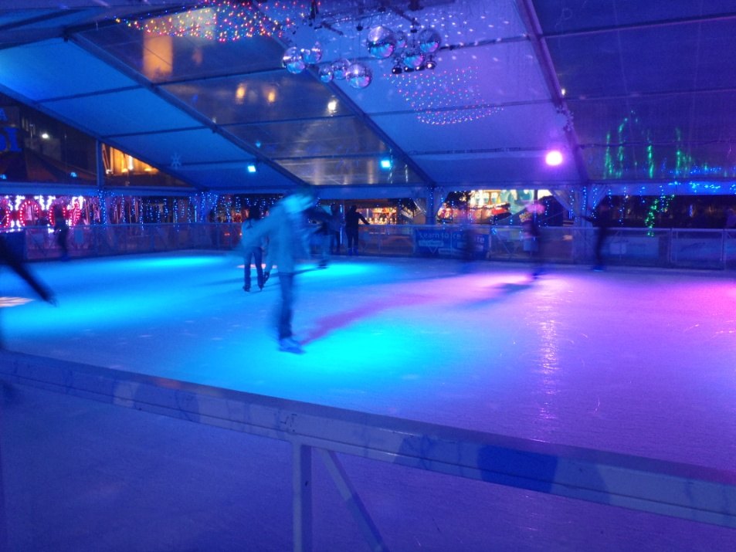
Auckland
Winter Festival in the CBD of Auckland
Ate pig tongue… it was chewy.
My actual dinner was really good Korean BBQ.

Slide 7
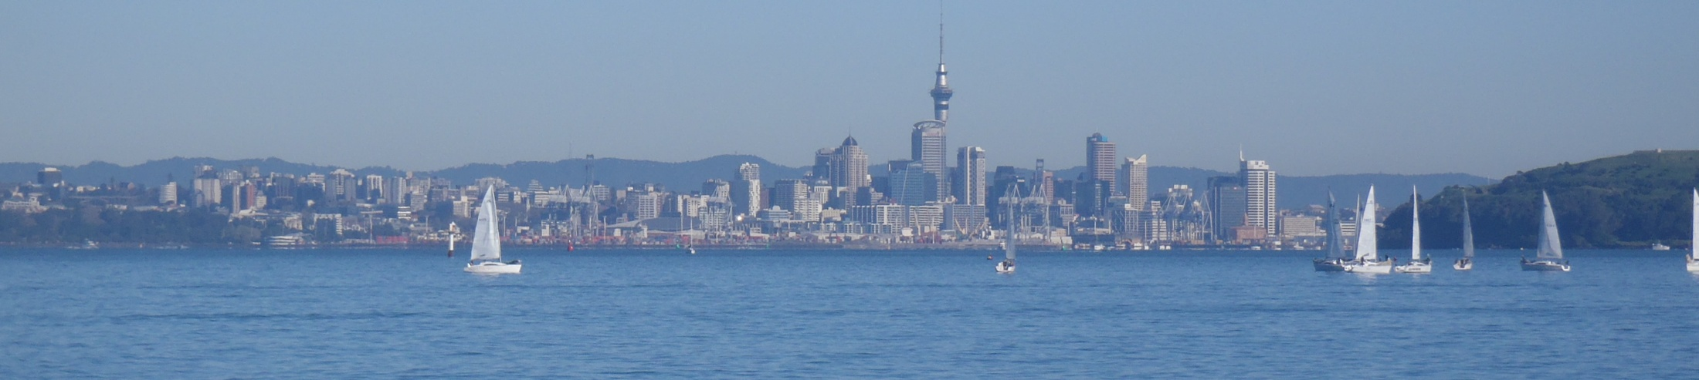
Acknowledgements
Thank you to everyone who has made this life changing experience possible!
Auckland Mentors: Liam Wotherspoon, Dmytro Dizhur
UCSD Mentor: Lelli Van Den Einde
PRIME: Gabriele Wienhausen, Peter Arzberger

