Slide 1
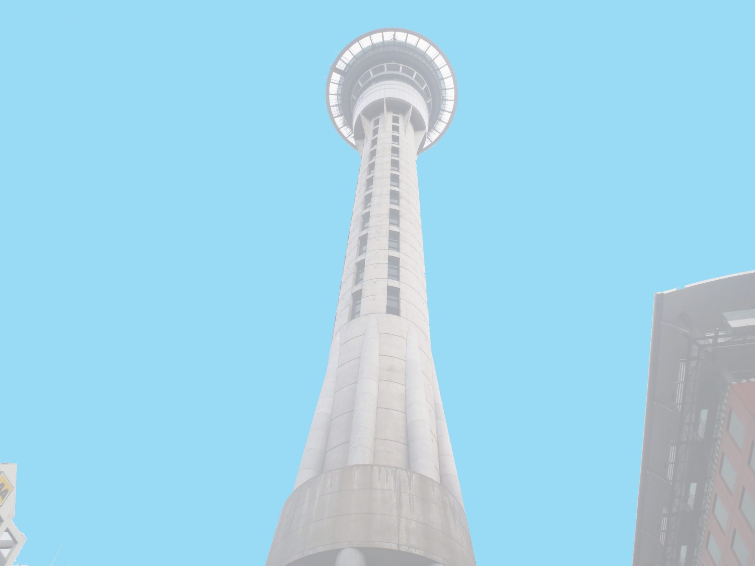



Anthony Adams
Securing of Unreinforced Masonry Parapets
The University of Auckland, New Zealand
Host Mentors: Dmytro Dizhur & Liam Wotherspoon
UCSD Mentor: Lelli Van Den Einde
Aug 22nd 2013

Slide 2
Experiment
Multiple two leaf parapets, secured using common retrofits of the area and experimentally validated retrofits, will be dynamically loaded on a Shake table to provide experimental data of their effectiveness in a dynamic setting.
Test both experimentally validated and industry accepted retrofits for URM parapets to see which methods are the most effective.
Goals

Slide 3
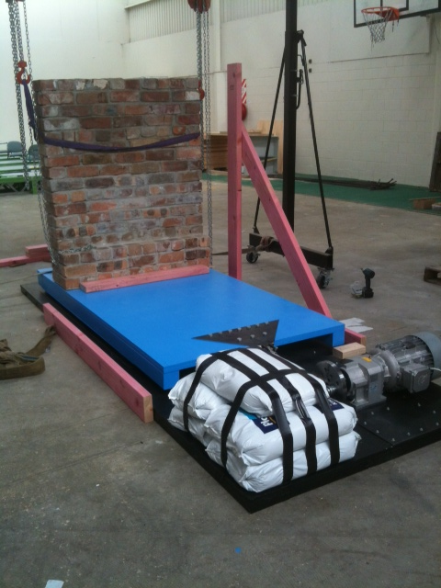
Securing of URM parapets
Unfortunately testing will begin right after my departure =( however I provided ample input on the project and we have planned to Skype during testing so I can see my hard work in action and see real time results.
Everything now works! We just needed to attach the measuring devices.

Slide 4
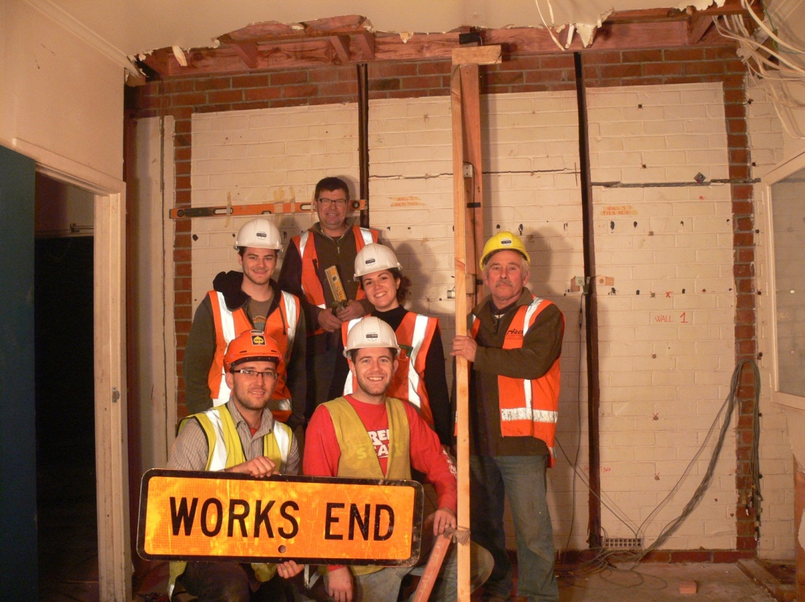
Victoria street testing
I have completed all of the data processing for the Victoria Street Airbag testing and even written a full report on our findings.
I presented our findings to members of the engineering faculty at school who plan on releasing the results to Industry.

Slide 5
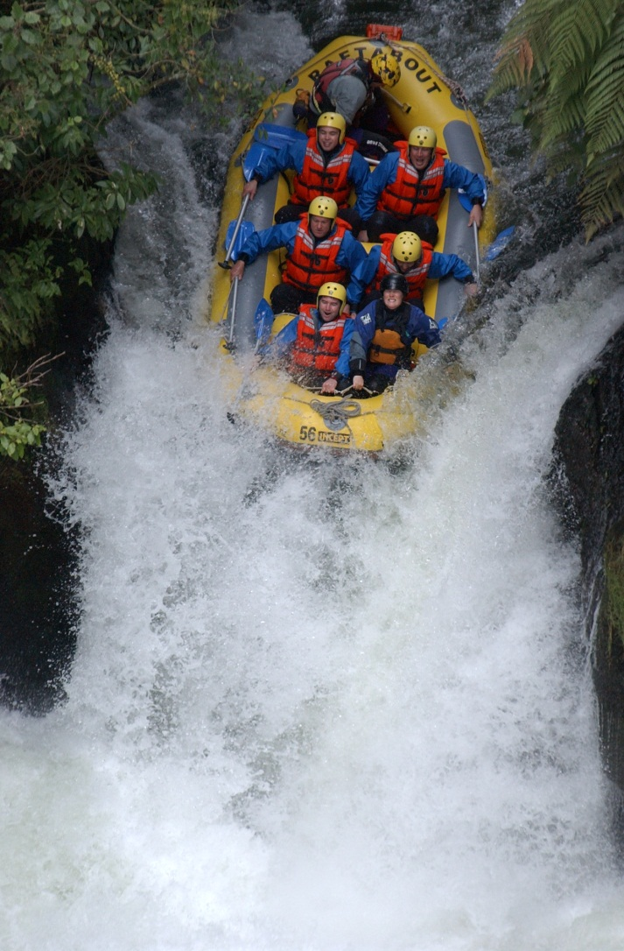
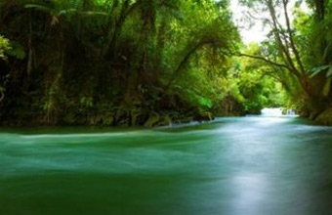
White Water Rafting
No pictures of our trip yet… but we went white water rafting on the Kaituna river in Rotorua. Class 5 rapids with 3 waterfalls, one of which is the highest commercially rafted waterfall in the world 7M =)
Scenery looked fake it was so perfect.

Slide 6
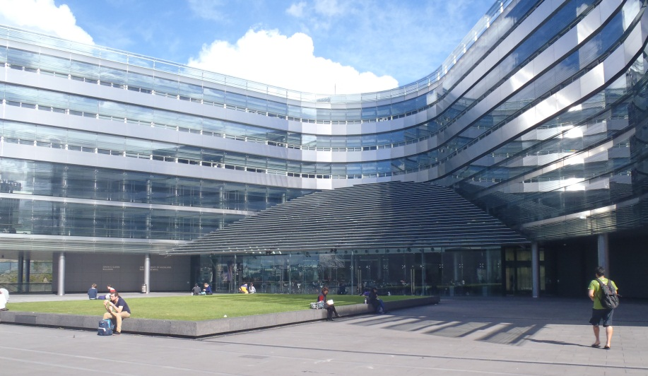
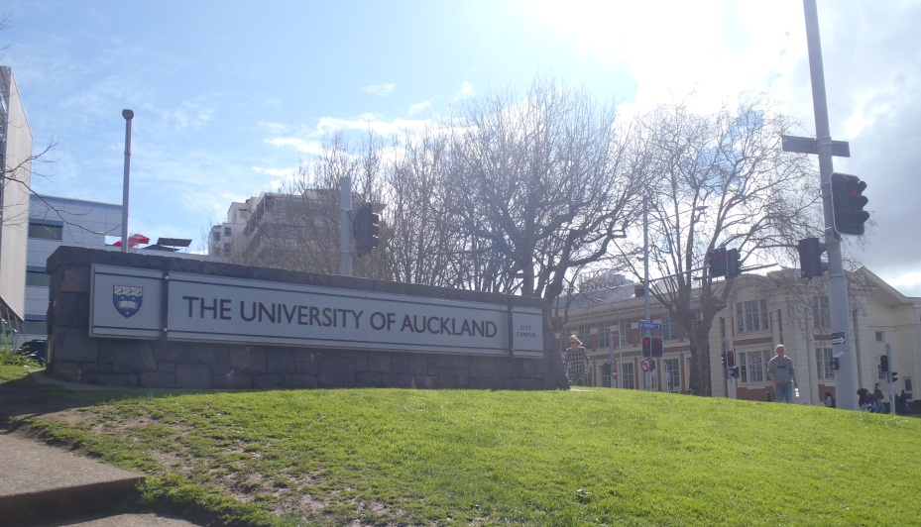
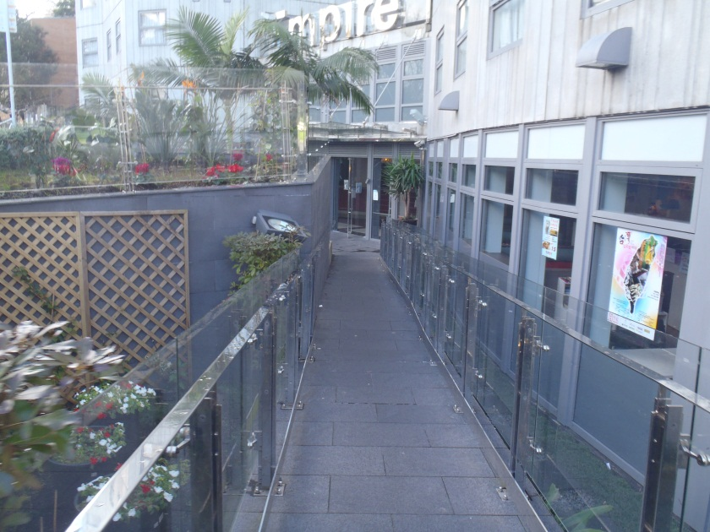
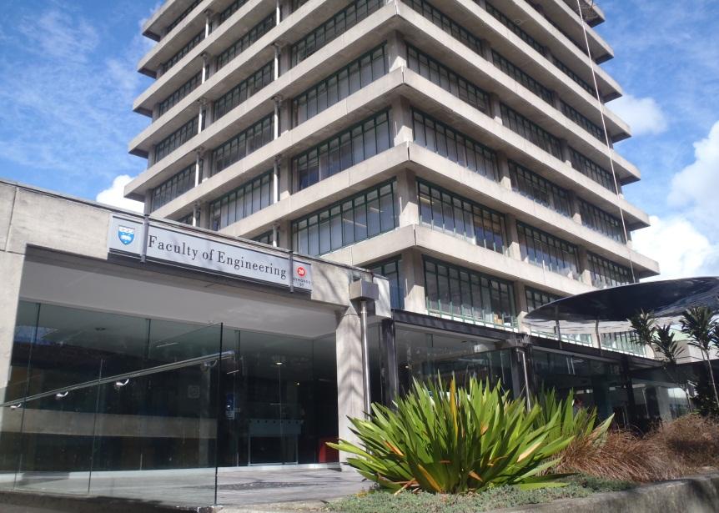
Goodbye Auckland, It’s been Fun!

Slide 7
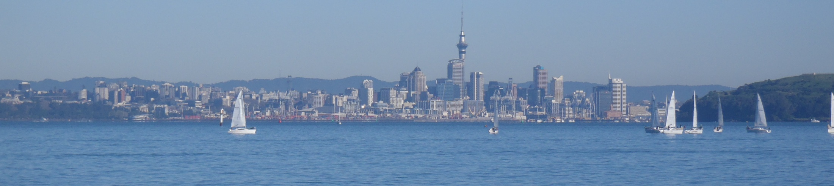
Acknowledgements
Thank you to everyone who has made this life changing experience possible!
Auckland Mentors: Liam Wotherspoon, Dmytro Dizhur
UCSD Mentor: Lelli Van Den Einde
PRIME: Gabriele Wienhausen, Peter Arzberger

