Slide 1
Structure Investigation of Fam20C, A Golgi Casein Kinase
Sharon Grubner
National Taiwan University
Second weekly report – July 3rd, 2013

Slide 2
Progress
Attended the first Taiwan-Korea Bilateral Biophysics Conference—my first conference in Taiwan!
130ns of the first free dynamics simulation, ~8ns of the second third simulations
Practiced using AutoDock Vina
Learned how to use various useful tools in VMD, such as:
MultiSuq- aligning two pdb structures
RMSD Visualizer Tool
Use Tk Console to show bond lengths between specific residues
Read more papers about Fam20C and its structure
Prepared presentations about Israel and my research project for the lab meeting on Thursday
My progress is being updated on a daily basis and shared with my mentors on Evernote.

Slide 3
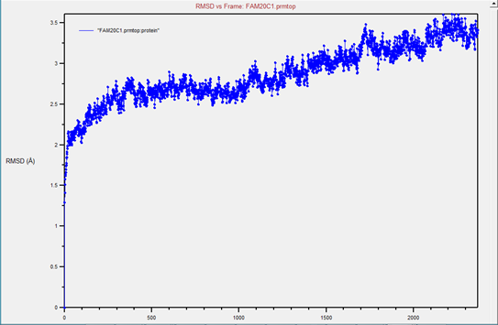
RMSD Visualizer Tool
RMSD for 118ns of simulation of the entire protein

Slide 4
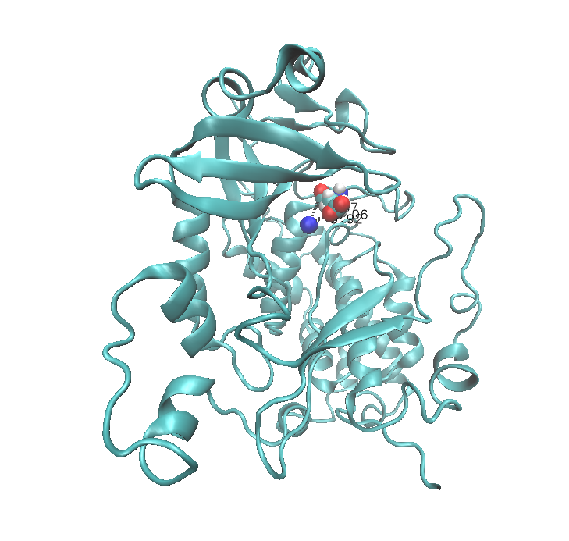
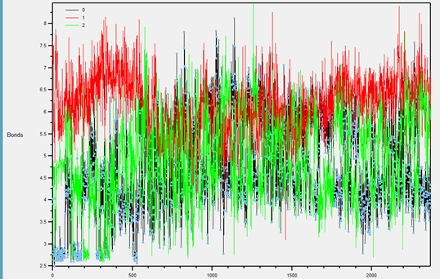
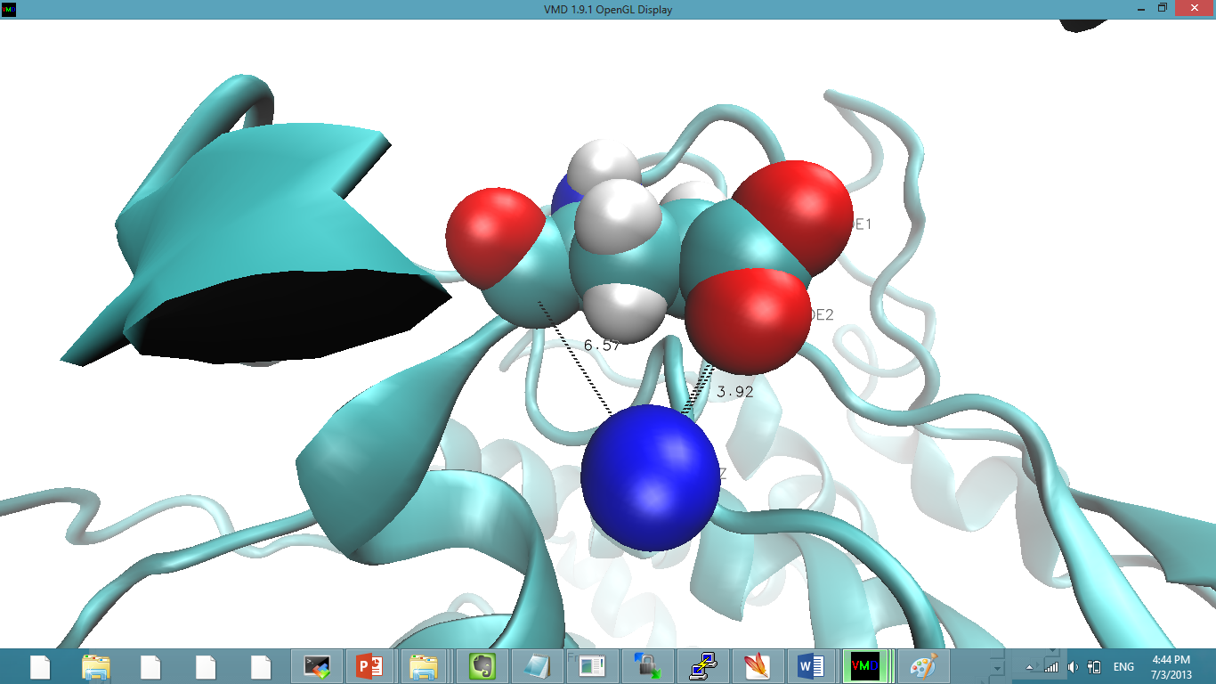
Bond lengths between Lys192-Glu213
Analysis of salt bridge interactions between the nitrogen of K and the oxygens of E
Measurement of the bond lengths throughout the simulation
What percentage of the time there is a salt bridge interaction (below 4A) – this value is not in this presentation

Slide 5
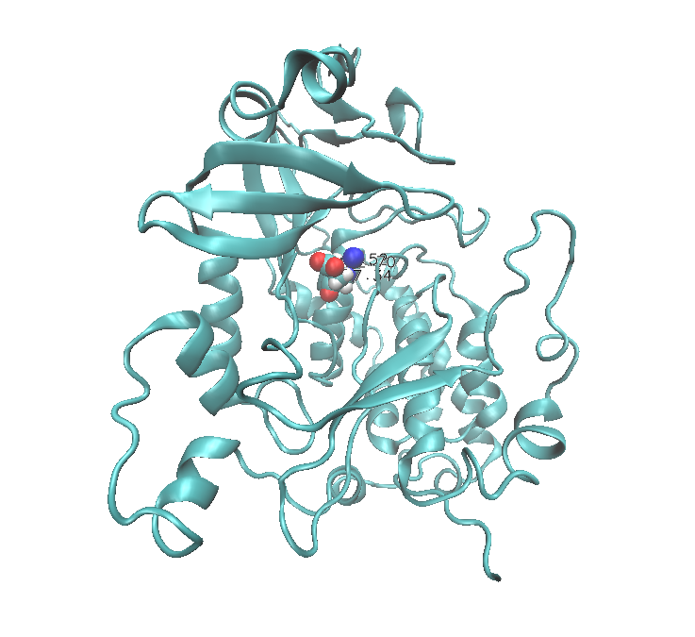
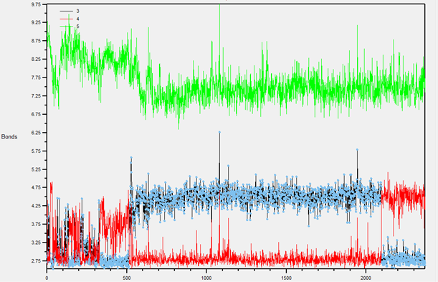
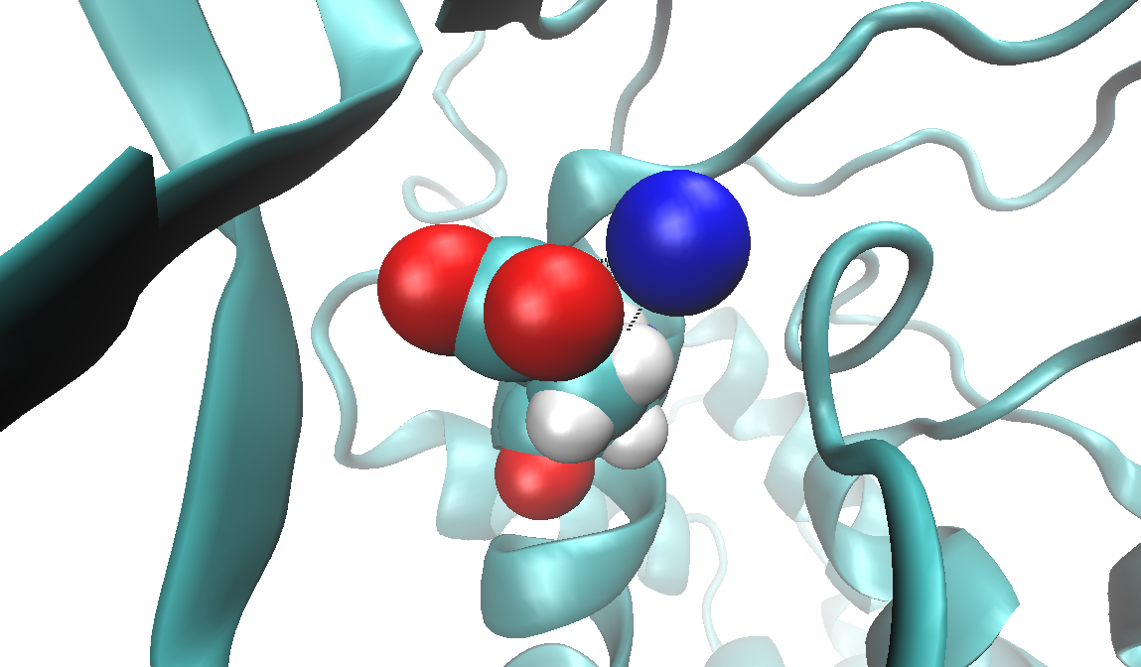
Bond lengths between Lys192-Glu218

Slide 6
Goals for the Next Week
Once the first simulation is done:
Watch the motion of various loops within the structures (K171-K178, p-loop, A300-R306):
Quantitative analysis – RMSD Visualizer Tool
Qualitative analysis- watch trajectory and draw conclusions for drug discovery purposes
Measure and plot distances between alpha carbons of certain residues (G173-H308, G174-H369, K192-E213 vs. E218)
Install and start learning how to use electrostatics plugin DeIEE in VMD

Slide 7
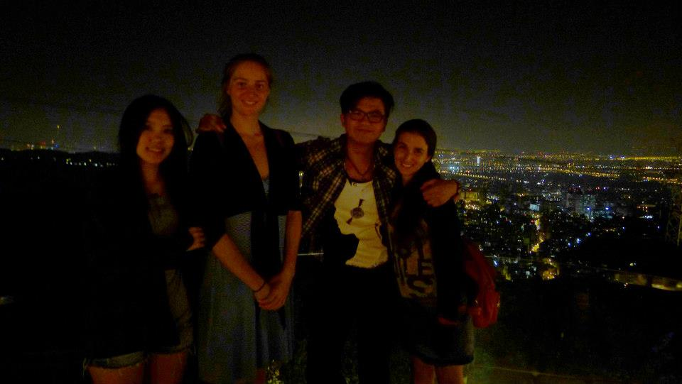
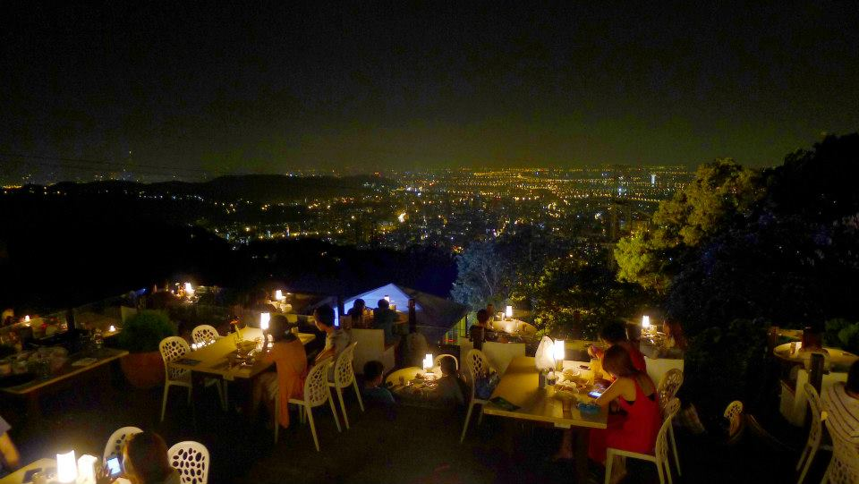
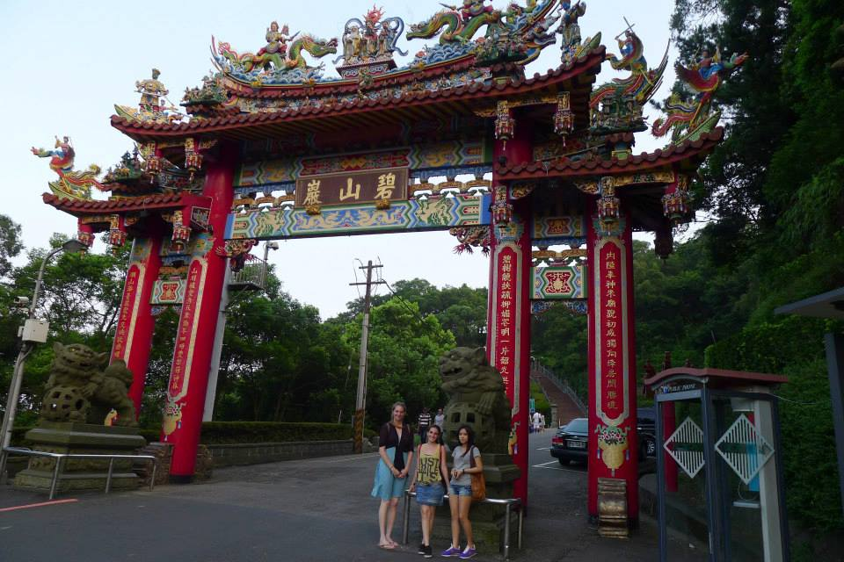
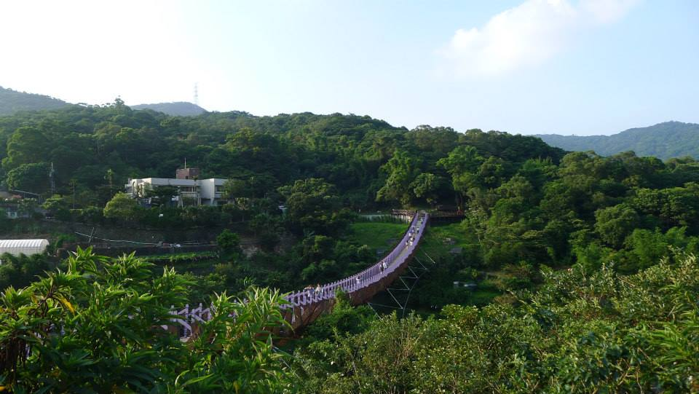
Culture
Our friends took us to a beautiful restaurant on Yangming mountain overlooking Taipei

Slide 8
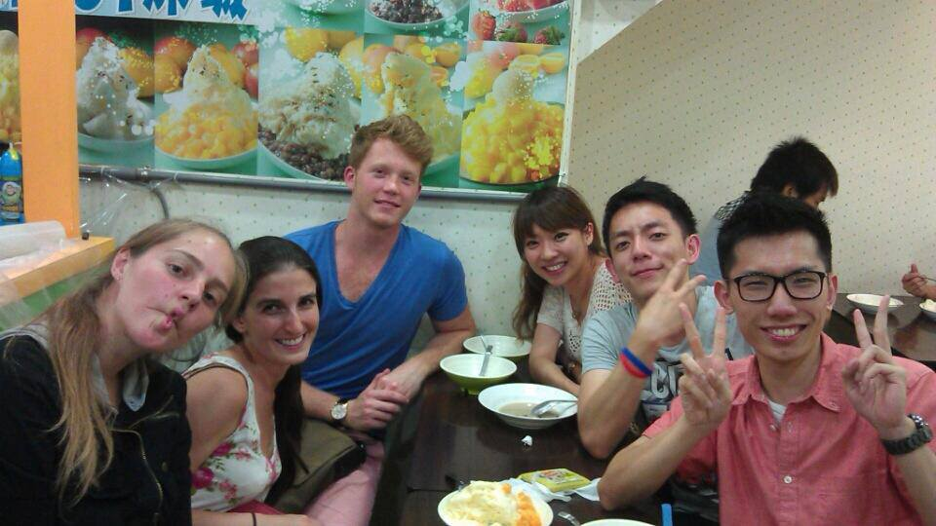

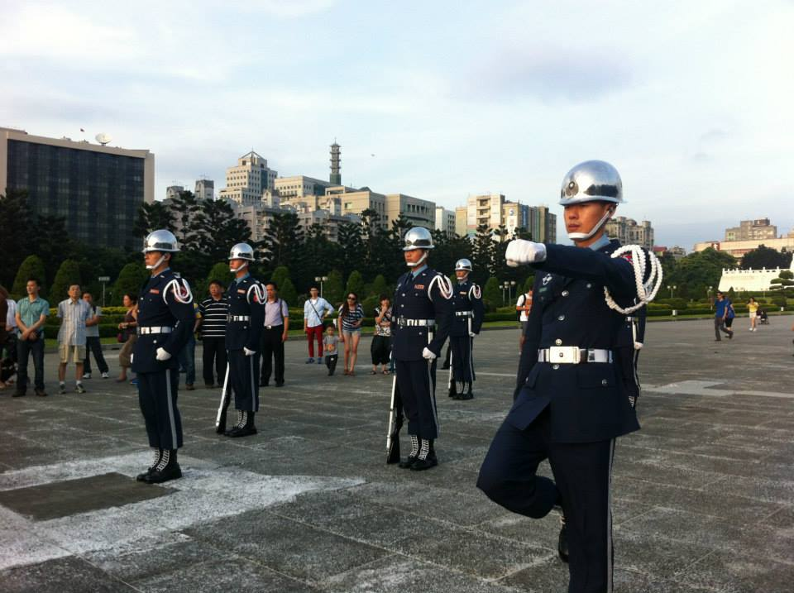
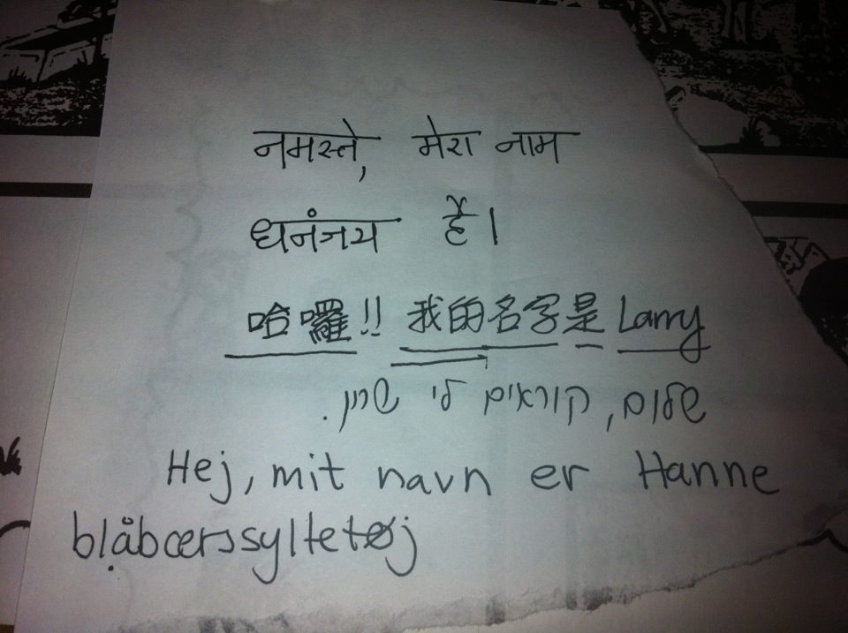
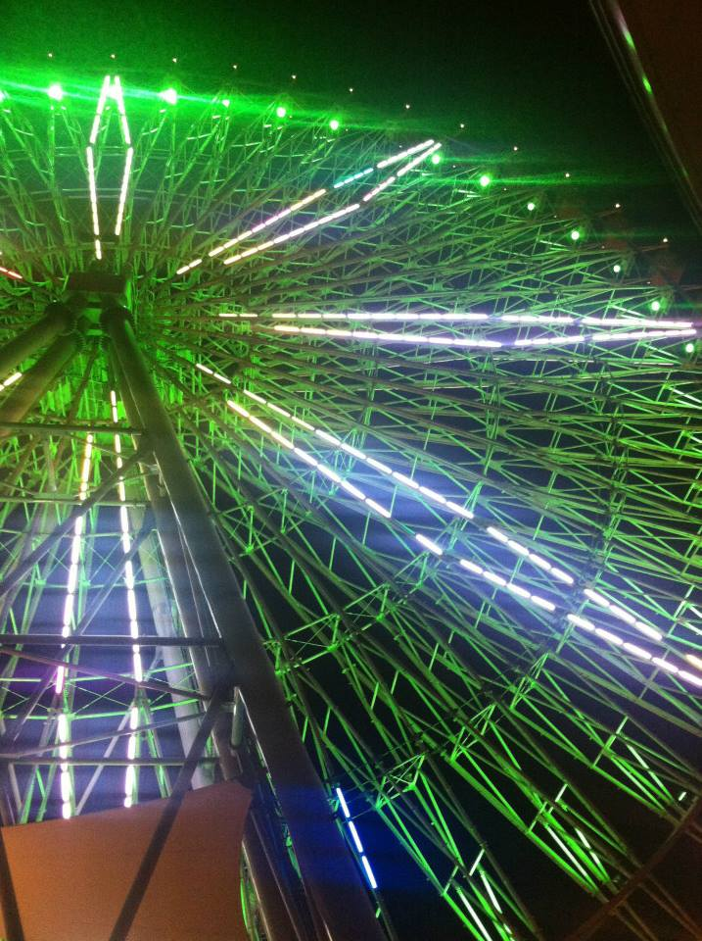
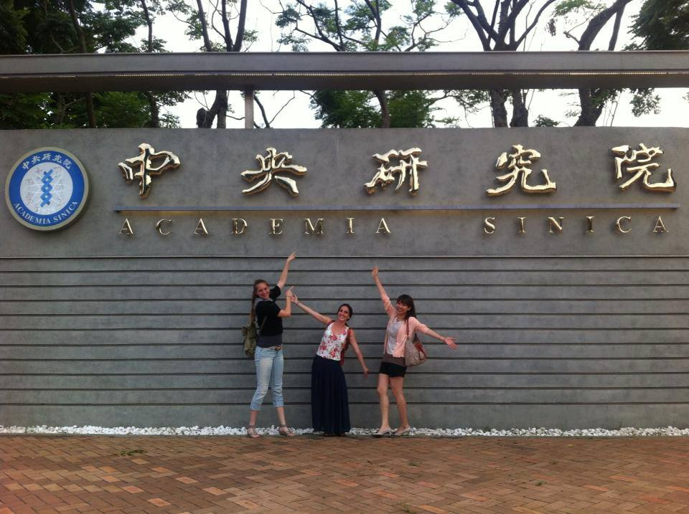
One dinner – 4 different languages
Our friends took us to their favorite place to get shaved ice at Shiling night market

Slide 9
Acknowledgments
UCSD (University of California San Diego)
Dr. Rommie Amaro
Dr. Gabriele Wienhausen
Dr. Peter Arzberger
Teri Simas
NTU (National Taiwan University)
Dr. Jung-Hsin Lin
Julia Brown Undergraduate Research Scholarship

