Slide 1
Structure Investigation of Fam20C, A Golgi Casein Kinase
Sharon Grubner
National Taiwan University
Third Weekly report – July 10th, 2013

Slide 2
Progress
First free dynamics simulation was completed today!
Learned how to use RMSD Visualizer in VMD
Select specific ranges of residues
Edit and analyze RMSD plots of bond interactions
Learned how to use VolMap Tool in VMD
Looking at the percentage of water molecules present inside the ATP binding pocket
Clustering
Learned about clustering
Practiced preparing the trajectory files and using GROMACS clustering- still having issues, will continue working on it next week
My progress is being updated on a daily basis and shared with my mentors on Evernote.

Slide 3
Goals for Next Week
Repeat and implement some of the analysis tools I have learned how to use in the past couple of weeks, on the first final free dynamics simulation which was just completed.
Watch the motion of various loops within Fam20C structure (K171-178, A300-306)
Quantitative analysis – RMSD Visualizer Tool
Qualitative analysis- watch trajectory and draw conclusions for drug discovery purposes
Analyze the distance between alpha carbons to analyze larger motions of P-loop
Start to measure and plot distances of salt bridge interactions between certain residues, throughout the simulation
Fix clustering tool errors

Slide 4
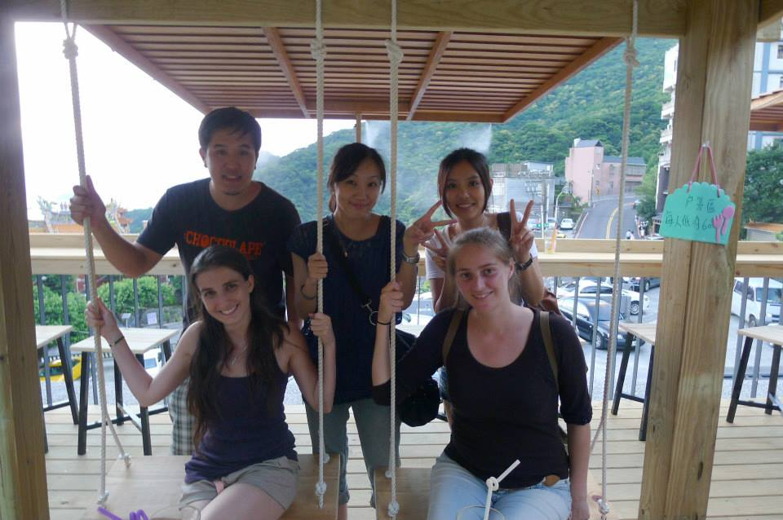
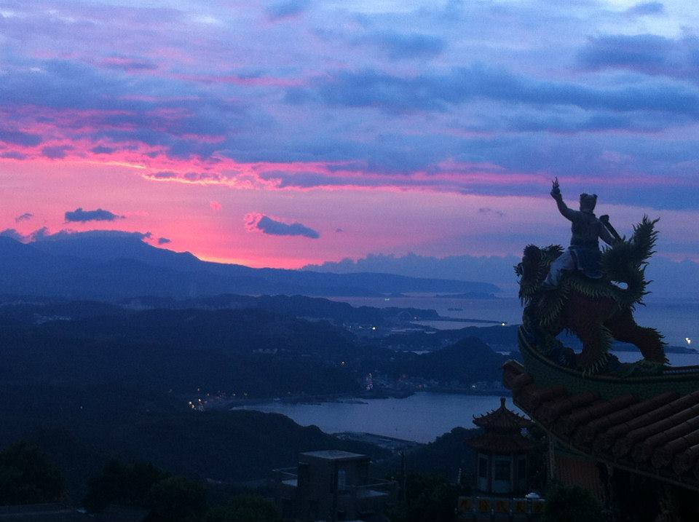
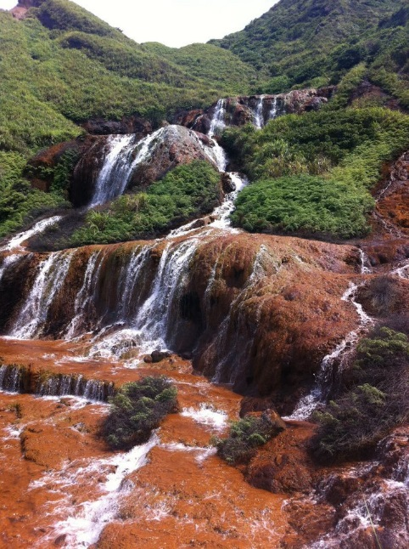
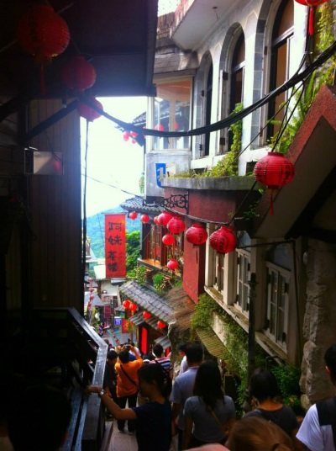
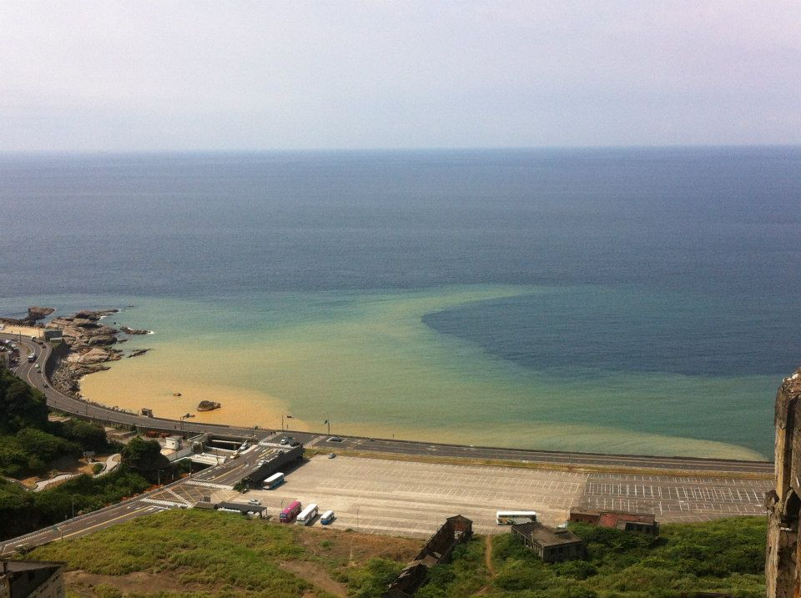
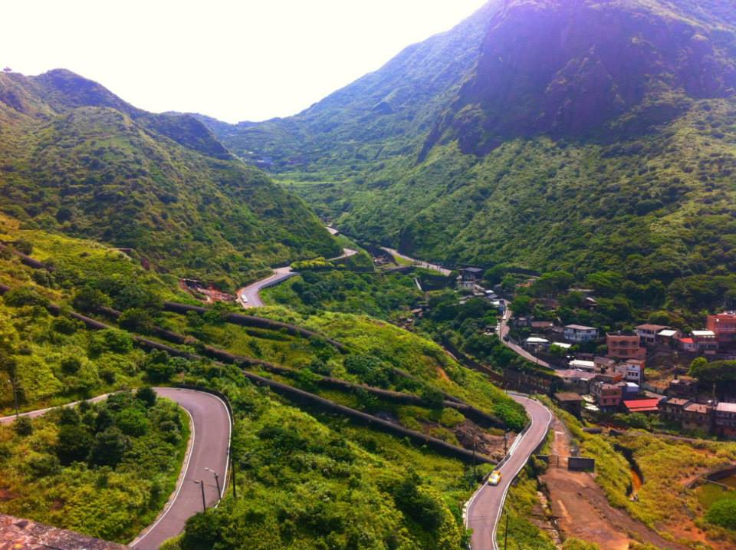
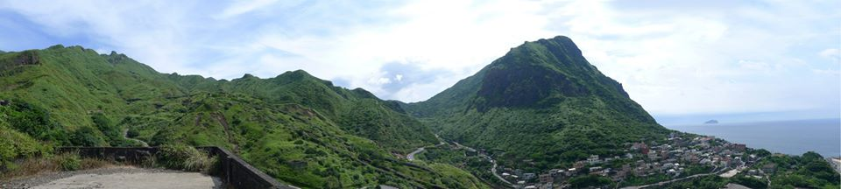
Culture
Had a great day with good friends at Jiufen

Slide 5
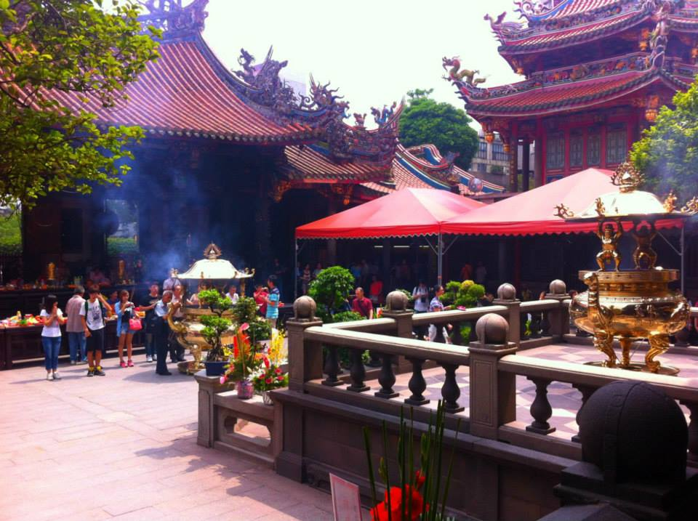
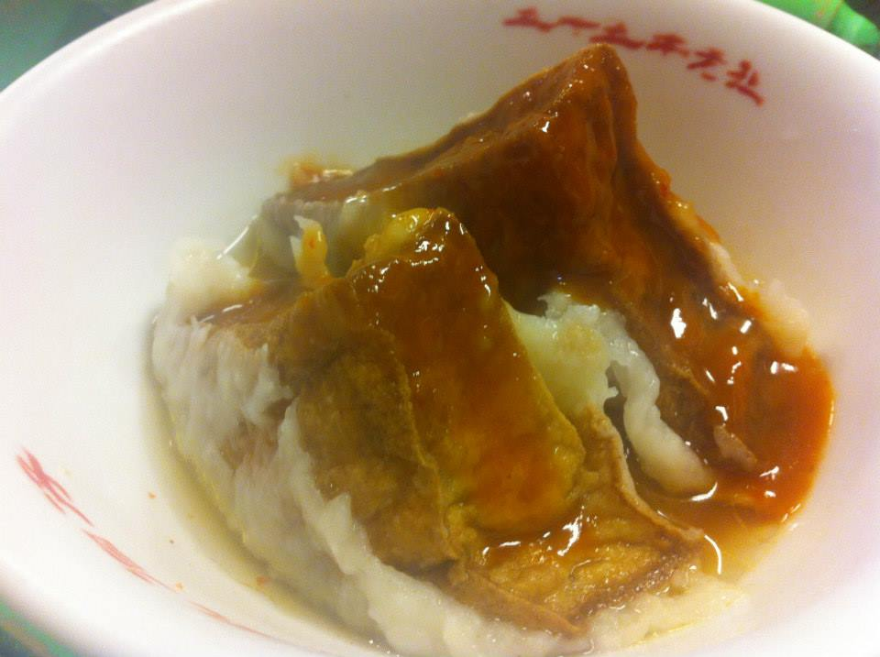
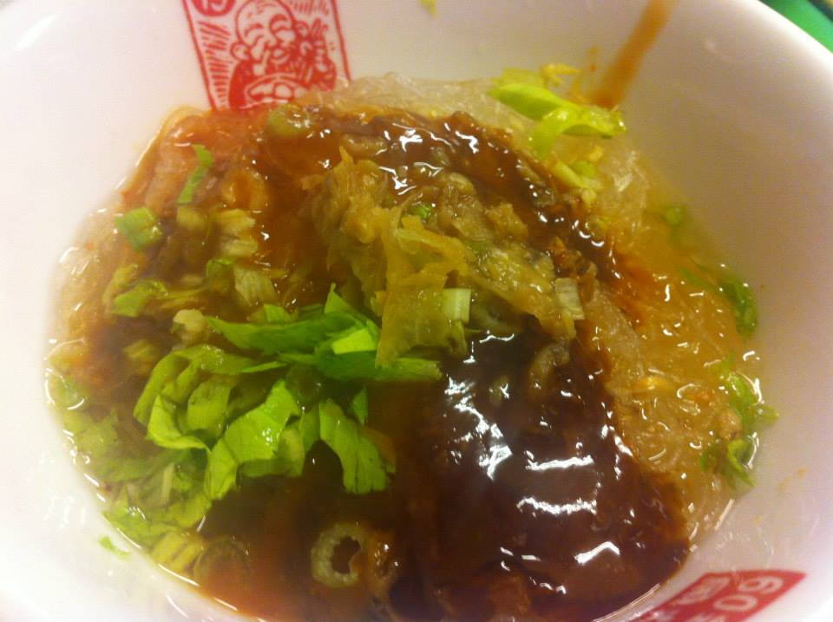
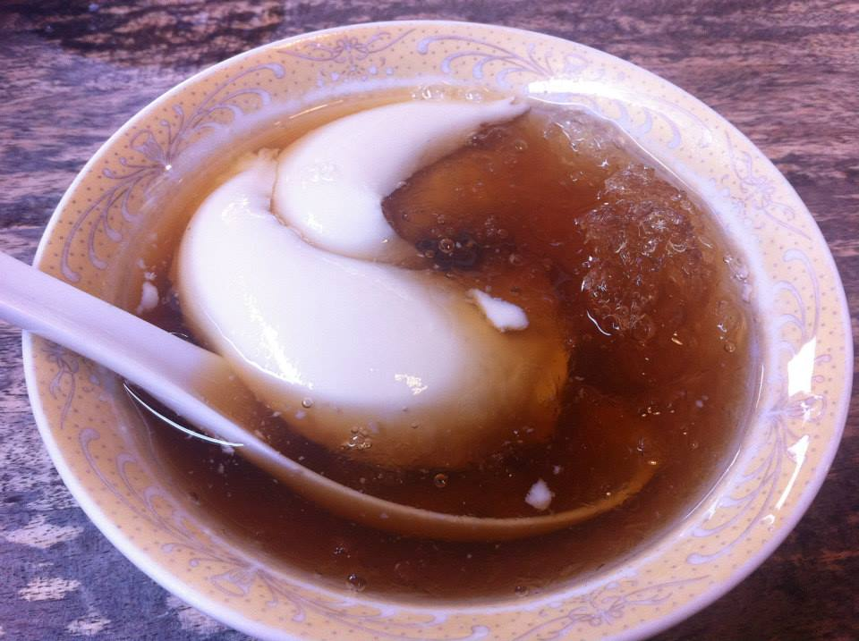
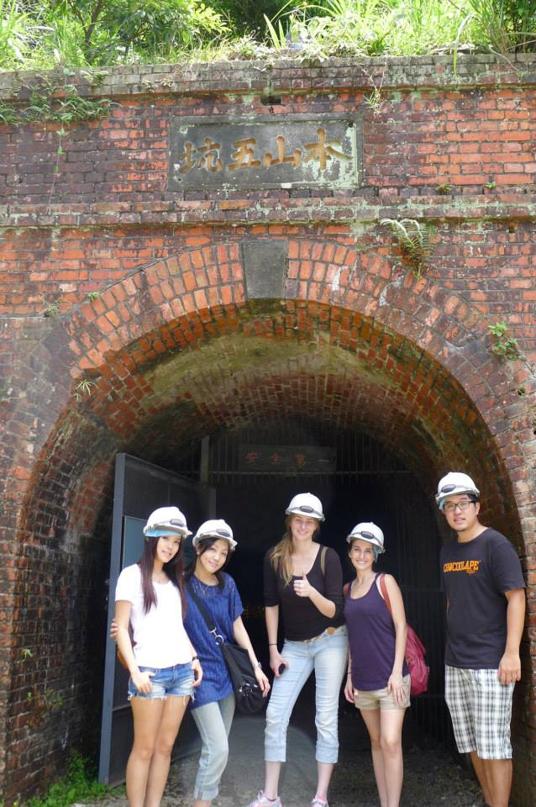
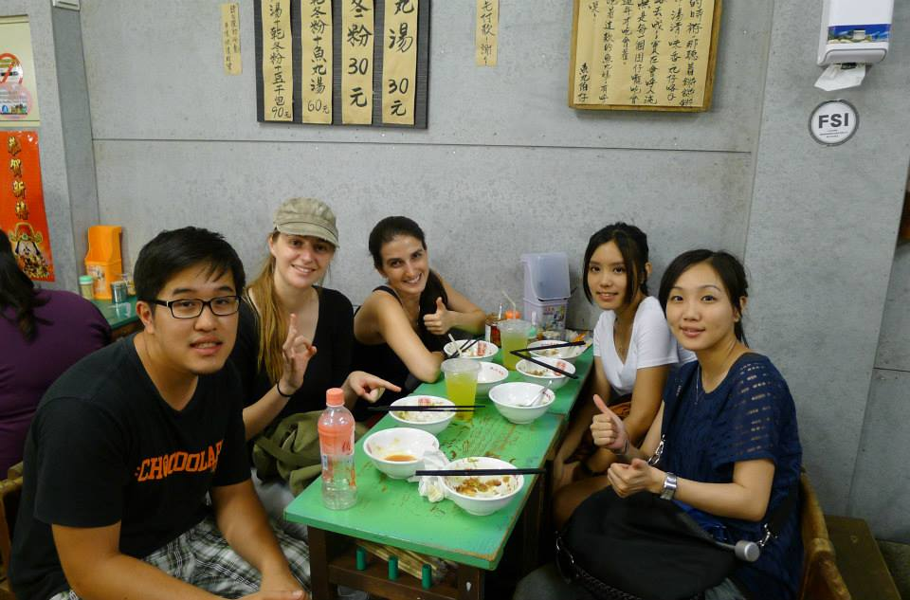
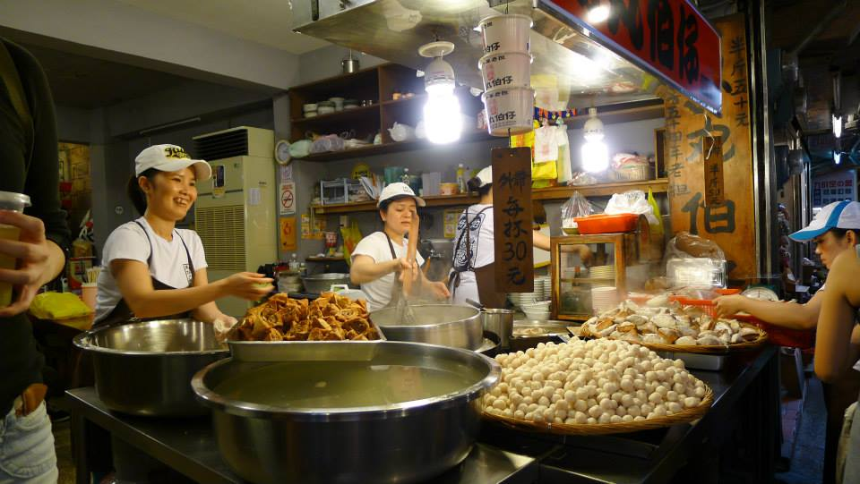
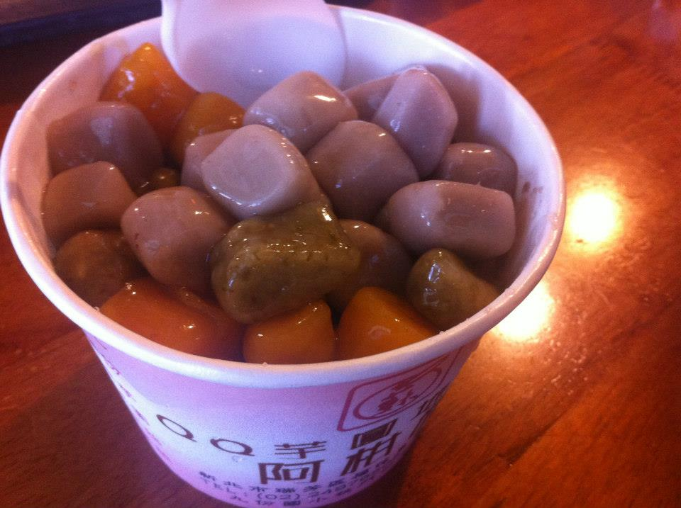
Gold Museum at Jiufen- a town used as inspiration for the movie Spirited Away
Longshan temple
Jiufen famous desert- sweet potato and yam dumplings with brown-sugar and ice

Slide 6
Acknowledgments
UCSD (University of California San Diego)
Dr. Rommie Amaro
Dr. Gabriele Wienhausen
Dr. Peter Arzberger
Teri Simas
NTU (National Taiwan University)
Dr. Jung-Hsin Lin
Julia Brown Undergraduate Research Scholarship

