Slide 1
Installation and Integration of Virtual Clusters onto Pragma Grid
NAIST Nara, Japan
Kevin Lam 07/17/13

Slide 2
Week 3: Testing
This entire week was comprised of testing dock and MPI using the predetermined “Protein Binding Mode Test Set” found on Dock’s main website.
Initially, there were problems running dock6.mpi. This was caused by missing .so files such as libopen-pal.so.0. A quick copy and transfer solved the issue.
Another problem was that MPI resulted in no output. After researching, the problem seemed to be due to firewall socket issues. Even after setting up an exception, virtual machines 1 and 3 would not run when grouped. The only solution was to disable the firewall.

Slide 3
Week 3: Testing (Continued)
Compound 1ABE was tested using both Grid and AMBER scoring to determine energy score accuracy. Results were around +5 off from given energy score.
In order to test a large set of ligands from the database, the input file needed to be configured so that Dock would run continuously. Each #_top.mol2 file was appended and combined together using a for loop command.
A problem came up where Dock6.mpi would not evenly distribute processes between the virtual machines.

Slide 4
Coming Up Next Week
The first issue would be to determine why dock6.mpi doesn’t distribute tasks because the machines are currently repeating the same jobs.
The firewall problem needs to be fixed before it can be put onto public clusters.
If no other problems come up, the virtual cluster can be integrated into NAIST clusters.

Slide 5

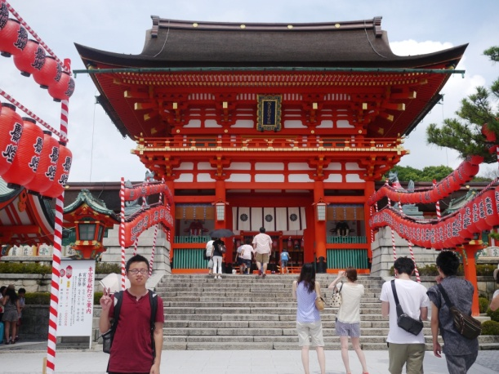
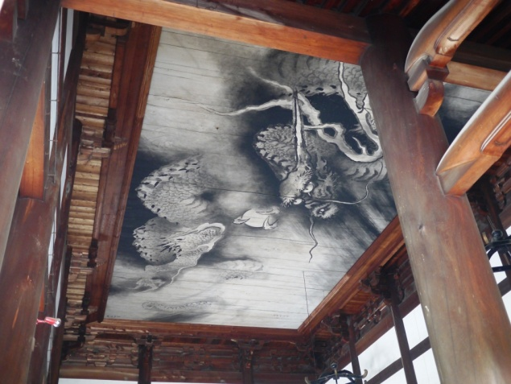
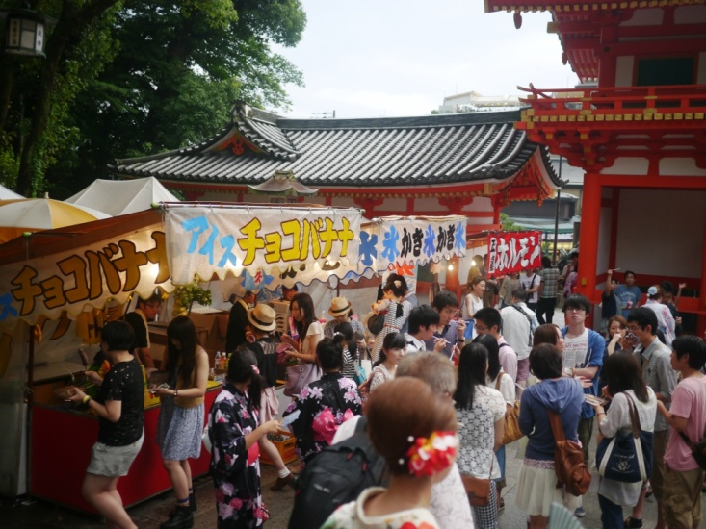

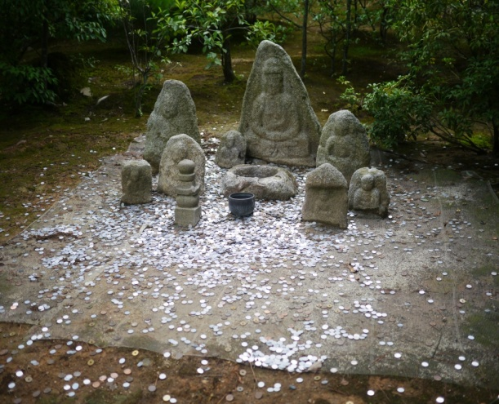
Exploring the Culture

Slide 6
Acknowledgments
I would like to thank
Dr. Haga for guiding us through this program.
Professor Ichikawa for his knowledge and assistance with clusters as well as his hospitality.
Peter Arzberger, Gabriele Wienhausen, Teri Simas and all PRIME staff for organizing this trip and making it possible.
NAIST and JASSO for providing the accommodations.

