Slide 1


Fabian Lema
Wk3
Remote Monitoring of Android Devices Using Inca Framework
University Of Queensland, Australia
July 17, 2013

Slide 2
Project Diagram
Wk3
Automated Reporter Agent
Android Device
(Data Collection Platform)
Suite
(Test)
Report Manager
(Script)
Data Collection
Service
Data
Depot
XML Report
The Reporter Agent sends a Test to the Report Manager.
The Report Manager then listens to a broadcast from the Data Collection Service to get information about the state of the Service.
The Report Manager creates an XML Report with the results of the Test and stores it in the Depot.

Slide 3
Progress to date
Wk3
My host mentor, David Abramson, in a meeting last week asked me to explain my project this task was difficult so I took a step back and based on the Inca overview I designed an aid to help me visualize my project.
Since “All communication between the interpreter and the Android API typically uses JSON to pass information” (Ferrill, Pro Android with Python with SL4A, p.6) I learned JSON to obtain the elusive data the Service broadcasts.
In order to send time-sensitive information, the Service now broadcasts from a thread. It creates a intent which is sent as a sticky broadcast. I took this approach since:
“Sticky Intents are cached by Android
New Intents overwrite older Intents they match” cs.umd.edu

Slide 4
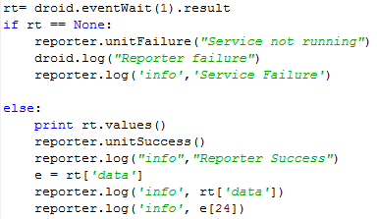
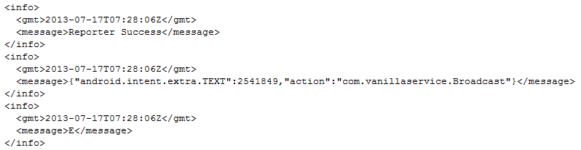
Issues
Wk3
The Service knows how long it has been running and transmits this information.
eventWait() returns a JSON object with keys data, name, time. The key “data” should have an object value, that has two keys “android.intent.extra.TEXT” and “action”. However, using rt.data.action generates errors. I can’t access this information, it seems like the value of “data” is a string and not an object. Further reading is needed.

Slide 5
Tentative objectives for next week
Wk3
Understand if the Inca Report Manager is a Daemon and take steps towards its implementation on the Android device.
Obtain the data broadcasted from the Service
Continue with the Inca framework workshops found at inca.sdsc.edu
Use Incat to execute simple tests in the device
Upload Reports to the Inca Depot

Slide 6
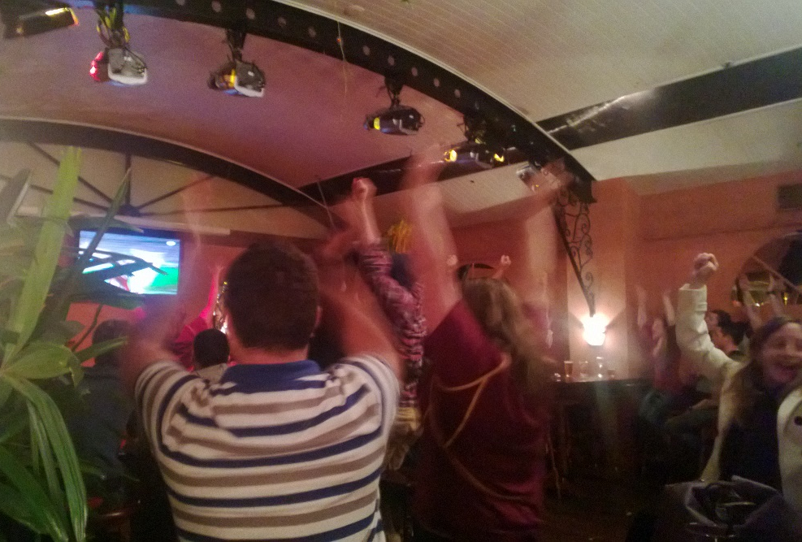

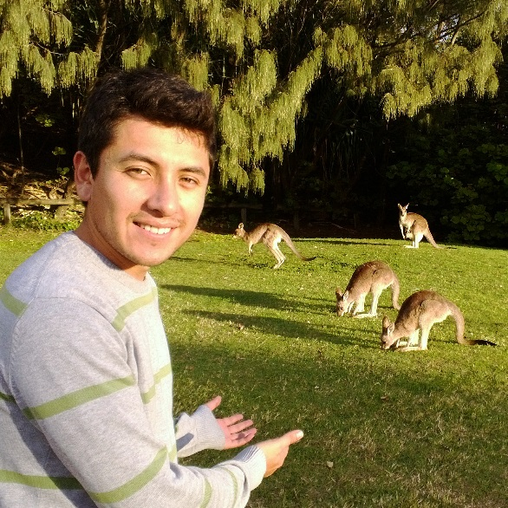

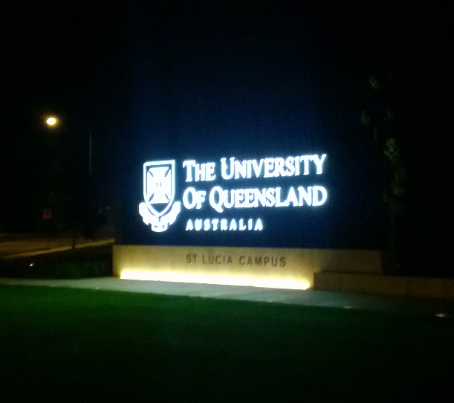
Cultural side
Wk3

Slide 7
Acknowledgments
Wk3
Sameer Tilak, Assistant Research Scientist Calit2, CLEOS SDSC
David Abramson, Director of The University of Queensland Research Computing Centre
Shava Smallen, Programmer at the San Diego Super Computer Center
Gabriele Wienhausen, Associate Dean for Education, Division of Biological Sciences, UCSD, Director and PI of NSF Award, Pacific Rim Experiences for Undergraduates (PRIME)
Peter Arzberger, Chair, PRAGMA Steering Committee, Principal Investigator / Director – NBCRC, co-director of PRIME
Teri Simas, PRIME Program Manager, PRAGMA Program Manager

