Slide 1


Fabian Lema
Wk5
Remote Monitoring of Android Devices Using Inca Framework
University Of Queensland, Australia
August 2, 2013

Slide 2
Progress and Issues to date
Wk5
The Reporter Manager is still an issue, I contacted Shava Smallen and she will help me providing a “trimmed down” version of the Reporter Manager which won’t have SSL.
I read more about the Android OS architecture and since it runs on the Linux Kernel it may be possible to install Perl and the Inca libraries.
I found several independent projects about installing Perl but I am yet to be able to install Perl on Android.
http://code.google.com/p/perldroid/
http://www.thenautilus.net/SW/perl-on-android/
https://github.com/castaway/perl/wiki

Slide 3
Tentative objectives for next week
Wk5
Install Perl on the Android device
Install the Inca Perl Modules that Shava Smallen pointed out:
XML::Namespace XML-NamespaceSupport-1.09 PERLSTANDARD
XML::SAX XML-SAX-0.14 PERLSTANDARD
XML::Simple XML-Simple-2.14 PERLSTANDARD
Schedule::Cron Schedule-Cron-0.97 PERLSTANDARD
Module::Build Module-Build-0.2609 PERLNON
Date::Manip Date-Manip-5.54 PERLSTANDARD
Params::Validate Params-Validate-0.91 PERLSTANDARD
URI URI-1.35 PERLSTANDARD…

Slide 4
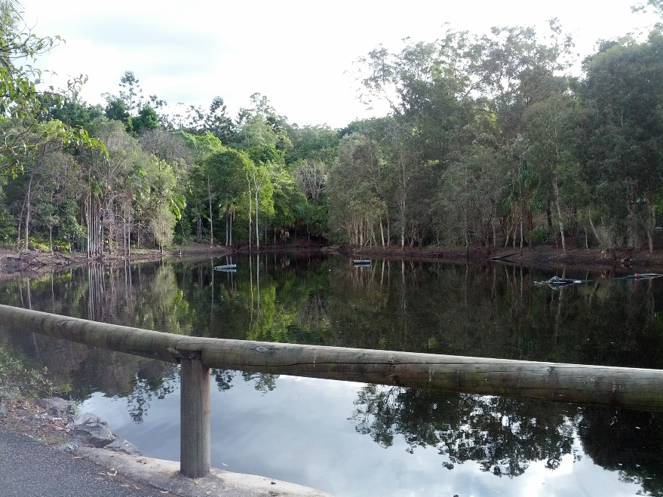
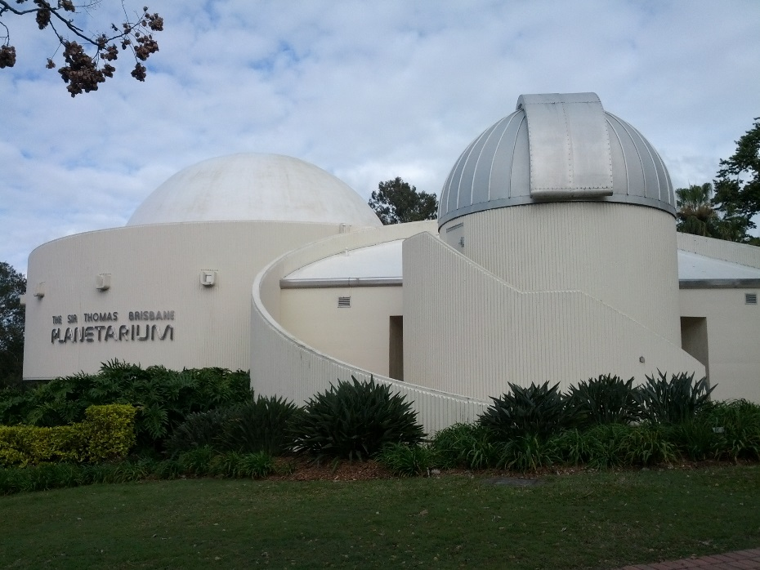
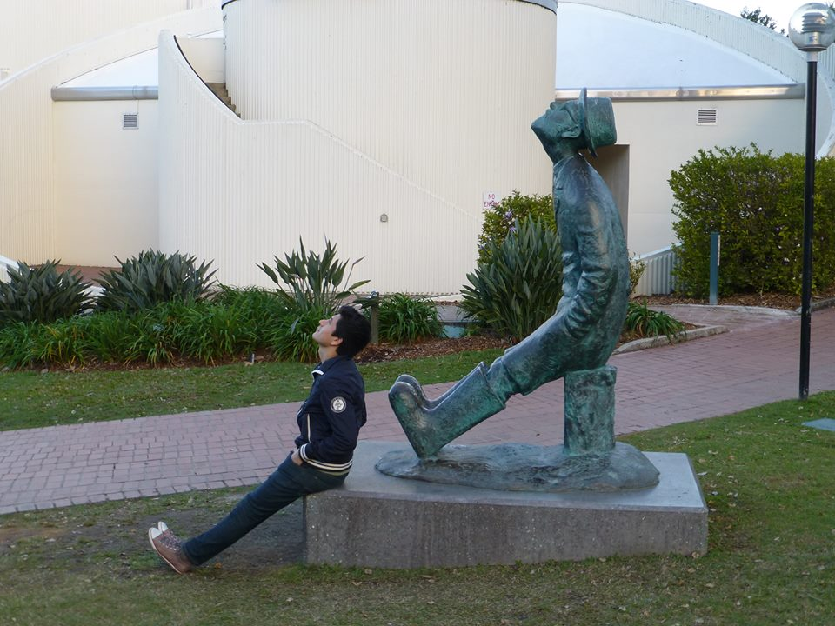
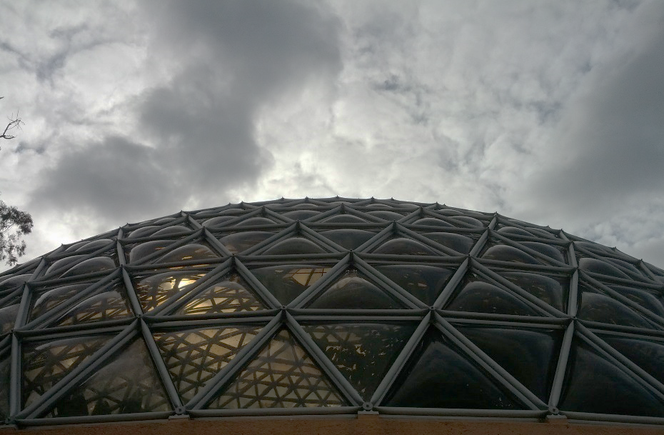
Cultural Aspect
Wk5

Slide 5
Acknowledgments
Wk5
Sameer Tilak, Assistant Research Scientist Calit2, CLEOS SDSC
David Abramson, Director of The University of Queensland Research Computing Centre
Shava Smallen, Project lead and developer for the Inca Grid monitoring software tool, SDSC's PI and chair of the Performance Committee for the FutureGrid.
Gabriele Wienhausen, Associate Dean for Education, Division of Biological Sciences, UCSD, Director and PI of NSF Award, Pacific Rim Experiences for Undergraduates (PRIME)
Peter Arzberger, Chair, PRAGMA Steering Committee, Principal Investigator / Director – NBCRC, co-director of PRIME
Teri Simas, PRIME Program Manager, PRAGMA Program Manager

