Slide 1


Fabian Lema
Wk6
Remote Monitoring of Android Devices Using Inca Framework
University Of Queensland, Australia
August 7, 2013

Slide 2
Progress and Issues to date
Wk6
The list of modules that are required by the Inca Reporter Manager were installed with the exception of BSD::Resource
With the help of Dr. Abramson’s PhD. Student, Hoang Nguyen, I was able to understand and learn many useful Linux commands, we went over several lines of code of the Inca Reporter Manager installer (Makefile.PL and the makefiles that are created when the former file is executed) to understand better the process of installation. We did the same with the modules that Inca requires.

Slide 3
Progress and Issues to date
Wk6
Although PerlDroid has the CPAN capabilities, all the attempts to install Perl modules from within Android proved to be futile. Moreover, since Android Shell is a very limited version of Bash Shell even with the added binaries, that were obtained by installing Busybox after rooting the phone, commands like $make are nonexistent.
To solve this I decided to install the Perl modules on my computer first, look where this files and directories were installed and then copy them to the phone’s directory: /data/data/com.googlecode.perlforandroid/extras/perl/site_perl

Slide 4
Progress and Tentative
Wk6
From empirical observation the installation of most of the modules copies directories that contain either .pm or .pod files to the local directory where Perl is installed. Since Perl is an interpreted language no binaries are generated, so I’m assuming copying and pasting will work.
Hoang, did warn me that there might be problems since I’m compiling the modules in different architectures (Windows and Android) but so far previous compilation errors are disappearing.
Hoang also pointed out that the installation of the Reporter Manager seems to be doing something similar, moving directories and modules around, so I installed it on a Linux VM and copied the entire folder to the phone. I will keep on working following this approach.

Slide 5
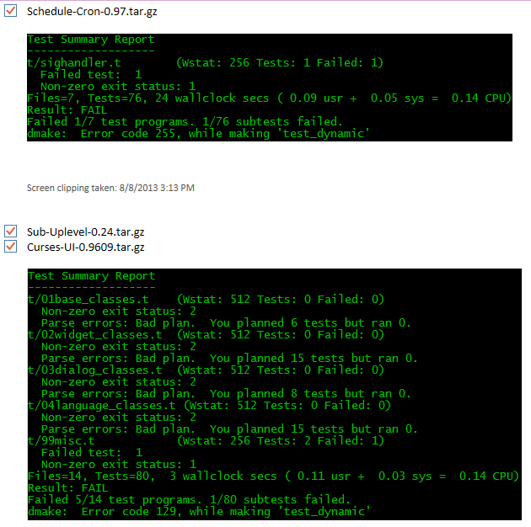
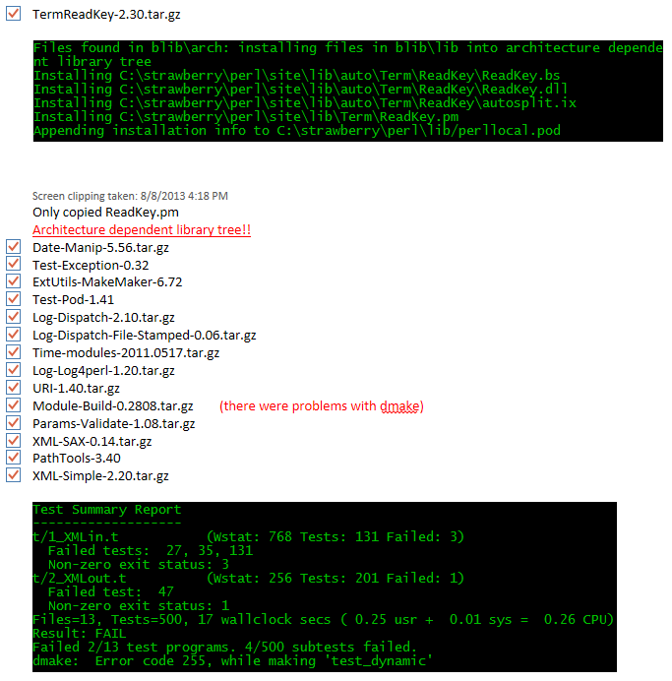
Progress and Issues to date
Wk6

Slide 6
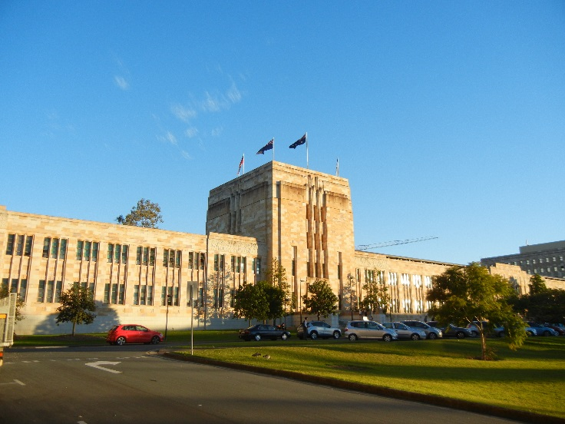
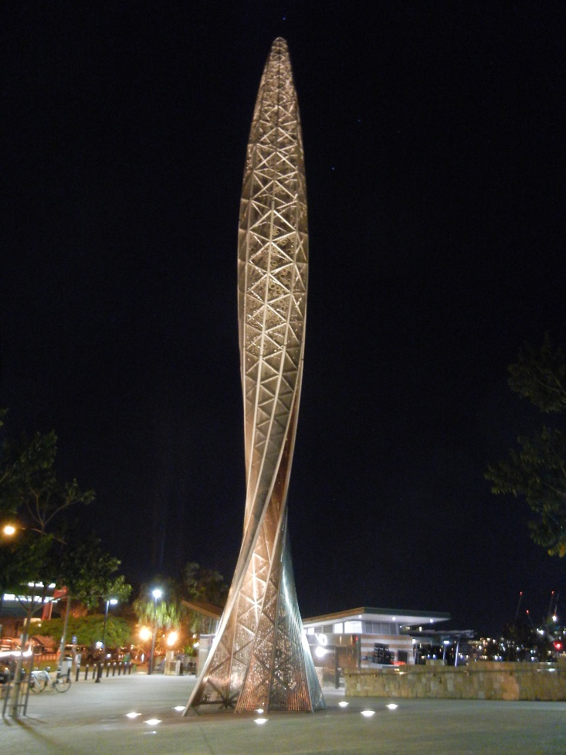


Cultural Aspect
Wk6

Slide 7
Acknowledgments
Wk6
Hoang Anh Nguyen, PhD. Student
Sameer Tilak, Assistant Research Scientist Calit2, CLEOS SDSC
David Abramson, Director of The University of Queensland Research Computing Centre
Shava Smallen, Project lead and developer for the Inca Grid monitoring software tool, SDSC's PI and chair of the Performance Committee for the FutureGrid.
Gabriele Wienhausen, Associate Dean for Education, Division of Biological Sciences, UCSD, Director and PI of NSF Award, Pacific Rim Experiences for Undergraduates (PRIME)
Peter Arzberger, Chair, PRAGMA Steering Committee, Principal Investigator / Director – NBCRC, co-director of PRIME
Teri Simas, PRIME Program Manager, PRAGMA Program Manager

