Slide 1


Fabian Lema
Wk7
Remote Monitoring of Android Devices Using Inca Framework
University Of Queensland, Australia
August 14, 2013

Slide 2
Progress and Issues to date
Wk7
Thanks to the Linux expertise of David’s PhD. Student, Hoang Nguyen, I was able to advance in some key factors of the Inca Reporter Manager Installation.
One of the main problems was several commands call /bin/sh when executing $perl ./sbin/inca <command>
To solve this with the help of the file explorer app called X-plore, the
creation of a directory /bin in the /root directory was possible
*Note that this is only possible in rooted devices
The /bin directory is then linked to /system/bin/sh since this is the
location of /bin/sh in Android. To achieve this:
$mount –o bind /system/bin bin
There are still several problems to solve prior to actually run the Reporter Manager, however, the manual installation of the modules seems to be working.

Slide 3
Progress and Issues to date
Wk7
The standard Perl installation comes with the Encode module, which is not included in Perl for Android. I tried copying this module to the phone but it did not work. The module has some code written in C which might the problem.
After talking to Shava Smallen, I decided to try to install Perl 5.16 on the phone and if this doesn’t work comment some lines of the Reporter Manager source code that make use of this module.
I noticed that when the phone reboots the link and the folder /bin disappear even though the phone is rooted. This added to the inability to add Perl to $PATH seem to me to be big issues if Inca were to be implemented on the field.

Slide 4
Tentative objectives for next week
Wk7
Have perl-arm- 5.16.0-14 installed on the phone.
Continue testing the Reporter Manager’s various modules.
Understand better the limits and capabilities of Android and Perldroid.

Slide 5

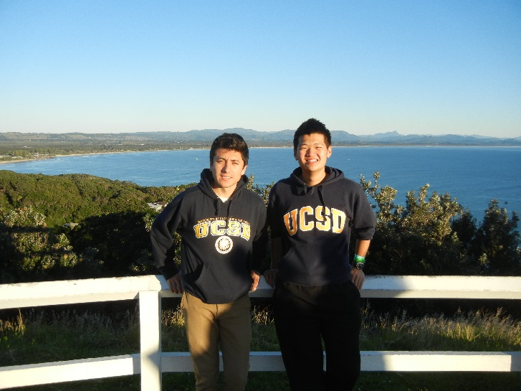


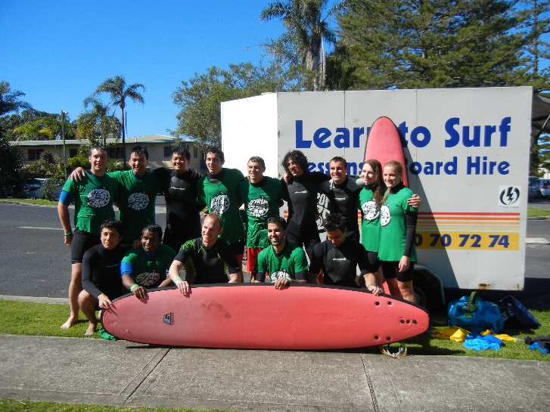
Cultural Aspect
Wk7

Slide 6
Acknowledgments
Wk7
Gabriele Wienhausen, Associate Dean for Education, Division of Biological Sciences, UCSD, Director and PI of NSF Award, Pacific Rim Experiences for Undergraduates (PRIME)
Peter Arzberger, Chair, PRAGMA Steering Committee, Principal Investigator / Director – NBCRC, co-director of PRIME
Teri Simas, PRIME Program Manager, PRAGMA Program Manager
Sameer Tilak, Assistant Research Scientist Calit2, CLEOS SDSC
David Abramson, Director of The University of Queensland Research Computing Centre
Shava Smallen, Project lead and developer for the Inca Grid monitoring software tool, SDSC's PI and chair of the Performance Committee for the FutureGrid.
Hoang Anh Nguyen, PhD. Student

