Slide 1


Fabian Lema
Wk8
Remote Monitoring of Android Devices Using Inca Framework
University Of Queensland, Australia
August 21, 2013

Slide 2
Progress to date
Wk8
The compilation of Perl 5.16 for Android was accomplished by following the steps on the Perldroid Google code website (click)
Perl 5.16 was copied to sdcard/perl for easy access.
Compiling Perl 5.16 gave me an idea of how the Android NDK works, and with the help of Hoang Nguyen and an internet resource I was able to cross compile the Encode module with the NDK gcc tool.
The Encode module was saved sdcard/com.googlecode.perlforandroid/extras/perl/site_perl
Added to the path LD_LIBRARY_PATH=$LD_LIBRARY_PATH:/sdcard/perl/lib/arm- linux-androideabi/CORE/
PERL5LIB=/sdcard/perl/lib:$PERL5LIB

Slide 3
Progress to date
Wk8
Link:
$mount –o bind system/bin bin
$mount –o bind usr/bin to bin/
Create the directory var/ on sdcard/
Type the following command:
$perl sbin/reporter-manager -d inca://vm-ops020.alamo.futuregrid.org:6324 -e /bin/inca-null-reporter -r /sdcard/var/reporter-packages -R /sbin/reporter-instance-manager -v var -w 1 -i android-test1 -L DEBUG -P false -a inca://vm-ops020.alamo.futuregrid.org:6323 -l /sdcard/var/rm.log
SUCCESS!!

Slide 4
Further objectives
Wk8
The cellphone connected to the Inca server and provided information about the Perl version it is running.
More testing is necessary.
Thanks to Hoang Nguyen for helping me this past two months especially this last two weeks.
Thanks to David and Sameer, my mentors, and thanks to everyone in PRIME for giving the opportunity to challenge myself and for allowing me to come to Australia.

Slide 5
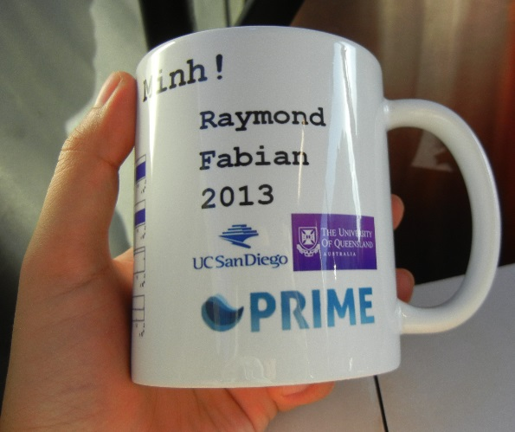
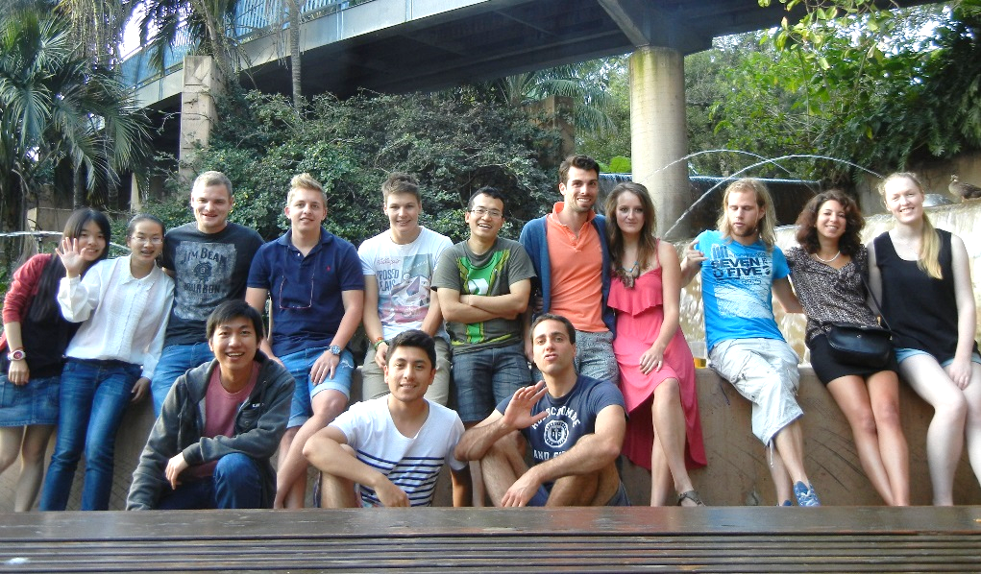
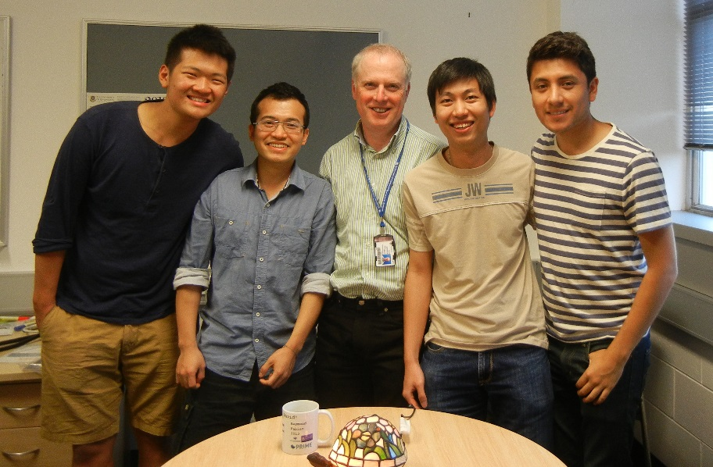
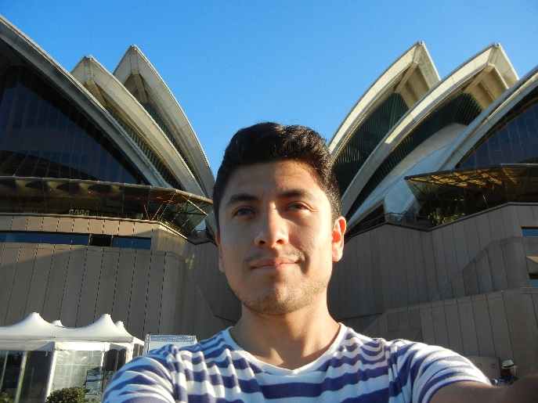
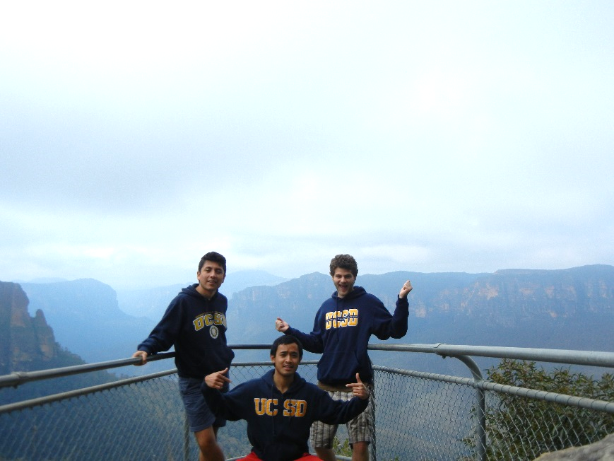

Cultural Aspect
Wk8

Slide 6
Acknowledgments
Wk8
Gabriele Wienhausen, Associate Dean for Education, Division of Biological Sciences, UCSD, Director and PI of NSF Award, Pacific Rim Experiences for Undergraduates (PRIME)
Peter Arzberger, Chair, PRAGMA Steering Committee, Principal Investigator / Director – NBCRC, co-director of PRIME
Teri Simas, PRIME Program Manager, PRAGMA Program Manager
Sameer Tilak, Assistant Research Scientist Calit2, CLEOS SDSC
David Abramson, Director of The University of Queensland Research Computing Centre
Shava Smallen, Project lead and developer for the Inca Grid monitoring software tool, SDSC's PI and chair of the Performance Committee for the FutureGrid.
Hoang Anh Nguyen, PhD. Student

