Slide 1


Investigation and modeling of the Avondale Bridge in Christchurch, New Zealand
Erickson Nguon
University of Auckland, New Zealand
7/3/2013

Slide 2
Proposal
The objective of this project is to investigate and model bridges, specifically the Avondale Bridge in Christchurch. The bridge suffered severe structural damage following the 2011 Christchurch Earthquake. I will create computer generated models of the bridges in SAP2000 with loadings that reflect the Christchurch Earthquake and with this model we can validate it by comparing the data from the model and the actual earthquake.

Slide 3
Current Progress
Completed paperwork to get University ID and Access Card
In depth background investigation of the earthquake; specifically the Avondale bridge. Additional investigation included soil properties, bridge/abutment/pile dimensions, earthquake magnitude, soil displacements, etc

Slide 4
Expected Progress
Begin modeling Avondale bridge southern abutment and pile in SAP2000
Travel to Christchurch to extract stone and mortar samples from damaged stone masonry buildings

Slide 5
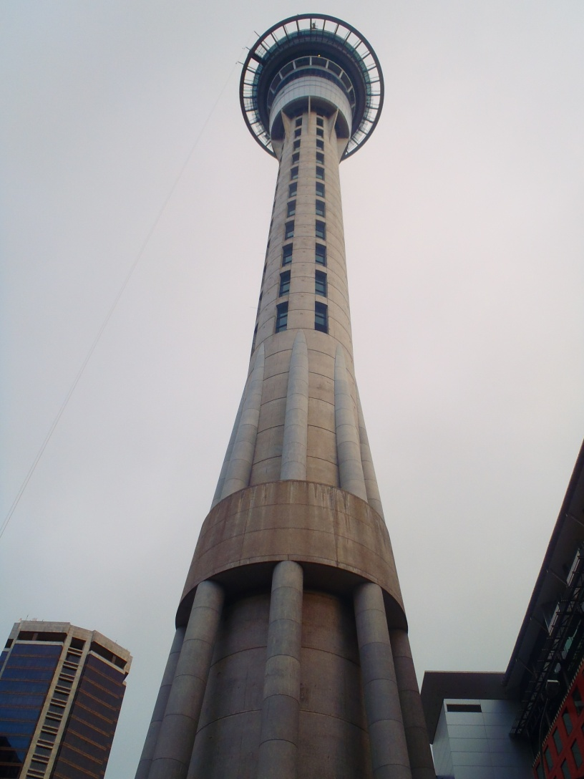
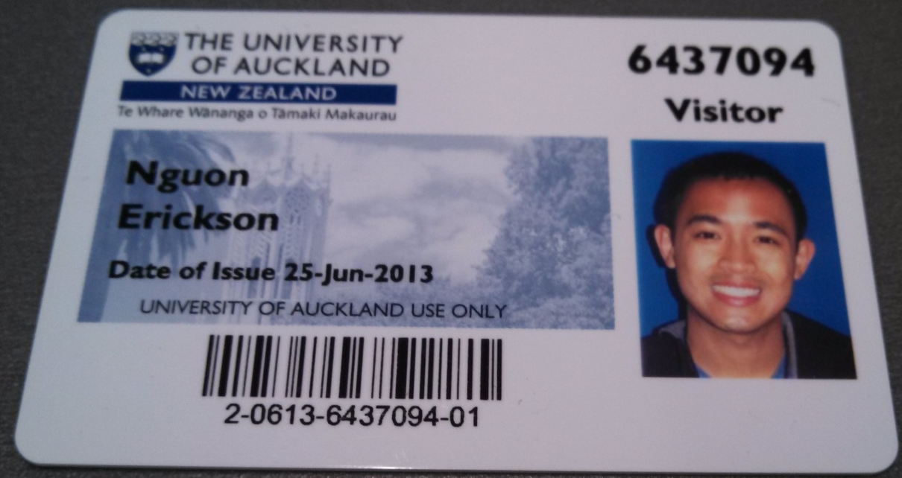

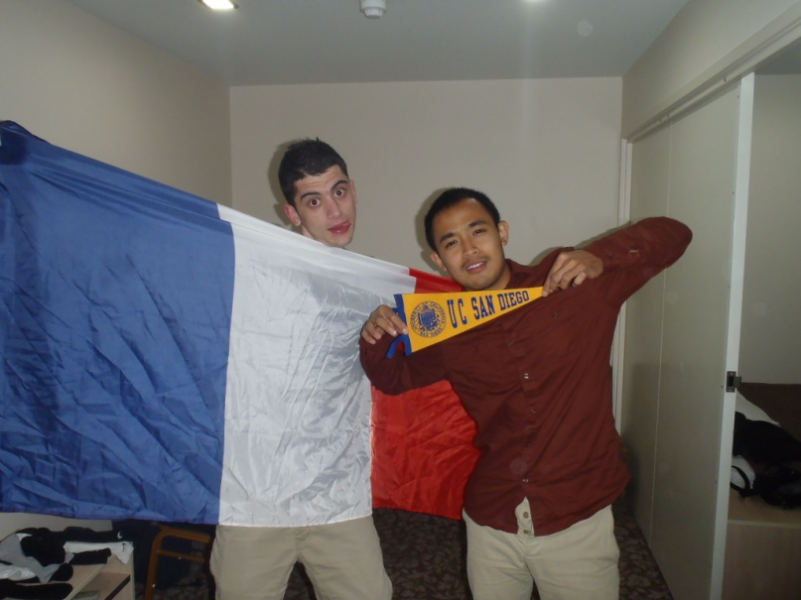
Getting Settled into U of A
My School ID
An interesting poster I saw on a bus
Sky Tower in the heart of Auckland
French Roommate representing France and me representing UCSD

Slide 6
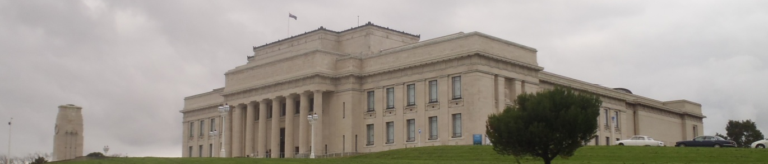
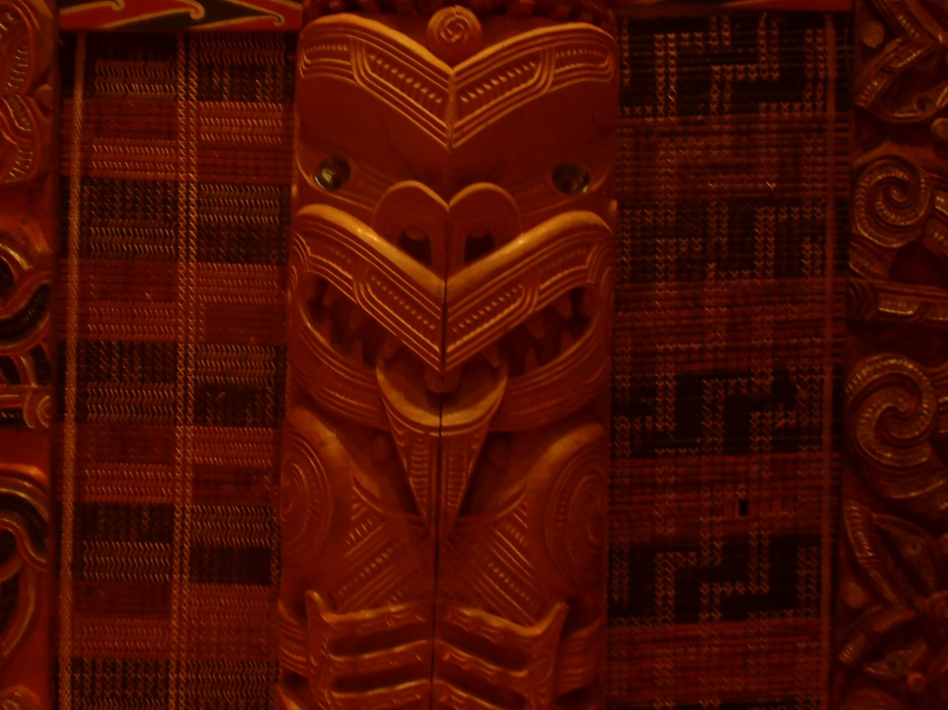
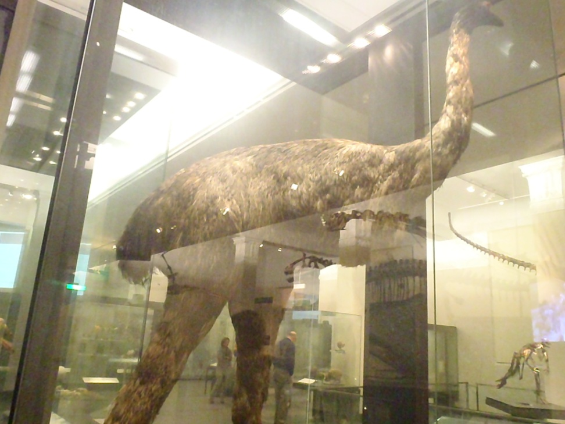
Auckland Museum
Auckland History / War Memorial Museum
A stuffed moa
One of the many Maori carvings in the Maori hut

Slide 7
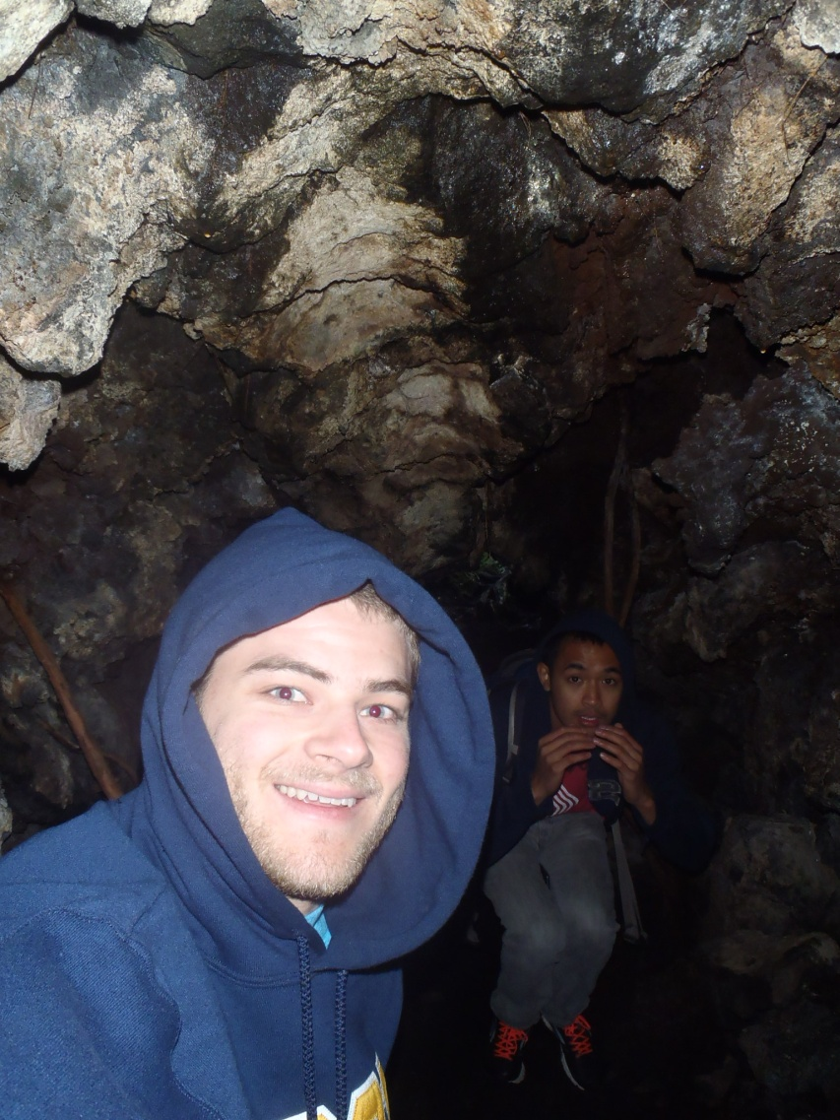
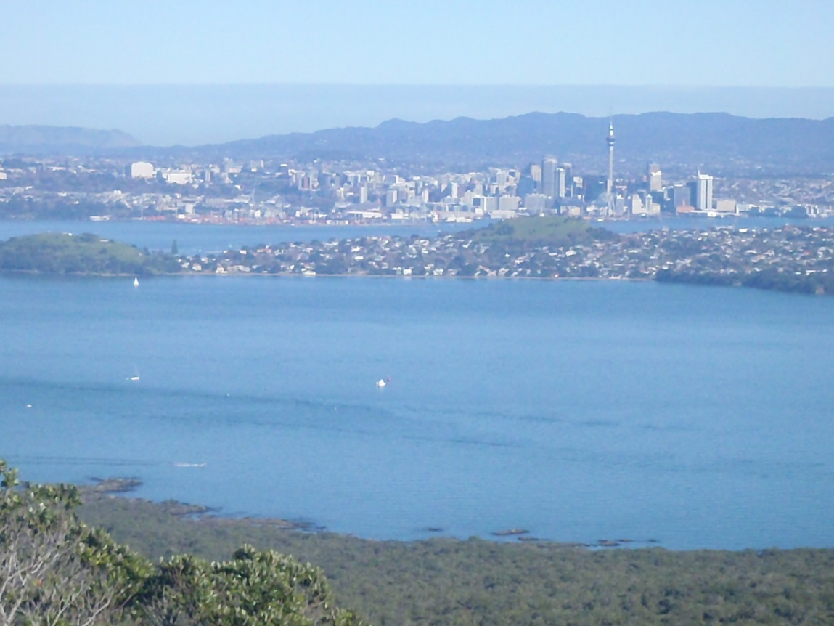
Rangítoto Island
Tramping our way to the summit of Rangítoto Island
Lost inside the lava caves of Rangítoto Island

