Slide 1


Week 3: Investigation and modeling of the Avondale Bridge in Christchurch, New Zealand
Erickson Nguon
University of Auckland, New Zealand
June 17, 2013

Slide 2
Project Overview
The objective of this project is to investigate and model bridges, specifically the Avondale Bridge in Christchurch. The bridge suffered severe structural damage following the 2011 Christchurch Earthquake.
To create computer generated models of the bridges in SAP2000 with loadings that reflect the Christchurch Earthquake and with this model we can validate it by comparing the data from the model and the actual earthquake.

Slide 3
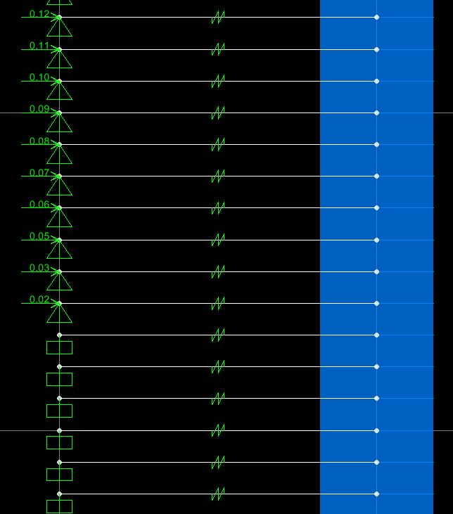
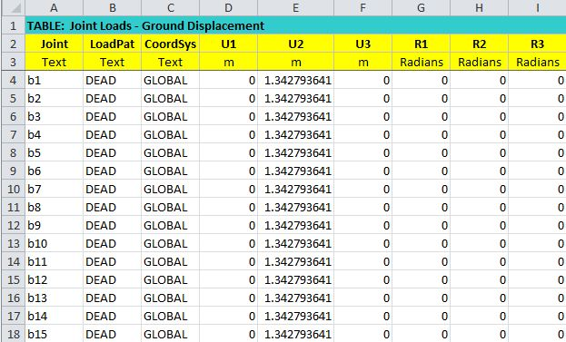
Recent Progress
Found an efficient method for changing spring stiffness values and restraints through Excel
Defined soil layers and applied peak displacements to the abutment and pile
Figure 1: Applied peak displacements and defined soil layers
Figure 2: Excel spread sheet to quickly change many different values of the model

Slide 4
Projected Progress
Meet with Liam to review my recent progress of the model bridge
Progress on modelling the north abutment of the bridge

Slide 5
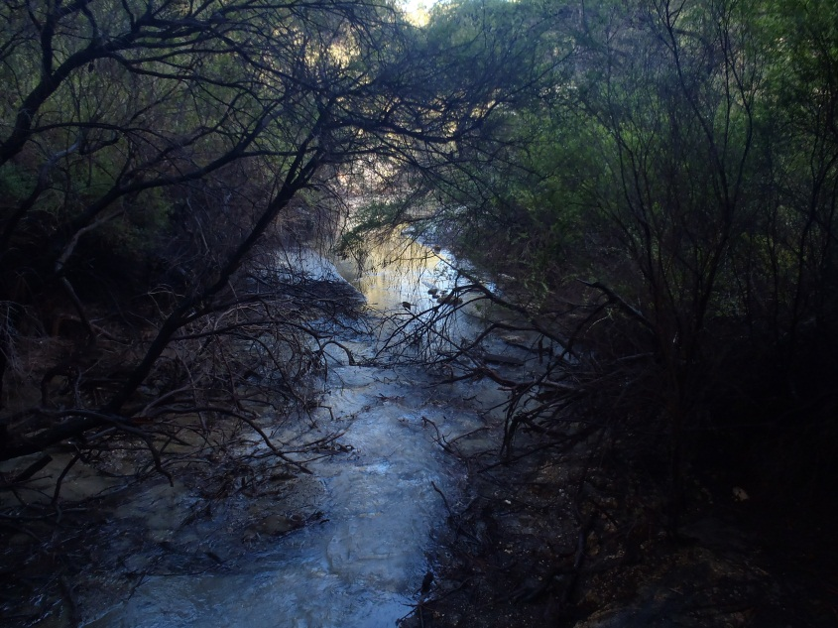
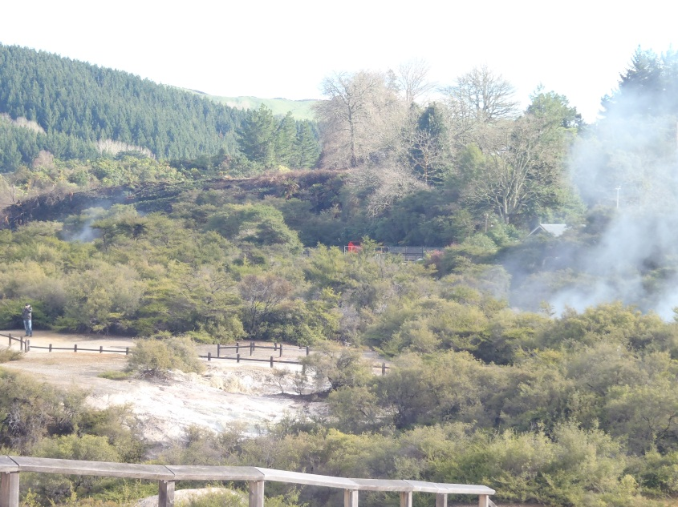
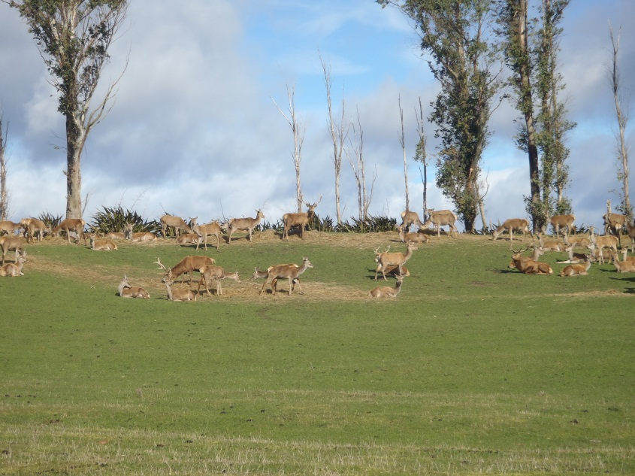
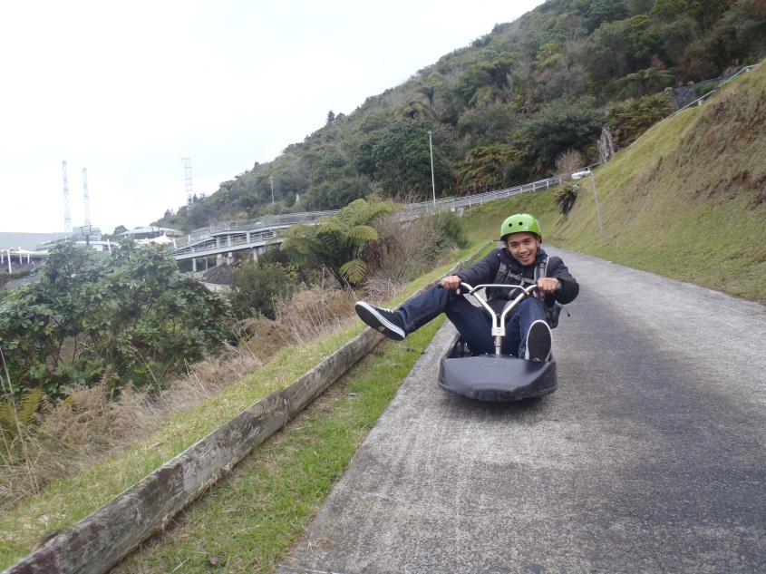
Rotorua
Wai-O-Tapu Thermal Park
Wai-O-Tapu Thermal Park
Bunch of deer on the side of road
Luging in Rotorua

Slide 6
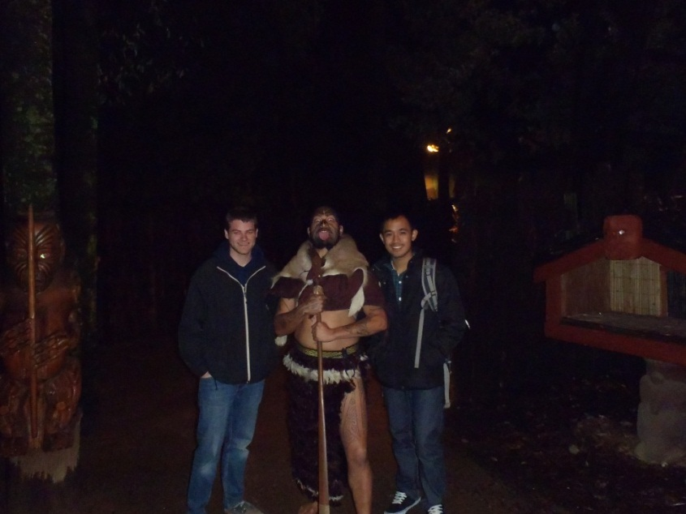
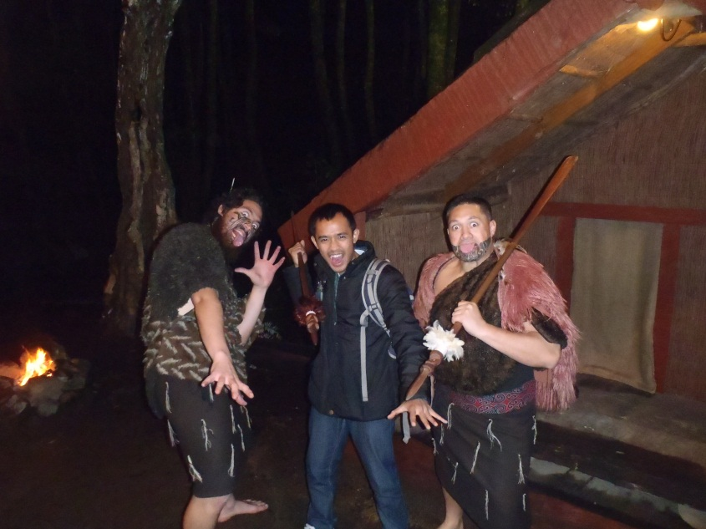
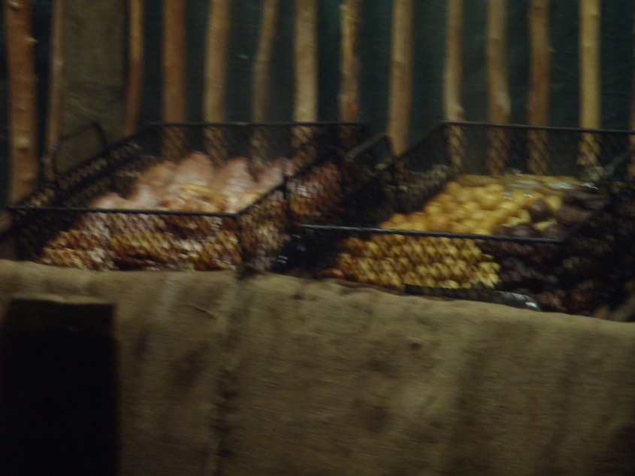
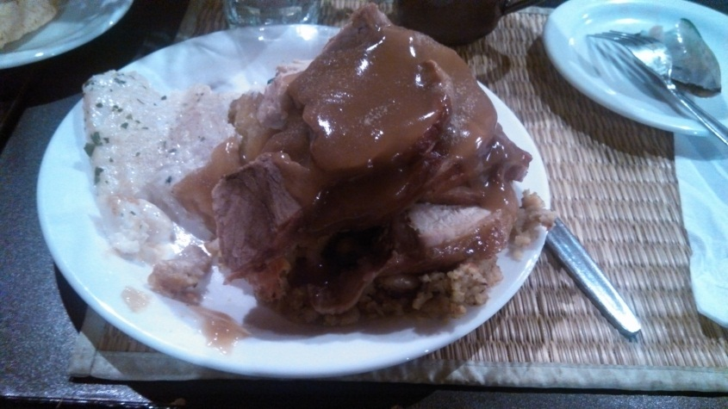
Tamaki Maori Village
Tamaki Maori Chief posing with Tony and I
Hanging with a few of the villagers
Chicken, beef, and potatoes cooling down after being cooked Hangi style
The buffet on my plate!

Slide 7
Acknowledgments
Thank you to:
Peter Arzberger
Gabriele Wienhausen
Liam Wotherspoon
Dmytro Dizhur
Lelli Van Den Einde
Teri Simas

