Slide 1


RESPONSE OF BRIDGES DUE TO LIQUEFACTION INDUCED LATERAL SPREADING
Erickson Nguon
University of Auckland, New Zealand
July 31, 2013

Slide 2
Project Overview
The objective of this project is to investigate and model bridge responses due to liquefaction induced lateral spreading. Specifically the Avondale Bridge in Christchurch will first be investigated and if time permits additional bridges in the Christchurch region will be investigated.
A computer generated Ruaumoko model of the bridges will be created under a displacement loading similar to the soil displacements investigated on-site. With the model the results will be validated with the actual results of the bridge.
After the model is validated sensitivity testing will be conducted and additional bridges will investigated.

Slide 3
Recent Progress
I ran into an issue with the SAP2000 model and recently scrapped all work with SAP2000 and transferred to New Zealand based program Ruaumoko
Modelled the Avondale bridge in Ruaumoko and produced plots of the displacement, rotation, bending moments, shear force, and spring forces due to a specific loading. Some of the plots are shown in the next slide

Slide 4
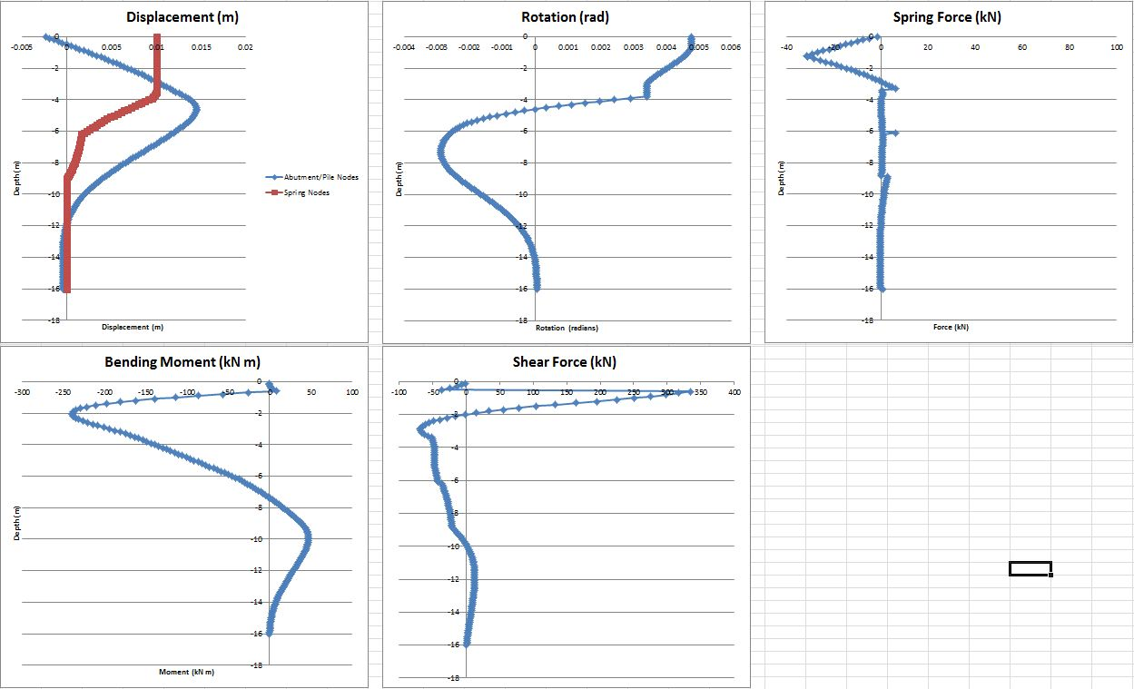
Figure 1: Displacement, Rotation, Spring Force, Bending Moments, and Shear Forces are shown respectively against the depth of the soil

Slide 5
Projected Progress
Meet with Liam to review my recent progress of the model bridge
Create a macro in excel to quickly determine the first yield and first crack of pile and the first yield and first crack at depth of the pile
Run sensitivity testing on the model

Slide 6
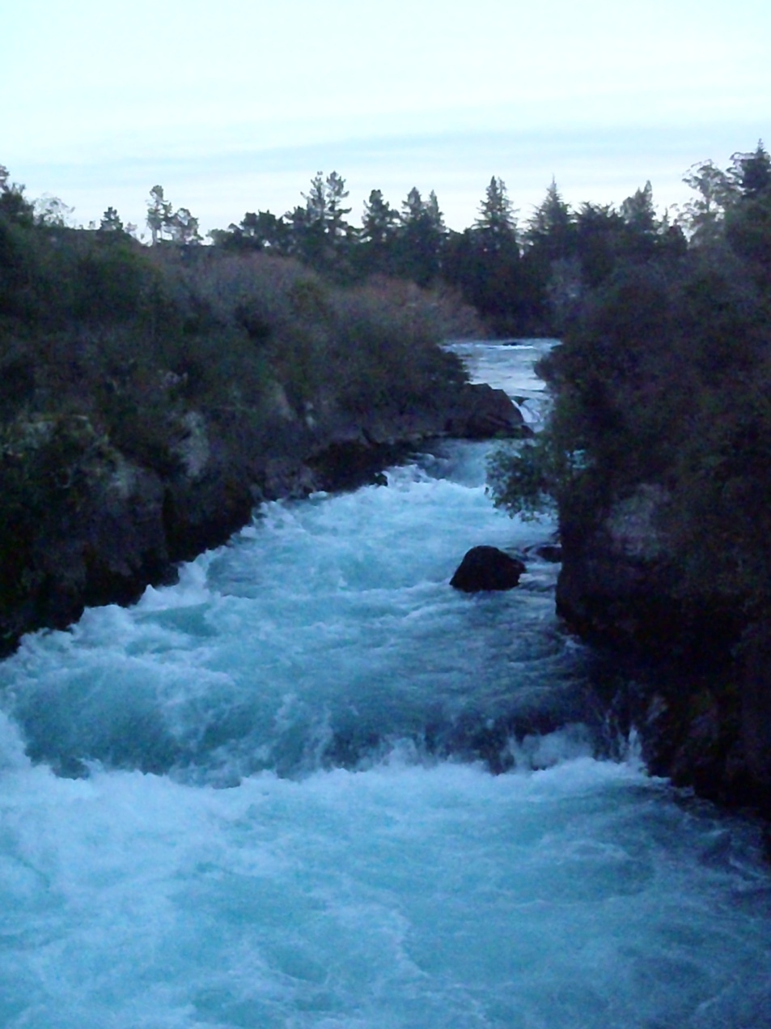
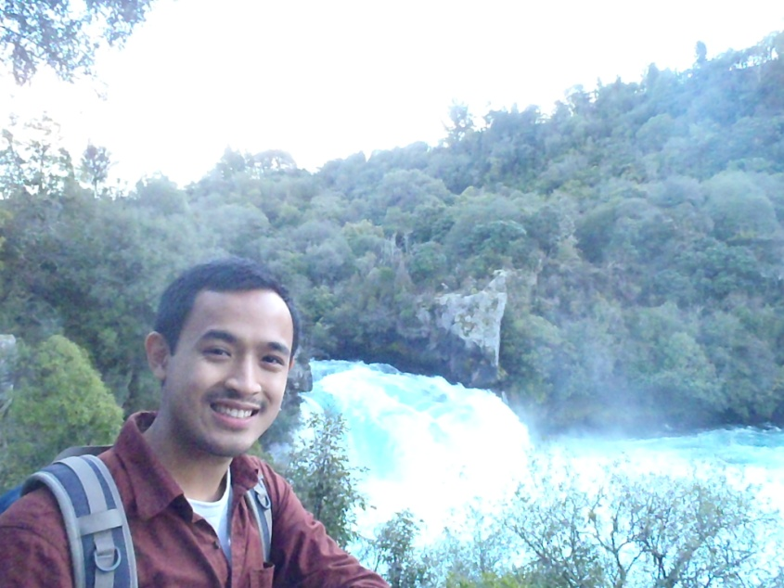

Taupo
Huka
Waterfall
Prepping for Skydiving
Huka Waterfall

Slide 7
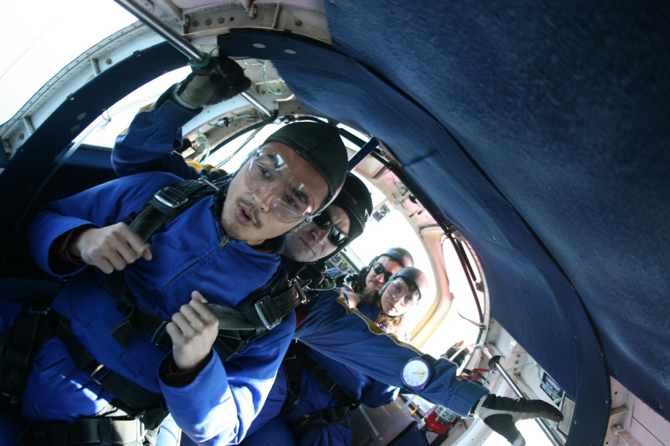
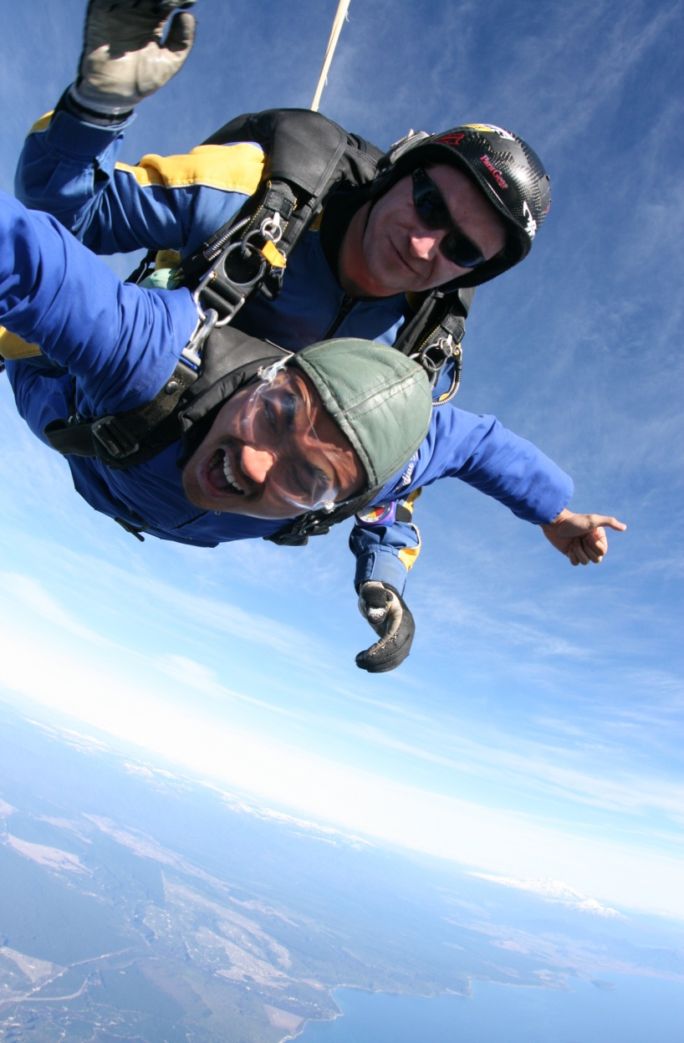
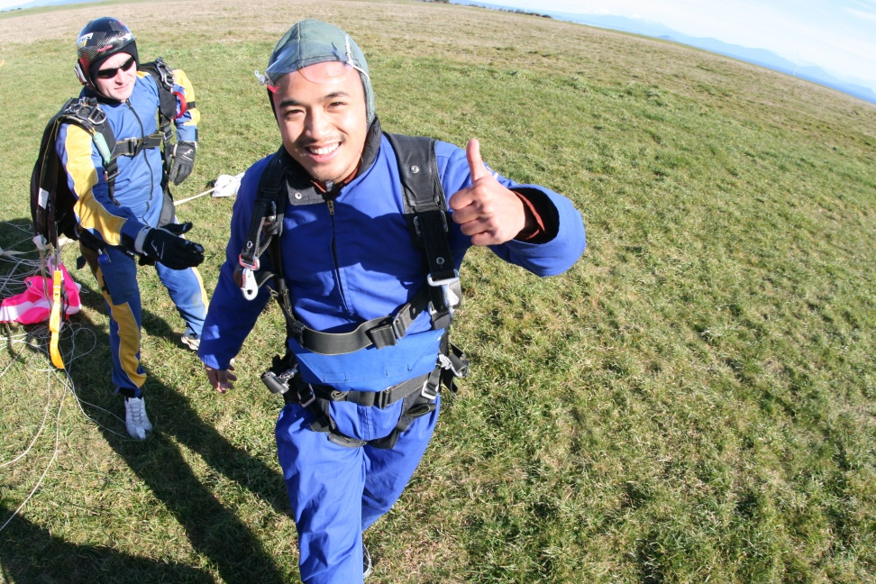


Erickson Nguon’s

Slide 8
UofA Canoe Club
Practiced kayaking techniques and rock climbed with other students in the canoe club

Slide 9

Acknowledgments
Thank you to:
PRIME: Peter Arzberger, Gabriele Wienhausen, Teri Simas
UCSD Mentor: Lelli Van Den Einde
UofA: Liam Wotherspoon, Dmytro Dizhur

