Slide 1


RESPONSE OF BRIDGES DUE TO LIQUEFACTION INDUCED LATERAL SPREADING
Erickson Nguon
University of Auckland, New Zealand
August 7, 2013

Slide 2
Project Overview
The objective of this project is to investigate and model bridge responses due to liquefaction induced lateral spreading. Specifically the Avondale Bridge in Christchurch will first be investigated and if time permits additional bridges in the Christchurch region will be investigated.
A computer generated Ruaumoko model of the bridges will be created under a displacement loading similar to the soil displacements investigated on-site. With the model the results will be validated with the actual results of the bridge.
After the model is validated sensitivity testing will be conducted and additional bridges will investigated.

Slide 3
Recent Progress
Created a Excel macro to:
Determine first yield and crack at the abutment-pile connection
Determine first yield and first crack at depth of the pile
Determine at which displacement step the rotation meets the actual back-rotation of the abutment
Save profile data for each respective cases
Comparative analysis of data

Slide 4
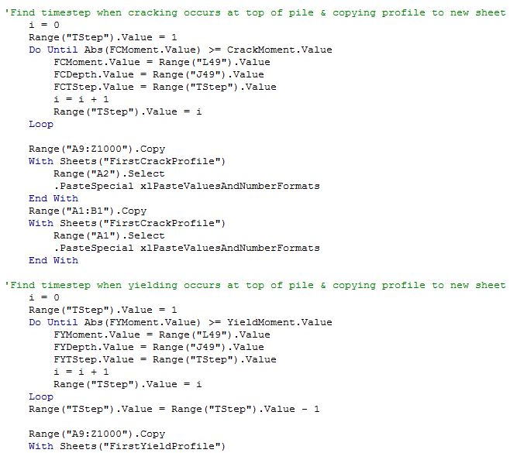
Figure 1: Snippet of excel macro that produces the time step when cracking and yielding occurs at the top of the pile

Slide 5
Goals
Fully create model of both abutments and piles and bridge deck together
Sensitivity testing of the entire model together
Make sense of data and comparative analysis with all the results
If time permits progress onto another bridge

Slide 6
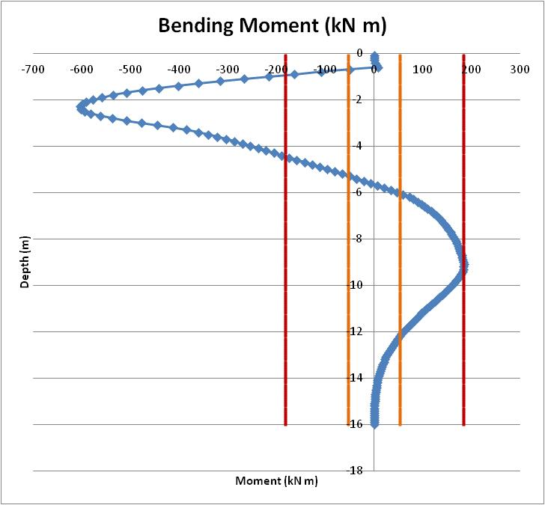
Projected Progress
Meet with Liam to review my recent progress of the model bridge.
Adjust moment curvature of hinges to better reflect results because current results yields a very large moment.
At ~4 meters depth you can see that the moment far exceeds the red line, which is where the yield moment is.

Slide 7
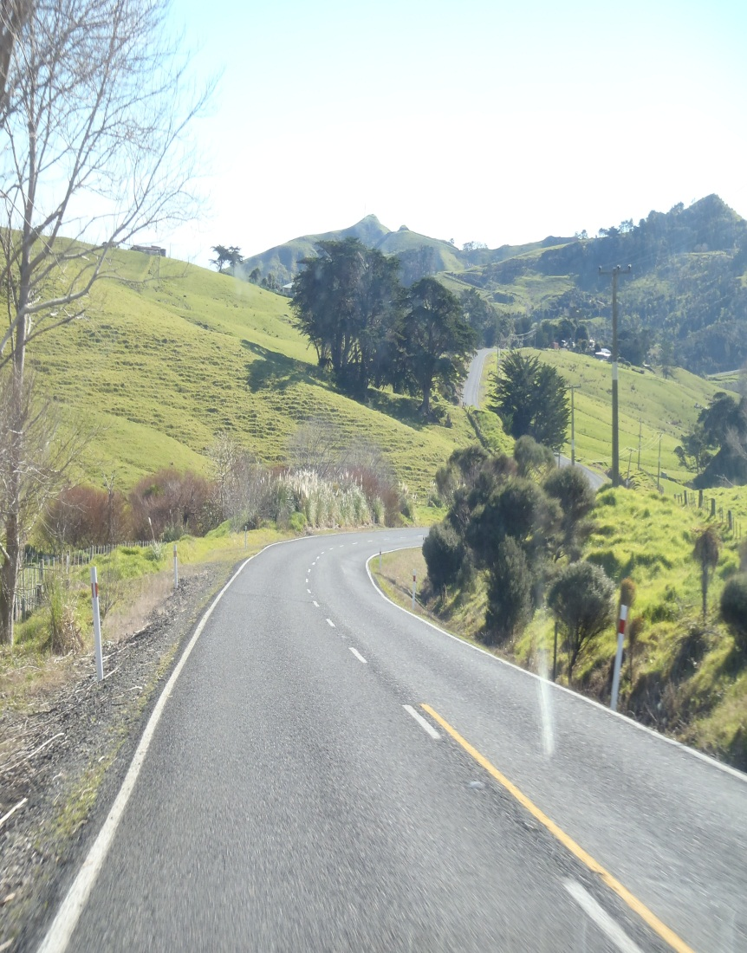

Auckland
We decided to take a weekend off from traveling, enjoy Auckland, and plan the rest of our trip to South Island and Australia.
We went to Sky City, checked out the NZ film festival, went shopping, and tried new restaurants around town.
Driving in New Zealand

Slide 8

Acknowledgments
Thank you to:
PRIME: Peter Arzberger, Gabriele Wienhausen, Teri Simas
UCSD Mentor: Lelli Van Den Einde
UofA: Liam Wotherspoon, Dmytro Dizhur

